Slide 1

Introduction to Bureaucracy
BMSW5101 – Week 8

Slide 2



In this session…
Introduce the concept of bureaucracy
Consider both advantages and disadvantages
Explore a journal article

Slide 3
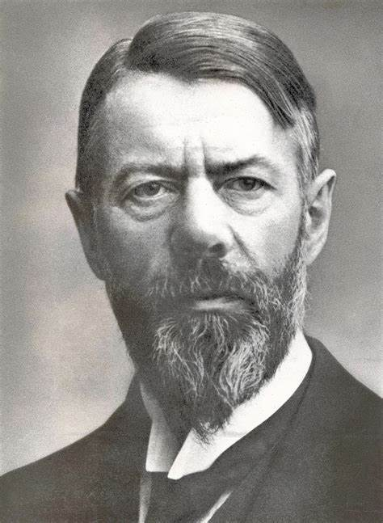
Max Weber
In 1946 Max Weber began discussing the theory of bureaucratic control and in 1964 published The Theory of Social and Economic Organisation.
As a sociologist, Weber proposed that bureaucracy offered principles that would provide structure and sustainability to an organisation. Whilst many modern organisations reject bureaucratic structures and processes, we will see that many companies rely on these principles even today in the 21st Century.

Slide 4
Core characteristics of bureaucracy
Fixed division of labour
A hierarchy of positions and authority
System of rules
Impersonality
Notes:
Explain each characteristic in turn.
Fixed division of labour – clear roles and responsibilities which relate to specialism, this ensures that the job role continues to exist even if the person doing the role leaves, the role is required to be complete by anyone that is capable, it is not person specific. If a department has a clear remit, they do not stray from that and into the roles and responsibility of other departments.
A hierarchy of positions and authority – This makes a clear distinction between the administrators and the administered or between managers and workers. Within the management ranks there are clearly defined levels of authority. Grading and line management often denote this line of authority. The armed forces and civil service have clearly defines ranks of office each equating to level of authority over decision making.
A system of rules – aims to provide an efficient and impersonal operation of an organisation. The system of rules is generally stable, some rules may be changed or modified over time. Knowledge of the rules is a requisite for holding a job is a bureaucracy. Rules might relate to the manner in which people interact, the manner in which decisions are made, the expectation of staff (conduct, punctuality, holiday, dress, communication).
Impersonality – This is the characteristic that most distinguishes bureaucracy from other organisational types. Impersonality is aimed at making officials rational in their role and decision making. The system of rules dictates the allocation of privileges and the exercising of authority, these are not arbitrary. There will also be clearly defined procedures for appealing against decisions.

Slide 5
The advantages of bureaucracy
Walton (2005) outlines key features of bureaucracy that may benefit any organisation:
Clearly defined roles and authority
  Allowing staff to know the limits of their role and authority.
  Allowing the reporting and decision making process to be clearly defined.
Specialism of roles
  Ensuring that an organisation plans for their needs and maintains roles even when staff change.
  Allow specialist staff to be the decision makers in their specialist field of expertise.
Notes:
We will examine the finding of the Walter 2006 study later in the session.

Slide 6
Disadvantages
Mullins (2005) details the extensive criticism that Weber received in the 20th Century. Identifying the following main disadvantages:
Over-emphasis on rules and procedures
Initiative prevented
Lack of responsiveness to individuals
Notes:
Over-emphasis on rules and procedures, record keeping. With paperwork becoming more important in its own right than a means to an ends.
Initiative may be stifled and when a situation is not covered by a complete set of rules or procedure there may be a lack of flexibility or adaption to a change in circumstances (or market forces).
Positions and responsibilities may lead of officious behaviour, there may be a tendency to conceal rules and processes from outsiders.
Impersonal relations can lead to stereotyped behaviour and a lack of responsiveness to individual incidents or problems. This may also affect psychological growth of staff leading to feelings of failure, frustration and conflict.

Slide 7
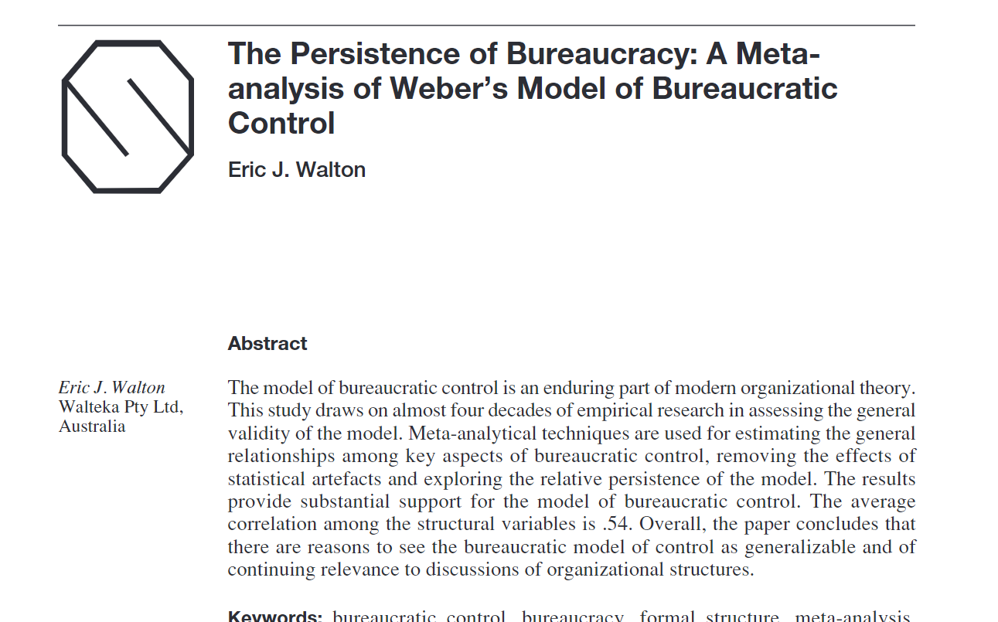
Article for discussion
Link to article in UWTSD library
Read p588 (p20 of 32)
The Model of Bureaucratic Control and Modern Organization Theory.
and p589 Conclusions
Take 30mins to complete the reading.
Notes:
https://librarysearch.uwtsd.ac.uk/permalink/44WHELF_UWTSD/1ir6fgh/cdi_proquest_miscellaneous_1417526612
Aid the students to locate the article online – printed copies of p588 and p589 can be made available but please do not print the entire 32 page article.
Allocate about 45mins for the reading task.

Slide 8
Discuss
What did you note from the article?
Do you have experience of a bureaucratic organisation?
Do you think bureaucratic organisations have a role to play in modern business?
Notes:
Share thoughts and notes from the article findings and conclusions.
If you have extra time - A happy little video from youtube can be used to recap The Bureaucratic Leader Video Lesson Transcript Study com – YouTube

Slide 9
References
Mullins, L.J. (2005) Management and organisational behaviour. 7th ed. Harlow: Pearson.
Walton, E.J. (2005) ‘The Persistence of Bureaucracy: A Meta-analysis of Weber’s Model of Bureaucratic Control’, Organization studies, 26(4), pp. 569–600. Available at: https://doi.org/10.1177/0170840605051481.

