Slide 1
Certificate of Higher Education in Skills for the Workplace
Effective Team Working & Communications
(BMSW 4002)
Teams Roles and Creating Effective Teams

Slide 2

In this session…..
Session Objectives – In this session we will discuss
Belbin’s Team roles
How to create effective teams
Session Outcome - At the end of the lesson
You should be able discuss the Belbin’s Team roles.
Have detailed knowledge of how to create effective teams.

Slide 3
Roles within teams.
According to Belbin, team composition is crucial to the success of a team and is concerned with individual team member’s ability to fulfil or perform different team roles.
According to Belbin (1981), there is a better team balance when a diversity of all the ideal role propensities are present in the team.
One major success factor for any team is - Team Composition – Who is on the team? What are their personalities, mental abilities, values & motivation, experience & working environment, culture and role learning.
Belbin developed the idea a team needs a balance of personalities and roles if they are to be successful. There are 9 roles divided into 3 categories
We will now explore these nine roles in more detail.

Slide 4
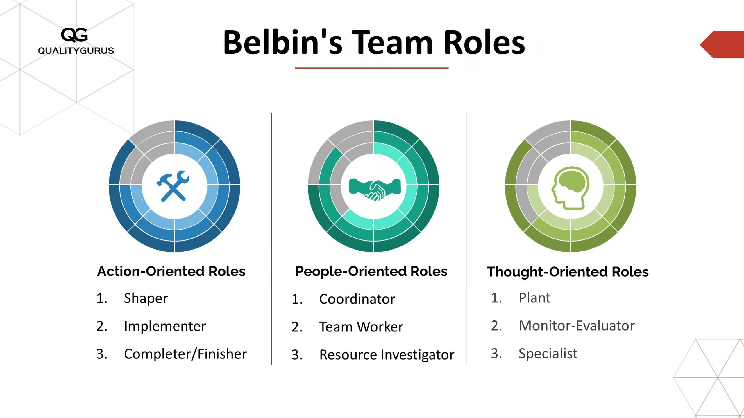
Belbin’s 9 Team Roles

Slide 5
Action-Oriented Roles
Shaper
The task leader, where the Coordinator is a sociable leader.
If no Coordinator is present, the Shaper will lead and give shape to the application of the team’s efforts.
Seeks to convert ideas into decisions and action.
Impulsive and impatient, people outside the team regard him/ her as arrogant.
Can even make the team feel uncomfortable, but makes things happen.
Implementer
The practical organiser, concerned with what is feasible.
Turns decisions into defined and manageable tasks that people can actually get on with.
Not easily discouraged, though will not do so well in unstable, quickly changing situations.
Efficient, systematic, methodical, but can be inflexible.
If you need to know what was decided, or what needs to be done, the implementer is the one to see.
Completer/Finisher
Worries about what might go wrong.
Checks every detail, this obsession being an expression of anxiety.
Preoccupied with order, compulsive in meeting deadlines, maintains a permanent sense of urgency.
Although an asset to the team, can be a morale-lowering worrier, and be side-tracked by trivia.

Slide 6
People-Oriented Roles
Coordinator
Natural team leaders.
Intelligent rather than brilliant; not really an ‘ideas’ person.
Establishes roles / work boundaries according to individual abilities and focuses people on what they do best.
Presides over the team and coordinates efforts to meet targets.
If a decision is necessary, it is taken firmly after everyone has had a say.
Team-Worker
Most aware of individual needs and emotional undercurrents within the team. Most active internal communicator.
Likeable, popular, unassertive: the cement of the team. Diplomats
Loyal to the team unit, builds on ideas rather than demolishes them. Dislikes confrontation, avoids it, and helps cool it down in others.
Exemplary team member, particularly in times of stress.
Resource Investigator
Sociable, positive, enthusiastic.
Goes outside the group and brings back information, ideas etc.
The diplomat, the liaison officer, always looking for new possibilities in the wider world outside.
Needs the stimulus of others, gets bored in solitary work.
Within the team, though, a good improviser, active under pressure.
Prevents the team from losing touch with reality.

Slide 7
Thinking-Oriented Roles
Plant
The ‘ideas’ person, innovator. Works alone
Most imaginative and intelligent member of the team and the one most likely to look for a new approach to a problem if the team gets bogged down.
Can cause offence when criticising other people’s ideas, usually counter-proposing own ideas.
Can sulk if own ideas are dissected or rejected.
Needs careful handling by the coordinator to ensure that vital spark is provided.
Monitor-Evaluator
Measured, dispassionate, analysis is his / her forte. Separates good ideas from bad ones
Critic rather than creator – but only if he / she can see a flaw in the argument.
The most objective mind in the team, likes time to mull things over.
Most likely to stop the team from committing itself to a misguided project.
One quality makes him / her indispensable – judgement is hardly ever wrong.
Specialist
The Specialist is an expert.
May be brought in as a consultant or advisor for a team.
Because a specialist is often in high demand they are not a permanent member of the team. This can sometimes lead to tension with other members.

Slide 8
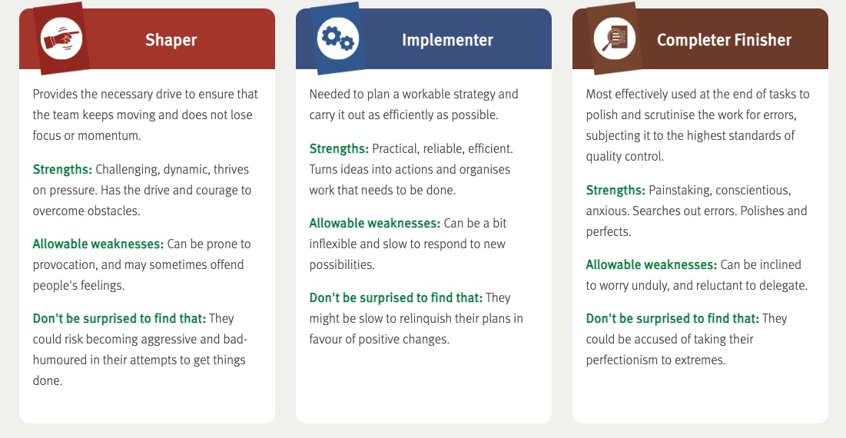
Strengths and Weakness of Belbin’s Team Roles

Slide 9
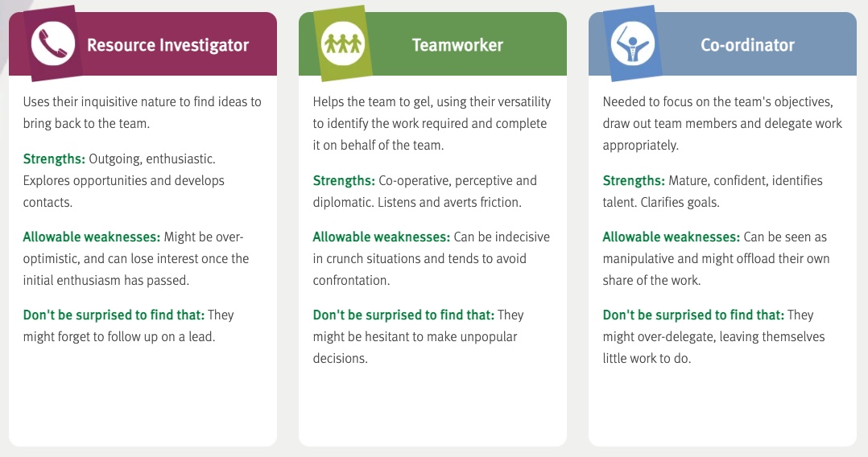
Strengths and Weakness of Belbin’s Team Roles

Slide 10
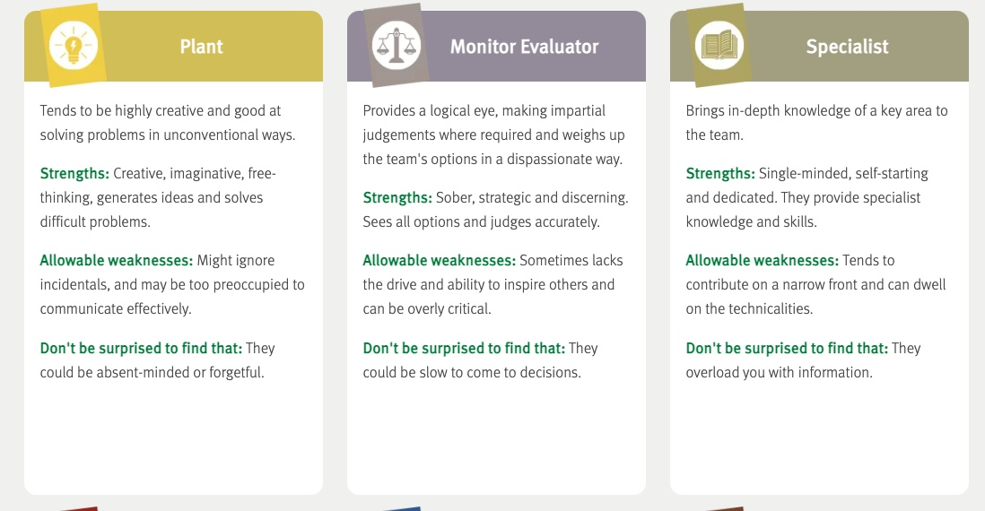
Strengths and Weakness of Belbin’s Team Roles

Slide 11
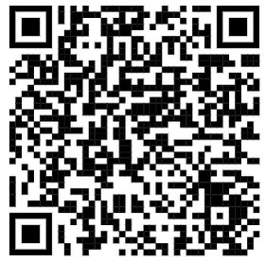
Activity 1 – Personality Test
Click the link or scan QR code to find out.
Meyer's Briggs Personality Test
After answering all questions, read the description of your personality type and relate it to which Belbin’s team role you think you might be”
Be honest and reflect on your strengths as well as areas for improvement.

Slide 12
Break

Slide 13
How to create effective teams - The Culture Code – by Coyle (2018)
Coyle (2018) identifies the secrets of successful groups and discuss how this develops into effective teams.
Skill 1 – Build Safety
Skill 2 – Share Vulnerability
Skill 3 – Establish Purpose

Slide 14
Skill 1 – Build Safety
Coyle (2018)
Overcommunicate listening
  use body language and eye contact to show each other that you are attending to what they are saying.
  especially if you are the leader.
  Use phrases like:
    “Of course, I could be wrong.”
    “What am I missing?”
    “What do you think?”
Spotlight your fallibility early on
  if negative feedback or bad news is received from a team member, respond in a receptive way
    “Thank you for letting us know”,
    “I am pleased that you have told me”.
Embrace the messenger

Slide 15
Skill 2 – Share Vulnerability
Coyle (2018)
Make sure the leader is vulnerable first and often.
  Tell the truth to your team.
  Ask questions – “What is one thing that I currently do that you’d like me to continue to do? “
  Remember that vulnerability is a strength not a weakness.
Deliver the negative stuff in person
  Any negative news or negative feedback should be done face-to-face.
  Reconnect immediately afterwards, “Let’s go get a coffee and plan how we move forward”.
  Good listening is more than nodding attentively; add insight and steer creative ideas.
    Make the other person feel safe and supported.
    Take a helping, cooperative stance.
    Ask questions that gently challenge old assumptions.
    Make occasional suggestions to open up alternative paths.
Listen like a Trampoline

Slide 16
Skill 3 – Establish Purpose
Name and rank your priorities
  In order to move toward a target – you must first have a target.
  Most successful groups have five or less.
  How members treat each other is top of the list in successful teams.
Be ten times as clearer about priorities than you think you should be.
  Leaders should not assume team members know or remember them.
  Paint priorities on the wall, stamp it on emails.
  Test awareness – “What are we about? Where are we headed?”

Slide 17
Are you a performing team?
Pentland (2008) identified five key factors which drive performance within team.
Everyone in the team talks and listens in roughly equal measure, keeping contributions short.
Members communicate directly with one another, not just with the team leader.
Members carry on back-channel or side conversations within the team.
Members maintain high levels of eye contact, and their conversation and gestures are energetic.
Members periodically break, go exploring outside the team, and bring information back to share with the others.
Do you think teams that you work in or have worked in are performing?

Slide 18
Being a good team member
Wheelan (2014) outlines key advice for members of groups.
Don’t blame others for group problems.
- Give everyone the benefit of the doubt for the sake of the group .
- Blame starts a cycle of revenge and retaliation.
- Instead, find other factors that might be blocking progress and fix them,
Encourage clarification.
- If you don’t know what is happening or understand why something is happening ask questions.
Listen to others input and be heard.
Balance ‘task communications’ and ‘supportive communications’

Slide 19
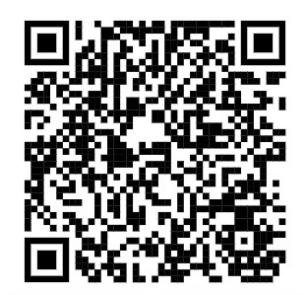
Activity 2 - Are you an effective team member?
Click the link or scan QR code to find out.
https://www.mindtools.com/pages/article/newTMM_84.htm
After answering all 15 questions click on ”calculate my total” and compare your total score with the comments on the “score interpretation section”
Be honest and reflect on your strengths as well as areas for improvement.
Notes:
Lecturers should please allow time for students to copy and paste the link into their mobile phone browser or laptops.

Slide 20
Size
Team composition
Diversity
Do team size and diversity make a difference to how effective a team can be?

Slide 21
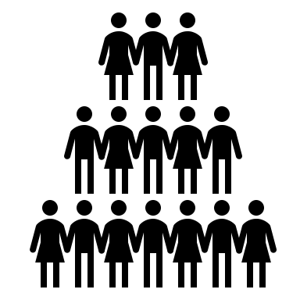
Size
Wheelan (2016, p131) states that, “In small groups, each individual member and the leader can discuss her or his ideas and participate in decision making. In larger groups, a number of members may not have the opportunity to speak; usually, a small number of members discuss things while the rest of the members listen.”
Every team will be different in terms of its goals, task and resources, for some teams four or five members will be optimum, whereas other teams will benefit from having eight to ten members. Larger teams will need greater support and leadership during the early phases of group development.

Slide 22
Diversity
Van Knippenburg and Schippers (2007) found that the diversity of a team impacted their:
Information and decision making
Inter group bias
+ Diversity is an information resource to the team, the more diverse is age, gender, race, socioeconomic background that a team is the broader the pool of ‘task-relevant’ information, knowledge and perspectives are available to the team. Improving performance.
The Social categorization perspective
views team diversity as a source of inter-group bias. ‘Us’ and ‘Them’ (nurses vs doctors or young vs old) with less liking, trust or cooperation with those who are dissimilar from ourselves which can disrupt team performance. This can be reduced by building a strong team identity which unites members.

Slide 23
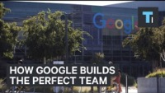
Creating Effective Teams in Business.
Notes:
This video is from the US but many of the points highlighted apply in the NHS also. Warning – it ends abruptly.

Slide 24
Summary
Can you explain the factors affecting the effectiveness of a Team?
Can you explain the methods to be used to turn individuals in to team players?
Questions & Answers

Slide 25
References
Aranzabal, A., Epelde, E. and Artetxe, M., 2022. Team formation on the basis of Belbin’s roles to enhance students’ performance in project based learning. Education for Chemical Engineers, 38, 22-37.
Coyle, D. (2018), The Culture Code, London, Random House Business.
Morgan, P. (2017), The Business Student’s guide to study and employability, London, SAGE.
Pentland, A., (2008), Honest Signals, Cambridge, MA, MIT Press.
Rahmani, F., Scott-Young, C., Tadayon, A. and van der Walt, J.D., 2021. Team composition in relational contracting (RC) in large infrastructure projects: a Belbin’s team roles model approach. Engineering, Construction and Architectural Management.
Wheelan, S.A., (2016), Creating Effective Teams, 5th Ed, London, SAGE
van Knippenburg, D. and Schnippers, M.C. (2007) Work group diversity. Annual Review of Psychology, 58, 515-541.

Slide 26
Next session…..
We will look at;
Group decision making.

