Slide 1

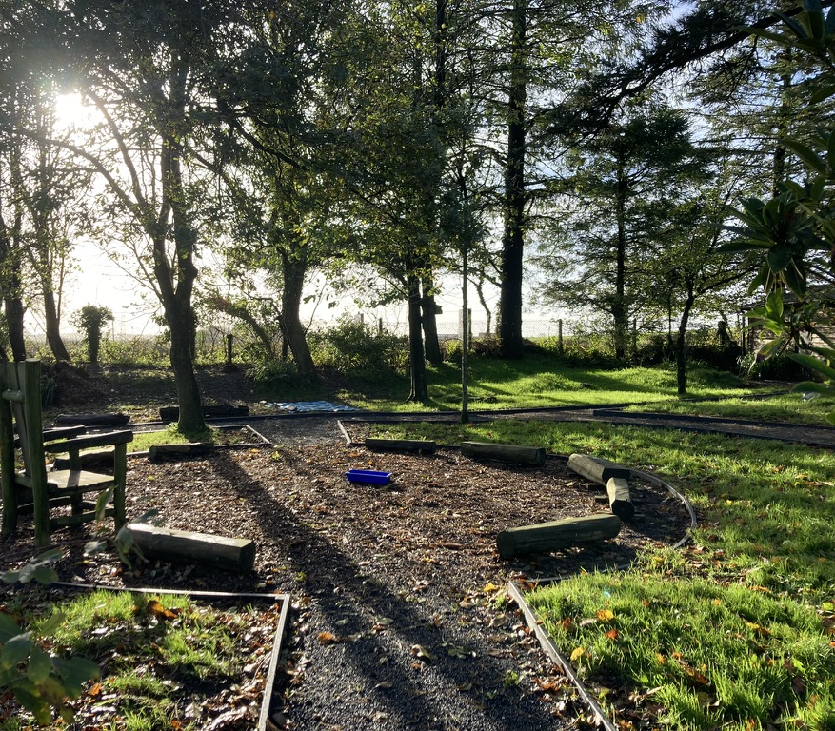
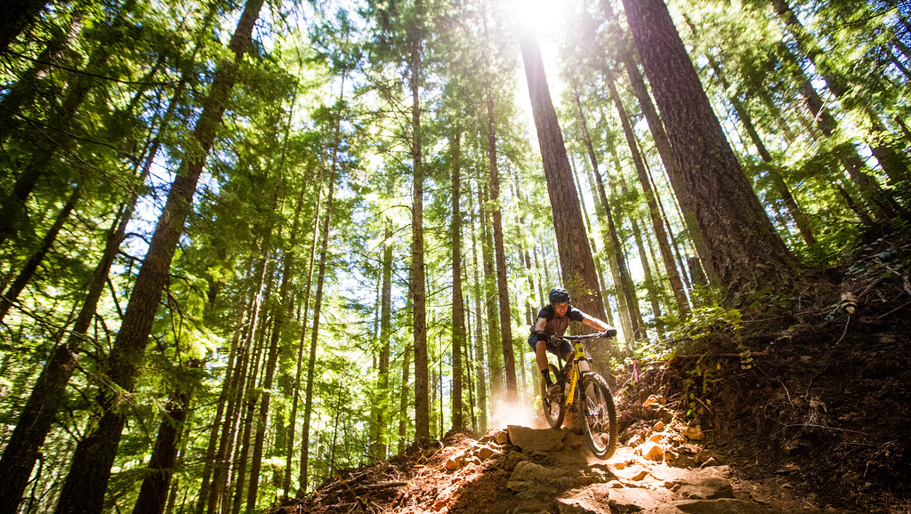
UNIT OF WORK FOR OUTDOOR ADVENTUROUS ACTIVITIES
Rebecca Fountain
1900711
BMOE6002
This Photo by Unknown Author is licensed under CC BY

Slide 2
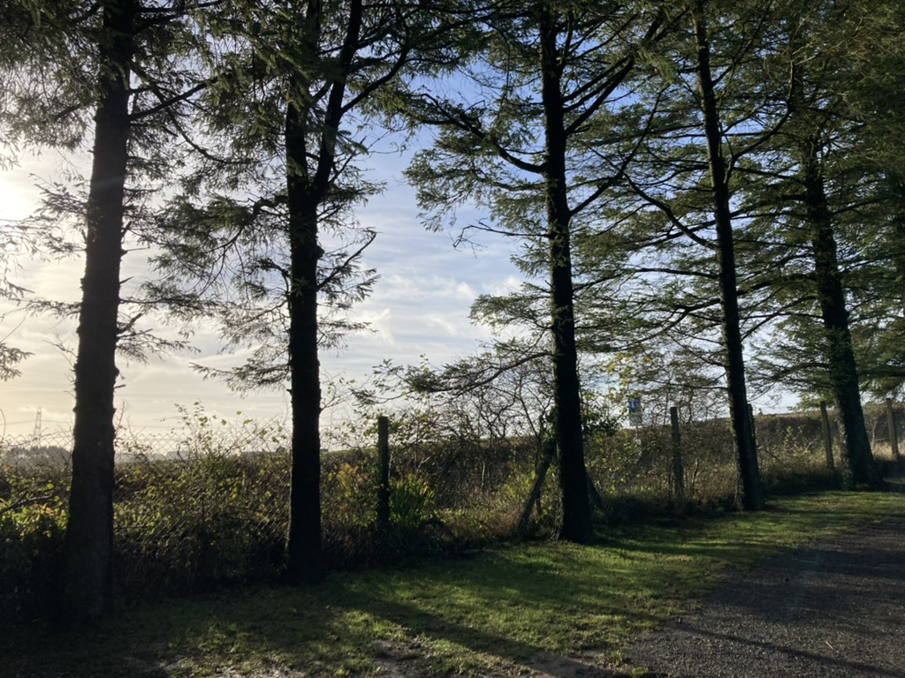
INTRODUCTION
As the quote from Richard Louv (2005) suggests, students must engage in a variety of environments and landscapes which enriches their lives and learning experiences.
The COVID 19 pandemic has however, shifted the perspective of education quite significantly, with physical activity becoming a dominating factor for change in the curriculum (Varea, González-Calvo and García-Monge, 2022).
Outdoor Adventurous Activities are fast becoming a more prominent feature within our school curriculums.
This presentation will look to justify their inclusion and present a unit of work based on incorporating such activities into a school curriculum.
Whilst also considering how the developments brought into this school ground can support the Health and Wellbeing AoLE (Welsh Government, 2022).
“An environment-based education movement at all levels of education will help students realize that school isn't supposed to be a polite form of incarceration, but a portal to the wider world.”
Richard Louv – Last Child in the Woods

Slide 3

Designing a curriculum around health and wellbeing
The health and wellbeing AoLE is concerned with developing opportunities where students can thrive through challenges faced throughout life.
By developing learners’ motivation, resilience, empathy and decision-making abilities, they can be supported to become ambitious, capable learners, ready to learn throughout their lives.
(Welsh Government, 2020)
One of the 4 purposes highlighting how through team games, personal, social and moral values can be developed to aid students to become capable learners who can continue to learn throughout life.
These values can be enhanced through natural environments, where different affordances can aid mental health issues and create resilient students who can thrive and flourish in an outdoor learning environment (Shellman and Hill, 2017)
The new pedagogical model for OAA (Williams and Wainwright, 2016) conveys how this instructional model can be utilized within the curriculum to provide development opportunities alongside health and wellbeing, physical literacy and connection between communities and local activity providers.
This will create a positive image for outdoor education (Neville, Petrass and Ben, 2022).

Slide 4
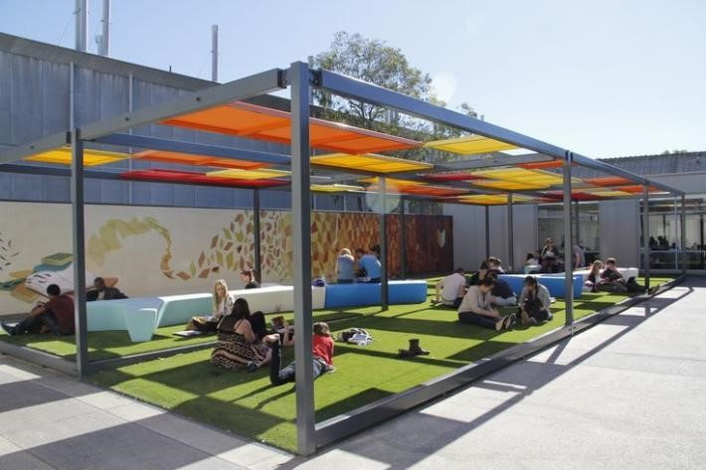
ENVIRONMENT-BASED EDUCATION
Creating the right environment for outdoor learning within a secondary school ground is crucial to the development of each individual student.
Research by Christie et al (2015) highlights how the Scottish Government are leading the way in incorporating more outdoor learning areas and environments. Additionally, the Scottish Curriculum for Excellence (CfE) are designing a curriculum with more flexibility for outdoor education (Christie et al, 2015).
The school ground developments discussed previously in the essay have adopted this mindset for this school’s landscape, and now the new curriculum for Wales (Welsh Government, 2022) are seeking to create a whole-school approach to health and wellbeing whilst implementing outdoor education opportunities.
Therefore, Teambuilding has been chosen as the focus for this unit of work, where students will work collaboratively in problem-solving activities whilst increasing community wellbeing and their own.
By setting these teambuilding activities in an outdoor environment, this will increase the social capital of outdoor education (Beames and Atencio, 2008) whilst also making a case for the implementation of the model for outdoor adventurous activities in the curriculum (Williams and Wainwright, 2016).

Slide 5
Unit of Work for Key Stage 3:
6-8 week half term
Linking to what’s in local area and environment
Focus is on health and wellbeing AoLE
Progression steps for lifelong learning
Use of outdoor learning cards to help progression

Slide 6
Unit of Work for OAA Key Stage 3 6-weeks Year 9
Title: Team Building in an outdoor learning, nature environment.
Aims:
Develop team building from KS2 to KS3 through games in an outdoor environment.
Develop life skills of students such as communication, working with others and self-esteem.
Undertaking problem-solving tasks with others.
Understand how the outdoors can be a valuable landscape to learn in.
Curriculum Links:
Focus is on the Health and Wellbeing Area of Learning and Experience (Welsh Government, 2022).
How OAA model can be utilized alongside this area of learning.
Development of personal, social and moral skills.
Team building activities will progress from small, problem-solving scenarios within the school environment on to more recreational team building activities, with the progression for residentials and undertaking the DofE expedition.
Having progression through levels (Welsh Government, 2022) within team building activities will allow for students to develop and enhance their skills and put those skills like communication and leadership into practice.

Slide 7
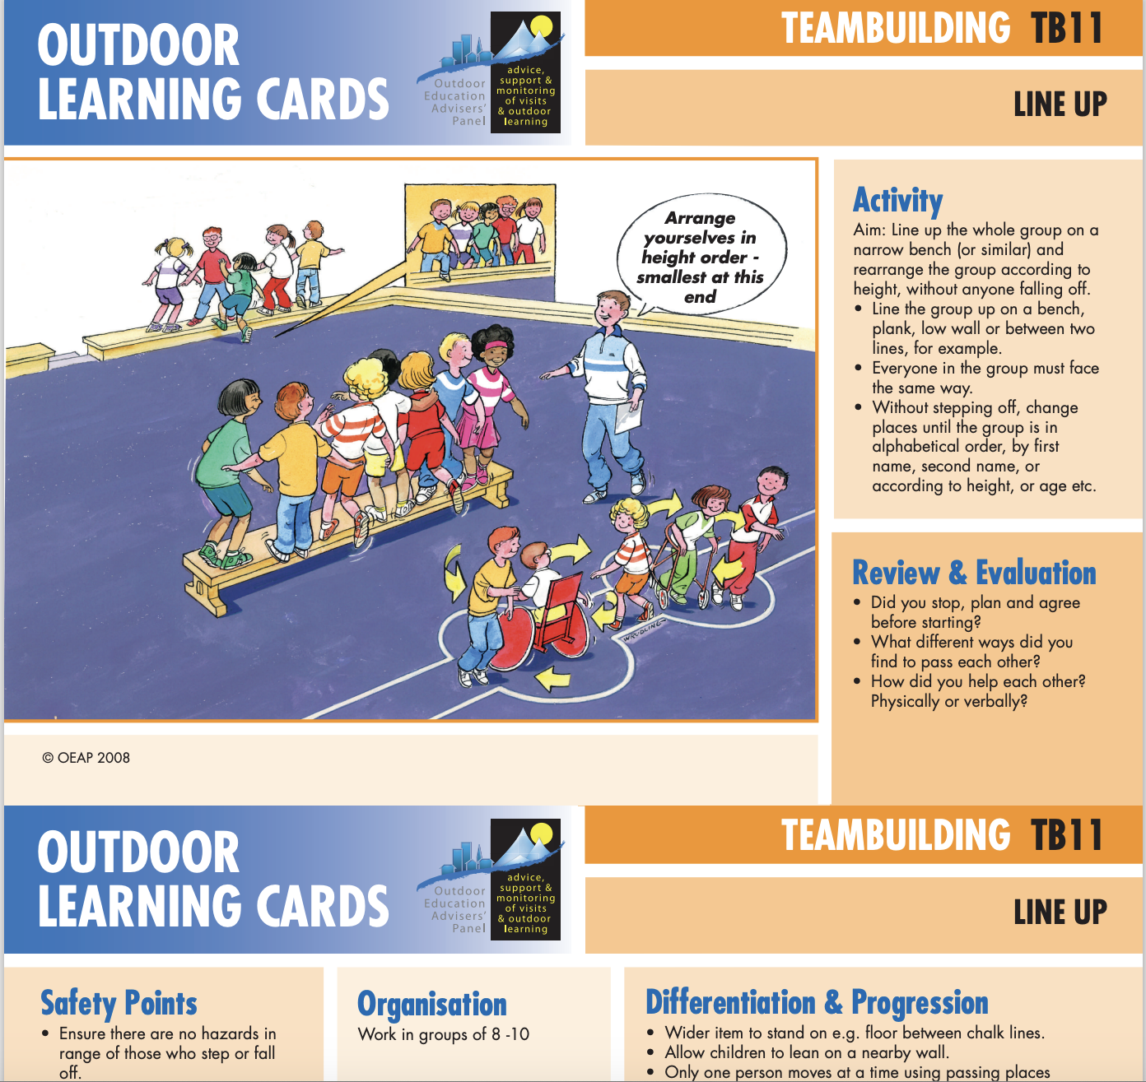
Lesson | Learning Outcome | Teaching Activity | Skills Developed | Progression/Level | Differentiation
WEEK 1 (2 lessons) Introduction to team building activities and problem-solving scenarios Lesson 1 – Introduction to unit and learning outcomes. Lesson 2 – Take part in problem solving tasks and games using Teambuilding outdoor learning cards. | To learn how to work with others in an outdoor environment and what it means to learn in nature. To collaborate in groups on the learning cards and use the outdoor space to work together. | Teacher will set small team building games. Use of outdoor learning cards for teambuilding: The activity in this learning card will be implemented in an outdoor environment. | Communication Leadership Collaboration Responsibility | Progression step 3: “I can develop and apply a range of skills in familiar, unfamiliar and changing situations, exploring space creatively in response to a variety of stimuli”. (Welsh Government, 2022) From the classroom environment, progression to the outdoors will involve using natural affordances such as trees and logs to use as the bench. | Students with ALN (Additional Learning Needs) will be able to take part in an outdoors environment due to the open landscape. Access for wheelchair users, unstructured classroom (no walls etc). Example of this would be to create circles using leaves rather than benches from tree stumps.

Slide 8
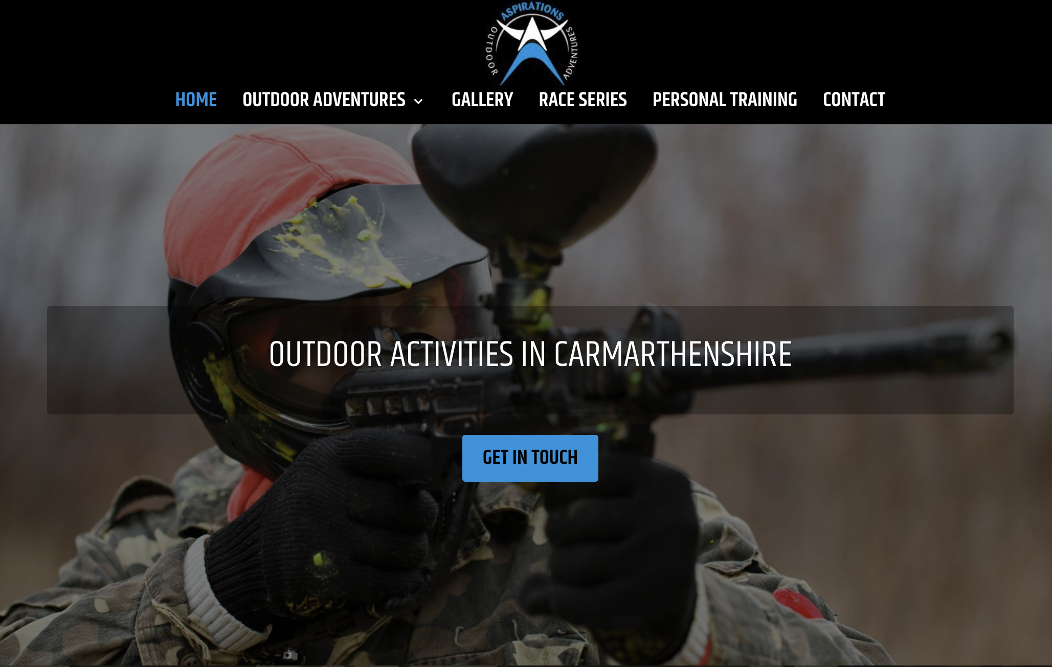
Lesson | Learning Outcome | Teaching Activity | Skills Developed | Progression | Differentiation
WEEK 2 (1 day) This week’s lesson is designed around trust and how to communicate effectively. | To learn how to develop trust in one another, a skill forgotten in secondary school students once they transition from KS2. | Outdoor pursuit centre: Teambuilding activities in an outdoor pursuit centre for a day’s trip. Local centre to the school so utilizing what’s in local community. | Trust Communication Listening Confidence | Progression step 3 Progression seen through self-esteem of students in learning to trust their peers again through small team games and exercises. | Activities on offer will be designed to allow for all ALN of all students, whether that e physical or mental. Challenge by Choice will be offered allowing students to feel comfortable in their own decision making. (Summative Assessment)
Giving students autonomy in their own choices is an important pedagogical tool (Sibthorp et al, 2008) especially in adventure education where students are being challenged to make adventurous choices all within a safe and open environment.

Slide 9
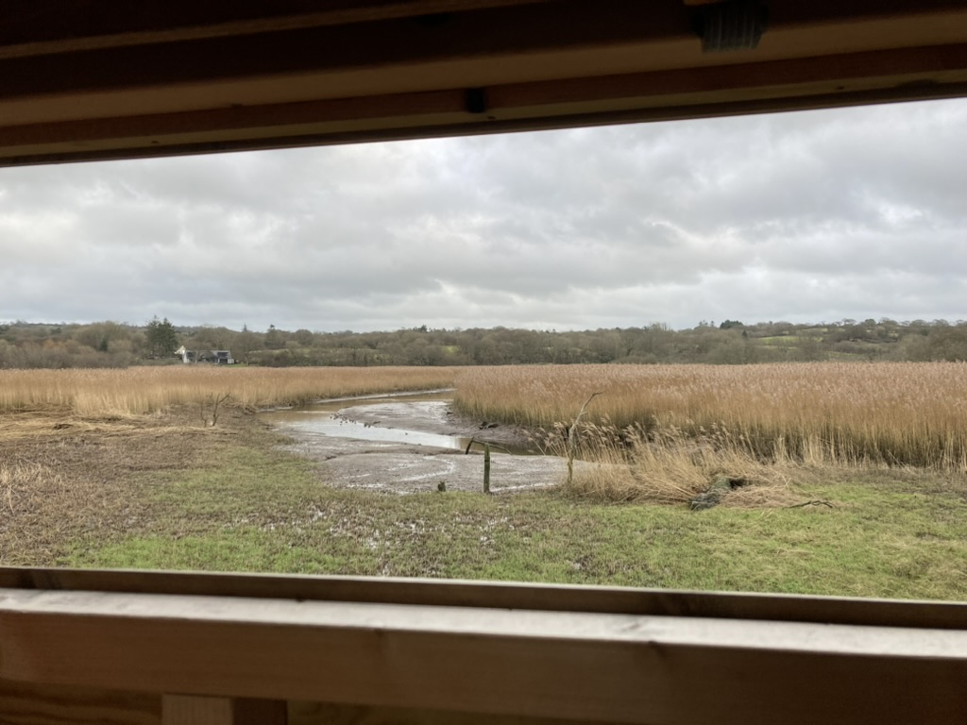
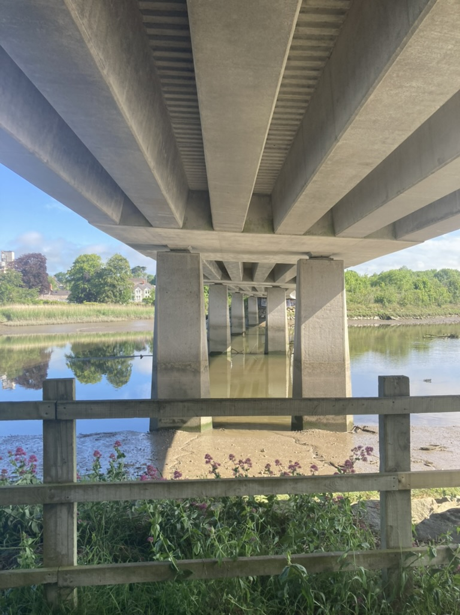
Lesson | Learning Outcome | Teaching Activity | Skills Developed | Progression | Differentiation
WEEK 3 ( 2 lessons – One in grounds of school/ second in local wildlife park) Lesson 1 – Wildlife park. Lesson 2 – Reflective writing back in school ground outdoor learning classroom. (Formative Assessment) | To use the local area to develop awareness of being in the outdoors. To harness these thoughts and write them down in a reflective journal (formative assessment task). |  | Awareness Thinking Analyzing Literacy (cross-curricular theme of Welsh curriculum (Welsh Government, 2022). | Progression step 4: “I can transfer a range of movement skills from familiar to unfamiliar and changing situations and environments, using space creatively in response to a variety of stimuli”. (Welsh Government, 2022). Taking this outdoor learning and utilizing local wildlife park to problem solve different tasks. And to reflect on how this links to student’s mental wellbeing. By being reflective in practice. | There is an accessible, inclusive path which runs all the way through the wildlife park so there is access for all students.

Slide 10
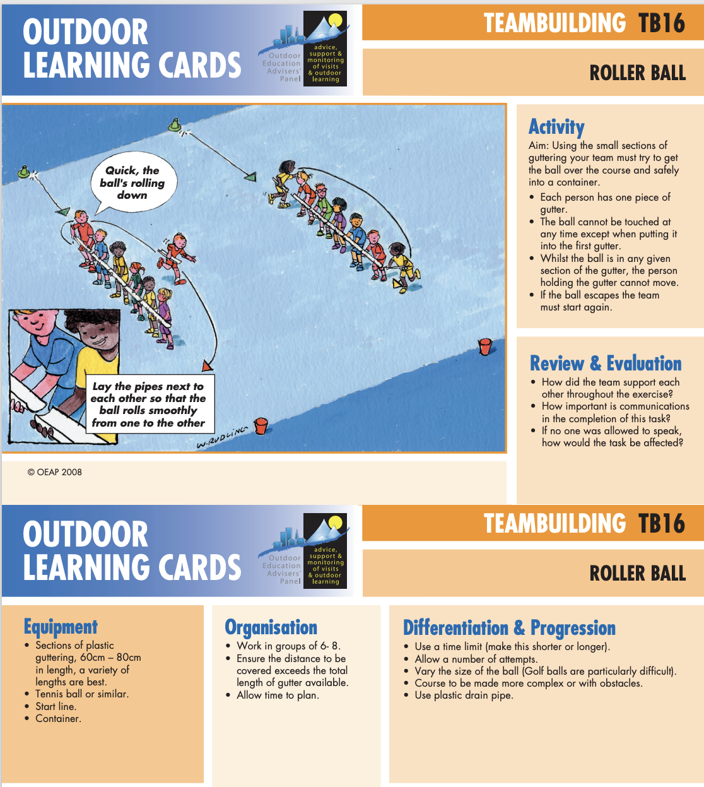
Lesson | Learning Outcome | Teaching Activity | Skills Developed | Progression | Differentiation
WEEK 4 (2 lessons) Introducing more team building activities and problem-solving scenarios. Lesson 1 – Taking part in more teambuilding games, focusing on teamwork. Lesson 2 – Using new outdoor spaces of the school ground for more outdoor learning. | To use the outdoor learning card to successfully complete a problem-solving challenge. Students will take this into an outdoor learning environment. | Roller Ball: | Communication Leadership Collaboration Responsibility Thinking Listening | Progression step 4 | Students with ALN (Additional Learning Needs) will be able to take part in an outdoors environment due to the open landscape. Access for wheelchair users, unstructured classroom (no walls etc). Students can position themselves in order which is inclusive for each students and gives each student a fair and equal chance to complete the task.

Slide 11

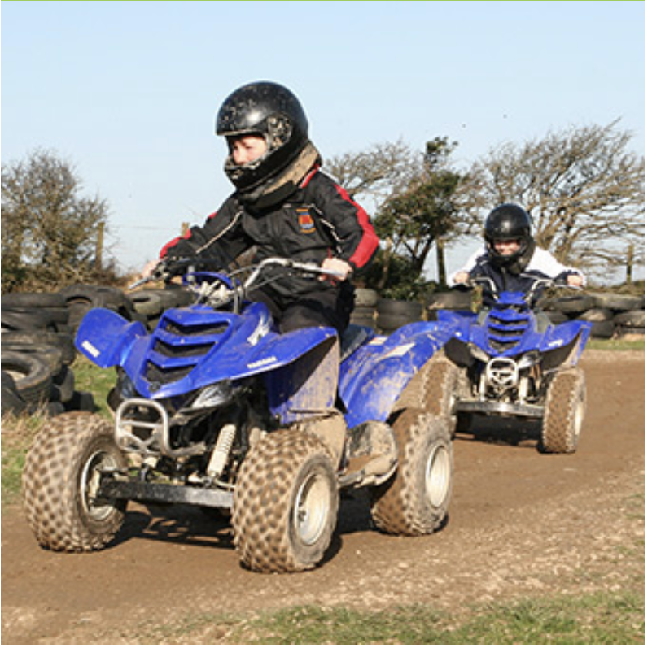
Lesson | Learning Outcome | Teaching Activity | Skills Developed | Progression | Differentiation
WEEK 5 Residential stay (1 day, 1 night). Gwersyll yr URDD Llangrannog Students in year 9 will have the chance to stay overnight at the local URDD camp where they will participate in a range of outdoor adventurous activities and teambuilding activities. | To experience being away in a different environment other than school or home. To develop student’s confidence in challenging themselves by choice in different activities which are adventurous. (Formative assessment asking students what they enjoyed the most from experience). | Students in year 7 will experience staying overnight on a residential visit for the first time. Progression from KS2 where usually children would only go for a day’s visit. Activities will include: Go-Karts Horse riding Skiing Climbing Mud assault course Teambuilding games | Responsibility of themselves. Self-esteem Awareness Confidence Communication Being adventurous Taking chances Challenge by choice | Progression step 5: “I can independently adapt and apply movement skills across a range of activities and environments, managing space creatively in response to a variety of stimuli”. (Welsh Government, 2022) This progression in week 5 takes the students completely out of their comfort zone and the familiarity of the school ground environment. Much more student-centred. | All activities on the residential will be inclusive and open for all students with ALN and those who have mental health problems such as anxiety.

Slide 12

Lesson | Learning Outcome | Teaching Activity | Skills Developed | Progression | Differentiation
WEEK 6 Duke of Edinburgh Expedition (2 nights) Final activity of the 6 weeks is to take part in a Duke of Edinburgh bronze expedition. | To undertake an expedition which is student-led. To use problem-solving skills learnt in previous weeks to navigate a route together as a group. | The teaching here will be student-centred and allow the students autonomy in their own collaboration with others. Improve their communication skills and problem-solving skills by working as a group to reach an intended target or end. (Summative assessment concluding on the evaluation of the programme). | Teamwork Confidence Communication Leadership Problem solving Empathy | Progression step 5 The final progression asks the students to harness their problem-solving skills from weeks 1 and 2 and use these to work effectively as a team to reach their final destination of the expedition. | Ensuring each individual student is comfortable before embarking on expedition. Creating different routs for students with ALN which are more accessible and inclusive.

Slide 13
Reference List
Aspirations Outdoor Adventures (2023). Outdoor Activities in Carmarthenshire. Available at: Aspirations Outdoor Adventures: personal trainer in Carmarthen | Do you need a trainer for outdoor activities? For a quality personal trainer in and around Carmarthen, call Aspirations Outdoor Adventures on 07817 480 386 (Accessed January 6, 2023).
Beames, S. and Atencio, M., (2008). Building social capital through outdoor education. Journal of Adventure Education & Outdoor Learning, 8(2), 99-112.
Christie, B; Beames, S; & Higgins, P. (2016). Context, culture and critical thinking: Scottish secondary school teachers’ and pupils’ experiences of outdoor learning. British Educational Research Journal, 42(3), 417-437. DOI: doi:10.1002/berj.3213.
Louv, R. (2005). Last Child in the Woods: SAVING OUR CHILDREN FROM NATURE – DEFICIT DISORDER. London: ATLANTIC BOOKS.
Neville A, I; Petrass A, L; & Ben, F. (2022). Cross disciplinary teaching: A pedagogical model to support teachers in the development and implementation of outdoor learning opportunities. Journal of Outdoor and Environmental Education, 1-21, Springer. Retried from DOI: https://doi.org/10.1007/s42322-022-00109-x.
Shellman, H. & Hill, E. (2017). Flourishing through Resilience: The Impact of a College Outdoor Education Program. Journal of Park and Recreation Administration, 35(4), 59-68. DOI: https://doi.org/10.18666/JPRA-2017-V35-I4-7779.
Sibthorp, J., Paisley, K., Gookin, J. and Furman, N., (2008). The pedagogic value of student autonomy in adventure education. Journal of Experiential Education, 31(2),136-151.
The Duke of Edinburgh’s Award (2022). DofE Expedition Skills [Online] Available at: DofE Expedition Skills Information - The Duke of Edinburgh's Award (Accessed January 8, 2023).
Urdd Gobaith Cymru (2023). Things To Do [Online] Available at: Things to do | Urdd Gobaith Cymru (Accessed January 8, 2023).
Varea, V., González-Calvo, G. and García-Monge, A., (2022). Exploring the changes of physical education in the age of Covid-19. Physical Education and Sport Pedagogy, 27(1), pp.32-42.
Welsh Government (2022). Area of Learning and Experience: Health and Well-being. Available at: https://hwb.gov.wales/curriculum-for-wales/health-and-well-being/descriptions-of-learning/
Welsh Government (2020). Developing a vision for curriculum design. Available at: https://hwb.gov.wales/curriculum-for-wales/designing-your-curriculum/developing-a-vision-for-curriculum-design/#curriculum-design-and-the-four-purposes.
Williams, A; & Wainwright, N. (2016). A new pedagogical model for adventure in the curriculum: part one - advocating for the model. Physical Education and Sport Pedagogy, 21(5), 481-500, Routledge Taylor & Francis Group. Retrieved from https://www.tandfonline.com/doi/epdf/10.1080/17408989.2015.1048211?needAccess=true&role=button.

