Slide 1

Enquiring Minds: Creative Approaches
Creativity in Today’s Curriculum

Slide 2
Lesson Aims and Objectives
Aims
To explore the current role of creativity in education
Objectives
To define the classic and contemporary perspectives of creative approaches in education
To evaluate the purpose of scientific enquiry and creative enquiry in the current curriculum

Slide 3
Key Influences
Reggio Emelia
Maria Montessori
HighScope
Sir Ken Robinson
Find one key point for each of them that links to creativity.
Notes:
Reggio Emelia – founded by Loris Malaguzzi – ‘children can express the 100 languages of children’ – refers to unlimited creative potential .
He believes that all learning and creatvity involves trying something out and seeing what happens, but this process involves making many mistakes. -In order to feel free to experiment and make mistakes, you need a supportive environment
Montessori - Montessori saw the ability of the child to express himself as an individual as something of paramount importance (free drawing) – but some people believe that the Montessori method is too rigid (set up environment etc) – but this environment allows children to learn skills without pressure – therefore allowing children to be creative
Highscope - HighScope allows children to develop their own daily schedule and learning interests with the teacher as a facilitator who guides the process (exploring and discovering = creativity enquiry)
Sir Ken Robinsion – expert in creativity – challenges the way we think about creativity
led the British government's 1998 advisory committee on creative and cultural education,

Slide 4
What is Enquiry?
Children need to experience paradox and uncertainty, they need lessons that produce an effective surprise. (Fisher and Williams, 2004)
Enquiry is the way that children explore and experience the environment around them. (Jeffrey,2006)
Notes:
Fisher and Williams - a combination of approaches which are developed in an environment where pupils and teachers are encouraged to be more creative can develop more creative people – creative enquiry about children finding out things and teaching staff facilitating it.
Fisher and Williams – knowledge and problem solving will be key to survival – creative enquiry promotes this.
Jeffery considered that creative enquiry focuses on children asking questions about the world around them – problem based, experiential learning

Slide 5
Creative Enquiry
Pupils encouraged to actively ‘take control’ of their own learning (Fisher 2003)
Enquiries should be about something that students don’t know the answer to. Following rigid instructions in order to arrive at a desired result doesn’t develop enquiry skills (Jones and Carter 2009)
Creativity involves both practitioner and children participating in risk taking activities (Jones and Wyse 2012)
Notes:
Creative enquiry- practical thinking skills and problem solving skills are develop problem solving skills
Pupils are actively involved and engaged in learning – promote children (as our future citizens) to be confident and creative enquirers.
Pupils need to find out knowledge for themselves and should have the freedom to do so – does this happen in all schools?

Slide 6
Scientific Enquiry
Types of enquiry:
  exploring,
  fair testing,
  classifying/identifying,
  pattern seeking,
  investigating models
  making things (Watson et al1998).
A process of investigation and observation (Phipps 2000)
Economic competitiveness and capacity for innovation depends on it.
Notes:
By rooting learning in real-life investigations, learning is contextualised and purposeful.
The future economies of these children depend on well these children are able to exercise creative and scientific enquiries – how well are other economies nurturing children’s creativity (creative industries more advanced than others?)
Ongoing cycle in which children are always finding out information – see cycle
Types of enquiry - Firstly, some ‘ways of finding out’ are more accessible
to primary and foundation phase children than others; for
example, although teachers do use models to develop children’s
scientific understanding, children rarely have opportunity to test
their suitability.

Slide 7
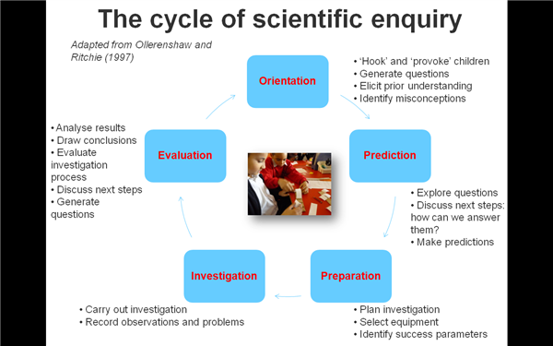
Notes:
Question is asked – how will that question be found out? – prepare to answer question – answer question – evaluate answers

Slide 8
Task
Think of an activity (anything you have to research for, e.g baking a cake, writing an assignment)
Complete your own diagram of scientific enquiry

Slide 9
Recap
Who are the key proponents for creative learning?
What is enquiry based learning?
What are some of the benefits of creative approaches to learning

Slide 10
How does creative learning fit into the curriculum?

Slide 11
ESDGC
Education for Sustainable Development and Global Citizenship
One key aim - to promote pupils creative and critical thinking skills.
Seven key themes
Part of Estyn inspection framework
Notes:
Sustainability does not just focus on recycling!
Choices and decisions
Consumption of waste
Health
The natural environment
Wealth and poverty
Climate change
Identity and culture
Topics should be naturally embedded into the curriculum
In September 2004 Estyn introduced a Common Inspection
Framework that made it a requirement for all school inspection
reports to comment on ESDGC (a unique feature of the inspection
process in Wales).
Not just classroom based but runs across the school - links with community, management etc.

Slide 12
Task
Using the internet find one ESDGC case study
In your groups discuss:
  How creativity is promoted
  How are the core themes of ESGDC incorporated into the case study
  How are the core themes linked together
  How does the ESGDC link to the LNF

Slide 13
ESDGC
Case Study:
Llanigon Primary School, Powys - the decision to lay a 200-mile gas pipeline through the Welsh countryside directly affected the small village of Llanigon in the foothills of the Black Mountains - it impacted not only on the environment but on the economy and the local community. The children and staff of the school used drama, role play and debate to consider the choices and decisions made by the community relating to the pipeline. They were able to relate this theme to wealth and poverty by exploring the unequal effects of the pipeline on local families and businesses and to consider how the 21st century needs and technologies affected the natural environment and their perception of it.
Notes:
Creative element, key themes flow naturally together and link – not always possible and sometimes can appear to be forced.

Slide 14
The Benefits of Creative Approaches to Learning
Students are motivated by carrying out practical work which provides the evidence to ‘re-discover’ ideas.
Improves thinking skills so that pupils become better learners
Creativity improves self-esteem, motivation and achievement for learners
Notes:
Learners feel more motivated because they are taking part in activities where they ‘have charge’
Allowed to follow own interests captivates that more in education.
By always asking ‘why’ children are expanding on their knowledge
A feeling of ‘can do’ when exploring increases pupil confidence and self esteem in their own ability to achieve

Slide 15
Problems with developing creativity
Lack of time in curriculum (Wilkins, 2012)
Conflicts between reports about the importance of creativity (NACCCE (1999), The Rose Report (2009))
Hard to identify what creativity is
Creativity is a low priority for teachers in comparison to other aspects of teaching and learning (Hondzel, 2012)
Issues with health and safety
Lack of resources
Notes:
Wilkins 2013 - 65% of teachers feel that they should be doing more to enhance pupils creativity skills – these were teachers across primary, secondary, fe and he, - teachers felt that there was no time and that creativity was under valued . – view also felt by parents:
Need more tools and techniques
Gap in technological developments (training, resources)
Hondzel - She found that teachers were typically positive about promoting creativity in their classrooms but had a narrow idea of what creativity looks like and how to promote it.
Limitations - risk assessments – what is ‘safe’? – different definitions of risk taking

Slide 16
Questions?

Slide 17
Thursday
Guest speakers =
Ash and Ryan (11-12) Mad Science
Ross (1-3) ESDGC Project

