Slide 1


Criminal Litigation – Week 2
Police Powers – PACE 1984
Part one: Stop Search, Arrest, Detention

Slide 2

Aims
Understand the role and function of the police
Understand the powers of police to stop and search, arrest and detain a person to investigate a crime/criminal offence

Slide 3

We will be looking at…
the powers the police may exercise when a suspect has been arrested and detained at the police station; and
what rights a suspect has whilst so detained; and
what advice a solicitor (or accredited police station representative) would be expected to give such a client.

Slide 4
Importance…
What occurs at the police station is likely to represent a critical stage of the investigation and influence the decision whether or not to charge the suspect with any offences.
This may also be of great significance when a case gets to trial, particularly if the defendant’s solicitor attempts to argue that prosecution evidence obtained whilst their client was detained at the police station is inadmissible because the police behaved improperly or unlawfully

Slide 5




The Police (1)
43 geographically-based police forces in England and Wales, together with others, such as the British Transport Police and Civil Nuclear Constabulary, covering specific institutions.
Each police force is led by a Chief Constable or a Commissioner (Chief Officers of Police).
Chief Officers of Police have, to a great extent, operational independence, although police forces are subject to inspection by HM Inspectorate of Constabulary and Fire & Rescue Services.

Slide 6
The Police (2)
Police forces are also answerable to local Police and Crime Commissioners (PCCs), who are elected officials charged with the delivery of effective and efficient policing in each police area (except for London, which has its own arrangements).
They are elected for a term of four years.
The role of the PCC is to be the voice of the people and hold the police to account.

Slide 7
The Police (3)
Under the Police Reform and Social Responsibility Act 2011, PCCs must:
secure an efficient and effective police for their area;
appoint the Chief Constable, hold them to account for running the force, and if necessary dismiss them;
set the police and crime objectives for their area through a police and crime plan;
set the force budget and determine the part of the council tax bill set aside for policing;
contribute to the national and international policing capabilities; and
bring together community safety and criminal justice partners, to make sure local priorities are joined up.

Slide 8

Investigation
Wide range of statutory powers: -
to stop and search people and vehicles,
to search property and premises,
to arrest and detain those suspected of having committed the crime, and
to gather evidence to assist in constructing a case where there is sufficient evidence to charge a person with a suspected criminal offence.

Slide 9
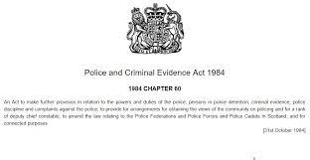
Police and Criminal Evidence Act 1984 (PACE)
Introduced with the aim of striking a balance between the powers of the police and the rights of the individual.
Gives the police statutory authority to search, arrest and detain a suspect.
PACE is supplemented by the PACE Codes of Practice – detailed provisions about how the police must exercise their powers under PACE.
There are 8 codes of practice – Codes A-H.

Slide 10
PACE Codes of Practice – 8 Codes
Code A – stop and search
Code B – searches of premises by police officers and seizures of property found on persons or premises
Code C – detention, treatment and questioning of persons by police officers
Code D – identification of persons by police officers
Code E – the audio recording of interview with suspects the police station
Code F – the visual recording of interviews with suspects at the police station
Code G – the statutory power of arrest
Code H – the detention, treatment and questioning of persons under s41 Terrorism Act 2000

Slide 11

Safeguards for the Suspect
If the police obtain evidence in breach of PACE and the Codes, the admissibility of the evidence will likely be challenged by the defendant.
Court will need to make a ruling on whether the evidence can be admitted.
Bear in mind the Human Rights Act 1998.
Think of articles 5 (Right to Liberty and Security) and 6 (Right to a Fair Trial) of the ECHR.

Slide 12
Role of the Legal Adviser
A legal adviser’s role in the police station is to protect and advance the legal rights of their client. This means that a legal adviser is required to:
ensure that the police act fairly at all times and comply with the substantive provisions of the Police and Criminal Evidence Act 1984 (PACE 1984) and the Codes of Practice;
protect the suspect from unnecessary pressure and distress through intervention or clarification if necessary (most significantly, this ensures that the client does not make a false confession);
ensure that the suspect fully understands the choices available to them in terms of what they should do in interview;
ensure that an accurate record is kept of the interview; and
protect a vulnerable suspect.

Slide 13
Police Station Accreditation Scheme…
Solicitors can attend the police station, but may also delegate attendance to an accredited representative, for example, a legal executive
The accreditation scheme ensures that such representatives are competent.
Representatives must pass a test, consisting of:
a portfolio stage, covering visits to police stations;
a written examination; and
a taped critical incidents test covering certain matters which might arise during a police station visit.
Barristers, anyone who has successfully completed the Legal Practice Course and fellows or members of CILEX who have passed the criminal law and litigation papers are exempt from the written examination. The Legal Aid Agency maintains a register of accredited police station representatives.

Slide 14
Police Powers covered in this module
Stop and Search
Arrest
Search of premises
Detention
Interview
Obtaining Evidence
Charge

Slide 15

Stop and Search

Slide 16
Stop and Search
Code A requires that stop and search powers must be used fairly, responsibly, with respect for people being searched and without unlawful discrimination.
s1 PACE 1984 gives a constable (a term covering an officer of any rank) the power to stop and search any person or vehicle in a public place where they have reasonable grounds to suspect that the person is in possession of stolen or prohibited articles or articles to which s1(7)–(8A) applies. viz:
stolen articles (s1(2)(a));
offensive weapons (s1(7)(a));
articles made or adapted for use in or intended for use in burglary, theft, offences of taking a motor vehicle under s12 Theft Act 1968 (TA 1968) or fraud as defined by s1 Fraud Act 2006 (FA 2006);
an article made or adapted for use or intended by the person having it with them or by some other person in connection with an offence under the Criminal Damage Act 1971 (destroying or damaging property);
articles which have a blade, or are sharply pointed, including pocket knives where the cutting edge of the blade exceeds three inches (s1(8A)); and
‘prohibited fireworks’, which includes where a person is under the age of 18 years and found in possession of adult fireworks in a public place or an adult is found in possession of display fireworks in a public place.

Slide 17
S 1 PACE 1984…
must be reasonable grounds to suspect that a person is in possession of a stolen or prohibited article. T
2 stage test (supplemented by provisions in Code A), viz.
  the officer must have formed a genuine suspicion that he or she will find the object for which the search power being exercised authorises the search; and
  the suspicion must be reasonable.
Stop and search procedures can be carried out in places to which the public, or any section of it, have access, or
S 1 (4):If the suspect is in the garden or yard of a dwelling or other land so occupied, and the officer has reasonable grounds to believe:
that they do not reside in the dwelling; and
that they are not where they are with the express or implied permission of a person who resides in the dwelling,
This is clearly intended for the apprehension of burglars.

Slide 18
S 1 PACE 1984…
ss2(2) and 2(3) PACE 1984 require that if the officer is not in uniform they should provide documentary evidence to prove that they are a police officer and should
  inform the suspect of their name and their designated police station, as well as the object and the grounds of the search; and
  The officer should make a record of the search unless there are exceptional circumstances that make this wholly impracticable (para 4.1 Code A). A copy of the search record will be made available to the suspect on request.
Para 3 Code A :co-operation of person to be searched must be sought in every case although reasonable force can be used if necessary as a last resort
PC should only require suspect to remove outer clothing: jacket, gloves, coat

Slide 19
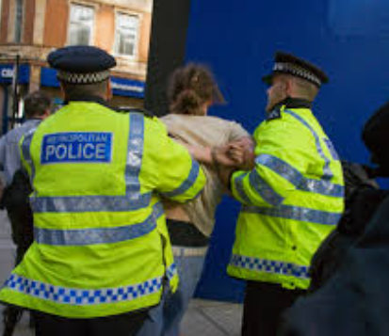
Arrest

Slide 20
Powers of Arrest
The arrest must be carried out in accordance with specific legal authority. If police do not, the arrest will be unlawful.
Common law – for suspected breach of the peace
With a warrant – s1 MCA 1980
Without a warrant - s24 PACE – where officer has reasonable grounds to believe;
  offence has been committed/is being/about to be committed AND
  an arrest is necessary for any of the reasons in s24(5) (known as the necessity test)

Slide 21
Arrest with a warrant (s 1 MCA 1980)
1 Issue of summons to accused or warrant for his arrest.
(1) On an information being laid before a justice of the peace that a person has, or is suspected of having, committed an offence, the justice may issue—
(a)a summons directed to that person requiring him to appear before a magistrates' court to answer the information, or
(b)a warrant to arrest that person and bring him before a magistrates' court.
(2) . . . . . . . . . . . . . . . . . . .
(3)No warrant shall be issued under this section unless the information is in writing. . .
(4)No warrant shall be issued under this section for the arrest of any person who has attained the age of 18 years unless—
(a)the offence to which the warrant relates is an indictable offence or is punishable with imprisonment, or
(b)the person’s address is not sufficiently established for a summons to be served on him.

Slide 22
Arrest without a warrant (s 24 PACE 1984)
(1) A constable may arrest without a warrant—
(a) anyone who is about to commit an offence;
(b) anyone who is in the act of committing an offence;
(c) anyone whom he has reasonable grounds for suspecting to be about to commit an offence;
(d) anyone whom he has reasonable grounds for suspecting to be committing an offence.
(2) If a constable has reasonable grounds for suspecting that an offence has been committed, he may arrest without a warrant anyone whom he has reasonable grounds to suspect of being guilty of it.
(3) If an offence has been committed, a constable may arrest without a warrant—
(a) anyone who is guilty of the offence;
(b) anyone whom he has reasonable grounds for suspecting to be guilty of it.
(4) But the power of summary arrest conferred by subsection (1), (2) or (3) is exercisable only if the constable has reasonable grounds for believing that for any of the reasons mentioned in subsection (5) it is necessary to arrest the person in question.

Slide 23
Arrest without a warrant…. continued
(5) The reasons are—
(a) to enable the name of the person in question to be ascertained (in the case where the constable does not know, and cannot readily ascertain, the person's name, or has reasonable grounds for doubting whether a name given by the person as his name is his real name);
(b) correspondingly as regards the person's address;
(c) to prevent the person in question—
(i) causing physical injury to himself or any other person;
(ii) suffering physical injury;
(iii) causing loss of or damage to property;
(iv) committing an offence against public decency (subject to subsection (6)); or
(v) causing an unlawful obstruction of the highway;
(d) to protect a child or other vulnerable person from the person in question;
(e) to allow the prompt and effective investigation of the offence or of the conduct of the person in question;
(f) to prevent any prosecution for the offence from being hindered by the disappearance of the person in question.

Slide 24
Arrest under s 24… the necessity test
S24 (5) sets out six criteria for determining whether the arrest is necessary, all of which are further defined in Code G:
(1) To enable the name of the person in question to be ascertained.
(2) To enable an officer to ascertain a person’s address in circumstances identical to those referred to in (a) above.
(3) To prevent the person concerned: causing of suffering physical injury, causing property damage, committing offences of public decency or obstruction of the highway
(4) To protect a child or other vulnerable person from the person in question.
(5) To allow the prompt and effective investigation of the offence or of the conduct of the person in question.
(6) To prevent any prosecution for the offence being hindered by the disappearance of the person in question.

Slide 25
To arrest with or without a warrant?
Warrants are issued upon application by the police to a magistrate.
It is a formal document authorising the police to take the person into custody and to bring them before the court.
Only used at the start of an investigation to compel attendance at the police station.
Police have powers of arrest without warrant under s24 PACE supplemented by Code G.

Slide 26
Arrest by someone other than police? ( Citizen’s arrest)
Section 24A of the Police and Criminal Evidence Act 1984 (PACE) states that an individual can perform an arrest on somebody they suspect of committing an indictable offence.
Applies to serious offences that must be tried in a Crown Court, for example, assault, burglary, murder, manslaughter, terrorism, trafficking, rape or criminal damage worth over £5000.
This means that you cannot perform a citizen’s arrest on someone committing a summary offence, such as road traffic offences, minor assaults, or minor criminal damage.
The act states that you can arrest somebody to prevent them from:
  Causing physical injury to themselves or someone else
  Suffering a physical injury
  Causing loss or damage to property
  Attempting to escape before a Police officer is able to assume responsibility of them

Slide 27
Arrest by someone other than police?
Civilians also have a common law ‘power of arrest’ where there is a breach of peace or if there are reasonable grounds to suggest there may be a breach of peace. In these circumstances, an arrest can be conducted if:
(a) a breach of the peace is committed in the person effecting the arrest’s presence,
(b) the person effecting the arrest reasonably believes that such a breach will be committed in the immediate future by the person arrested, or
(c) a breach of the peace has been committed or the person effecting the arrest reasonably believes that a breach of the peace has occurred and that a further breach is threatened.
In any circumstance, it’s vital to make certain you have an appropriate reason to make the arrest, as arresting someone who is found innocent can leave you open to being charged with unlawful arrest or false imprisonment.

Slide 28
QUESTION: What is a ‘breach of the peace’?

Slide 29

Elkington v DPP (2012)
Read up about this case
What was the case about?
What are your thoughts?

Slide 30
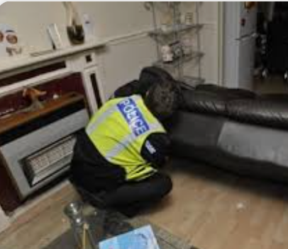
Search of premises

Slide 31
Power to Search After Arrest
s54 PACE - Of arrested person, on arrival at police station.
s32 PACE - Of arrested person, at a place other than police station.
  officer has reasonable grounds to believe arrested person presents a danger to others.
  For items which may be used for escape.
  For evidence relating to an offence
  (Indictable offences only) the premises where suspect arrested/was immediately prior to arrest for evidence
  s18 PACE - Of premises “occupied or controlled” by arrested person, after arrest
  officer has reasonable grounds to believe evidence on the premises.
  Requires written authority from Inspector

Slide 32
Search Warrants
Code B applies
Section 8 PACE entitles p.c. to make an application to a magistrate for a warrant to enter and search
Must be reasonable grounds to believe:
  An indictable offence has been committed
  Material on premises likely to be of substantial value to the investigation
  Material is likely to be relevant evidence: and
  The items do not consist of or include items subject to legal professional privilege or excluded material or special procedure material.
Types of warrant: specific premises or all premises
To comply with right under ECHR the power must:
  Be prescribed by law;
  Exercised in pursuit of a legitimate aim
  Be proportionate to the aim

Slide 33
Search of property
Code B para 5 applies
Powers under:
  Common law: with permission of the occupier
  Common law: to deal with a breach of the peace
  S 8 PACE – with search warrant from magistrate
  S 17 PACE – in order to locate and arrest a suspect for an indictable offence
  S 32 PACE – after arrest for an indictable or either way offence, pc can search premises where the suspect was at the time of arrest or immediately prior
  S 18 PACE – after arrest for an indictable or either way offence, pc may search premises occupied or controlled by the suspect for evidence relating to the offence for which they were arrested.
  Part 4 Terrorism Act 2000: Assistant Chief Const.can authorise a search where necessary to prevent terrorist acts. Equality Act 2010 applies and officers must avoid racial or religious profiling when making these search decisions.
Section 19 PACE - Power to seize anything on the premises search if r. grounds for believing:
  Item(s) have been obtained in consequence of commission of an offence or evidence relating to it; and
  Necessary to seize to prevent loss or destruction or being hidden

Slide 34

Detention

Slide 35
Power to Detain/Question
A person can voluntarily attend the police station “helping the police with their enquiries”
PACE Code C
Suspect to be taken to police station as soon as practicable after arrest – s30 PACE
Custody Officer
  To make up Custody Record (Code C:2)
  To ensure PACE Codes complied with – rights explained to suspect (Code C:3.1)
  To determine if sufficient evidence to charge – s37(1) PACE
  To authorise detention if necessary to secure/preserve evidence or obtain evidence by questioning – s37 (3) PACE
  To charge/liaise with CPS re charge if sufficient evidence exists
  To consider bail (s37 (7) PACE)

Slide 36
Detention at the Police Station
Period of Detention without charge:
  Basic period – 24 hours from time brought to police station – s41 PACE
  Extension up to 36 hours if authorised by Superintendent –(indictable offences only) – s42 PACE.
  Magistrates’ warrants of up to 36 hours required thereafter – max period 96 hours – s43 PACE/ s44 PACE
  6/9 hourly reviews.
  Separate provisions under Terrorism Act (for information only)
Requirements of Code C

Slide 37
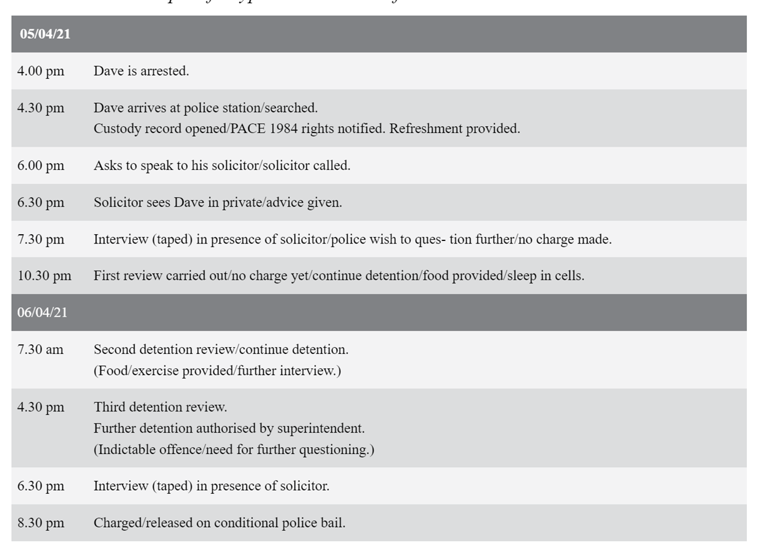
Example timeline of events

Slide 38
Power of the police to take samples from detained persons
s61 PACE – Fingerprints may be taken with consent or without where suspect arrested/detained for a recordable offence
s62 PACE – Intimate samples can be taken by consent if authorised by inspector (recordable offences).
s63 PACE – Non-intimate samples – no consent required if suspect has been arrested and detained in connection with a recordable offence AND no sample has been taken previously.

Slide 39
Powers of police to carry out identification procedures
PACE Code D
Used where identification is disputed and “known” and “available” suspect (D:3.4)
Objective is to test witness’s ability to identify a person and provide safeguards against mistaken identification.
Possible procedures are:
  Video identification (D:3.5);
  Identification Parade (D:3.7);
  Group identification (D:3.9);
  Confrontation (D Annex D) ;
  Voice identification (Code D:1.2)

Slide 40
Tutorial Task – Consider the case of John Thomas
The police are investigating a burglary at the local school which is said to have occurred at 6:30. Two new laptops and other computer equipment have been stolen. An eyewitness gives a description of two youths seen running from the scene. The eyewitness thinks that one of the youths is John Thomas.
John, who is 20, has a number of previous convictions for offences of dishonesty. He is a known drug user and lives with his brother.
PC Jones sees John in the street and is aware of his previous convictions and that he is suspected of the burglary. He approaches John but he attempts to run off. PC Jones chases John and catches up with him.
Does PC Jones have grounds for arresting John Thomas? Explain your answer using the relevant statutory authority.
What must PC Jones do to ensure an arrest of John Thomas is carried out lawfully?
Can John be searched upon arrest? Explain your answer with reference to the relevant statutory authority.

Slide 41

Any Questions?

Slide 42
Next Steps
Next week we will be looking at early procedure at the police station and the role of the lawyer
Please read PACE CODE C

