Slide 1
Employability and Career Development
(LCLM4005) – September 2026
Session 3: Career Planning and PDP
Students’ version

Slide 2
Week | Topic of focus
1 | Introduction to the module + Personal Development Plans
2 | Self-Awareness
3 | Exploring Employment Opportunities
4 | Recruitment and Selection Process
5 | CV and Cover Letter Writing
6 | Job Interview Preparation
7 | Present Task 1 in class (Mock Interview)
8 | Employment Legislation
9 | Career Development
10 | Alternative Pathways to Consider upon Graduation + Revision Submit Task 2 via Moodle (Portfolio of Written Tasks)

Slide 3
Session Aims
To explore career options
To begin planning for these options by creating a personal development plan

Slide 4
Explore Career Options

Slide 5
Career Planning
Why is career planning important?

Slide 6
Areas to Explore in Career Planning
What areas are you interested in exploring?

Slide 7
Career Planning
‘Ownership of careers is being transferred from the organisation to the individual. In a career sense, we are all self-employed now.’
(Golzen and Garner, 2020)
How are you interpreting this statement?
Do you feel equipped to take on such responsibility?

Slide 8
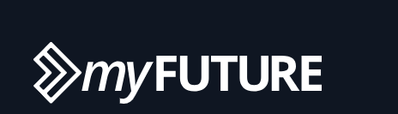
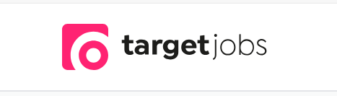
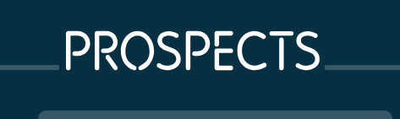
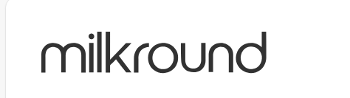

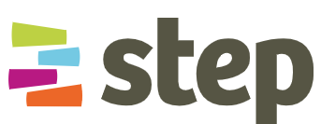
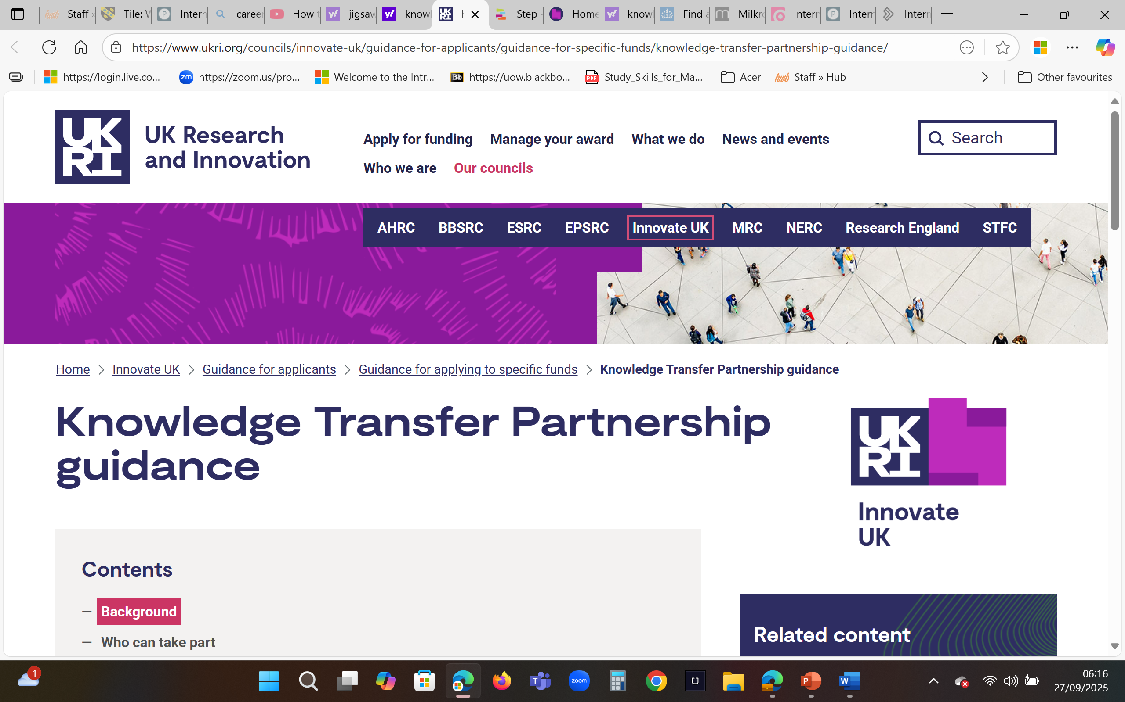
Resources for finding employment
GRADUATE SCHEMES
INTERNSHIPS
    Graduate Talent Pool: opportunities for graduates - mainly in England
    Step: opportunities for students and graduates - primarily in England
    Knowledge Transfer Partnerships: UK-wide programme where (a) the selected graduate, (b) their affiliated university or research organisation and (c) the recruiting organisation shall partner up on projects
ENGAGE WITH EMPLOYERS
Notes:
https://myfuture.com/mapping-your-future/employment/internships/
https://targetjobs.co.uk/internships
https://www.prospects.ac.uk/jobs-and-work-experience/work-experience-and-internships/internships
https://www.milkround.com/
https://www.gov.uk/find-internship
https://www.step.org.uk/
https://iuk-ktp.org.uk/discover/graduates/

Slide 9

The Future of Workplaces
You are about to carry out a jigsaw reading activity. Do you know what this term means?
Person A will read the first part of the text. They will then report back on what they have learnt to their group.
Person B will read the middle part of the text. They will then report back on what they have learnt to their group.
Person C will read the final part of the text. They will then report back on what they have learnt to their group.
A

Slide 10
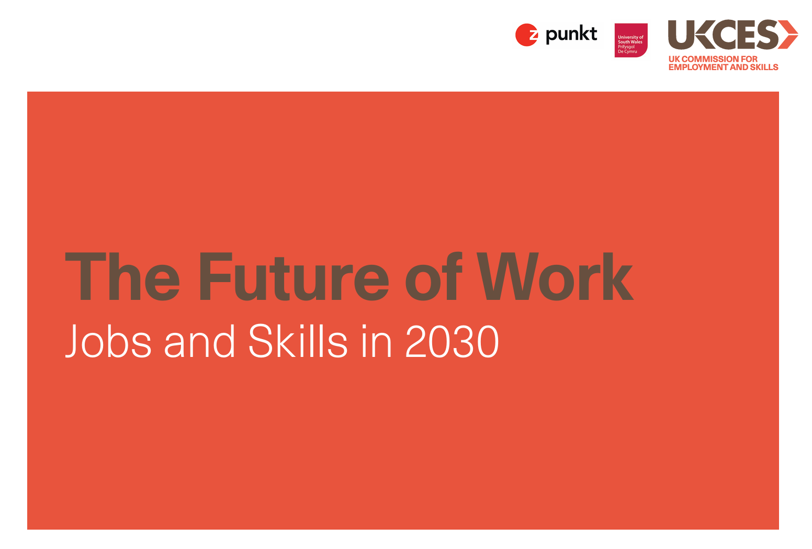
The Future of Workplaces
Title: The future of work: Jobs and Skills in 2023.
Author: UK commission for Employment and Skills.
Read the text and then report back to your group:
Person A to read slides 1-5
Person B to read slides 6-10
Person C to read slides 11-15
B

Slide 11
The Future of Workplaces
Class discussion:
What trends are shaping the future of UK jobs and skills?
What disruptions could potentially change the future of work?
What actions could be considered to address such trends and disruptions?
C

Slide 12
The Future of Workplaces
Summary
This study looks ahead to the labour market of 2030. It identifies the stable trends in a UK-based context.
It seeks to understand what disruptions may occur.
It suggests potential actions for future skills using 4 scenarios: (a) employers, (b) individuals, (c) education and training providers, and (d) policy makers.

Slide 13
Creating a Personal Development Plan (PDP)

Slide 14
What is a Personal Development Plan?

Slide 15
Personal Development Plan
When writing professional development plans:
Think carefully about what should be your career goals
  furthering your education?
  starting your own business?
  switching to a new career?
  other options?
Consider ways of setting out SMART goals. Thinking clearly will enable you to state (a) what are your priorities and (b) how you plan to achieve them.

Slide 16
Personal Development Planning
Goalsetting should lead to specific actions being carried out
the process of creating an action plan should be based on:
  your awareness
  your values
  your reflection
  your ability for further goal-setting and planning
Actions should lead to elements of self-improvement

Slide 17
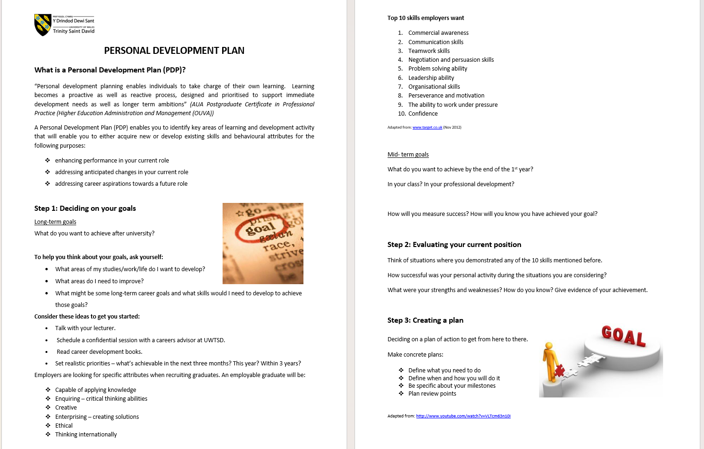
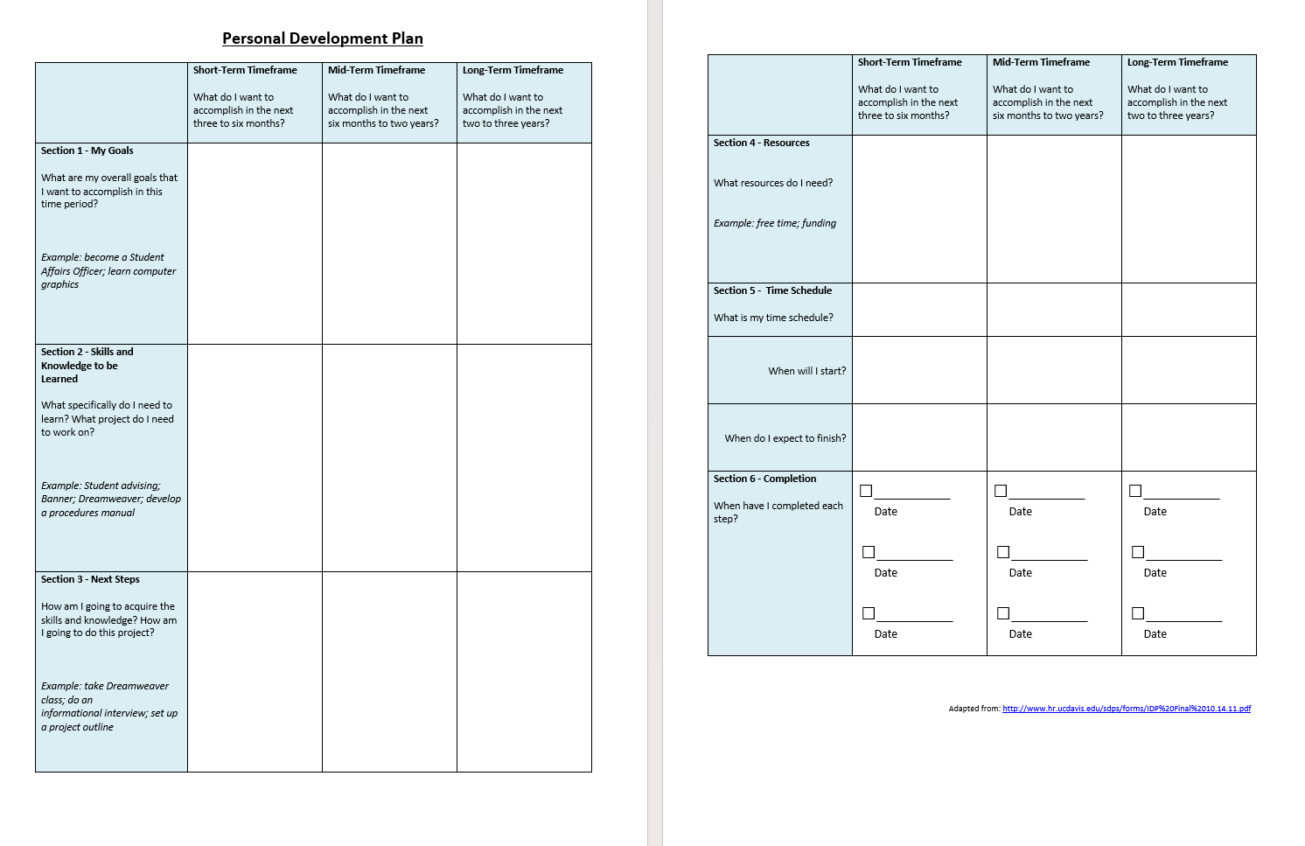
Personal Development Planning
See the PDP guidance sheet and accompanying template.
This single document can be found on Moodle - in the week 3 folder.
Use sections of the template to begin completing your PDP. →
A

Slide 18
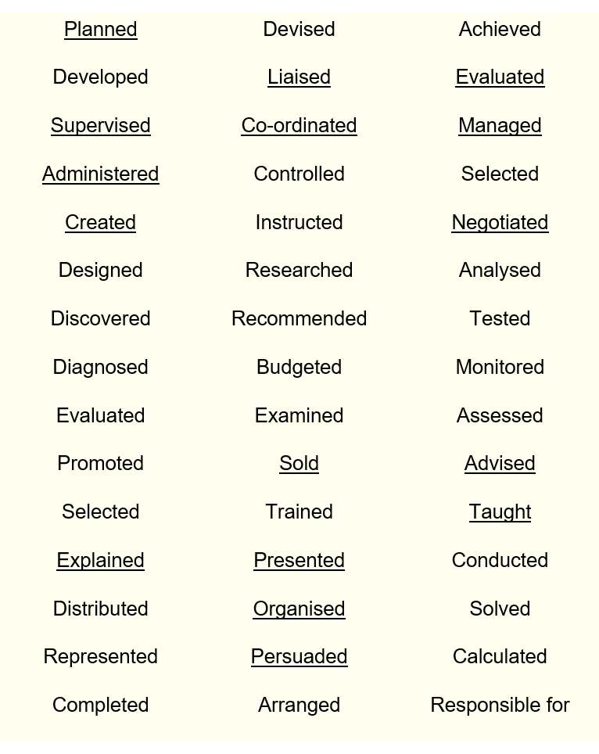
Personal Development Planning
For this task, you can make use of the action words list.
This document can also be found in the week 3 folder.
B

Slide 19
Personal Development Planning
Use a range of resources to identify and research your career options
Your findings can feed into your decision making and the planning document.
Prospects (2026) is one such resource for you to explore: www.prospects.ac.uk
Numerous other resources are available.
LinkedIn
linkedin.com
Skills for Careers
skillsforcareers.education.gov.uk
Future Goals
futuregoals.co.uk
Graduate Jobs
graduatejobs.com
Give a Grad a Go
giveagradago.com
C

Slide 20

Recap
We have explored career options
We have started the process of career planning by developing a personal development plan

Slide 21
Task 1 progress tracker
Have you finalised a job advert to use for this assessment?
Ensure it also has an accompanying job description and person specification.
Take a screenshot of the documents or download them. Do not just note down the weblink as it may be lost or stop working. It might also become a dead link if the vacancy is filled.

Slide 22
References
Indeed (2022) How to write a professional development plan (with example). Available at: https://uk.indeed.com/career-advice/career-development/professional-development-plan (Accessed: 26 May 2026)
Reed (2023) How to: Make a career plan. Available at: https://www.reed.co.uk/career-advice/how-to-make-a-career-plan/ (Accessed: 26 May 2026)
What types of sources are these?
How do you know?

