Slide 1
Information engineering
Access Input Masks and Validation rules

Slide 2
Input Mask
An input mask is used in fields (in tables and queries) and in text boxes and combo boxes (in forms) to format data and provide some control over what values can be entered.
An input mask consists of literal characters (such as spaces, dots, dashes, and parentheses) that separate blanks to fill in.
The Input Mask property setting consists of literal characters along with special characters that determine the kind of value that can be entered into the blank in that position.
Input masks are primarily used in Text and Date/Time fields, but can also be used in Number or Currency fields.

Slide 3
Input Mask Characters
Character Description
0 Digit (0 through 9, entry required; plus [+] and minus [-] signs not allowed).
9 Digit or space (entry not required; plus and minus signs not allowed).
# Digit or space (entry not required; blank positions converted to spaces, plus and minus signs allowed).
L Letter (A through Z, entry required).
? Letter (A through Z, entry optional).
A Letter or digit (entry required).
a Letter or digit (entry optional).
& Any character or a space (entry required).
C Any character or a space (entry optional).

Slide 4
Input Mask Characters
Character Description
. , : ; - / Decimal placeholder and thousands, date, and time separators. (The actual character used depends on the regional settings specified by double-clicking Regional Settings in the Windows Control Panel.)
< Causes all characters that follow to be converted to lowercase.
> Causes all characters that follow to be converted to uppercase.
! Causes the input mask to display from right to left, rather than from left to right. Characters typed into the mask always fill it from left to right. You can include the exclamation point anywhere in the input mask.

Slide 5
Input Mask Characters
Character Description
\ Causes the character that follows to be displayed as a literal character. Used to display any of the characters listed in this table as literal characters (for example, \A is displayed as just A).
Password Setting the InputMask property to the word Password creates a password entry text box. Any character typed in the text box is stored as the character but is displayed as an asterisk (*).

Slide 6
Example of Input Masks
Input mask definition Examples of values
(000) 000-0000 (206) 555-0248
(999) 999-9999! (206) 555-0248
( ) 555-0248
(000) AAA-AAAA (206) 555-TELE
#999 -20
    2000
>L????L?000L0 GREENGR339M3
  MAY R 452B7
>L0L 0L0 T2F 8M4
00000-9999 98115-98115-3007

Slide 7
Examples of Input Masks
>L<?????????????? Maria
Pierre
ISBN 0-&&&&&&&&&-0 ISBN 1-55615-507-7
      ISBN 0-13-964262-5
>LL00000-0000 DB51392-0493

Slide 8
Sample Format rules
Symbol Description
@Text character (either a character or a space) is required.
&Text character is not required.
<Force all characters to lowercase.
>Force all characters to uppercase

Slide 9
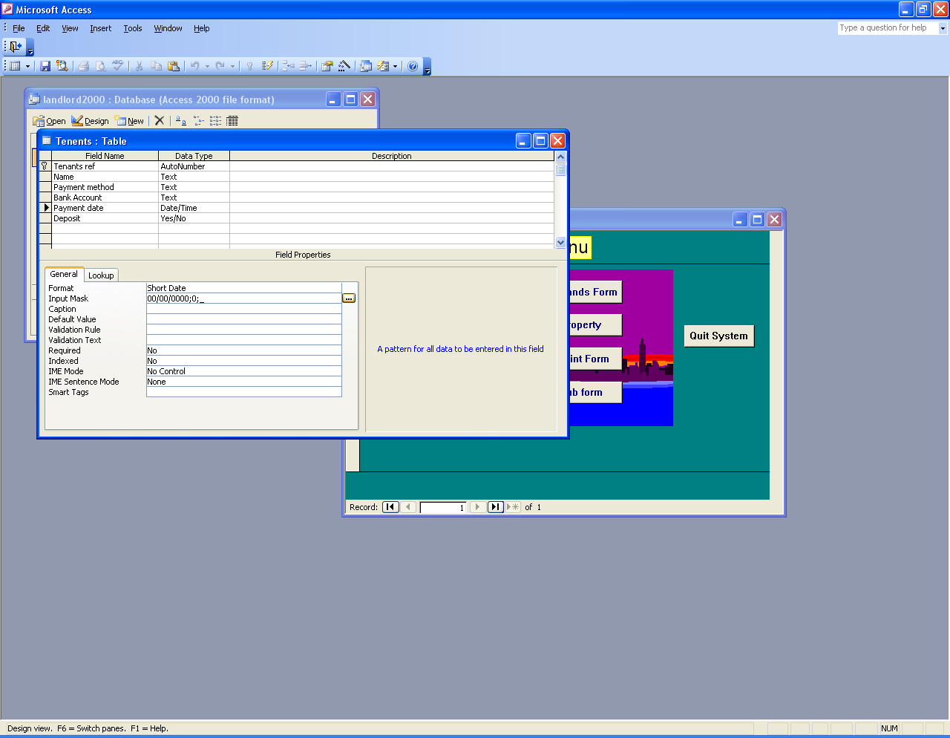
Example
Press the event button

Slide 10
Validation Rules
ValidationRule SettingValidationTextsetting
<>0 Please enter a nonzero value
.0 or >100 Value must be either 0 or over 100.
<#1/1/2000# Enter a date before 2000.
>=#1/1/2000# and <#1/1/2001# Date must be in 2000.
StrComp(UCase([LastName]),[LastName],0) = 0
Data in the LastName field must be uppercase.

Slide 11
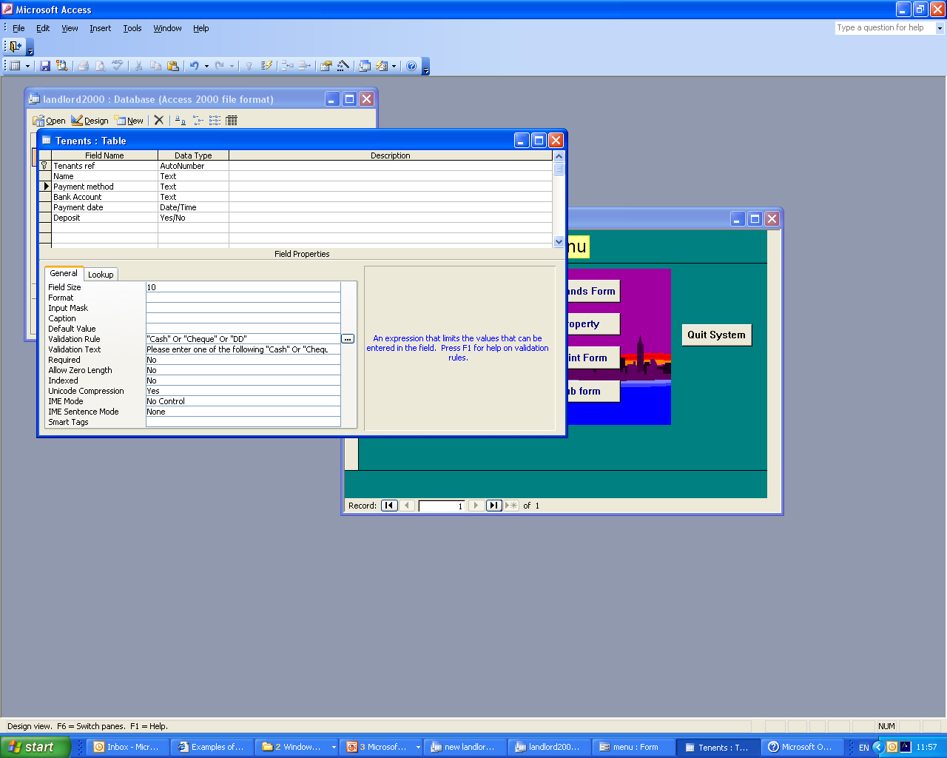
Example

Slide 12
Validation rule Expression builder
Within the access table creation environment you are able to define the way in which a user will enter data.
This is different to a mask and will give you more control i.e you will be able to build some simple code to provide a check on data entry

Slide 13
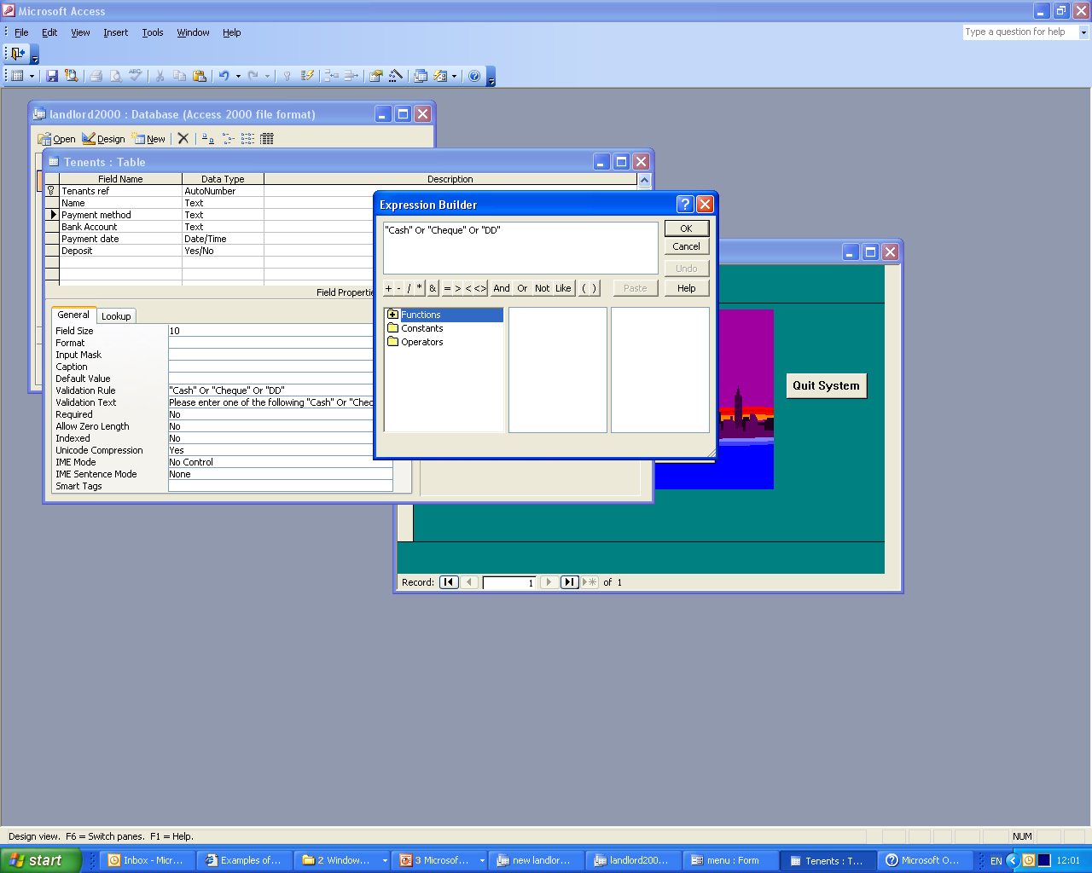
Example

