Slide 1
Children and Young People, Resilience and Well-being:
Introduction to contemporary discourses.

Slide 2
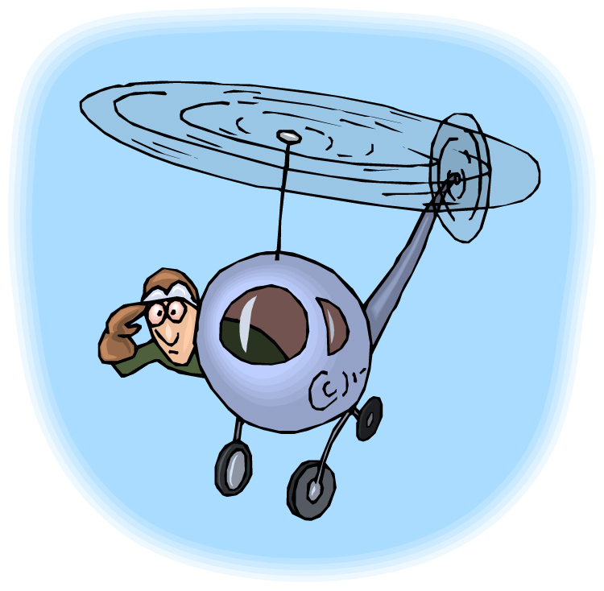
A Holistic View
As practitioners we are in a unique position within the whole range of organisations seeking to work with children and young people. We must seek to understand the child and young person in the context of their groups, their family, their community and wider society. This has implications for our work with them.

Slide 3
Contemporary issues facing families, children and young people
In small groups spend 30 minutes discussing and compiling a list of issues facing families, children and young people with whom you are familiar.
Calder, G. Soundings, ‘Of course we do’: inequality, the family, and the spell of social mobility. Iss 64 (Winter, 2016) 117-127.
Dimitra. Hartas (2014) Parenting, Family Policy and Children’s Well-Being in an Unequal society A New Culture War for Parents. London: Palgrave.
Patton, P. New Formations. Foucault’s ‘Critique’ of neoliberalism: Rawls and the Genealogy of Public Reason. 80/81 (2013), 39-51.

Slide 4
Commentary on well-being
The well-being of children and young people is important not only for their own sake, but also for the future health of society. The debate around patterns and trends in young people’s well-being and their causes is marked by uncertainty and contradiction.
Social changes in the last half century have harmed successive generations of young people because of their developmental vulnerability and these young people are carrying their burdens into later life.
Eckersley, 2010.

Slide 5
Well-being, what is it?
Well-being has been defined as a dynamic process that gives people a sense of how their lives are going, through the interaction between their circumstances, activities and psychological resources or ‘mental capital’
New Economics Foundation (no date)

Slide 6
Well-being and Ill-being
Material well-being: having enough
Bodily well-being: being and appearing well
Social well-being
Mental well-being
Subjective well-being: life satisfaction and happiness
Physical ill-being: hunger, pain, discomfort
Social exclusion: inability to benefit from social goods
Insecurity, vulnerability, worry and fear
Feelings of powerlessness
Mental ill-being

Slide 7

Reading
Danny Dorling article – why inequalities persist

Slide 8
Well-being of Future Generations (Wales) Act 2015
In pairs, take 15 minutes and discuss the core requirements of the Act
  Building happier young people will contribute to:
  A resilient Wales
  A healthier Wales
  A more equal Wales
  A Wales of cohesive communities

Slide 9
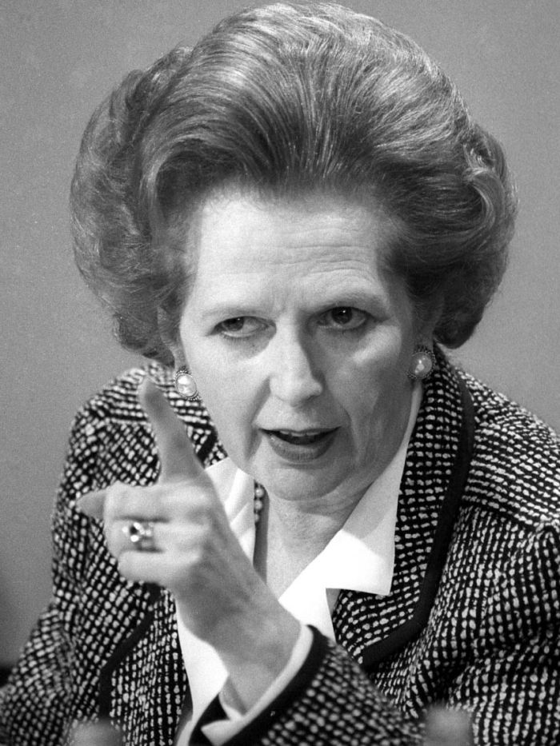
Neoliberal Policy Agenda
There is no such thing as society. There are individual men and women, and there are families, and no Government can do anything except through the people, and people must look to themselves. It is our duty to look after ourselves and then to look after our neighbour (Thatcher, 1987)

Slide 10
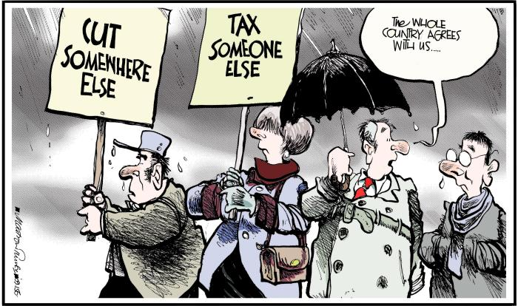
Results of Neoliberalism
Resulting from the work of von Mises and Hayek, the effects of which have been summed up as ‘massive tax cuts for the rich, the crushing of trade unions, deregulation, privatisation, outsourcing and competition in public services’
(Monbiot, 2016, np).

Slide 11
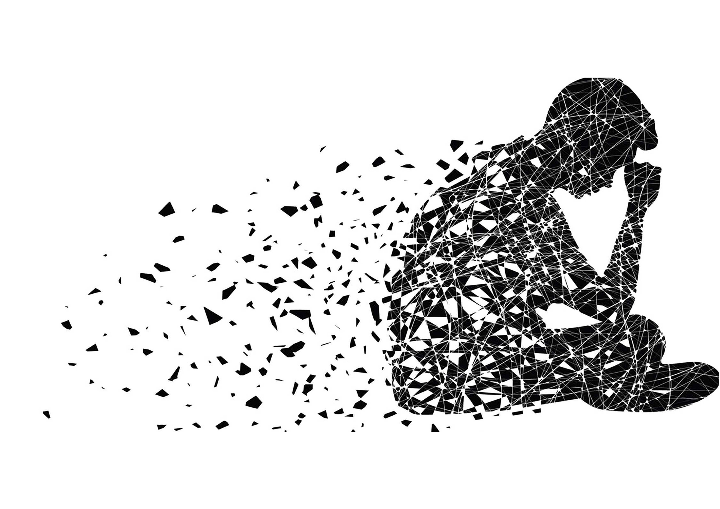
Impacts
Influences, stemming from the free market are having an undue impact upon society and therefore, young people growing up in this context.
Between 2012 and 2016 a 100% increase in demand for CAMHS services in Wales
Young people awaiting outpatient’s treatment has the highest numbers (2,410) compared to adults (1,291) and those in later life (682)
Welsh Government statistics on spend per person in 2012- 13 showed spending to be £200.87 per person on mental health problems. Of this £13.94 was spent on child and adolescent mental health
Between 2013 and 2014 more than 1,500 patients aged 10-19 were treated at Welsh hospitals with 1,223 girls being treated for self-harm compared with 319 boys.
Mental Health Foundation, (2016, pg 6).

Slide 12
Impact
Critique – too much focus on attainment. This is a considerable source of anxiety for children and young people in Wales.
Why do we put our children and young people through this?
In small groups, take 15 minutes to discuss both where and when young people are supported to be happy.
 | Maths | Reading | Science
Wales | 478 (30+) | 477 (30+) | 485 (30+)
Norway | 502 (19th) | 513 (9th) | 498 (24th)
OECD (2018) Pisa Results (Programme for International Student Assessment).

Slide 13

Impact conundrum
Evidence of impact is both unavoidable and necessary (Maitland Hudson, 2017), the debate we are all involved in can be summarised by an ‘impact movement’ and ‘the resistance’, think the Empire (the New Order) and the Resistance (Jedi et. al.) where one party rejects the existence of the efficacy of something that can’t be seen or counted (the Force), while the other party holds a spiritual connection and commitment to its effectiveness.

Slide 14
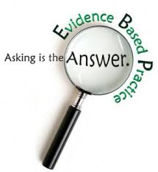
What evidence is there?
Time-trend analysis, malaise, youth suicide rates, referrals to mental health services and general psychological distress.
Cross sectional studies, self harm; mental health problems; mental disorders which are the main burden of disease among young people.

Slide 15
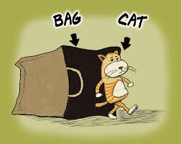
Data dilemma
The search for data and evidence drives an approach to what might be regarded as passive services which perpetuates the discourse where children and young people and their communities are deficient, needing a job, needing intervention, needing broader horizons.
This has become the predominant social discourse over the last 20 years.
What is needed is a radical, pragmatic transformational approach to contemporary practice where the sector stands up for young people who are getting a raw deal from the status quo.

Slide 16
Who is asking questions? Where does the power lie?
Power
Use of Knowledge
Strategic Brokerage
Political Lobbying & Advocacy
Something is happening in society, on our watch, which is impacting on the lives of many children and young people and, that all this despite apparent material progress ‘real GDP in the UK has typically increased every year.. the UK economy experienced sixteen consecutive years of growth before output fell in 2008’ (Office for National Statistics, 2015).
Adapted from: Stanton-Salazar, R.D. A Social Capital Framework for the Study of Institutional Agents and Their Role in the Empowerment of Low-Status Students and Youth. Youth & Society, 2011, 43(3) 1066–1109.

Slide 17

Who’s steering the ship?
MA is timely – lots of mention of the well-being of children and young people in policy discourse.
Backdrop, reduction in spending on some services of 30% between 2010 and 2017 at the same time as a reduction in young people in contact with the service concerned of 23% (Welsh Government, 2018)

Slide 18
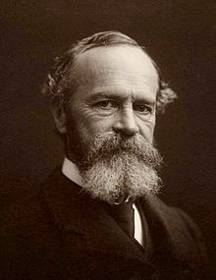
Being Pragmatic
The pragmatist turns away from abstraction and insufficiency, from verbal solutions, from bad a priori reasons, from fixed principles, closed systems, and pretended absolutes and origins. He turns towards concreteness and adequacy, towards facts, towards action and towards power (James, 1904).

Slide 19
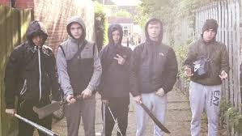
Who has the vision?
Often, in relation to policy making and subsequent resource allocation for children and young people the dominant paradigm which guides investment is one of risk assessment, where investment is put in place if results are judged to be potentially worth that investment (Piper, 2008).

Slide 20
Case study of impact – young pregnancy
Generally regarded that some young people make a conscious choice to become pregnant, however teenage pregnancy has been linked with poor outcomes for the mother and child.
Policy response?
There are a number of partners working in close collaboration and providing support in delivery of the schemes such as; youth services, outreach services, youth offending teams, general practitioners, schools nurses and within colleges (Șimșek, 2014, pg. 8).
Evidence of impact:
In 1997, the UK was the highest ranked among European Union countries for teenage pregnancy.
Pregnancy among girls aged under 16 in Wales fell by 50% from around 11 per thousand girls aged 13-15 in the late 1990’s to 5.5 in 2013.
Among girls aged under 18, levels fell by nearly 27%, from nearly 37 per thousand aged 15-17 in 2010, to 27.3 in 2013.
Public Health Network Cymru (2015

Slide 21
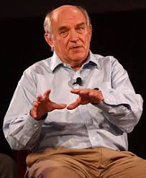
Charles Murray and the Underclass
https://youtu.be/-S9Qv29fOLY

Slide 22
Alternative voices
https://www.bbc.co.uk/programmes/p0682yvl
Britain’s Forgotten Men
Lavalette, M. Social Work in Crisis During Crisis: Whose side are we on? Canadian Social Work Review. Vol. 28. Issue 1 (2011) 7-24.

Slide 23
Paradox
So, we have evidence of the impacts of the efficacy of recent social change, policy and practice. As a nation we now know what we spend on our children and young people.
We increasingly know what impact this is having on our children and young people.
There is a gap between our investment in children and young people and the return on that investment (PISA, ONS, Young Minds).
In relation to both the well-being of our children and young people and also their educational attainment, evidence shows how Wales' PISA scores have failed to improve in Maths and Reading for 10 years, while falling back significantly in Science.(OECD, 2011; OECD, 2016).

Slide 24
UK Public Investment in Children and Young People
A UNICEF report in 2007 placed the UK at the bottom of the league table for child well-being across 21 industrialised nations and that whilst economic output has nearly doubled in the last 30 years, life satisfaction levels in the UK have remained steady (UNICEF, 2007). ‘High public spending on child welfare and education in the UK is failing to produce results in many key areas’ (OECD, 2009, p1), specifically that:
OECD Doing better for families study found that:
The UK spends more on each child than most other OECD countries, more than £138,000 from birth up to the age of 18, compared to an OECD average of £95,000 (OECD, 2011).
The spending though is skewed, in terms of ranking, the UK is 4th on public spending in relation to 0-5 year olds, 7th in spending on 6-11 year olds and slips to 10th position for spending on 12-17 year olds (OECD, 2011).

Slide 25

Happy Countries
https://vimeo.com/202941838
In the UK, 57% of the Generation Z young people surveyed rated themselves as ‘Happy’.
What of the other 43%

Slide 26
What makes young people feel unhappy?
More than half of young people in the UK (54%) said money worries were among their top three causes of anxiety. Next stressors were school, and health.
(Varkey Foundation, 2017)

Slide 27
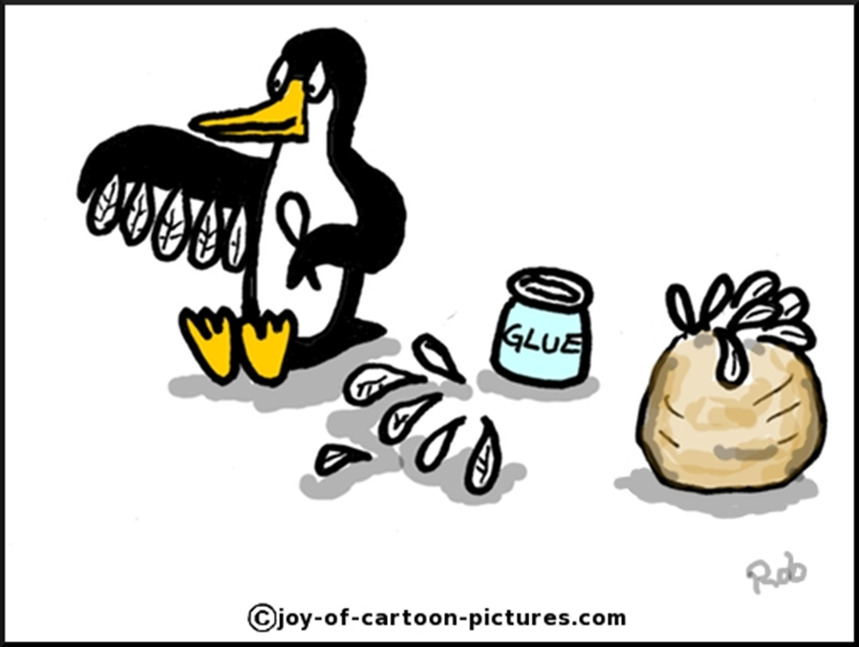
Summary
Most young people in Wales are happy, have good levels of well-being
Society is placing new demands and pressures on children and young people which are poorly understood
Radical work has a unique position to represent children and young people powerfully
Praxis has a unique selling point, we can offer children young people accessible and affordable ‘favourable adolescent and childhood experiences’
The sector needs to engage more effectively, adopting a radical pragmatic approach to broker more effectively for the children and young people of Wales

Slide 28
Bibliography
Conger R.D., Conger K.J. (2008) Understanding the processes through which economic hardship influences families and children, Handbook of families and poverty. Crane DR, Heaton TB, editors. Thousand Oaks, CA: Sage.
Eckersley, R. Commentary on Trzesniewski and Donnellan (2010): A Transdisciplinary Perspective on Young People’s Well-Being. Perspectives on Psychological Science, 5(1) pp. 76-80.
James, W. (1904) What is Pragmatism, from series of eight lectures dedicated to the memory of John Stuart Mill, A New Name for Some Old Ways of Thinking, in December 1904, from William James, Writings 1902-1920, The Library of America.
Maitland Hudson, G. (2017) The ins and outs of evidence: making sense of different perspectives on impact measurement. Centre for Youth Impact. http://www.youthimpact.uk/evaluation
Mental Health Foundation (2016) Mental Health in Wales, Fundamental Facts 2016.
Monbiot, G. (2016) Neoliberalism, the ideology at the root of all our problems. The Guardian (online) https://www.theguardian.com/books/2016/apr/15/neoliberalism-ideology-problem-george-monbiot (Accessed 05.01.17)
National Assembly for Wales, Children, Young People and Education Committee. (2014). Inquiry into Child and Adolescent Mental Health Services (CAMHS), [Online] Available at: http:// www.assembly.wales [Accessed: 19/08/2016].
New Economics Foundation (no date) National Accounts of Wellbeing (online) http://www.nationalaccountsofwellbeing.org/learn/what-is-well-being.html
OECD (2009) ‘Doing better for Children, UK Country Highlights’, [Online]. Available at www.oecd.org/els/social/childwellbeing (Accessed 31 October 2009).
Organisation for Economic Cooperation and Development (2011). PF1.6: Public spending by age of children (Online) Available at: http://www.oecd.org/social/family/PF1_6_Public_spending_by_age_of_children.pdf
Organisations for Economic Cooperation and Development (2013). Your Better Life Index Data access: http://stats.oecd.org/Index.aspx?DataSetCode=BLI Index website: http://www.oecdbetterlifeindex.org/
OECD (2018) PISA Results [Online] https://www.oecd.org/pisa/pisa-2015-results-in-focus.pdf
Piper, C. (2008) Investing in Children, Policy, law and practice in context. Devon: Willan Publishing.
Public Health Network Cymru (2015) Teenage Conception. [Online] https://www.publichealthnetwork.cymru/en/topics/sexual-health/teenage-conception/
Șimșek, A. (2014) An Evaluation of the All Wales C-Card Standards, Public Health Wales.
Thatcher, M. (1987) Interview with Woman’s Own. [Online] Available at: https://www.margaretthatcher.org/document/106689
Varkey Foundation (2017) What the World’s Young People Think and Feel. [Online] https://www.varkeyfoundation.org
Welsh Government. (2015) Talk to Me 2: Suicide and Self Harm reduction strategy for Wales Suicide and Self Harm Prevention Strategy for Wales 2015-2020, [Online] Available at: http://gov. wales/docs/dhss/publications/150716strategyen.pdf [Accessed on: 18/07/2016].
Welsh Government (2018) Youth Work, [Online] https://gov.wales/statistics-and-research/youth-services/?lang=en
Wylie, T. (2010) Youth Work in a Cold Climate, Youth and Policy, No. 105, 1-8, November 2010. Blaydon on Tyne: Youth and Policy.

