Slide 1

Student Name: Mary Tetteh
Student Number: 2321029
Programme: BSc (Hons) Health and Social Care
Module: Digital Transformation in the Health and Care Professions
Module Code: BMHP6026
Lecturer: Martin Svejda
Assignment Title: Component 2 : Viva Voce (Oral Presentation)
Submission Deadline: slides Due: Sunday 8th March 2026

Slide 2
Title: The NHS App as a Digital Innovation: Impacts on Workforce, Service Delivery, and Patients

Slide 3
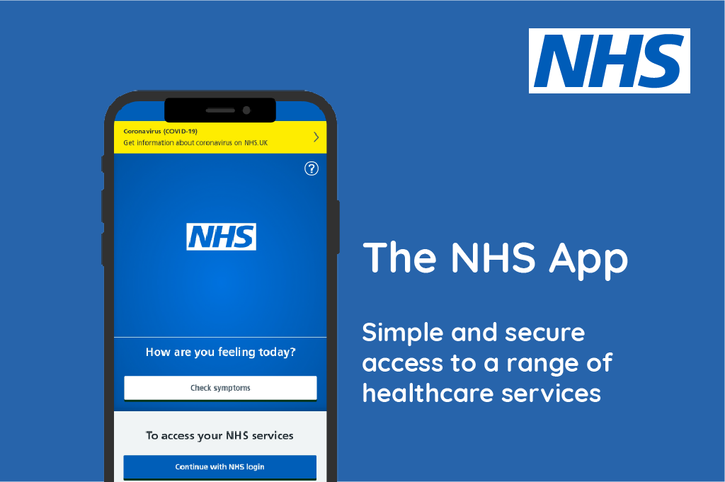
Introduction
This presentation introduces the NHS App as a key digital innovation in UK health and social care.
Innovation matters because it supports improved access, efficiency, and system sustainability.
The presentation will provide a critical evaluation rather than a descriptive overview.
It will analyse the impact on the workforce, service delivery, patients, and service users.
It will evaluate wider community implications, including digital inclusion and inequality.
Notes:
This presentation will discuss the NHS App as a significant digital innovation that was launched to streamline the procurement of health and social care services in the UK. The app is responsible for minimising the administrative load, increasing patient access, and improving the efficiency of the services. Instead of outlining the way the app works, this presentation will critically analyse its actual effect on the real world. The analysis is centred on four major areas, which include the workforce, service delivery, patients or service users, and the wider community. The advantages and disadvantages will be discussed to evaluate in terms of whether the NHS App adds to the equitable, sustainable and high-quality care.

Slide 4
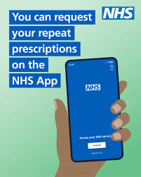
Overview of the Innovation
The NHS App is a national digital platform developed by NHS England to support patient self-service (NHS, 2024).
It allows users to book GP appointments, request repeat prescriptions, and access health information.
The app aims to reduce administrative workload and improve patient access.
It functions as the NHS’s official digital front door.
Notes:
The NHS App is a patient-centred digital platform that is aimed at centralising access to basic NHS services (Reidy et al., 2025). It empowers patients to conduct simple healthcare-related activities like appointments with GPs, prescriptions, and selected health records. The main aim of the app is to make it accessible with ease without additional burden on the administrative personnel, as well as clinical personnel. The NHS App also facilitates efficiency by transforming interactions. Nevertheless, it is efficient only when the patients are engaged and integrated with the system, but not with technology.

Slide 5
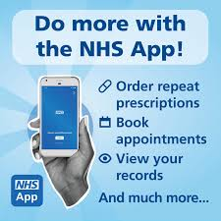
Overview of the Innovation (Contd.)
The NHS App works by connecting users to existing GP and hospital IT systems.
It is used across primary and secondary care services in England (Faulkner-Gurstein and Wyatt, 2022).
Functionality varies depending on local system integration and digital maturity.
Visual examples include the NHS App interface and service-access dashboard.
Notes:
The NHS App links to the current GP and hospital information systems, wherein a patient will be able to access and manage services online (Zhang et al., 2023). The app is used in England both in primary and secondary care settings throughout the whole country, although managing features may vary depending on the location. This variation indicates a difference in the local digital infrastructures and interoperability. That also emphasises the fact that user experience largely relies on the integration of a backend system.

Slide 6

Impact on Workforce
The NHS App has changed workforce practice by shifting routine administrative tasks to digital self-service (Zhou et al., 2025).
This improves efficiency and data accuracy but increases digital workload for staff.
Some staff experience skill gaps and resistance to change.
Barrier: Limited digital skills.
Solution: Protected CPD time and digital champions.
Notes:
NHS App has also changed workforce practice significantly, as manual administrative processes of booking appointments and requesting prescriptions are minimised (Ferreira, 2024). This has enhanced the efficiency of operations and data precision, especially in primary care, and helps to support personnel who currently operate under the continued workforce shortfall. It is proven that staff have become more responsible for using digital systems in addition to their clinical duties. Digital change has also been reported to be resisted, especially in environments that have poor systems integration. This issue can be overcome by providing a secure continuing professional development time and using digital champions as prescribed by NHS England.

Slide 7
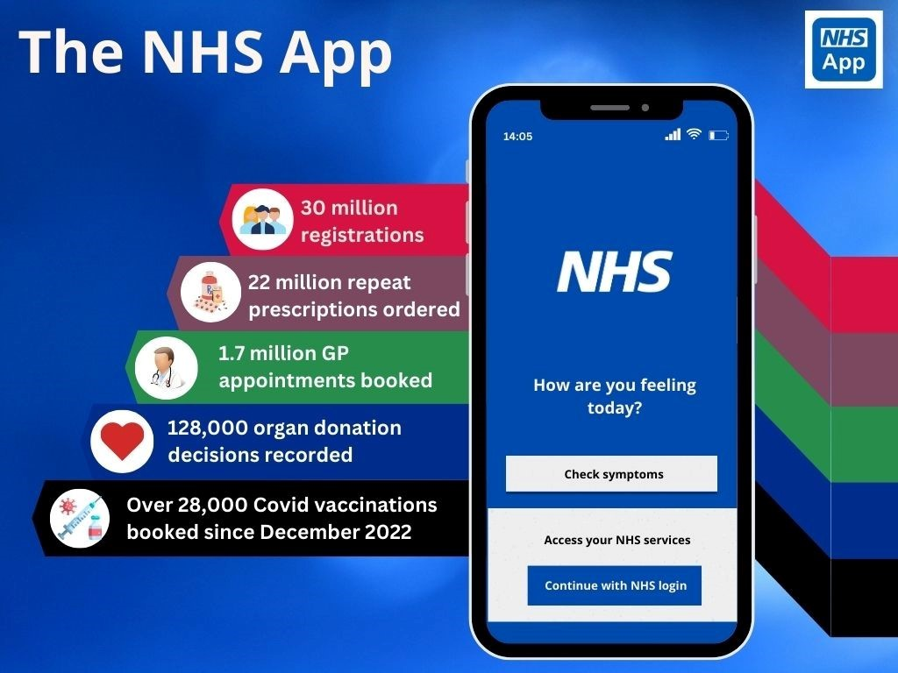
Impact on Service Delivery
The NHS App has changed service delivery by enabling digital-first access to routine NHS services (Salway et al., 2024).
It improves efficiency, communication, and appointment management across primary and secondary care.
However, system fragmentation and inconsistent integration limit full effectiveness.
Barrier: Poor interoperability.
Solution: National digital standards and phased integration.
Notes:
The NHS App enhanced the delivery of services within the hospital. This has improved conversation and the improved utilisation of clinical time, particularly in the primary care set-up (Dodson et al., 2024). According to NHS England records, there has been an incredible increase in the number of interactions made through the app. Conversely, IT systems among GP practices and hospital trusts restrict functionality and reduce the efficiency gains. The lack of proper integration of the systems is one of the largest challenges. This should be defeated as a way to have a national establishment of digital standards and progressive integration to suit sustainable service redesign.

Slide 8
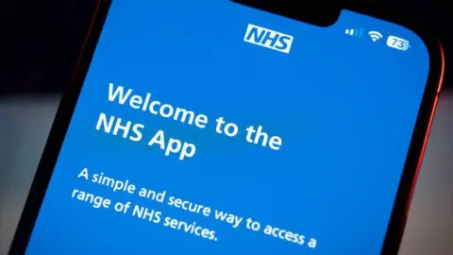
Impact on Patients/Service Users
The NHS App has improved patient access by enabling digital booking, prescriptions, and record viewing (Kaya et al., 2023).
It supports convenience, self-management, and patient empowerment.
However, digital exclusion and data privacy concerns limit equitable access.
Barrier: Low digital literacy.
Solution: Hybrid access models and targeted digital support.
Notes:
The NHS App has improved patient engagement and consumer healthcare services by providing one digital location for appointments, prescriptions, and health records. This has eased convenience and enhances patient autonomy and self-control in the case of individuals who have to deal with any long-term illness (Oskrochi et al., 2025). However, challenges remain. Digital inequality impacts elderly and disabled people, as well as socioeconomically disadvantaged populations, whereas data privacy and trust issues eliminate engagement. This can be overcome through hybrid service models and by providing digital support to people.

Slide 9
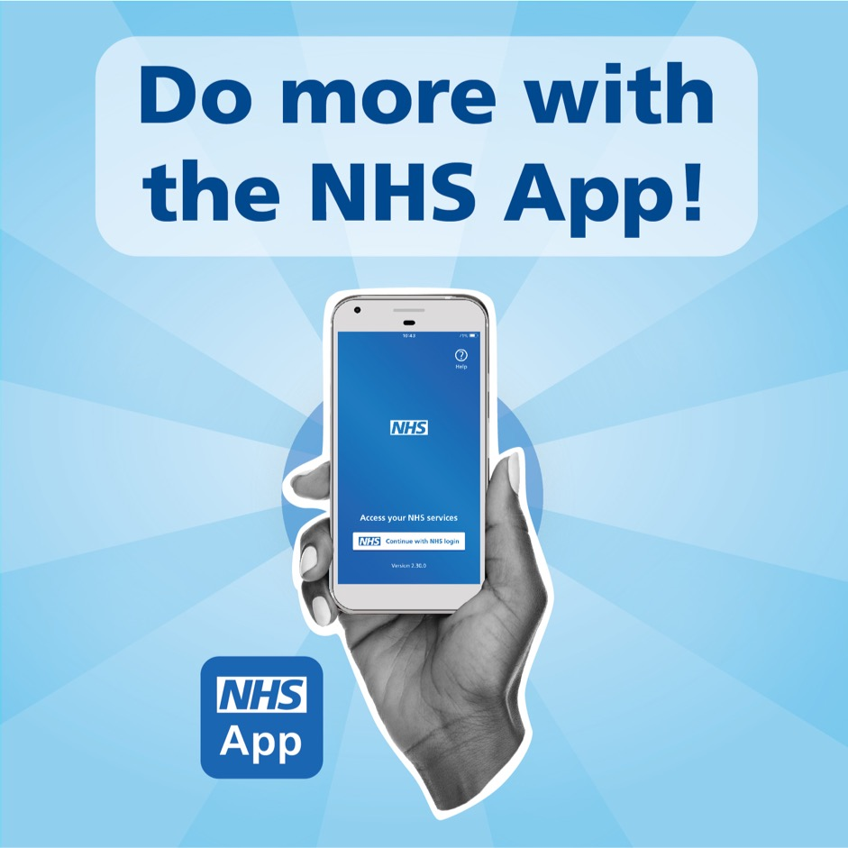
Impact on Community
The NHS App has improved community-level access by supporting remote service use and reducing travel (Russell et al., 2025).
It Benefits rural and underserved communities through digital access to routine care.
However, unequal digital infrastructure risks widening health inequalities.
Barrier: Poor connectivity and access.
Solution: Community digital inclusion programmes.
Notes:
The provision of health services to the community was improved through the NHS App since fewer physical meetings were required in rural and underserved areas to provide healthcare (Lyne et al., 2022). Standard digital access to appointment, prescription and health records can reduce a physical barrier to travelling as well as enhance continuity of care. The other challenge that needs to be addressed is the absence of digital connectivity and access, which could be overcome with the aid of special community digital inclusion programmes and investments in local digital infrastructure.

Slide 10

Challenges for implementing this innovation
Digital exclusion limits Equitable access for older adults, disadvantaged groups, and some communities (Mee et al., 2024).
Workforce capacity and digital skills gaps increase workload and resistance to change.
Fragmented IT systems and poor interoperability reduce service efficiency and consistency.
Ongoing funding and infrastructure constraints delay sustainable digital transformation.
Notes:
The NHS App has some major challenges that make its overall effectiveness rather restricted. The workforce issues also remain as staff are subjected to more digital work and a lack of training, which may cause resistance and stress (Wilson et al., 2024). Moreover, the presence of fragmented IT systems within the NHS organisations inhibits interoperability, and this inequality leads to dissimilar functionality and poor efficiency. Lastly, there are short-term funding demands and infrastructure constraints that slow long-term transformation to the digital.

Slide 11
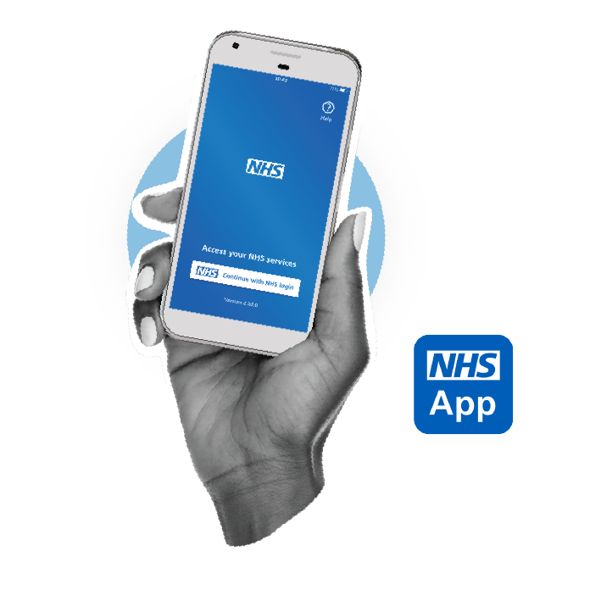
Recommendations
Hybrid service models should be maintained to reduce digital exclusion (Kar et al., 2024).
Targeted digital skills training should be provided for the NHS workforce.
National interoperability standards should be enforced across NHS systems.
Long-term, ring-fenced digital funding should support infrastructure development.
Community-based digital inclusion programmes should be expanded nationally.
Notes:
The hybrid service models would be helpful for reducing digital exclusion. Staff digital skills training can decrease workload pressures and change resistance (Kar et al., 2024). Implementing national interoperability would enhance uniformity and effectiveness in the services of the NHS. Ring-fenced funding should be done in the long term as a means of sustaining digital infrastructure as opposed to short-term projects. Inequalities can be reduced through increasing community-based digital inclusion programmes by alleviating access, skills, and confidence in the disadvantaged groups to enable equitable digital transformation, both in health and social care.

Slide 12
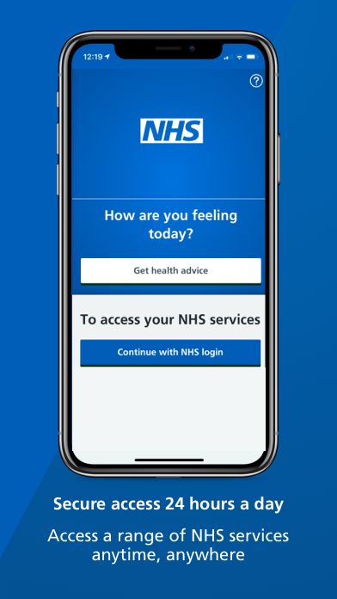
Conclusion
The NHS App Demonstrates significant potential to improve access, efficiency, and service coordination.
Its benefits remain uneven due to digital exclusion, workforce pressures, and system fragmentation.
Effective implementation requires sustained investment, inclusive service design, and workforce support.
Overall, the NHS App can support sustainable transformation if these challenges are addressed.
Notes:
The NHS App can be discussed as a significant move towards the digitalisation of health and social care in England. The NHS App optimise the service delivery, patient access and engagement. It has demonstrated in this presentation that digital innovation is not sufficient without simultaneous investment in people and infrastructure, as well as inclusive service design. The NHS App can play a significant role in making the healthcare system more sustainable, fair, and patient-focused.

Slide 13
Reference List
Dodson, P., Haase, A.M., Jeffreys, M. and Hales, C. (2024) ‘Capturing patient experiences of care with digital technology to improve service delivery and quality of care: A scoping review’, DIGITAL HEALTH, 10(1), pp. 23–67. Available at: https://doi.org/10.1177/20552076241282900.
Faulkner-Gurstein, R. and Wyatt, D. (2022) ‘Platform NHS: Reconfiguring a Public Service in the Age of Digital Capitalism’, Science, Technology, & Human Values, 48(4), pp. 888–908. Available at: https://doi.org/10.1177/01622439211055697.
Ferreira, T. (2024) ‘Escalating competition in NHS: implications for healthcare quality and workforce sustainability’, Postgraduate Medical Journal, 100(1184), pp. 34–90. Available at: https://doi.org/10.1093/postmj/qgad131.
Kar, E., Fakhimi, M., Turner, C. and Eldabi, T. (2024) ‘Hybrid simulation in healthcare: a systematic exploration of models, applications, and emerging trends’, Journal of Simulation, 5(9), pp. 1–19. Available at: https://doi.org/10.1080/17477778.2024.2354250.
Kaya, G.K., Üstebay, S., Nixon, J., Pilbeam, C.J. and Sujan, M.-A. (2023) ‘Exploring the Impact of Safety Culture on Incident reporting: Lessons Learned from Machine Learning Analysis of NHS England Staff Survey and Incident Data’, Safety Science, 166(106260), pp. 106260–106260. Available at: https://doi.org/10.1016/j.ssci.2023.106260.
Lyne, A., Ashley, P., Johnstone, M. and Duane, B. (2022) ‘The environmental impact of community caries prevention - part 1: fluoride varnish application’, British Dental Journal, 233(4), pp. 287–294. Available at: https://doi.org/10.1038/s41415-022-4901-7.
Mee, P., Gussy, M., Huntley, P., Kenny, A., Jarratt, T., Kenward, N., Ward, D. and Vaughan, A. (2024) ‘Digital exclusion as a barrier to accessing healthcare: a summary composite indicator and online tool to explore and quantify local differences in levels of exclusion’, Universal Access in the Information Society, 5(8), pp. 67–98. Available at: https://doi.org/10.1007/s10209-024-01148-5.

Slide 14
Reference List
NHS (2024) NHS App, NHS Digital. Available at: https://digital.nhs.uk/services/nhs-app (Accessed: 3 February 2026).
Oskrochi, Y., Roy-Highley, E., Grimes, K. and Shah, S. (2025) ‘Digitally Unsafe? Digital health technology compliance with clinical safety standards within the NHS in England: a national cross-sectional study. (Preprint)’, Journal of Medical Internet Research, 5(8), pp. 54–67. Available at: https://doi.org/10.2196/80076.
Reidy, C., Papoutsi, C., KC, S., Gudgin, B., Laverty, A.A., Greaves, F. and Powell, J. (2025) ‘Qualitative evaluation of the implementation and national roll-out of the NHS App in England’, BMC Medicine, 23(1), pp. 23–87. Available at: https://doi.org/10.1186/s12916-024-03842-w.
Russell, S., Stocker, R., Cockshott, Z., Mason, S., Knight, J., Hanratty, B. and Preston, N. (2025) ‘Use of a digital application to enhance communication and triage between care homes and national health service community services in the United Kingdom: a qualitative evaluation’, BMC Geriatrics, 25(1), pp. 56–87. Available at: https://doi.org/10.1186/s12877-025-06217-9.
Salway, R., Sillero-Rejon, C., Forte, C., Grey, E., Jessiman, P., McLeod, H., Harkes, R., Stokes, P., Vocht, F.D., Campbell, R. and Jago, R. (2024) ‘A service evaluation of the uptake and effectiveness of a digital delivery of the NHS health check service’, BMJ Open, 14(11), pp. 1417–1417. Available at: https://doi.org/10.1136/bmjopen-2024-091417.
Wilson, S., Tolley, C., McArdle, R., Slight, R. and Slight, S. (2024) ‘Who is most at risk of digital exclusion within healthcare?’, International Journal of Pharmacy Practice, 32(4), pp. i3–i4. Available at: https://doi.org/10.1093/ijpp/riae013.004.
Zhang, J., Ashrafian, H., Delaney, B. and Darzi, A. (2023) ‘Impact of primary to secondary care data sharing on care quality in NHS England hospitals’, npj digital medicine, 6(1), pp. 23–98. Available at: https://doi.org/10.1038/s41746-023-00891-y.
Zhou, X., Leiva-Granados, R., Yi, J., Yao, Z., Fang, J. and Skordis, J. (2025) ‘Staff Experience after Investment in Digital Technologies: a Difference-In-Differences Study in the English NHS’, A difference-in-differences study in the English NHS, 34(6). Available at: https://doi.org/10.2139/ssrn.5198150.

