Slide 1
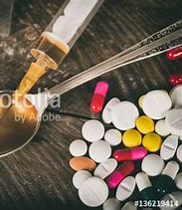
Drugs -
Types, effects and Consequences.
County Lines
Jane Davies
Blue Light Academy -
Professional Policing / Public Services /Criminology / Law

Slide 2
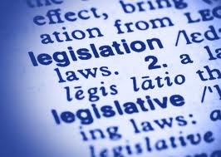
Misuse of Drugs Act 1971
Primary legislation for the United Kingdom –
Creates many offences in relation to –
Manufacturing
Importing
Supplying
Possession of ‘controlled’ drugs
Notes:
State:
The Misuse of Drugs Act 1971, creates many offences in relation to the illegal manufacturing, importing, supplying and possession of ‘controlled drugs’
https://www.health-ni.gov.uk/sites/default/files/publications/dhssps/pas-class-a.pdf shows pages of the classes of ALL drugs

Slide 3
Other Legislation’s
The Psychoactive Substances Act 2016 - Control Legal Highs
Medicines Act 1968 – Control, Prescription and Possession
Misuse of Drugs Regulations 2001 – more control over Prescribing, safe custody, dispensing, record keeping, destruction and of controlled drugs
Drugs Act 2005 - problems of drug abuse and the criminal activities

Slide 4

Drug classifications
Drugs are put into one of three categories, according to how dangerous they are and the impact they have on society.
Class A, B and C
Remember all drugs affect people in different ways and are dangerous!

Slide 5
Classification
Class A drugs are considered by Parliament to be the most harmful.
An offence involving a Class A substance carries the harshest penalties.
Class B drugs Class B drugs are considered by Parliament to be less harmful than Class A drugs. Certain Class B drugs are reclassified to Class A if they have been prepared for injection.
Class C drugs are considered by Parliament to be the least harmful of the controlled drugs.

Slide 6
Maximum Prison Sentences
For possession of each class of drug are:
up to seven years in prison or an unlimited fine (or both) for a Class A drug
up to five years in prison or an unlimited fine (or both) for a Class B drug
up to two years in prison or an unlimited fine (or both) for a Class C drug
Sentences can increase if you are dealing drugs or supplying them - even if it's just to friends with no money changing hands.

Slide 7
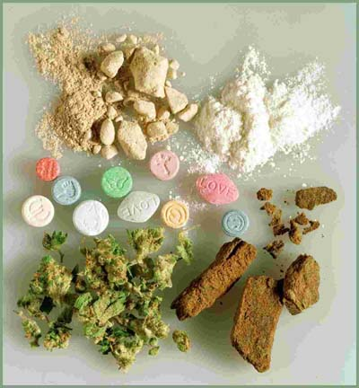
Game - Classification of Drugs
Controlled drugs are classified as Class ‘A’, ‘B’ or ‘C’ according to their toxicity
GAME!
Give the drugs their classification

Slide 8


Slide 9

Drugs and Effects
Game –
List of effects please match them up to the drug’s

Slide 10
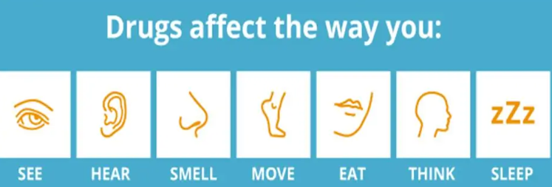
Effects
The effects of drugs on the body very much depend on the type of drug being used.

Slide 11
Effects
Physical effects
Mental health
Financial issues
Relationships
Drugs and driving
Legal issues

Slide 12
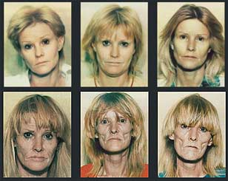
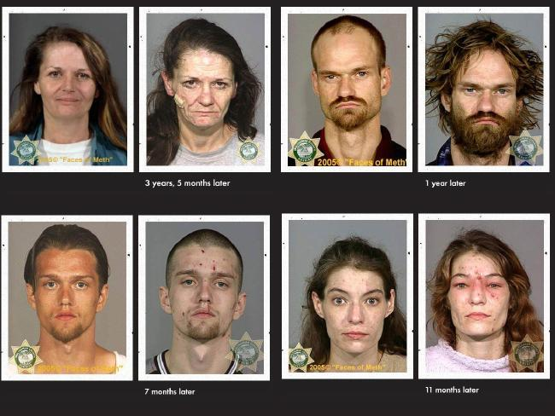
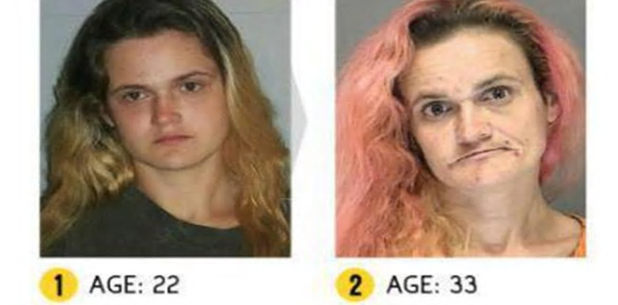
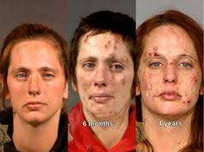

Slide 13
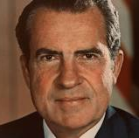
Quotes
“Drugs are the USA’s public enemy number one”
President Nixon, (1971)
“The global war on drugs has failed, with devastating consequences for individuals and societies around the world”.
Global Commission on Drugs Policy, 2011
Notes:
Nixon Presidential term: 20 January 1969 – 9 August 1974

Slide 14
Skin Rotting 'Zombie Drug' Causes Havoc Across The US Cities - YouTube
Skin Rotting 'Zombie Drug' Causes Havoc Across The US Cities - YouTube

Slide 15
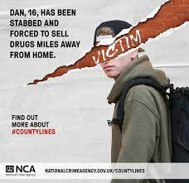
County Lines

Slide 16
What is it?
The 2018 Home Office Serious Crime Strategy states the definition of a County Line is a term used to describe gangs and organised criminal networks involved in exporting illegal drugs.
The use of a mobile phone is the ‘line’
Children and vulnerable adults are more likely to be involved in the moving and selling drugs.
Often the used of coercion, intimidation and violence is used.

Slide 17
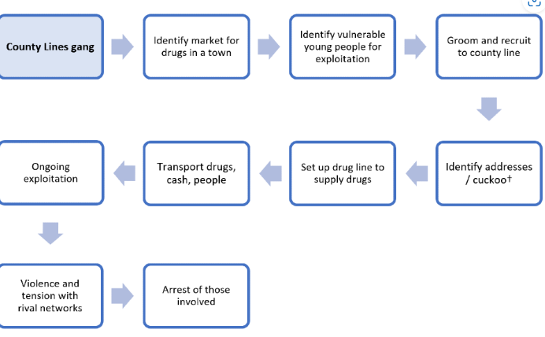

Slide 18
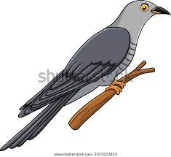
Cuckooing
When a county lines gang takes over the home of a vulnerable adult by coercion or force.
Home is used as a base to deal or store drugs
Children can be forced or coerced to stay at cuckooed addresses for long periods of time to deal drugs.

Slide 19
Phrases
Phrases that young people may use to refer to county lines include:
‘running a line’,
‘going OT/out there’
‘going country’
‘going cunch’.

Slide 20
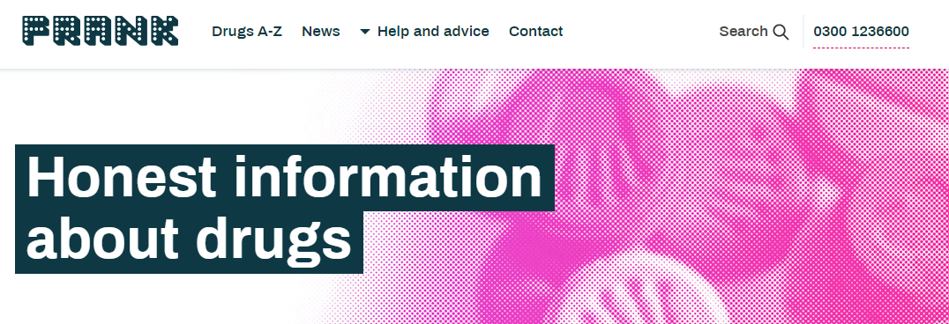
Talk to Frank

