Slide 1

BILINGUAL DIGITAL INFORMATION PLATFORM
to Support Refugee and Asylum Seeker Integration in the UK
Supervisor: Dr. Vijeyananthan Thayananthan
Name:
Hawraman Raheem
ID:
2238893
Programme:
BSc Applied Computing
Module Name:
Independent Project II
Module Code:
ACCA6020

Slide 2
Introduction and Background
  Refugees and asylum seekers face significant challenges when integrating into UK society[1]
  Limited English proficiency creates barriers to accessing essential information
  UK public services are complex and difficult to navigate for new arrivals[2]
  Many individuals rely on informal sources, which can be inaccurate or misleading

Slide 3
Problem Statement / Motivation
  Official information is often fragmented, complex, and English-only
  Refugees and asylum seekers struggle to find clear, step-by-step guidance[1]
  Informal advice from social media and community networks can be unreliable
  Lack of accessible information negatively affects integration and independence

Slide 4
Project Aim and Objectives
Project Aim
To design and develop a bilingual digital information platform that supports refugees and asylum seekers in understanding and navigating key services and systems in the UK.

Slide 5
Project Aim and Objectives
Project Objectives
  To analyse existing challenges faced by refugees and asylum seekers in accessing information
  To review relevant literature related to digital inclusion and integration support
  To design a user-friendly bilingual platform (Sorani Kurdish and English)
  To develop a functional prototype using appropriate web technologies
  To evaluate the platform through expert review and feedback

Slide 6
Methodology
  Secondary research to analyse existing literature and reports
  Identification of user needs and information gaps
  Design of a bilingual digital platform (Sorani Kurdish and English)
  Development of a functional prototype using web technologies
  Evaluation through expert review and feedback

Slide 7
Literature Review (Overview)
  Digital platforms can improve access to information for marginalised communities
  Language barriers are a key factor in digital and social exclusion
  Clear, structured, step-by-step guidance supports better integration outcomes
  Existing resources often lack accessibility and cultural relevance[3] [4]

Slide 8
Design Overview
  Web-based digital information platform
  Bilingual content: Sorani Kurdish and English
  Clear, structured, step-by-step information pages
  Simple and accessible user interface

Slide 9
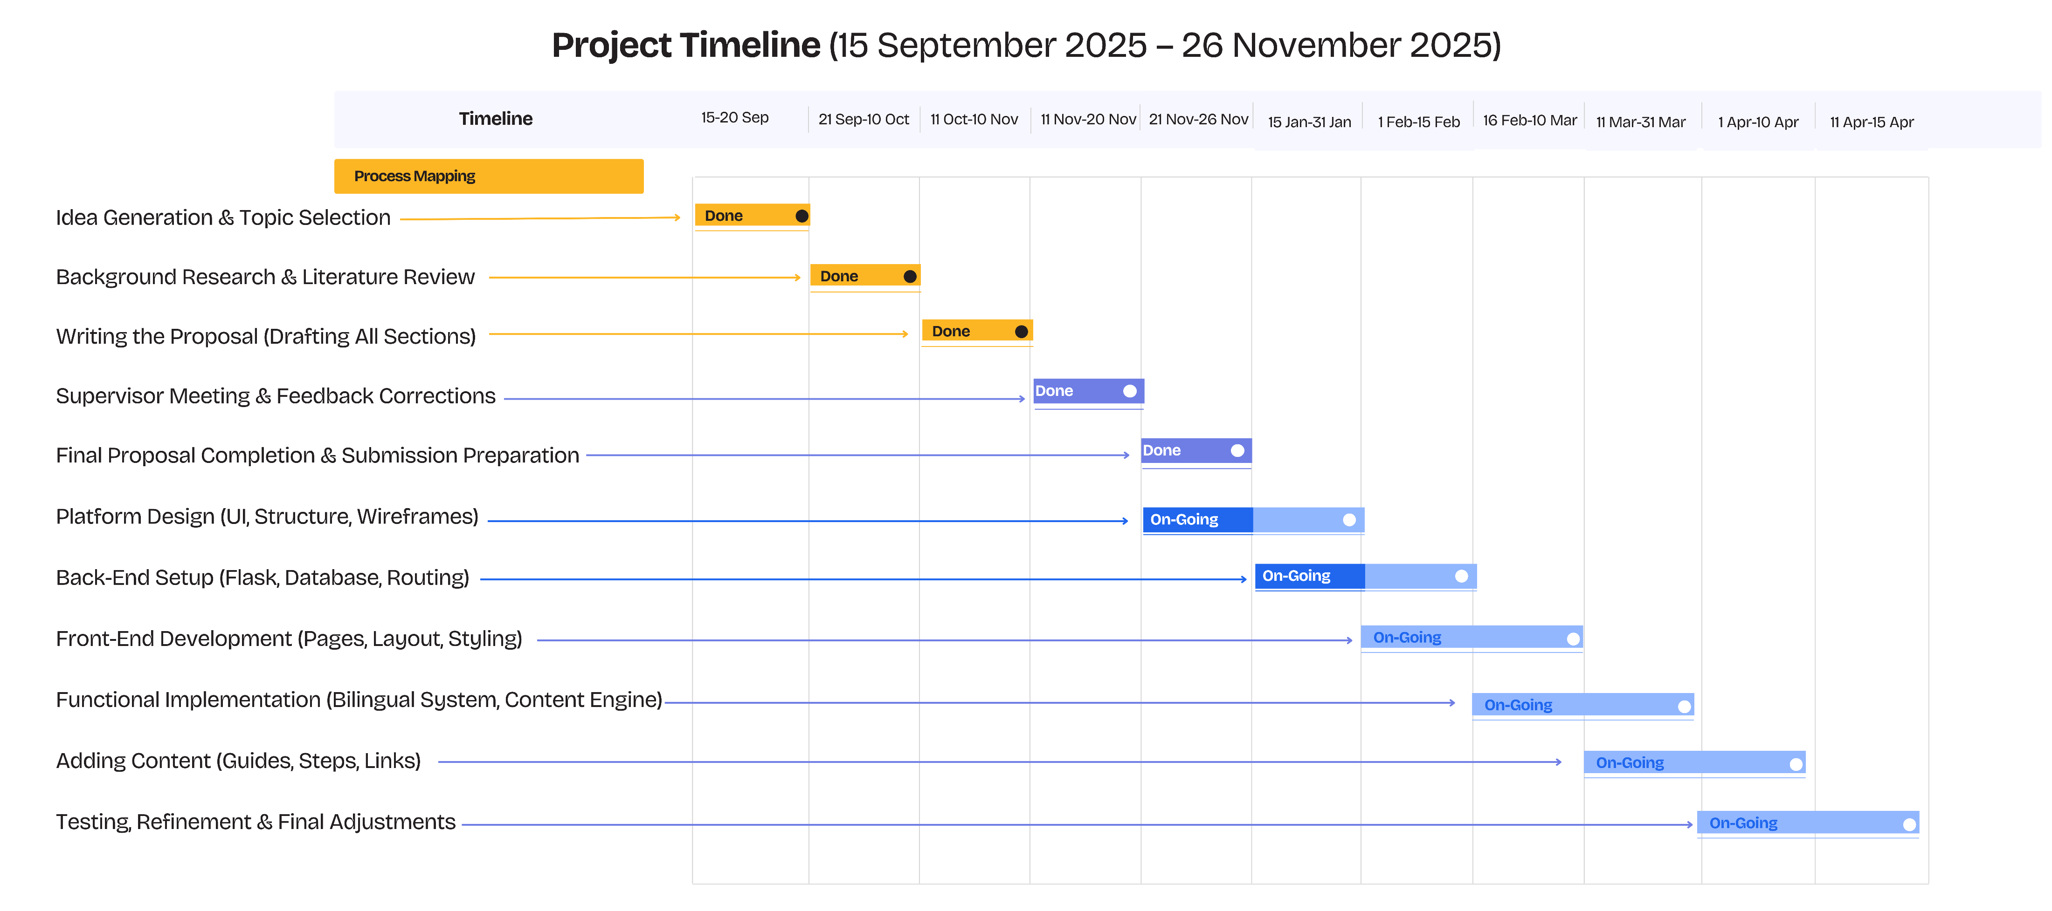
Project Timeline (Gantt Chart)

Slide 10
Conclusion
  Refugees and asylum seekers face significant barriers to accessing reliable information
  Language and system complexity contribute to misinformation and exclusion
  This project proposes a bilingual digital platform to address these challenges
  The platform aims to support integration through clear, accessible guidance

Slide 11
References
  [1] Home Office, “Home Office Indicators of Integration Framework 2019,” 2019
  [2] Refugee Council, "New Roots, New Futures: the need for a national refugee integration strategy," 2025.
  [3] Isabel Ruiz and Carlos Vargas-Silva, "What Works for Improving Refugee Outcomes in High-Income Countries? Policy Insights for the UK," University of OXFORD, Research 2021. [Online]. www.compas.ox.ac.uk
  [4] Naures Atto, Catherine Hirst, and Victoria Hall, "Integration Policies, Practices and Experiences; United Kingdom Country Report," Horizon Project 'RESPOND Multilevel Governance of Migration and Beyond' (770564), research 2020.

