Slide 1

AHAC 7005 Heritage project management in the modern world: session 9 PRINCE2, Agile and MoRPHE
Martin Locock

Slide 2
Outline
Discussion task –grey literature
GANTT charts
PRINCE2
Agile PM
MoRPHE
Task for next session

Slide 3
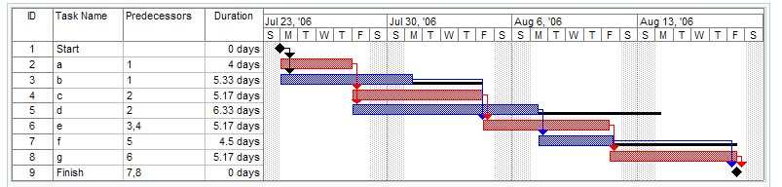
GANTT chart
Used to plan time and resources
Range of software: MS Project, Excel
Critical path analysis > sequence of tasks > define dependencies > bottlenecks

Slide 4
Agile Project Management
Software development
Sprint
Scrum
Incremental progress
Define customer needs

Slide 5
MoRPHE
Management of Research Project in the Historic Environment
Successor to MAP2 (Management of Archaeological Projects)
English Heritage

Slide 6
MoRPHE principles
Based on PRINCE2
Staged approach: Start Up, Initiation, Execution 1-n, Closure
Aims, Objectives, Products, Tasks
Review points
Project Executive, Project Manager, Project Board, Experts

Slide 7
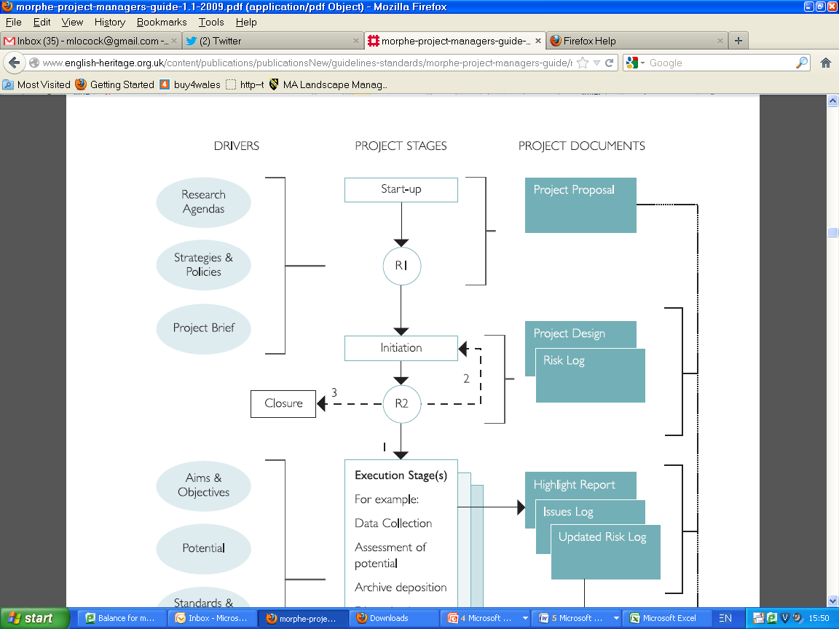

Slide 8
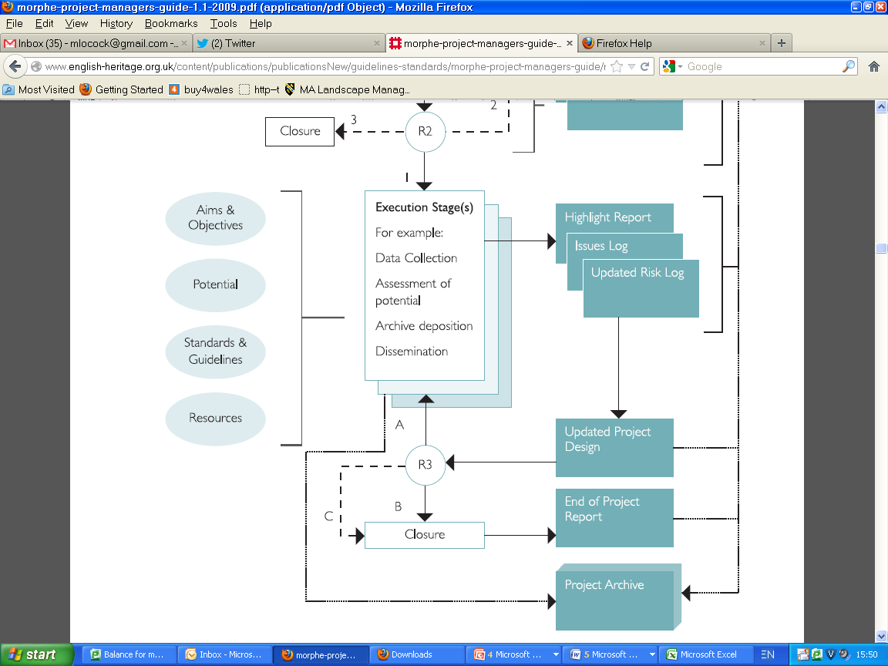

Slide 9
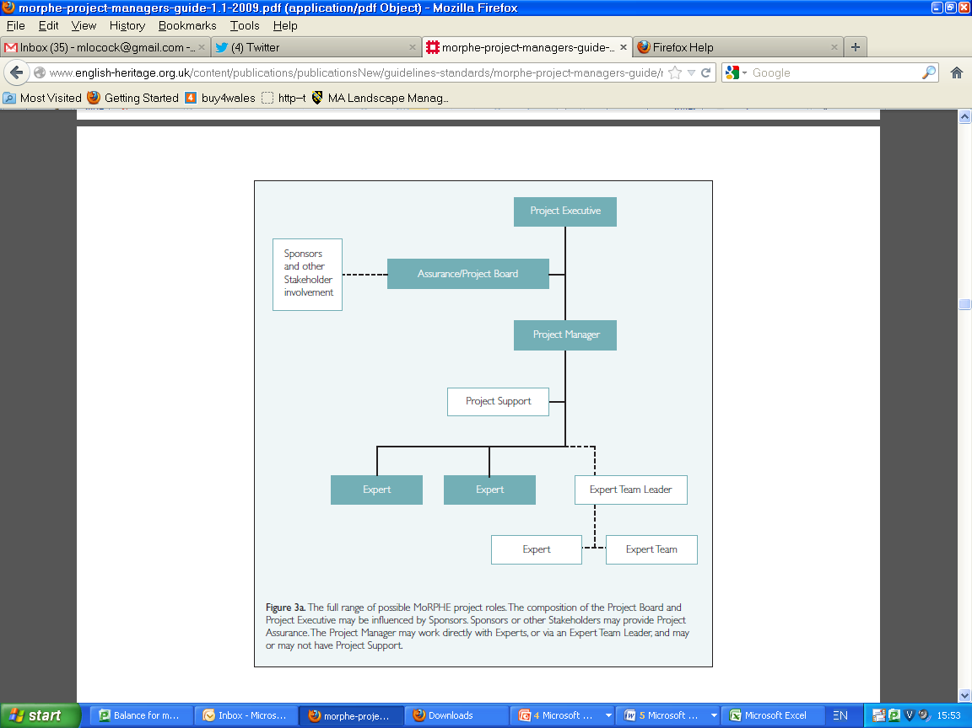

Slide 10
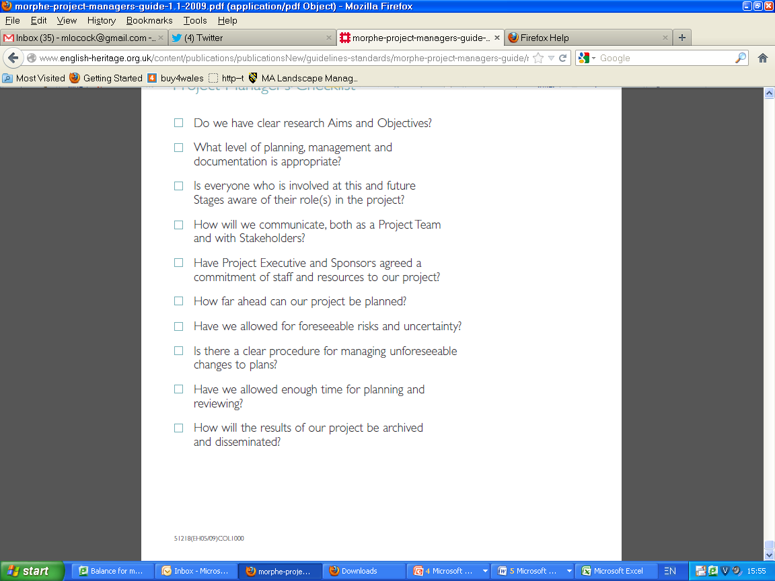

Slide 11
Preparation task
Online MoRPHE worksheet (see Moodle)

