Slide 1


Slide 2
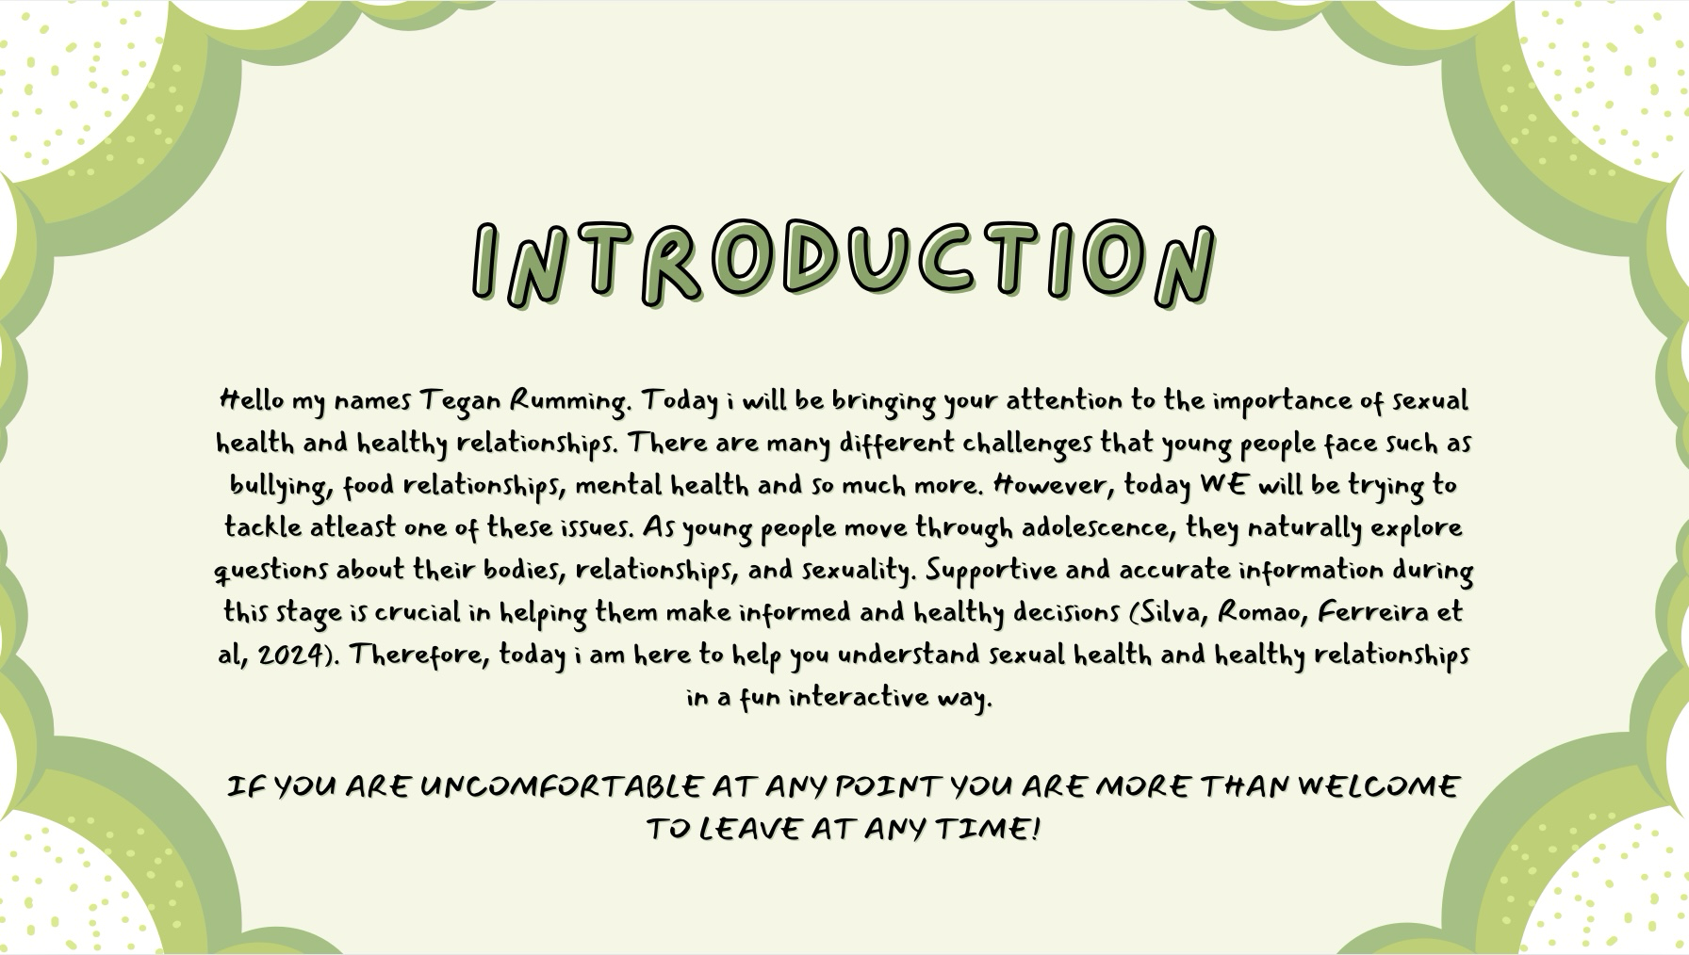
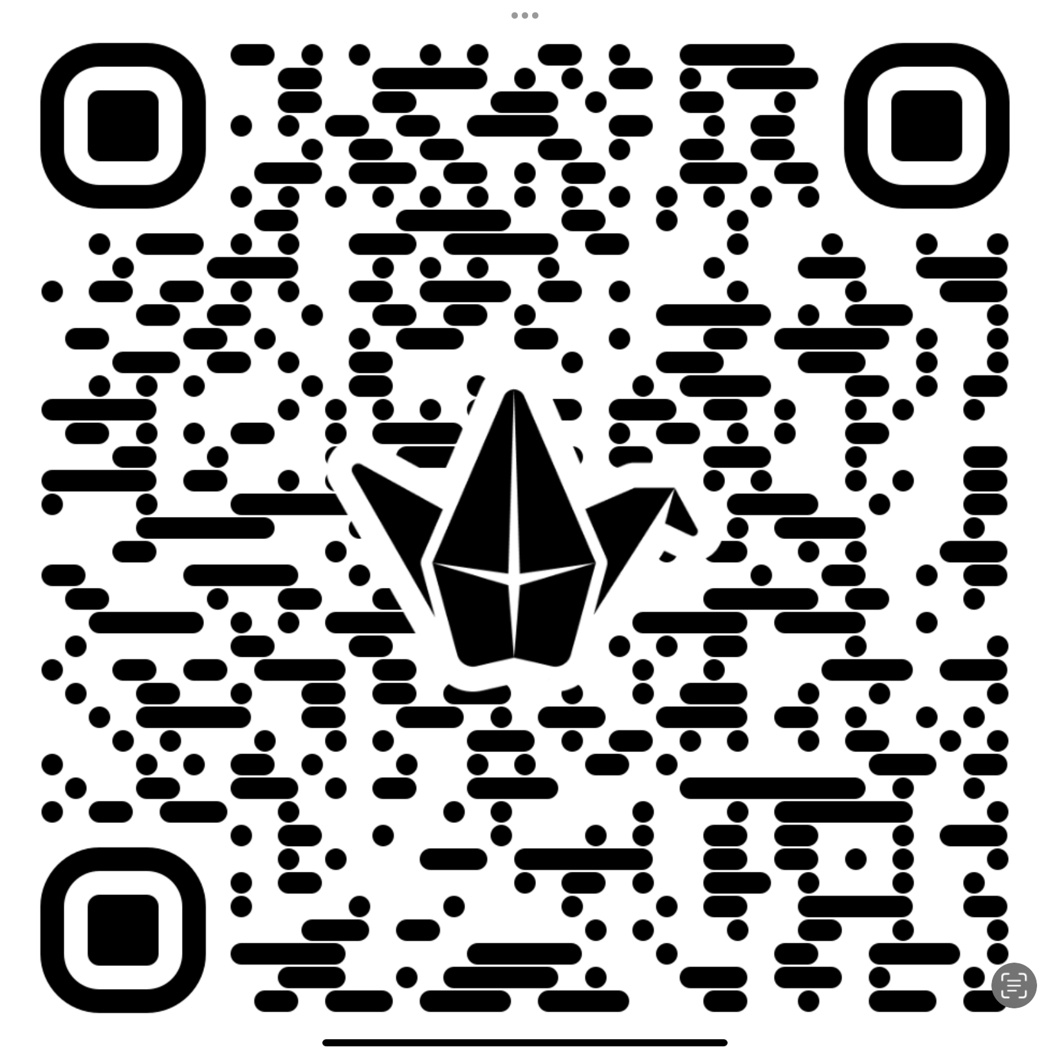

Slide 3
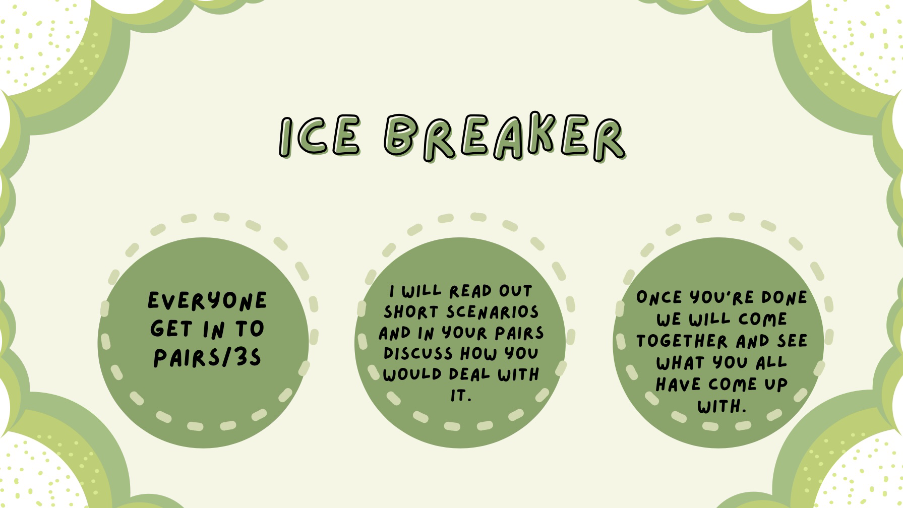

Slide 4
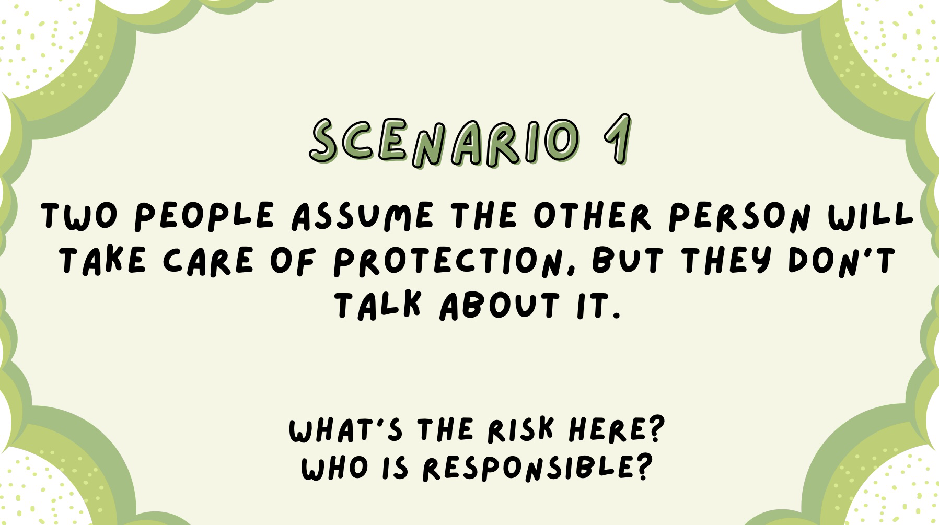

Slide 5
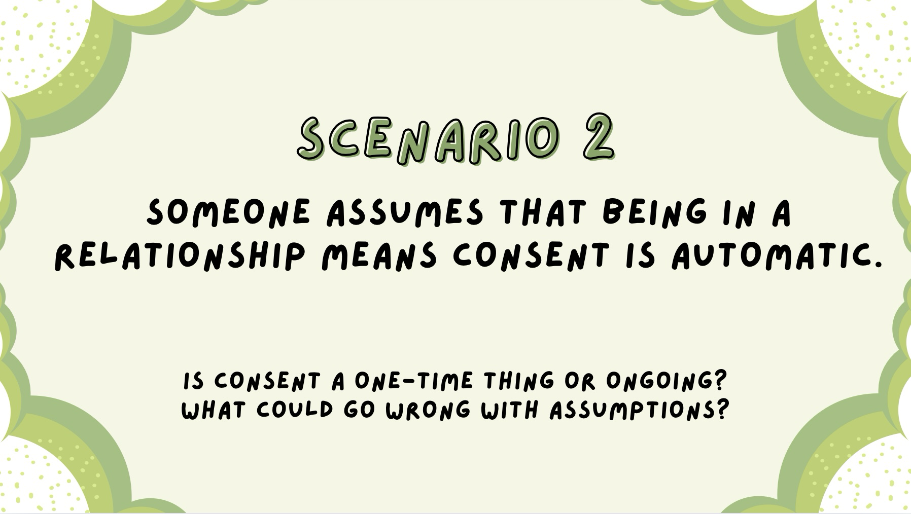

Slide 6


Slide 7
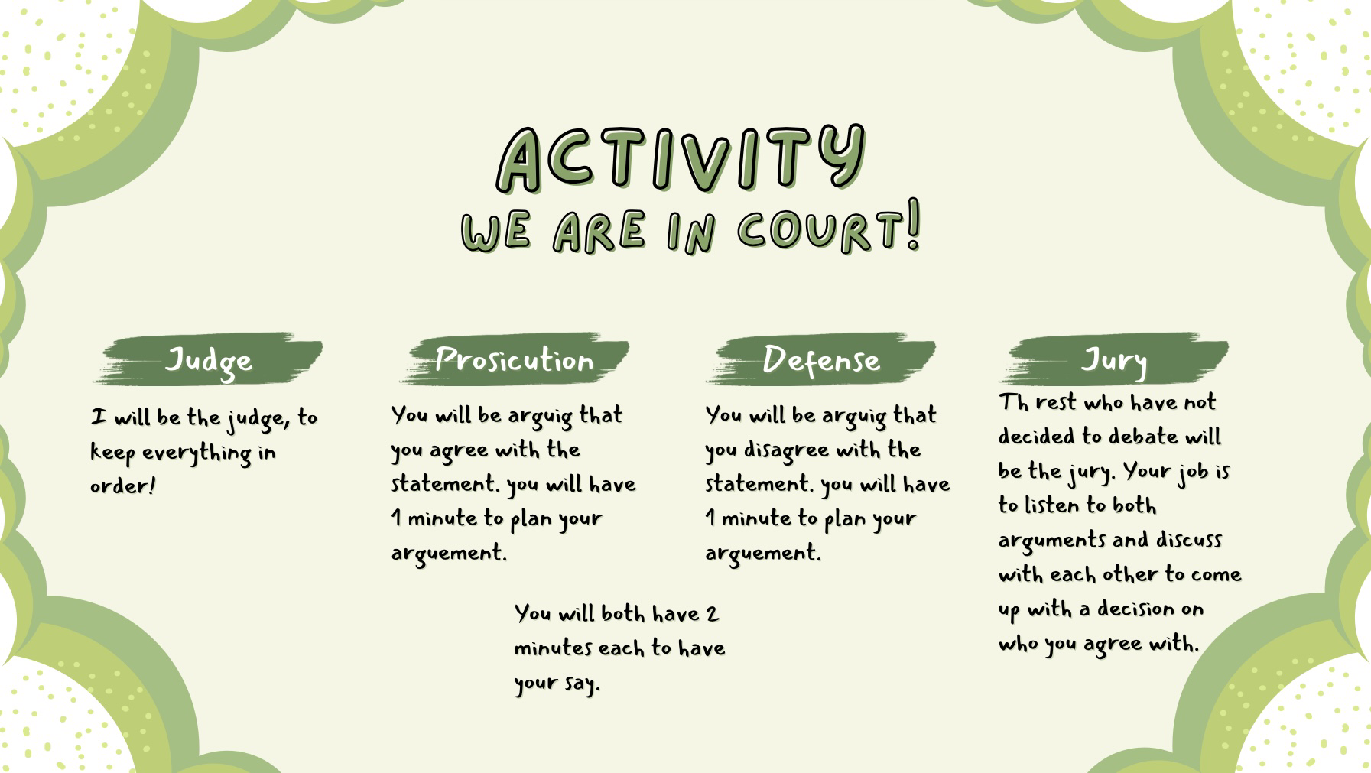

Slide 8


Slide 9


Slide 10


Slide 11


Slide 12


Slide 13


Slide 14
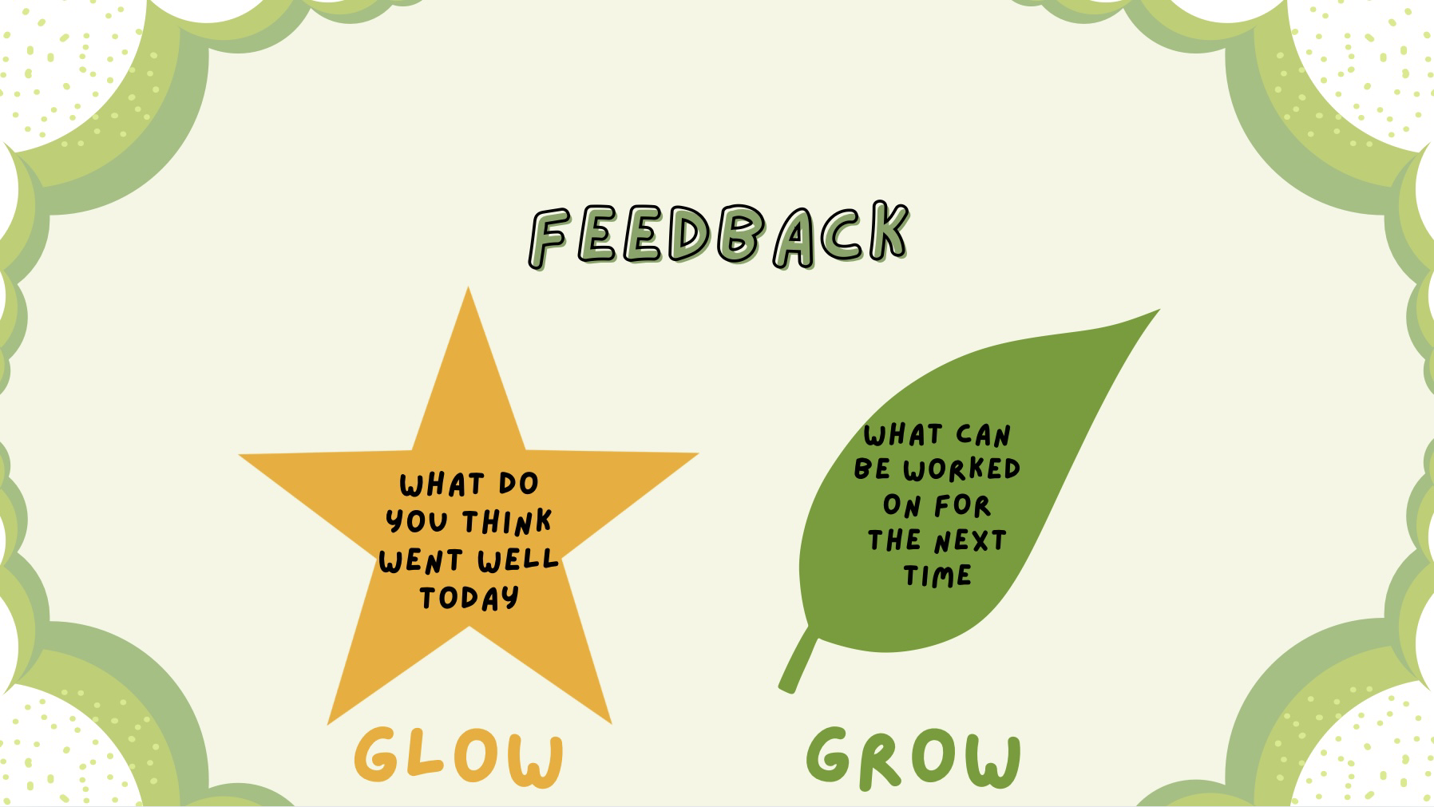

Slide 16


Slide 17
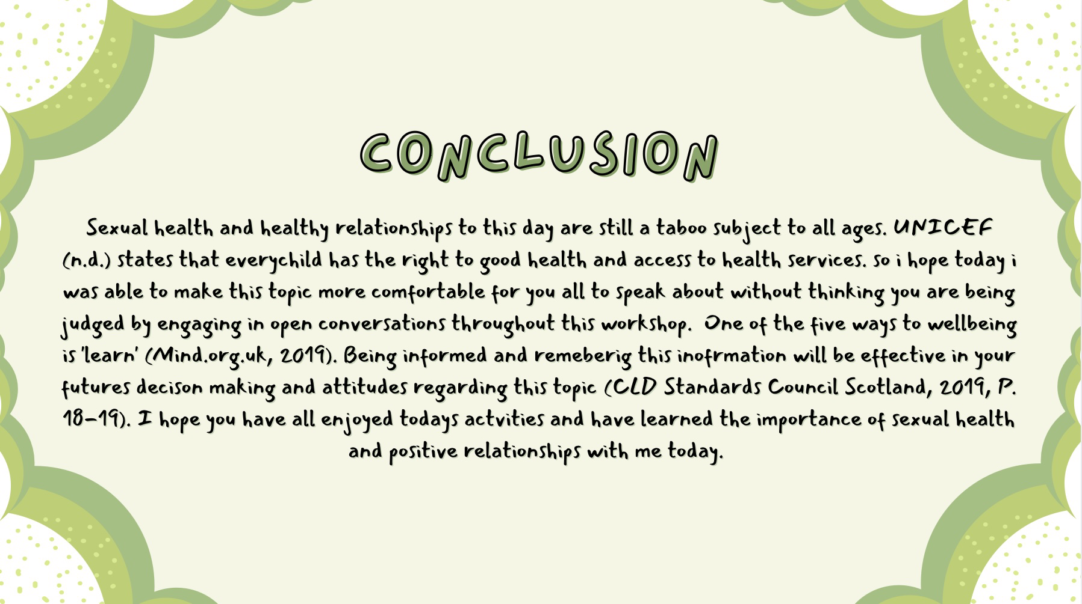

Slide 18
Reference list
Mind.org.uk. (2019). 5 Ways to Wellbeing | Mind. [online] Available at: https://www.mind.org.uk/workplace/my-mental-health-at-work/five-ways-to-wellbeing/.
CLD Standards Council Scotland (2019) National Occupational Standards. Available at: CombinedYouthWorkNOS.pdf
Silva, S. Romão, J., Ferreira, C.B., Figueiredo, P., Eduarda Ramião and Barroso, R. (2024). Sources and Types of Sexual Information Used by Adolescents: A Systematic Literature Review. Healthcare, [online] 12(22), pp.2291-2291. doi:https://doi.org/10.3390/healthcare12222291.
UNICEF (n.d.). UN convention on the rights of the child (UNCRC). [online] unicef. Available at: https://www.unicef.org.uk/what-we-do/un-convention-child-rights/.
World Health Organization (2023). Comprehensive sexuality education. [online] World Health Organization. Available at: https://www.who.int/news-room/questions-and-answers/item/comprehensive-sexuality-education.

