Slide 1

Bereavement

Slide 2
Aims
To introduce the presenting issue of bereavement
To understand the signs and symptoms in children and young people
To become familiar with strategies that can be used to support CYP

Slide 3
Context
According to the Office for National Statistics and the national census held in 2021
In 2020, there were 607,922 deaths registered in England and Wales; an increase of 14.5% compared with 2019 (530,841 deaths).
The leading cause of death in England and Wales in 2020 was COVID-19, with 73,766 deaths (12.1% of all deaths).
The second most common cause was dementia and Alzheimer's disease.
The number of deaths recorded on the census, was the highest recorded since 1918.

Slide 4

Loss and bereavement
Affects us all
Loss and Grief
For a child this could be a family pet, a favourite toy, or a significant member of their family.

Slide 5
Thinking about death
*Everyone has beliefs or ideas about death, whether they are linked to religious beliefs or not
*Everyone has experienced loss, whether this is the death of someone or whether it is a different sort of loss
*We will all experience death, how that occurs is unknown and how we will deal with it is also uncertain.

Slide 6

Grief
Reactions occur when an individual loses someone close to them (these can be emotional or behavioural)
Grief may not cause actual physical harm, but it is distressing and does upset daily functioning.
Grief can feel like an injury.
Loss and Deprivation.

Slide 7
Grief Models
Worden's (2018) model of grief provides tasks of mourning that a bereaved individual may experience as they navigate their loss.
To accept the reality of loss
To work through the pain of grief
To adjust to an environment in which the deceased is missing
To emotionally relocate the deceased and move on with life.
For the older adolescent, understanding how grief works, can often help them to work through their own loss.

Slide 8

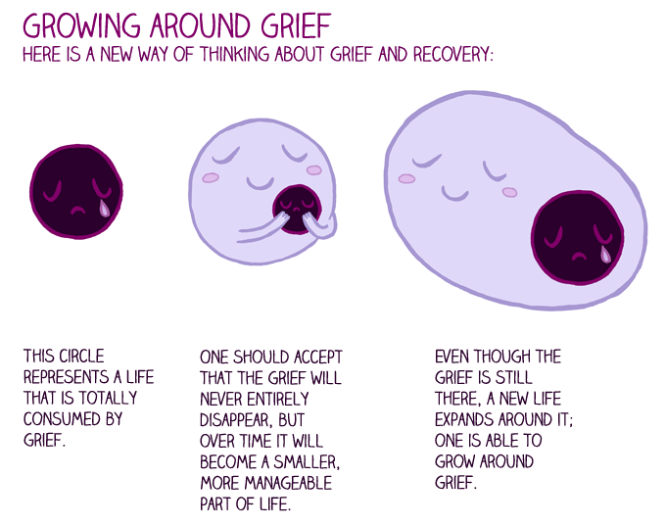
Tonkin's model(1996)

Slide 9
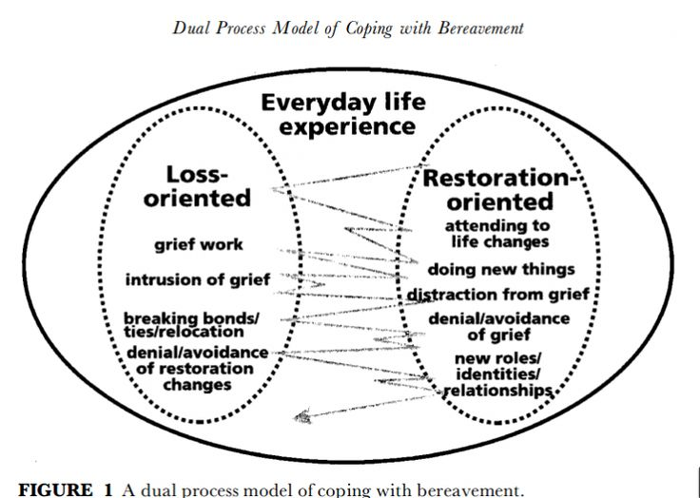
Dual process model
Within this model, the bereaved individual experiences a fluctuation of their grief as they move between loss-oriented and restoration-oriented experiences. (Stoebe and Schut,1999)

Slide 10

Impact of Grief on CYP
How a child or young person responds to the death of a loved one depends very much on their age.
General responses can include:
Sleep disturbance
Acting out
Withdrawal
Numbness, shock, fear, anxiety and sadness
Guilt and hopelessness.
Demonstrations of disbelief, blame, confusion and oversensitivity to noise.

Slide 11
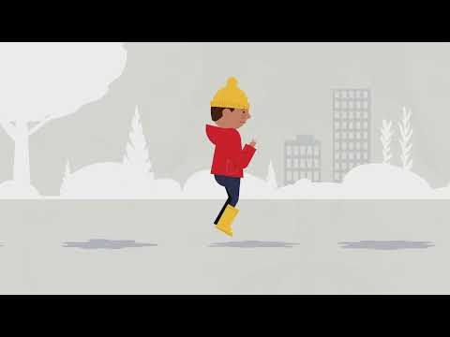
Puddle Jumping
Young children will experience their grief differently to adults.
They may experience their sadness for brief periods, before wanting to do something else, such as play with toys or watch a video.
This is called 'puddle-jumping'
The video here provides a lovely illustration of how this might be seen by adults and what is happening to the young child

Slide 12

How to support children who are grieving
Every child needs to feel heard. They may not be able to express their emotions clearly, but they may need time to cry or time to feel angry. We need to provide space for them to do so, so that they know they have been heard.
They also need to understand that there is no timeline for grief. Children and adults grieve in different ways and at different times. There are many emotions surrounding grief and they will be experienced differently by everyone.
Every child needs to know that they are not alone in their grief. As adults we can sit with them and witness their pain and their emotions.

Slide 13

Grief and mental Health
Grief can have a huge impact on mental health.
It can cause a range of emotions, such as anger, sadness as well as anxiety and bereavement.
These feelings can be overwhelming, particularly in the early days of the bereavement.
.

Slide 14
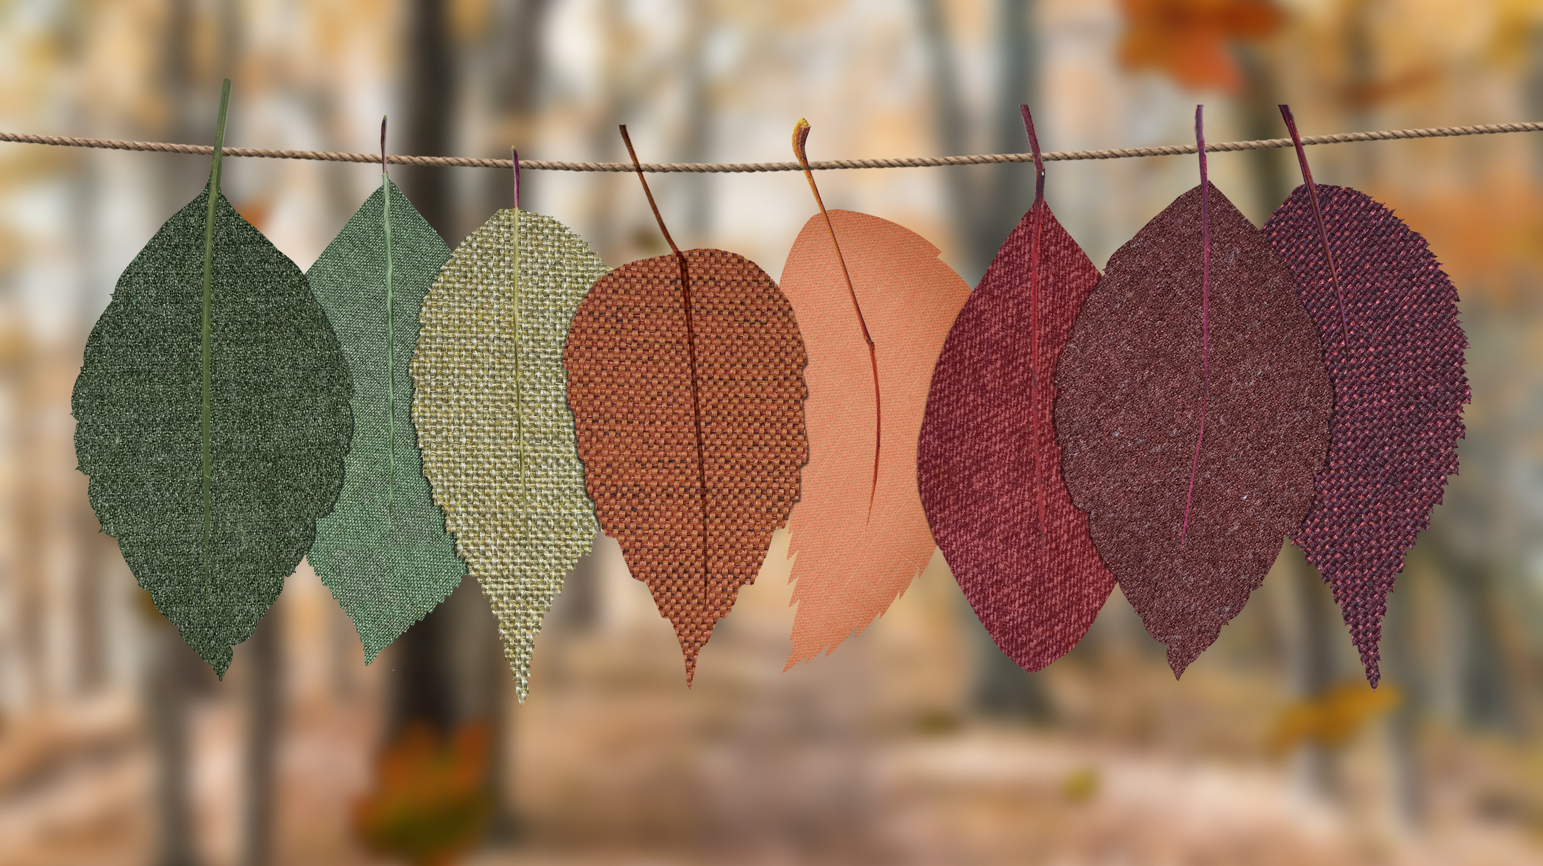
Grief and mental health
CYP may need additional support from their GP. Particularly if they are not sleeping for a prolonged period or are having intense feelings of anxiety or moving towards depression.
As with most mental health concerns, there is additional support that can be offered to children and young people. This includes a range of therapeutic interventions, such as:
Play Therapy
Humanistic Therapies
Creative Therapies

Slide 15
Resources
There are a range of resources available to support children and young people.
Sitting and reading a book is a quiet activity and may have a gentle resonance with the children.
Books and resources | Child Bereavement UK
In addition, providing play opportunities for the youngest child, will also allow them to jump in and out of the bereavement when they need to.
For the older child and adolescent, providing quiet spaces for them to talk about their feelings will give them an open opportunity to talk if they wish to do so.
There are also support groups and online forums and blogs available for the older children to engage with. The online support materials are often provided by young people who have experienced similar losses.

