Slide 2
ECEY4005C:Y 1000 Diwrnod Cyntaf
ECEY4005: The First 1000 Days

Slide 3
What is an Enabling Adult
Beth yw Oedolyn Galluogi?
Hwylusydd
Gyfathrebwr
Arweinydd
Proffesiynol
Arbenigol
Gofalwr
Addysgwr
Facilitator
Communicator
Leader
Professional
Expert
Carer
Educator
Notes:
An enabling adult is all of these things

Slide 4
Mae babis angen oedolion Babies need Adults.
Tueddiad i'r amgylchedd
Dibyniaeth ar rieni
Dibyniaeth ar wasanaethau
Dibyniaeth ar gymorth cymdeithasol
Anweledig i weithwyr proffesiynol.
Susceptibility to the environment
Dependency on parents
Dependency on services
Dependency on social support
Invisibility to professionals.
(First 1001 Days Movement, 2021)
Notes:
Babies need adults, babies are vulnerable and susceptible to the environment around them and therefore rely on adults for survival. Babies are completely dependant on adults, their parents, the services provided to them and social support.
https://assets.publishing.service.gov.uk/government/uploads/system/uploads/attachment_data/file/973112/The_best_start_for_life_a_vision_for_the_1_001_critical_days.pdf

Slide 5
Galluogi Oedolion
Enabling Adults
Galluogi oedolion i ymateb
Galluogi oedolion i greu amgylchedd sy'n gyfoethog o ran cyfathrebu
Galluogi oedolion i fodelu ymagwedd lawen at ddysgu
Enabling adults are responsive
Enabling adults create an environment that is communication rich
Enabling adults model a joyful approach to learning
Curriculum for funded non maintained (WG, 2022).
Notes:
We recognise that our role is integral to the progress of all children and is particularly significant in this period of early learning. We should set the expectation for learning by creating emotionally safe environments that support children to begin to express and regulate their feelings and behaviours in positive ways. We should model a joyful approach to learning, and encourage and support children’s natural curiosity, making best use of the teachable moments that occur naturally as we observe or engage in their play.

Slide 6
Galluogi Oedolion
Enabling Adults
Creu amgylcheddau sy’n ddiogel yn emosiynol
annog a chefnogi chwilfrydedd naturiol plant, gan wneud y defnydd gorau o’r cyfleoedd dysgu digymell sy’n digwydd yn naturiol
gwneud cysylltiadau cryf â chartref a chymuned y plentyn, er mwyn atgyfnerthu ei ymdeimlad o berthyn
Creates emotionally safe environments
encourage and support children’s natural curiosity, making best use of the teachable moments that occur naturally
make strong connections with the child’s home and community, to strengthen their sense of belonging
Curriculum for funded non maintained (WG, 2022).

Slide 7
Galluogi Oedolion
Enabling Adults
dangos parch at blant drwy gefnogi eu penderfyniadau a’u dewisiadau.
cael effaith gadarnhaol ar les plant drwy fod yn gyson yn ein gofal a bod yn batrwm o dosturi a charedigrwydd.
cyflwyno cwricwlwm eang a chytbwys
demonstrate respect for children, by supporting their decisions and choices.
have a positive impact on children’s well-being, through being consistent in our care and modelling compassion and kindness
deliver a broad and balanced curriculum
Curriculum for funded non maintained (WG, 2022).

Slide 8
Galluogi Oedolion
Enabling Adults
have a thorough knowledge and understanding of child development
use our careful observations to follow a child’s interests and plan future learning experiences.
support children to develop resilience, independence and confidence
bod â gwybodaeth a dealltwriaeth drylwyr ym maes datblygiad plant
defnyddio ein harsylwadau gofalus er mwyn dilyn diddordebau plentyn a chynllunio profiadau dysgu ar gyfer y dyfodol.
helpu plant i ddatblygu gwydnwch, annibyniaeth a hyder
Curriculum for funded non maintained (WG, 2022).

Slide 9
Canlyniadau/Outcomes
Roedd plant a oedd wedi mynychu unrhyw ysgol cyn-ysgol yn fwy tebygol o sefyll arholiadau Safon UG na'r rhai nad oeddent wedi mynychu arholiadau safon UWCH.
Roedd plant a brofodd Brofiad Bywyd Cartref cynnar da yn fwy tebygol o fynd i mewn i safon UG, Safon Uwch
Mae creu partneriaethau cyfatebol rhwng cyn-ysgol a chartref yn gwella canlyniadau ymhellach.
(Siraj-Blatchford et al. 2002)
Children who had attended any pre-school were more likely to enter AS-level exams than those who had not.
Children who experienced a good early Home Life Experience were more likely to enter AS-levels, A-levels
Creating reciprocal partnerships between pre school and home enhances outcomes further.
(Siraj-Blatchford et al. 2002)
Notes:
A good and heathy start in life leads to better future outcomes. The repey study highlighted this:
https://dera.ioe.ac.uk/4650/1/RR356.pdf - full report 158 pages 2002
https://discovery.ucl.ac.uk/id/eprint/10018684/1/RB69_EPPSE_endKeystage1.pdf - overview of findings 2004

Slide 10
Cwricwlwm sy'n dod i'r amlwg Emergent Curriculum
Mae cwricwlwm sy'n dod i'r amlwg yn esblygu'n gyson mewn ymateb i anghenion a diddordebau newidiol plant, diddordebau a phryderon rhieni a'r gymuned, a blaenoriaethau athrawon. Mae pob un o'r elfennau allweddol hyn yn llunio'r cyfeiriad ar gyfer dysgu yn y presennol a'r dyfodol.
An emergent curriculum is constantly evolving in response to children’s changing needs and interests, parental and community interests and concerns, and teachers’ priorities. Each of these key elements shapes the direction for present and future learning.
Notes:
While framed by the teacher, it is child initiated, allowing for collaborations between children and teachers, and giving everyone a voice. It is responsive to the child, the teacher takes on the role of facilitator, It is flexible in that curriculum planning, rather than being done well in advance, is constantly developing. It builds upon the work of Dewey, Piaget, Vygotsky – taken from page 19.
On Moodle:
Susan_Stacey-Emergent_Curriculum_in_Early_Childhood_Settings-Sample.pdf (iactivelearning.com)

Slide 11
Cwricwlwm sy'n dod i'r amlwg Emergent Curriculum
Ni allwch ysgrifennu cwricwlwm sy'n dod i'r amlwg a'i becynnu i'w werthu. Mae'r cwricwlwm sy'n dod i'r amlwg yn cael ei ddyfeisio gan ei gyfranogwyr.
Mae athrawon a rhoddwyr gofal plant ifanc ar eu gorau pan fyddant yn dilyn y plant fel modelau ar gyfer eu chwilfrydedd oedolion eu hunain, gan ddysgu gyda hwy ac amdanynt.
(Stacey, 2009)
You can’t write an emergent curriculum and package it for sale. Emergent curriculum is invented by its participants.
Teachers and caregivers of young children are at their best when they follow the children as models for their own adult curiosity, learning with them and about them.
(Stacey, 2009)

Slide 12
Gweithgareddau dan arweiniad plant
Child led activities
‘Mae digwyddiadau a gweithgareddau a gychwynnir gan blant yn codi pan fydd plant yn dewis yn rhydd o’u hamgylchedd dysgu – y tu mewn a’r tu allan – ac yn dewis a threfnu adnoddau, gan ddewis eu cymdeithion eu hunain ar y ffordd.’ Lindon (2010)
‘Child initiated events and activities arise when children choose freely from their learning environment – indoors and out – and select and organise resources, picking their own companions on the way.’ (Lindon, 2010)

Slide 13
Gweithgareddau dan arweiniad oedolion / Adult lead activities
Mae gweithgareddau a arweinir gan oedolion yn weithgareddau a ddewisir gan oedolion i annog agwedd ar ddysgu, neu mewn perthynas â diddordeb penodol y plentyn.
Mae'r cwricwlwm yng Nghymru yn nodi bod yn rhaid cael cydbwysedd rhwng dysgu strwythuredig drwy weithgareddau a gychwynnir gan blant a'r rhai a gyfarwyddir gan oedolion.
Adult led activities are activities that are chosen by adults to encourage an aspect of learning, or in relation to a particular interest of the child.
The curriculum in Wales states that there must be a balance between structured learning through child-initiated activities and those directed by adults.
(Pacey, no date).

Slide 14
Structural Factors
Developmentally appropriate curriculum
High adult-child ratio
Safe physical setting
Human Factors
Language-rich environment
•
Warm and responsive adult-child interactions
•
Skilled and well-compensated personnel
Small groups
Centre on the developing child (2020).
Notes:
In practise there are two different types of factors that impact the developing child, which the enabling adult is responsible for overseeing. First are the structural factors:
- having a safe physical environment
- having a high child to adult ratio, we have to follow the NMS but should ratios be lower or higher?
- an appropriate curriculum
- small groups, especially when working with very young children
And then you have the human factors which are your personal attributes and professional knowledge:
- promoting a language rich environment
- being warm and responsive and respectful when interacting with children
- being a skilled professional who uses their knowledge to best support children

Slide 15
Themâu Arwyddocaol Significant Themes
Creu a datblygu partneriaethau cynhwysol rhwng y cartref a'r amgylcheddau addysgol.
Datblygu dull cyfannol o ymdrin ag addysg.
Archwilio 'addysgeg' a 'chwricwla' yn y ddarpariaeth blynyddoedd cynnar.
Creating and developing inclusive partnerships between the home and educational environments.
Developing a holistic approach to education.
Exploring ‘pedagogy’ and ‘curricula’ in early years provision.
Notes:
Significant themes in being an enabling adult:
Inclusive partnerships between home and settings, developing positive and respectful relationships between children and families
Developing, promoting and maintaining a holistic approach to learning and developing
Exploring, researching and developing effective pedagogy and curriculum

Slide 16
Babanod / Babies
Mae gan bob eiliad o fywyd babi ei bwysigrwydd: mae'n rhaid cadw cysondeb gofal, y parch at ei adnoddau ei hun, gan gryfder yr amgylchedd a grëwyd o'i gwmpas. (Vamos, 2019)
Every second of a baby’s life has its importance: the consistency of care, the respect for his own resources, all have to be preserved by the strength of the environment created around him. (Vamos, 2019)
Notes:
It is the responsibility of the enabling adult to ensure this

Slide 17
Professional Love
Cariad Proffesiynol
Mae'r gwir fater, o gariad proffesiynol priodol, yn parhau i fod ar y cyfan heb ei ystyried yn yr arfer dyddiol o leoliadau blynyddoedd cynnar, oherwydd mae wedi'i guddio yn yr un hinsawdd o rybuddion.
The real issue, of an appropriate professional love, remains for the most part unexamined in the daily practice of early years settings, because it is obscured in the same climate of wariness.

Slide 18
Professional Love
Cariad Proffesiynol
Mae 'Cariad Proffesiynol' yn rhoi'r iaith i ymarferwyr ddisgrifio'n briodol y bond agos, cariadus ac annwyl sydd, dros amser, yn anochel yn cael ei ddatblygu gyda'r plant dan eu gofal.
‘Professional Love’ provides practitioners with the language to appropriately describe the close, loving intimate and affectionate bond which, over time, is inevitably developed with the children in their care.

Slide 19
Professional Love
Cariad Proffesiynol
Mae diffinio cariad mewn rolau proffesiynol yn broblem gan nad oes set sgiliau y gellir ei chymhwyso, ei haddysgu na'i mesur. Serch hynny, i wadu bodolaeth cariad, yn enwedig pan fydd ymchwil eisoes wedi cadarnhau nad yw materion cariad yn fuddiol.
Defining love in professional roles is problematic because there is no skill set that can be applied, taught or measured. Nevertheless, to deny the existence of love, particularly when research has already confirmed that love matters is unhelpful.

Slide 20
Professional Love
Cariad Proffesiynol
Mae cariad proffesiynol yn ymwneud â sensitifrwydd oedolion tuag at y plant ifanc iawn yn eu gofal a ""darllen"" yr hyn sydd ei angen i wneud i blentyn deimlo ei fod yn cael ei garu ar unrhyw adeg.
(Prifysgol Sheffield, 2015).
Professional love is about adults’ sensitivity towards the very young children in their care and “”reading”” what is needed to make a child feel loved at any moment in time.
(University of Sheffield, 2015).

Slide 21
Professional Love
Cariad Proffesiynol
'Cariad yw'r hyn y mae pobl yn ei ddweud', yn golygu mewn ystyr ffenomenolegol y dylai profiadau byw pobl a disgrifiadau o gariad gael eu cymryd o ddifrif gan ymchwilwyr cariad. Cariad yw'r hyn y mae pobl yn ei ddisgrifio fel un sy'n
(Gratzke, 2015)
‘Love is what people say it is’, means in a phenomenological sense that people’s lived experiences and descriptions of love should be taken seriously by love researchers. Love is what people describe it as being
(Gratzke, 2015)
Notes:
Discuss the ideas of professional love

Slide 22
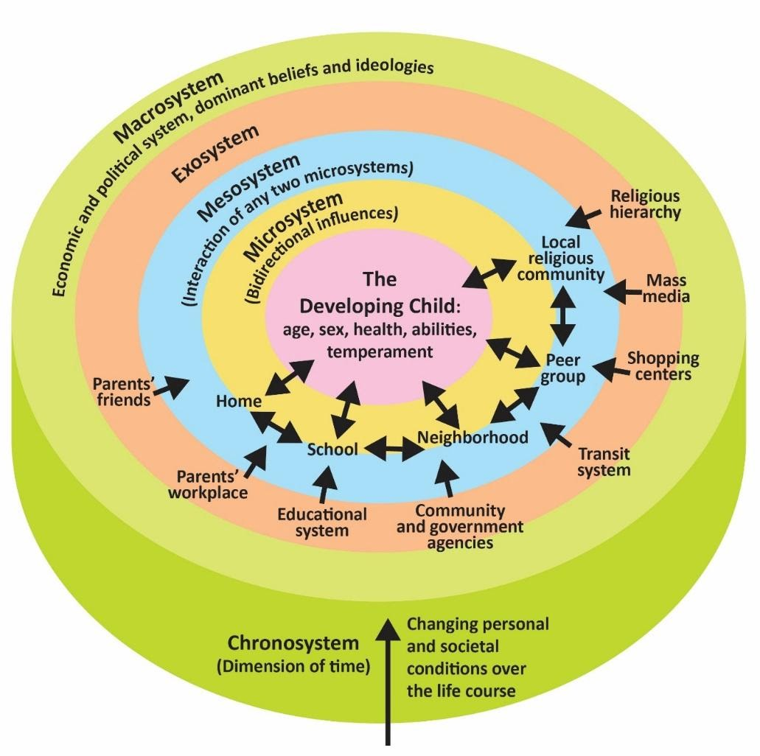
Perthynas / Relationships
Notes:
Bronfenbrenner - the importance of the relationships between those within the microsystem and the impact this has on the child

Slide 23
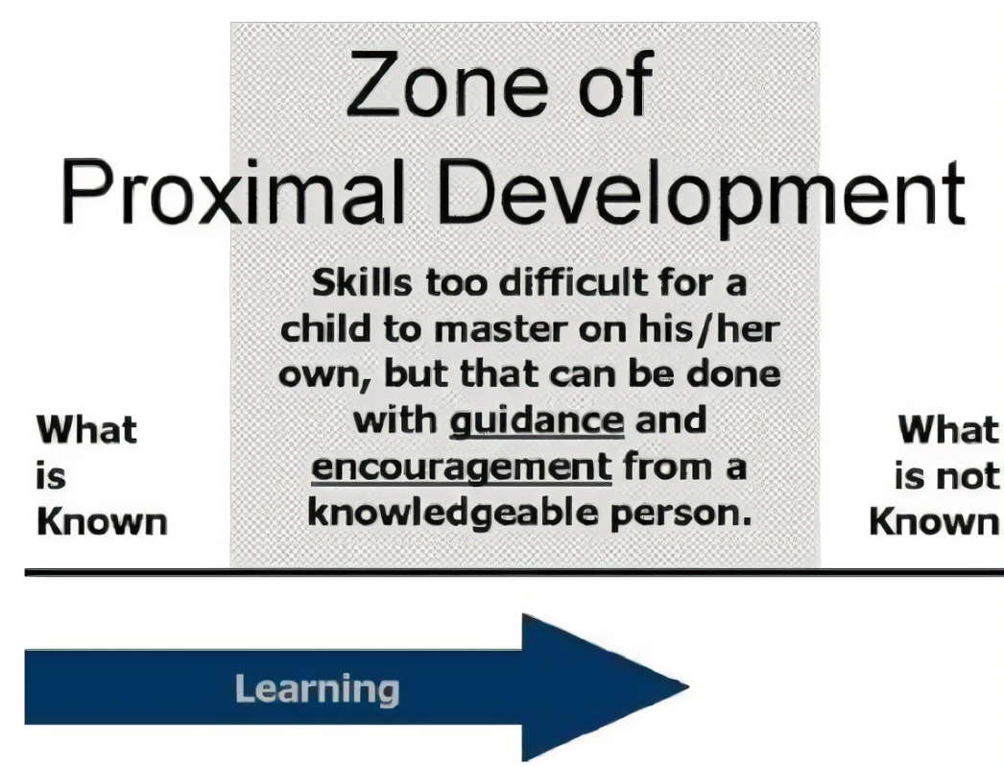
Notes:
Vygotsky – being the facilitating scaffolder to help children progress from what they already know to what is not know so new skills. Adults act as the more knowledgeable other to guide the children if a skill is too difficult to master on ones own.

Slide 24
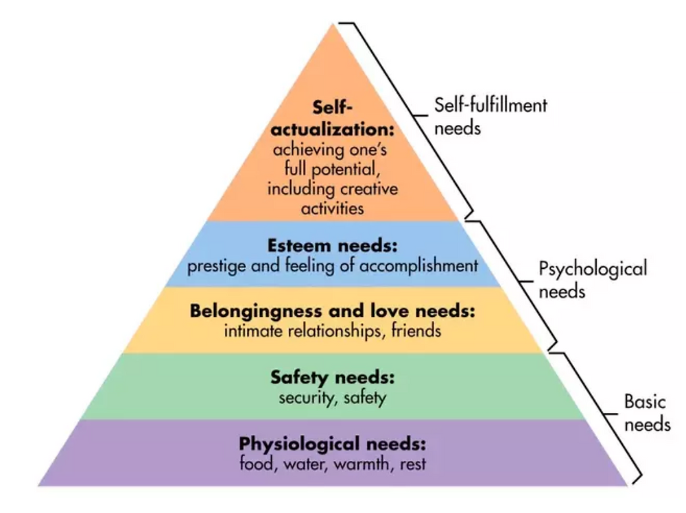

Slide 25
Tasg / Task
Ymchwilio i rôl yr oedolyn sy'n galluogi gan ddefnyddio'r cwricwlwm ar gyfer lleoliadau meithrin a ariennir na chynhelir a ffynonellau eraill. Cofiwch gofnodi eich geirdaon!
Research the role of the enabling adult using the curriculum for funded non-maintained nursery settings and other sources. Remember to record your references!

Slide 26
Cyfeirnodau / References
Centre on the Developing Child. (2020) An Action Guide for Policymakers: Three Key Points from Working Paper 15: ‘Connecting the Brain to the Rest of the Body’ Health and Learning Are Deeply Interconnected in the Body. Available at: Health and Learning Are Deeply Interconnected in the Body: An Action Guide for Policymakers (wpengine.com) (Accessed 17/11/21).
Gratzke, M. (2015) “Love is What People Say It Is.” Gratzke Inaugural Speech. April 27. Love Research Hull Available at: https://archive.org/details/MichaelGratzkeInaugural Hull2015 (Accessed: October 1, 2017).
Lindon, J. (2010) Child-Initiated Learning (Positive Relationships in the Early Years). Practical Pre-school Books: England.
Pacey. (no date) Role of the adult / Rôl yr oedolyn. Available at: https://www.pacey.org.uk/working-in-childcare/inspiring-environments/role-of-the-adult/. (Accessed: 14/8/23).
Siraj-Blatchford, I.et al. (2002), Researching effective pedagogy in the early years. (Research Report No. 356), Department for Education: London.
Stacey, S. (2009) Emergent Curriculum in Early Childhood Settings. Redleaf Press: Yorkton Court.
University of Sheffield. (2015). Professional Love in Early Years Settings: A Report of the Summary of Findings
Vamos, J. (2019) A Primal Environment for a 21st Century’s ‘Naissance’, Thoughts on the Language of Tenderness in Ferenczi’s Footsteps. The American journal of psychoanalysis. [Online] 79 (4), 594–600.
Welsh Government (2021a) Consultation Document: A curriculum for funded non-maintained nursery settings. Available at: curriculum-funded-non-maintained-settings-consultation-doc.pdf (gov.wales) [Accessed 17/11/21]
Welsh Government (2021b) Consultation Document: Enabling Pathways. Available at: enabling-pathways-consultation-document_0.pdf (gov.wales) [Accessed 25/11/21]

