Slide 1

Porter’s Five Forces
Devised by Michael Porter.
A framework for analysing the nature of competition within an industry.

Slide 2
The Five Forces
Porter’s Five Forces Framework helps identify the attractiveness of an industry in terms of five competitive forces:
Threat of new entrants to a market
Bargaining power of suppliers
Bargaining power of buyers (“customers”)
Threat of substitute products
Degree of competitive rivalry
These five forces constitute an industry’s ‘structure’

Slide 3
1. Threat of new entrants
If new entrants move into an industry they will gain market share and rivalry will intensify.
The position of existing firms is stronger if there are barriers to entering the market.
Barriers to entry are the factors that need to be overcome by new entrants if they are to compete.
The threat of entry is low when the barriers to entry are high and vice versa.

Slide 4
Barriers to entry depend on:
Investment cost
– High cost will deter entry
– High capital requirements might mean that only large businesses can compete.
Economies of scale available to existing firms
– Lower unit costs make it difficult for smaller newcomers to break into the market and compete effectively.
Regulatory and legal restrictions
– Each restriction can act as a barrier to entry
– E.g. patents provide the patent holder with protection, at least in the short run.
Source: Frésard & Valta (2015)

Slide 5
Barriers to entry depend on (contd.):
Product differentiation (including brands)
– Existing products with strong USP’s increase customer loyalty and make it difficult for newcomers to gain market share.
Access to suppliers and distribution channels
– A lack of access will make it difficult for newcomers to enter the market.
Retaliation by established products
– E.g. the threat of price war will act to discourage new entrants
– But competition law outlaws actions like predatory pricing.
Source: Frésard & Valta (2015)

Slide 6
2. Bargaining power of suppliers
Suppliers are those who supply what organisations need to produce the product or service. Powerful suppliers can reduce an organisation’s profits.
Supplier power is likely to be high when:
– There are only a few suppliers
– The resource they supply is scarce
– The cost of switching to an alternative supplier is high
– Suppliers can integrate forwards (e.g. low- cost airlines have cut out the use of travel agents).

Slide 7
3. Bargaining power of buyers
Buyers are the organisation’s immediate customers, not necessarily the ultimate consumers.
If buyers are powerful, then they can demand cheap prices or product/service improvements to reduce profits.

Slide 8
3. Bargaining power of buyers (contd.)
Buyer power is likely to be high when:
– There are only a few of them
– They can supply their own inputs (backward vertical integration)
– They can choose from a wide range of supply firms
– They have low switching costs.

Slide 9


Slide 10
4. Threat of substitute products
A substitute product can be regarded as something that meets the same need.
Substitute products are produced in a different industry but crucially satisfy the same customer need.
If there are substitutes to a firm’s product, they will limit the price that can be charged and will reduce profits.

Slide 11
4. Threat of substitute products (contd.)
The extent of the threat depends upon
– The extent to which the price and performance of the substitute can match the industry’s product
– The willingness of customers to switch
– Customer loyalty and switching costs.
If there is a threat from a rival product the firm will have to improve the performance of their products by reducing costs and therefore prices and by differentiation.

Slide 12
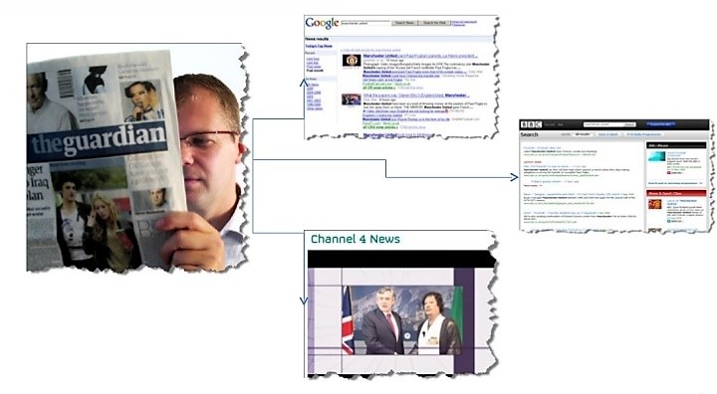
Substitute for newspapers

Slide 13
5. Degree of competitive rivalry
Competitive rivals are organisations with similar products and services aimed at the same customer group and are direct competitors in the same industry/market (distinct from substitutes).
The degree of rivalry increases when
– Competitors are of roughly equal size
– Competitors are aggressive in seeking leadership
– The market is mature or declining
– There is a low level of differentiation.
– The exit barriers are high
– There are high fixed costs

Slide 14

Michael Porter Explains All
https://www.youtube.com/watch?v=mYF2_FBCvXw
[Watch Michael Porter talking about the Five Competitive Forces]

Slide 15
References
Porter, M. E. (1980). Competitive strategy: Techniques for analysing industries and competitors. New York: Free Press.
Porter, M. E. (1985). Competitive advantage: creating and sustaining superior performance. New York: Free Press.
Further Readings
Frésard, L., & Valta, P. (2015). How does corporate investment respond to increased entry threat?. Review of Corporate Finance Studies, 5(1), 1-35.
Miller, A., & Dess, G. G. (1993). Assessing Porter's (1980) model in terms of its generalisability, accuracy and simplicity. Journal of Management Studies, 30(4), 553-585.
Porter, M. E., & Millar, V. E. (1985). How information gives you competitive advantage. Harvard Business Review, July-August, 149-160.
Porter, M. E. (2008) The five competitive forces that shape strategy. Harvard Business Review, January, 78-93.

