Slide 1
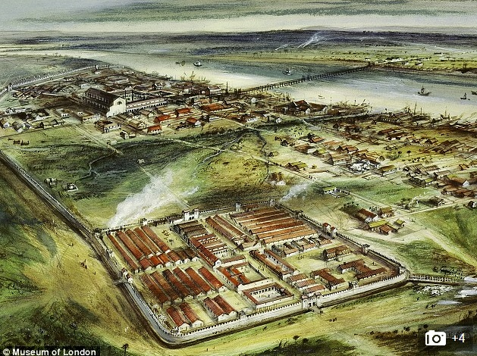
Londinium in Roman Times

Slide 2
HOW LEGISLATION BEGAN
It all began in London, as London was the only ‘large’ urban dwelling place – about 1000 inhabitants.
As early as 1189 regulations were in force – generally to prevent fires.
After a major London fire in 1212, thatched roofs were banned within the City of London.
Complaints about building nuisances could be brought against a neighbour through Court, called the Assize of Nuisance.

Slide 3
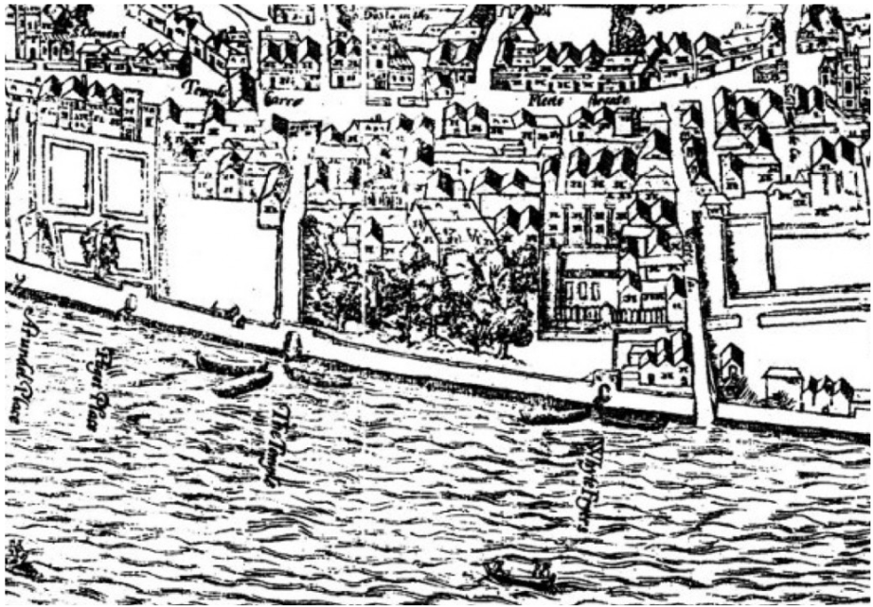
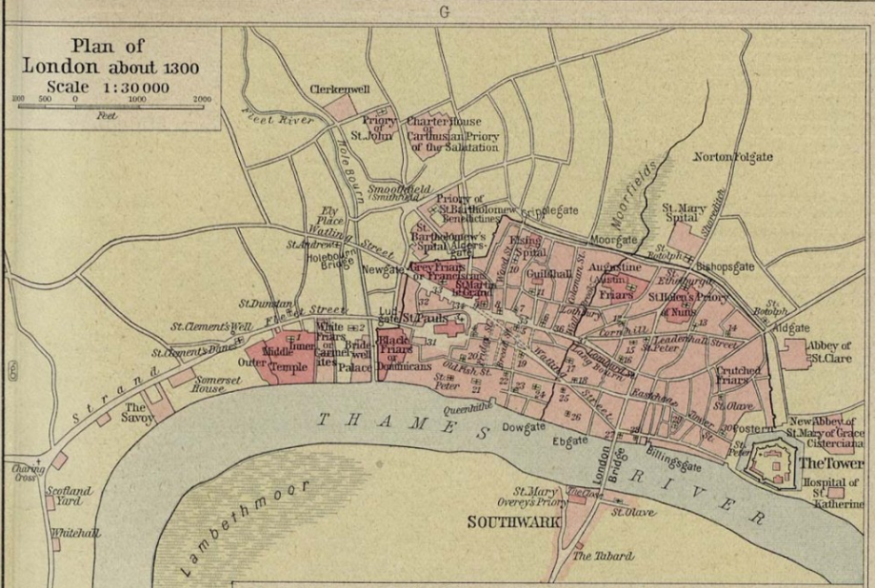
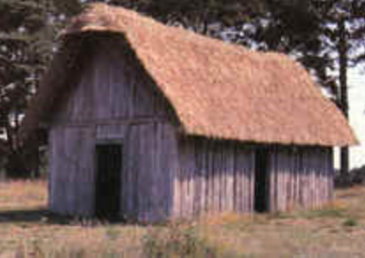
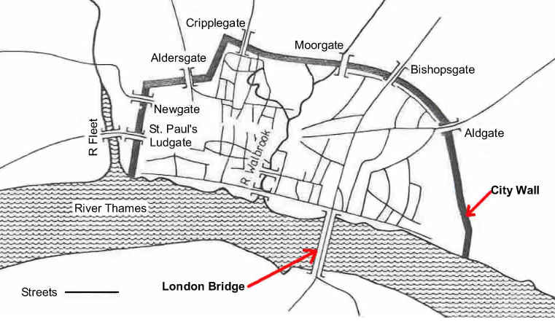
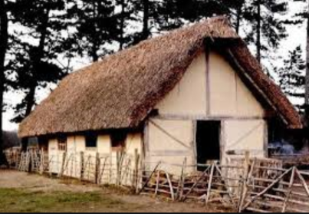
Area Covered by the City of London

Slide 4
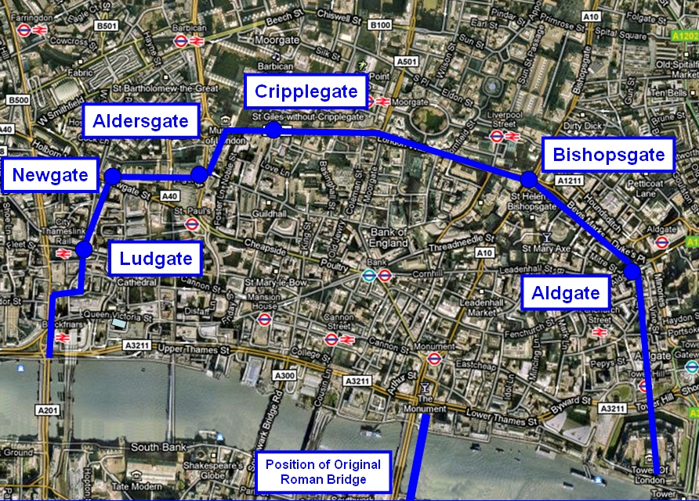
City of London Wall superimposed on a Google Earth image

Slide 5
The Late Medieval Period
1300-1500 AD
By 1300 AD, over 30 towns had over 5000 inhabitants.
London’s population would have been about 100,000 inhabitants, both inside and outside of the city wall.
As living space became limited, houses with multiple stories were built and to support the extra storeys, the upper floors were jettisoned over the ground floor.

Slide 6

London, September 1st, 1666
By this date, London had over a half million inhabitants

Slide 7
London, September 2nd, 1666
The Great Fire of London was a major conflagration that swept through the central parts of the city of London, from Sunday, 2nd September to Wednesday, 5th September 1666.
The fire gutted the medieval City of London inside the old Roman city wall.

Slide 8
Cause & Spread of the Fire
The Great Fire started at the bakery of Thomas Farriner on Pudding Lane.
The fire consumed 13,200 houses, 87 parish churches, St. Paul's Cathedral and most of the buildings of the City authorities.
It is estimated to have destroyed the homes of 70,000 of the City's 80,000 inhabitants.

Slide 9
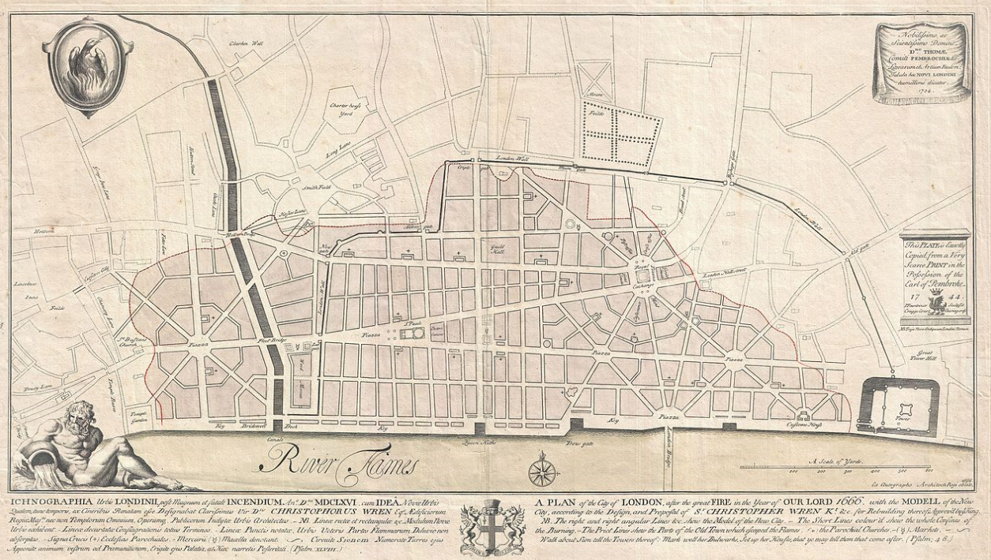
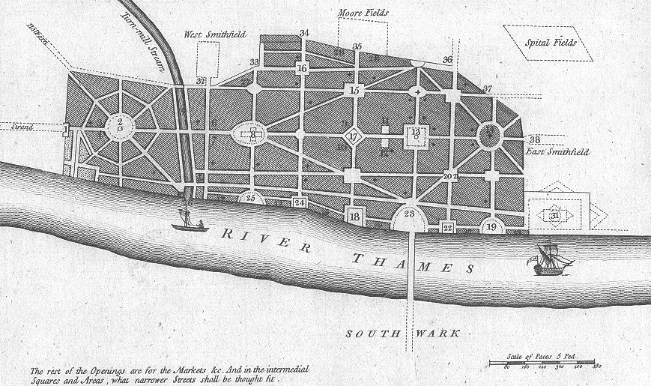
The Aftermath
Christopher Wren’s Proposal
John Evelyn’s Proposal

Slide 10
The Aftermath
None of the submitted designs were accepted by King Charles 11.
The City was largely rebuilt upon the same design and street layout due to disputes in land ownerships.
Much of the old street plan was recreated in the new City, with improvements in hygiene and fire safety: wider streets, open and accessible wharves along the length of the Thames, with no houses obstructing access to the river, and, most importantly, buildings constructed of brick and stone, not wood.

Slide 11
The Aftermath
In 1667, the London Building Act came into force.
It laid down that all houses were to be built in brick or stone. The number of storeys and width of walls were carefully specified. Streets should be wide enough to act as a fire break. This first Act applied to the walled City of London.

Slide 12
The Beginning of Building Control
The Building Acts of 1707 and 1709 extended that control to Westminster. They added a prohibition on timber cornices and required brick parapets to rise two and half feet above the garret floor. A comprehensive Act in 1774 covered the whole built-up area. Its detailed set of regulations included the stipulation that doors and windows should be recessed at least four inches from the front of the building. (The statute set a fashion which was soon emulated outside London.)

Slide 13
The Rise of Building Control
By the 18th century some kind of building control had been established in many British cities.
The London Building Acts provided prototypes for provincial towns.

Slide 14
Improvement Acts
Towns sought to tackle a variety of problems through local improvement Acts. An Act of Parliament in 1757 established the Wide Streets Commission for Dublin. It operated until 1851, generating minute books, architectural drawings and maps, which are held by Dublin City Archives. Between 1800 and 1845 nearly 400 improvement Acts were passed for 208 towns in England and Wales. They might be concerned with street cleaning and lighting, or more ambitious.
Acts for creating new streets and widening old ones gave the local authority at least a limited degree of building control.
However, Building Regulation was a patchwork of different provisions in different places.

Slide 15
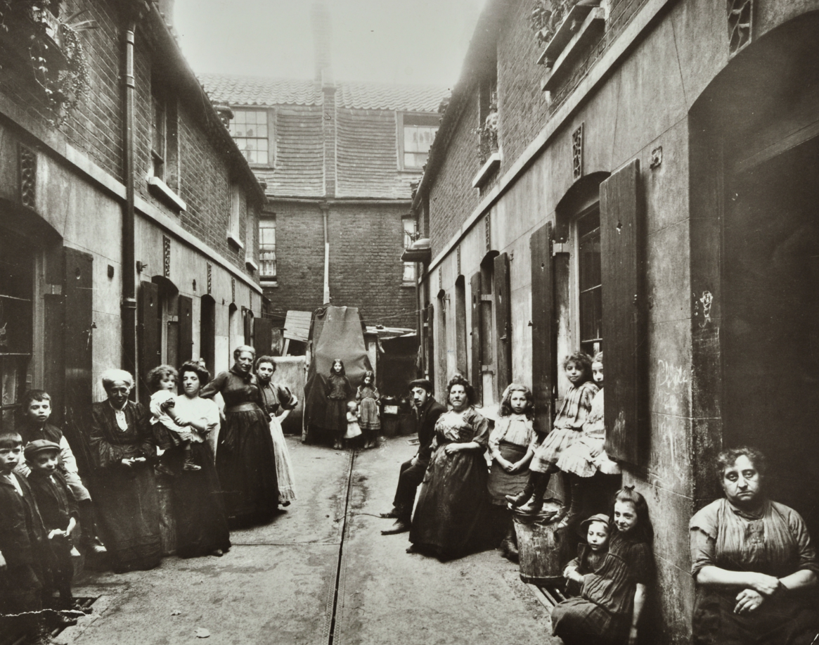
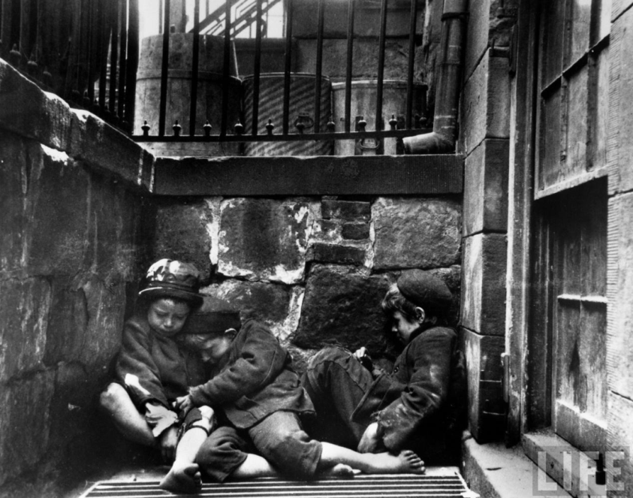
Early Victorian Period
Concern mainly about the urban poor and their living conditions.
Cholera was rife.

Slide 16
Mid to Late Victorian Period
It was a series of Public Health Acts that established a more consistent apparatus for controlling the urban fabric. The first such Act in 1848 had limited impact on buildings, but laid out the framework of local authority in England and Wales, known initially as boards of health. The Local Government Act of 1858 extended the powers of these local authorities to regulate the structure of buildings through bye-laws. The government issued a set of guidelines called the Form of Bye-laws, which were followed quite closely by most English and Welsh urban authorities in the 1860s. The Public Health Act of 1875 and associated Model Bye-laws consolidated building.

Slide 17
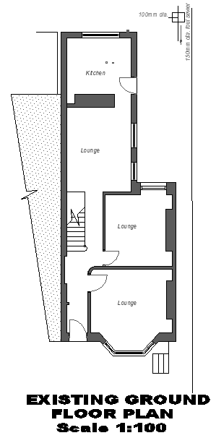
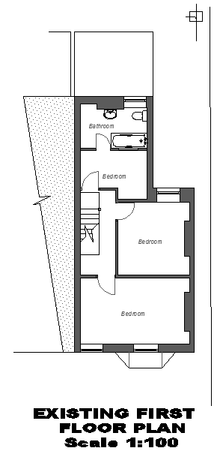
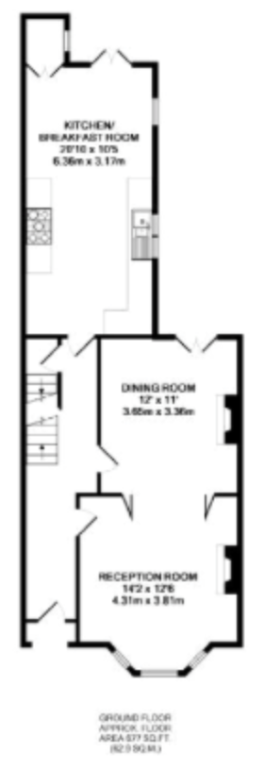
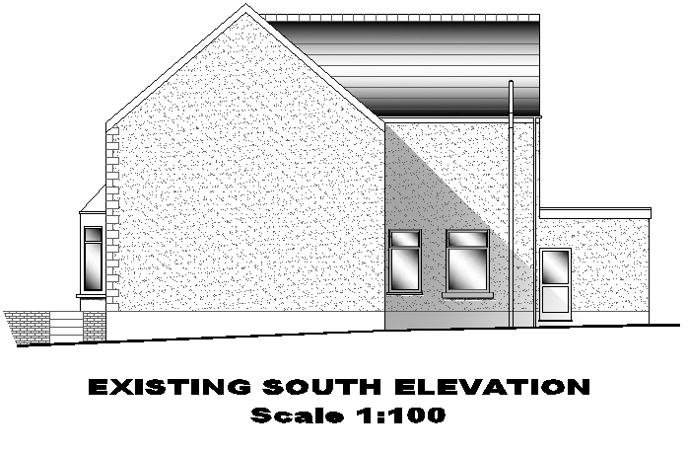
Mid to Late Victorian Period
The Act of 1858 permitted local boards in England and Wales to require the deposit of plans for any new buildings or alterations.

