Slide 1
Digital Transformation in the Health and Care Professions (BMHP6026)
Component 2 Assessment
Student name: Tonye Tikili
Student ID:2335476

Slide 2

Use of AI Acknowledgement
I acknowledge I did not use AI to do my work.

Slide 3

Introduction to Telemedicine/Virtual Consultation
Telemedicine is a video or telephone consultation
used between clinicians and patients outside
clinical settings.
Has been used in the UK for over 10 years,
with major expansion from
2019 onwards.
It had rapid national adoption during COVID‑19
It also supports digital-first care and remote
access
(Greenhaigh et al., 2021) www.freepick.com
www.freepick.com

Slide 4

Impact on Workforce
GPs, ANPs, and AHPs shift from face‑to‑face clinics to digital triage
and screen‑based schedules
Admin staff become digital navigators (connectivity support, digital
triage and routing.
Clinicians rely on visual/auditory cues instead of physical examination
Increased screen time and higher cognitive load
Reduced peer interaction, professional isolation and burnout.
( Hughes et al., 2022).
www.ctol.digital

Slide 5
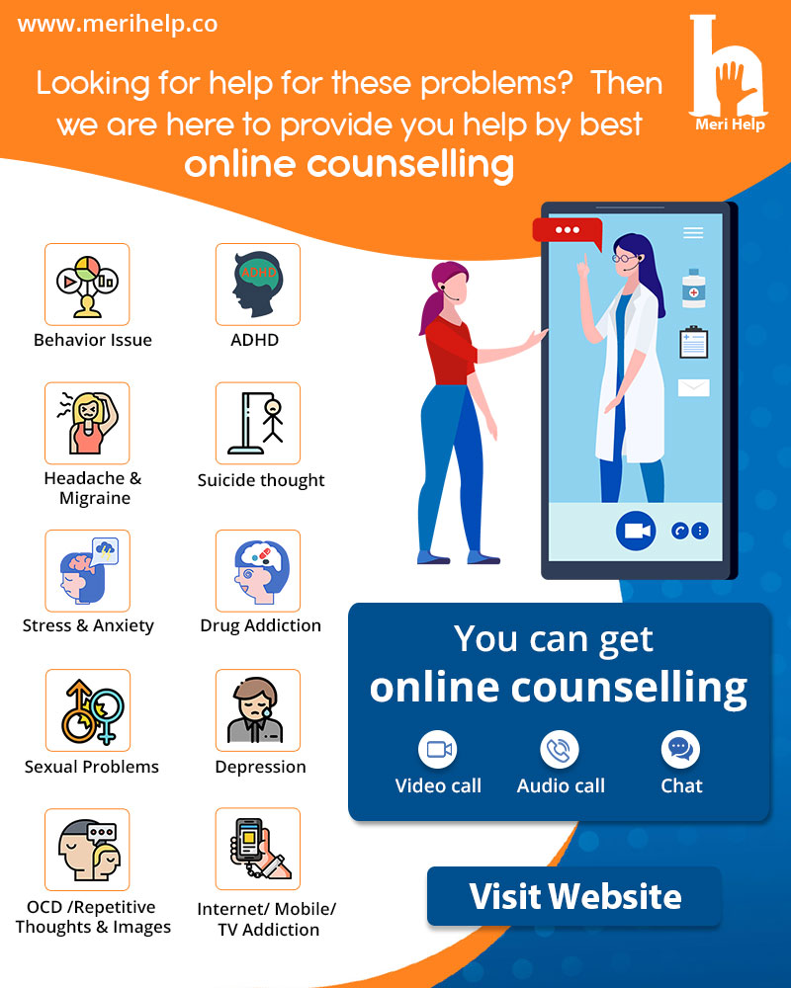
Impact on service delivery
Automated digital triage replaced receptionist-led system.
Reduced footfall and improved space utilisation.
Lower DNA rates and more flexible scheduling.
(Turner et al., 2021).
Healthdrop.in

Slide 6
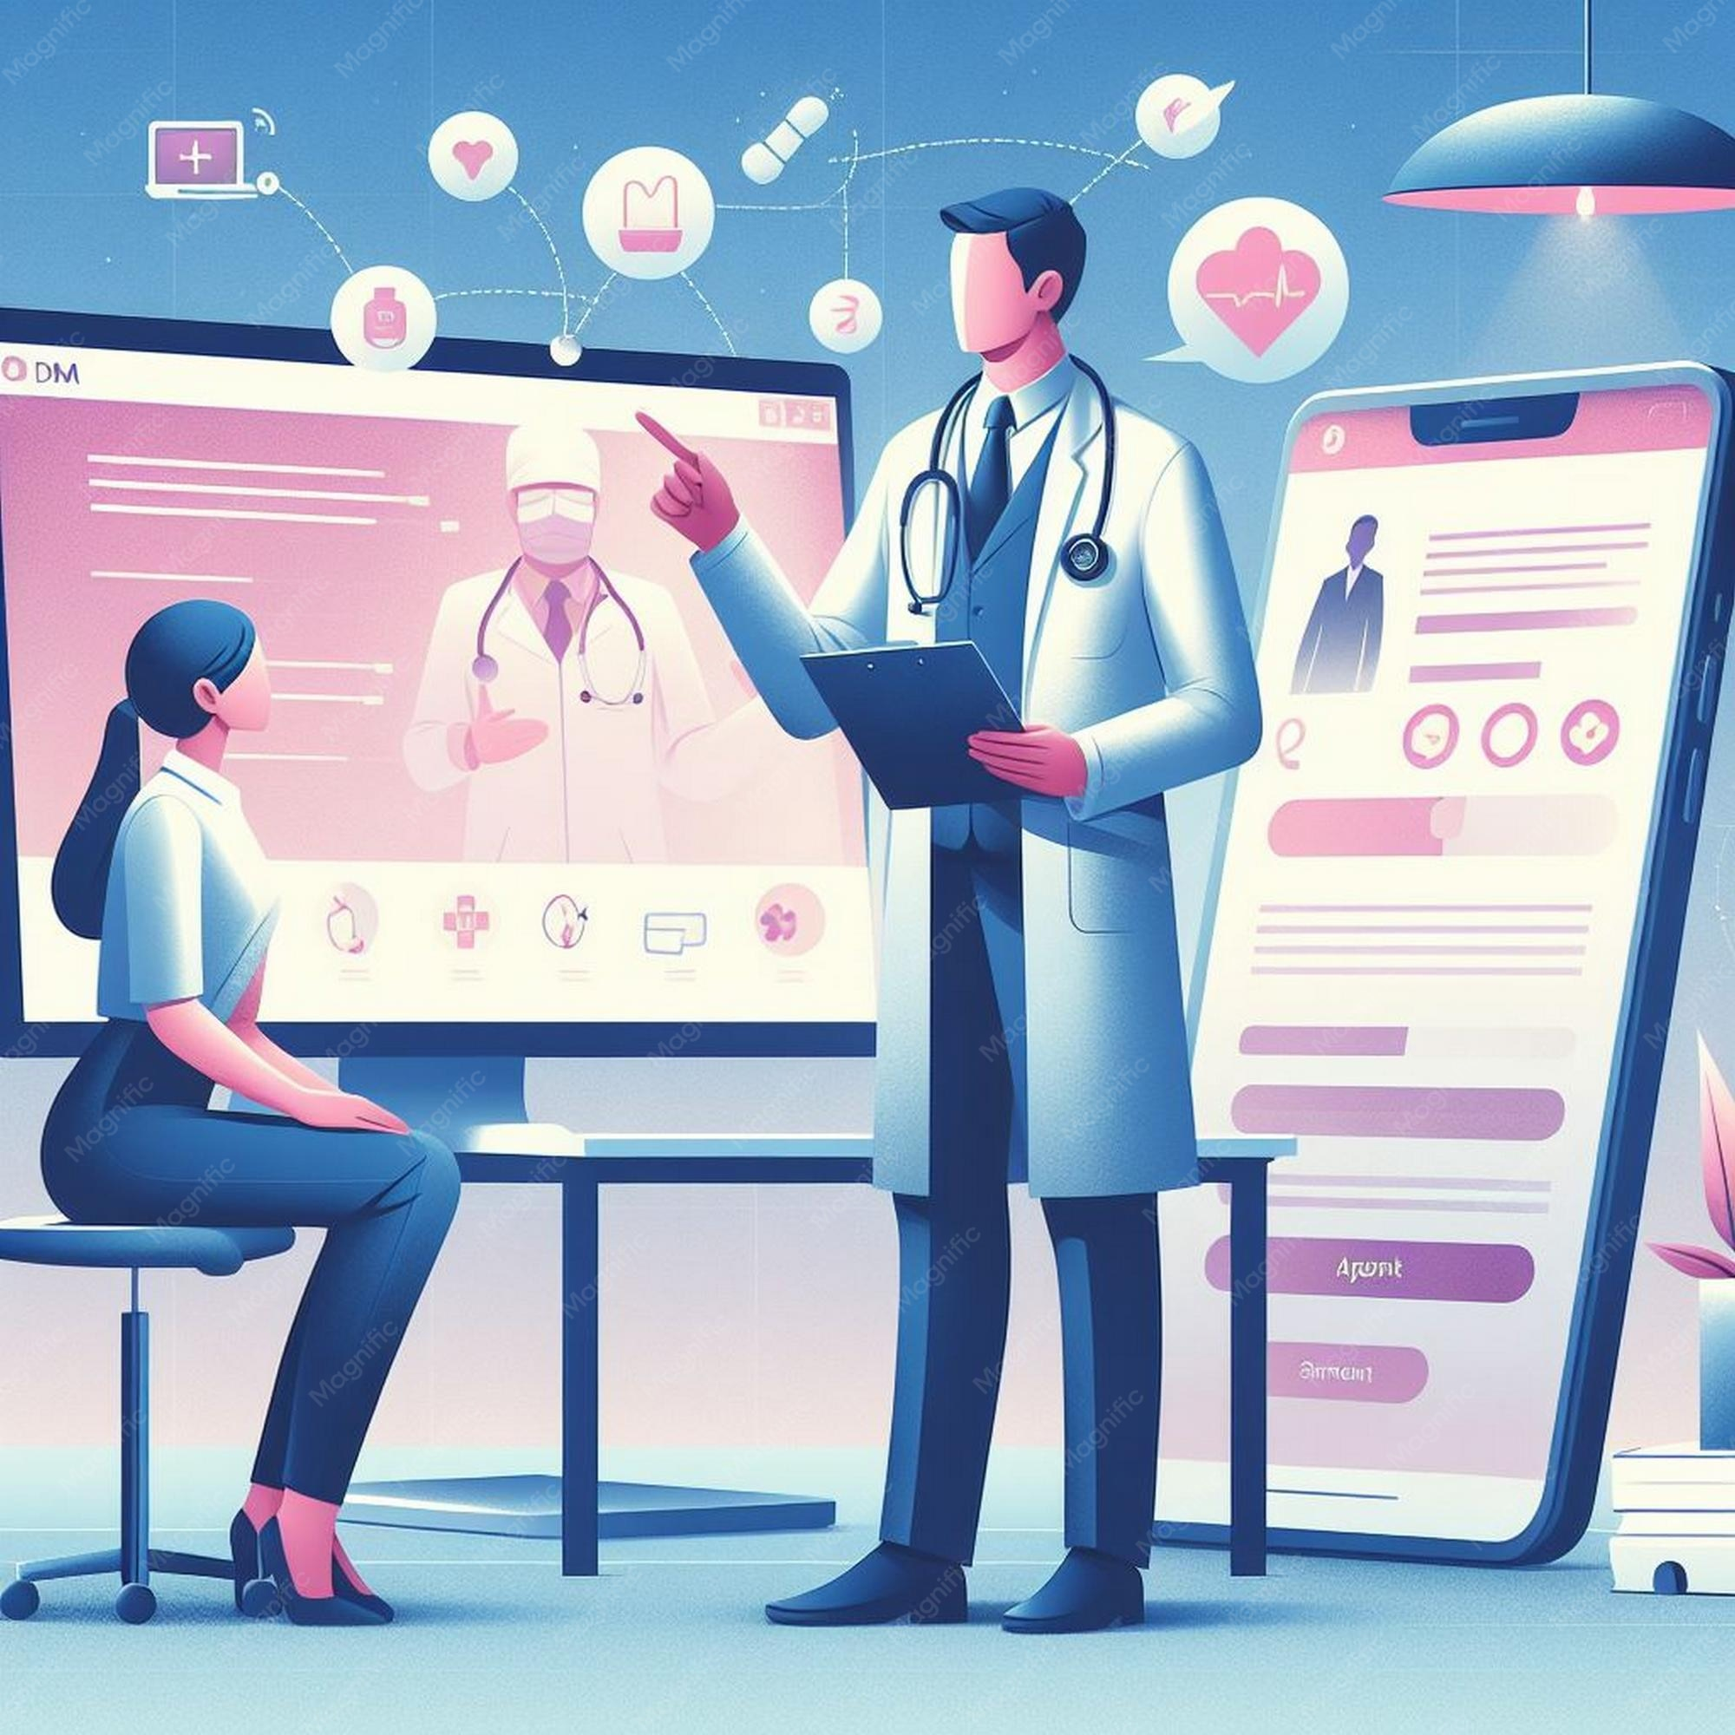
Impact on patients
Greater convenience and reduced travel burden.
Enhanced autonomy for digitally literate users.
Reduced therapeutic presence and rapport. (Greenhalgh et al., 2016)
www.freepik.com

Slide 7
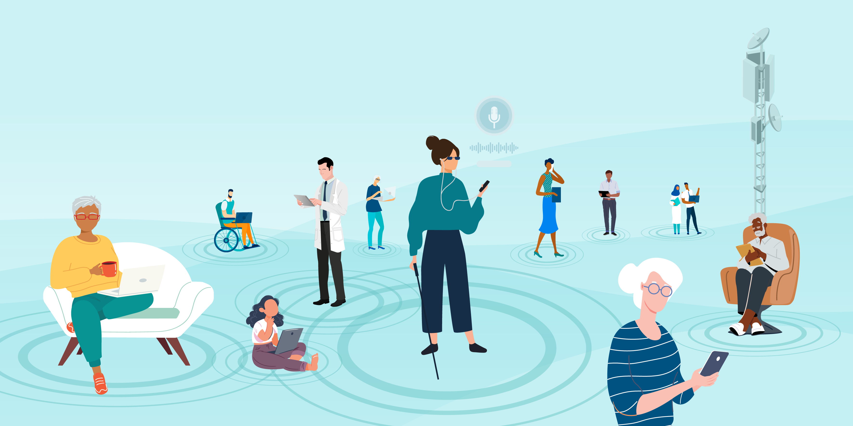
Impact on community
Digital exclusion affects older adults, low‑income households, and people
with limited digital literacy.
Families often act as unpaid technical support, increasing carer burden.
Community access becomes uneven, favouring digitally confident groups.
Loss of incidental observations, mobility, and safeguarding cues
(Kyratsis, 2026).
Reduced opportunities for preventative public health interventions.
(Mold et al., 2021).
Storage.googleloopies.com

Slide 8
Challenges of the innovation
Advantages of innovation
Rapid digital transformation requires significant workforce adaptation.
Clinicians must develop new digital communication and safeguarding skills (Karibdzhanov, 2026).
Loss of physical examination reduces diagnostic certainty.
Technology failures (poor connectivity, device issues) can disrupt consultation.
Disadvantages of the Innovation
Limited ability to assess non‑verbal cues and physical symptoms.
Increased clinician anxiety around medicolegal risks.
Higher administrative workload due to follow‑up appointments.
Not suitable for complex or sensitive cases. (Donaghy et al., 2019).

Slide 9
Recommendations
Adopt hybrid care pathways.
Strengthen digital literacy training for staff and patients.
Improve accessibility for digitally excluded groups.
Support families with guidance to reduce technical burden
(Bangla, Kapoor & Jeer, 2026).

Slide 10
Conclusion
Telemedicine improves efficiency and convenience.
Challenges include workload, reduced holistic care, and digital exclusion.
Hybrid models ensure safe, equitable, person‑centred care.
(Greenhalgh et al., 2022).

Slide 11
References
Bangla, S., Kapoor, A., & Jeer, G. (2026). Toward equitable digital health: an integrated framework addressing exclusion, ethics, and implementation across healthcare systems. International Journal for Equity in Health, 10.1186/s12939-026-02903-1. Advance online publication. https://doi.org/10.1186/s12939-026-02903-1
Donaghy, E., Atherton, H., Hammersley, V., McNeilly, H., Bikker, A., Robbins, L., Campbell, J. and McKinstry, B. (2019). Acceptability, benefits, and challenges of video consulting: A qualitative study in primary care. British Journal of General Practice, [online] 69(686), pp.586–594. doi:10.3399/bjgp19x704141
.
Greenhalgh, T. et al. (2022) “Why do GPs rarely do video consultations? qualitative study in UK general practice,” British Journal of General Practice, 72(718), pp. e351–e360. Available at: https://doi.org/10.3399/BJGP.2021.0658.
Greenhalgh, T. et al. (2016) Virtual online consultations: advantages and limitations (VOCAL) study. BMJ Open [online]. 6 (1), p. e009388. Available from: https://bmjopen.bmj.com/content/6/1/e009388 [Accessed 6 August 2026].
Hughes, G., Moore, L., Maniatopoulos, G., Wherton, J., Wood, G.W., Greenhalgh, T. and Shaw, S., (2022). Theorising the shift to video consulting in the UK during the COVID-19 pandemic: Analysis of a mixed methods study using practice theory. Social Science & Medicine, 311, p.115368. https://doi.org/10.1016/j.socscimed.2022.115368
.

Slide 12
Reference
Karibdzhanov C. (2026). The Strategy Implementation Fidelity Gap in Transitional Healthcare Systems. International journal of health care quality assurance, 1–10. Advance online publication. https://doi.org/10.1108/IJHCQA-11-2025-0205
Kyratsis Y. (2026). From bedside to bytes: the digital transformation of the healthcare workforce. Frontiers in digital health, 8, 1777607. https://doi.org/10.3389/fdgth.2026.1777607
NHS England (2019). NHS long-term plan. [online] NHS England. Available at: https://www.longtermplan.nhs.uk/ [Accessed 6 Aug. 2026].
Turner, A., Morris, R., Rakhra, D., Stevenson, F., McDonagh, L., Hamilton, F., Atherton, H., Farr, M., Blake, S., Banks, J. and Lasseter, G. (2021). Unintended consequences of online consultations: a qualitative study in UK primary care. British Journal of General Practice, 72(715), pp e128-e137. https://doi.org/10.3399/bjgp.2021.0426
Vas, V., North, Shirley, Rua, T., Chilton, D., Cashman, M., Malhotra, B. and Garrood, T. (2022). Delivering outpatient virtual clinics during the COVID-19 pandemic: early evaluation of clinicians’ experiences. BMJ Open Quality, 11(1), pp e001313. https://doi.org/10.1136/bmjoq-2020-001313

