Slide 1
PLENTYNDOD Childhood
Lluniadau a Chysyniadau Hanesyddol Historic Constructs and Concepts

Slide 2
PRYD MAE PLANT YN PEIDIO Â BOD YN BLANT? TRAFODWCH.
When do children stop being children? Discuss.
Plentyndod fel lluniad cymdeithasol
Childhood as a social construct
Beth mae gwyddonwyr cymdeithasol yn ei olygu gyda hyn?
Gallwn edrych ar bortreadau o blant yn y cyfryngau
Deddfau sy’n rheoli plant
Hanes plentyndod
Cymryd safbwynt byd-eang
What do social scientists mean by that?
We can look at depictions of children in the media
Laws governing children
History of childhood
Take a global perspective
Notes:
Today we are not taking a global perspective, we are looking at childhood in Wales and the UK and in the Western World.

Slide 3
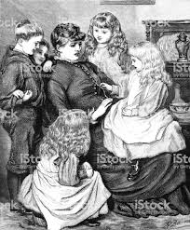
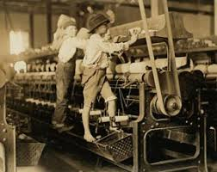
Oedd ‘oedran’ yn rhan o’ch atebion?
Was ‘age’ part of your answers?
Problemau wrth ddefnyddio ‘oedran’ yn derm i ddiffinio diwedd plentyndod.
Tan y bedwaredd ganrif ar bymtheg nid oedd llawer o bobl yn y DG yn gwybod eu dyddiad geni iawn ac roedd rhaid dyfalu eu hoedran.
Yn aml byddai statws oedran yn cael ei farnu yn ôl sut roedd rhywun yn edrych ac yn ymddwyn.
Problematic using ‘age’ as a defining term for the end of childhood.
Until the nineteenth century many people in the UK did not know their actual date of birth and had to guess as to their age.
Age status was often judged by how a person looked and behaved.
(Hicks, 2010)

Slide 4
Legal definitions relating to age
Diffiniadau cyfreithiol ynghylch oedran
Yng Nghymru, ar ba oedran gallwch wneud y canlynol yn gyfreithlon:
Cael dedfryd o garchar os cewch euogfarn o drosedd?
Yfed cwrw neu win gyda phryd o fwyd mewn tŷ bwyta trwyddedig?
Ymfudo heb eich rhieni?
Cydsynio i driniaeth feddygol neu ddeintyddol?
Bod â hawl gyfreithiol i gael eich clywed?
Prynu anifail anwes?
Rhoi tystiolaeth mewn llys barn?
Bod mewn gwaith rhan-amser?
Cael eich pasbort eich hun?
In Wales, at what age can you legally:
Be given a custodial sentence if convicted of a crime?
Drink beer or wine with a meal in a licensed restaurant?
Emigrate without your parents?
Consent to medical or dental treatment?
Have a legal right to be heard?
Buy a pet?
Give evidence in a court of law?
Be in part-time employment?
Hold your own passport?

Slide 5
Let’s do ‘a Google’: Childhood UK or Childhood
Gadewch i ni chwilio ar Google: Childhood UK neu Childhood
Beth yw’ch barn ar ôl dadansoddi’r lluniau a’r erthyglau cysylltiedig?
Ydy hon yn ffordd ddefnyddiol o feddwl am y modd y mae plentyndod wedi’i lunio?
What do you think after analysing the images and linked articles?
Is this a useful way to think about how childhood is constructed?

Slide 6
Gweithgaredd:
Activity:
Cofiwch y lluniau o blant a oedd yn rhan o’ch plentyndod.
Beth roedden nhw’n ei olygu i chi?
Beth roedden nhw’n ei symboleiddio?
Gweithiwch mewn grwpiau bach / parau a chymryd nodiadau
Remember the images of children that were part of your childhood.
What did they mean to you?
What did they symbolise?
Work in small groups/pairs and take notes

Slide 7
Ydy plentyndod yn well neu’n waeth nawr?
Is childhood better or worse now?
Mae rhai cymdeithasegwyr (ac eraill) yn dadlau bod plentyndod bellach yn llawer gwell nag yr oedd yn y gorffennol. Cyfeirir at y syniadau hyn yn aml fel damcaniaethau ‘gorymdaith cynnydd’(McBlain, Dunne, Luke, 2017)
Yn erbyn y syniadau hyn y mae’r rheini sy’n ystyried bod plentyndod yn waeth mewn llawer ffordd nag yr oedd mewn blynyddoedd blaenorol. Mae rhai o’r syniadau hyn wedi cael eu beirniadu am ddangos barn ramantus am blentyndod yn y gorffennol (Palmer, 2015).
Some sociologists (and others) argue that childhood is now much better than it was in the past. These ideas are often referred to as the ‘march of progress’ theories (McBlain, Dunne, Luke, 2017)
.
Against these ideas are those which see childhood as worse in many ways than it was in previous years. Some of these ideas have been criticised as showing a romanticised view of childhood in the past (Palmer, 2015).

Slide 8
“Fat, spoilt, feral and stupid. Who would be a child or teenager today? They even mistime their coming-of-age, apparently” (Geoghegan, 2008).
Oedd plentyndod yn ddiniwed erioed?
Was childhood ever innocent?
"I think children act like adults at an alarmingly early age," meddai’r Fonesig Jacqueline Wilson, sydd wedi gwerthu mwy na 30 miliwn o lyfrau. Daeth ei sylwadau wrth i arolwg gan ei chyhoeddwr awgrymu bod mwy na hanner rhieni’n credu bod plentyndod bellach drosodd erbyn 11 (Geoghegan, 2008).
"I think children act like adults at an alarmingly early age," said Dame Jacqueline Wilson, who has sold more than 30 million books. Her remarks came as a poll by her publisher suggested that more than half of parents believe childhood is now over by 11 (Geoghegan, 2008).
Notes:
Encourage the students to read the article.

Slide 9
Plentyndod yn ‘well nawr’
Childhood as ‘better now’
gostyngiad yng nghyfradd marwolaethau babanod a gwelliannau gofal iechyd plant
amryw o ddarnau o ddeddfwriaeth sydd wedi tynnu plant o waith amser-llawn ar oedran gynnar, ac wedi cynnig diogelwch i bobl ifanc yn y gwaith (Woodhead et al, 2007)
ymestyniad graddol i’r cyfnod pryd mae plant mewn addysg amser llawn
datblygiad hawliau cyfreithiol i blant
twf gwasanaethau arbennig i blant a rhieni i helpu i sicrhau lles plant
datblygu teganau arbenigol a llenyddiaeth a ystyrir yn ‘briodol i’r oedran’
deddfwriaeth i amddiffyn plant rhag pethau a fyddai’n niweidiol iddynt e.e. cyffuriau, oedolion sy’n cam-drin, dod i gysylltiad â deunydd a ystyrir yn ‘amhriodol’ (Prout, 2005)
the fall in the infant mortality rate and improvements in child healthcare
various pieces of legislation which have removed children from full-time work at an early age, and offered young people protection when at work (Woodhead et al, 2007)
the gradual extension of the period in which children are in full-time education
the development of legal rights for children
the growth of specialist services for both children and parents to help to ensure the wellbeing of children
the development of specialist toys and literature considered ‘age-appropriate’
legislation to protect children from things which would be harmful to them, e.g. drugs, abusive adults, exposure to material considered ‘inappropriate’ (Prout, 2005)

Slide 10
Plentyndod yn waeth nawr
Childhood as worse now
cynnydd o ran gordewdra a phroblemau iechyd ymhlith llawer o blant
cyfraddau uwch o iselder a phroblemau iechyd meddwl (Cymdeithas y Plant, 2019)
anhrefn hinsawdd a cholli bioamrywiaeth (Lawton, 2019)
mwy o bwysau ar blant a phobl ifanc i ‘lwyddo’, yn enwedig ym myd addysg
y niwed a achosir i lawer o blant gan eu teulu’n chwalu
pylu’r ffiniau rhwng plant ac oedolion, gan arwain at ‘golli diniweidrwydd’ (Palmer, 2015)
the rise of obesity and health problems among many children
increased rates of depression and mental health problems (The Children’s Society, 2019).
climate chaos and biodiversity loss (Lawton, 2019)
increased pressures on children and young people to ‘succeed’, especially in education
the damage inflicted on many children by the break-up of their family
the blurring of the lines between children and adults, leading to the ‘loss of innocence’ (Palmer, 2015).

Slide 11
MEDDYLWYR ENWOG AM BLENTYNDOD Famous thinkers on childhood
Philippe Ariès (1960)
Philippe Ariès (1960)
Hanesydd amatur o Ffrainc yn adnabyddus i gymdeithasegwyr oherwydd ei farn bod y syniad o ‘blentyndod’ fel cyflwr ar wahân yn gymharol newydd.
Dywedodd fod y farn fodern am y teulu fel ‘cylch domestig preifat a seilir ar hoffter o’i gilydd’ heb ddod i’r amlwg tan yr ail ganrif ar bymtheg (Woodhead et al, 20017
French amateur historian known to sociologists for his view that the notion of ‘childhood’ as a separate state is relatively new.
He said that the modern view of the family as ‘a private domestic circle founded on mutual affection’ did not emerge until the seventeenth century (Woodhead et al, 20017).
Notes:
He studied medieval writings on age and development, particularly those which
talked about the ‘ages of man [sic]’, and attempted to show which things were
appropriate at different phases of life.
• He looked at the portrayal of children and childhood in medieval art.
• He looked at ideas of how children should dress.
• He looked at the history of games and pastimes.
• He studied the way moralists and others wrote about the idea of childhood
‘innocence’.

Slide 12
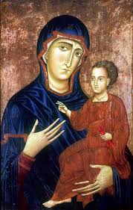
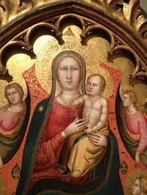
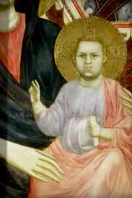
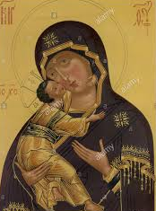
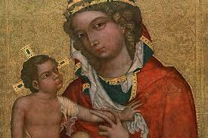
Ariès (1960)
Ariès (1960)
edrychodd ar bortreadau o blant yng nghymdeithas yr oesoedd canol
un o’i osodiadau a ddyfynnir fwyaf aml yw ‘Yng nghymdeithas yr oesoedd canol nid oedd y syniad o blentyndod yn bodoli’ (Woodhead, 2007; t.125).
Fodd bynnag, fel arfer rydym yn darllen ei destun mewn cyfieithiad o’r Ffrangeg gwreiddiol, ac mae Cunningham (1991) yn nodi mai ‘sentiment’ yw’r gair Ffrangeg a gyfieithir yn ‘syniad’, a’i fod hefyd yn gallu golygu ‘teimlad’.
Awgryma Cunningham (1992) fod Ariès yn golygu nad oedd plentyndod yn yr oesoedd canol yn cael ei gydnabod a’i werthfawrogi fel cyfnod penodol (dyfynnwyd yn Clarke, dyddiad anhysbys).
looked at depictions of children in medieval society
one of his most-quoted statements is “In medieval society the idea of childhood did not exist (Woodhead, 2007; p.125).”
However, our reading of his text is usually a translation from the original French, and Cunningham (1991) points out that the French word translated as ‘idea’ is ‘sentiment’, which can also mean ‘feeling’.
Cunningham (1992) suggests that Ariès meant that in medieval times childhood was not recognised and valued as a distinct phase (cited in Clarke, date unknown).
(Edwards, 2015)
Notes:
This led Ariès to develop his claim. For example, his study of medieval painting
suggested that in early medieval art children tended to be portrayed as if they were
small versions of adults. The most common portrayal of a child in medieval European
art was of course the picture of Jesus in innumerable paintings of the Madonna
and Child. You can find some examples at http://www.sjsu.edu/depts/te/cd/cd106/
slide3.html.
Ariès argues that these portrayals show Jesus as a small version of an adult – the
faces have very ‘grown up’ features and the bodies are elongated and developed like
an adult. Only size indicated that a figure was that of a child. This suggests that
medieval artists saw children as simply ‘reduced’ versions of adults. Ariès says:
‘medieval art until the twelfth century did not know childhood or did not attempt
lG
Histories of Childhood 5
to portray it’ (Ariès 1960: 31). This view is reinforced, says Ariès, by the study of
medieval children’s clothing, which was generally simply smaller versions of what
was fashionable for adults. Infants wore baby clothes which were generally the same
for boys and girls, but at about the age of seven people moved on to smaller versions
of adult outfits.
Perhaps most controversially, Ariès and other historians associated with his view
have tended to see childhood in medieval times as having less emotional loading or
significance to their parents. The suggestion is that parents, especially fathers, were
less emotionally tied to children and were less affected by the impact of children’s
illness or death.
From the seventeenth century onwards, Ariès argues, our conception of childhood
in the modern sense begins to develop. This is reflected in art; for example, by the
beginning of the representation of ordinary children (i.e. not Jesus or angels) in
everyday situations and even the portrayal of dead children. This is described as
‘a very important point in the history of feelings’ (Ariès 1960: 352). This change in
sentiment takes two forms: firstly, within families children take on a more central
role: ‘parents begin to recognize pleasure from watching children’s antics and
“coddling” them’ (Ariès 1960: 127). Secondly, among moralists and writers on
social life there begins to emerge an idea of children as fragile beings who need to
be safeguarded and reformed.
It is important before moving on from Ariès to note that his work is essentially
about ideas, not about the reality on the ground. He writes about childhood, not
children, and what he is trying to do is to construct a history of the way people think
about the idea of childhood rather than how individual children were reared or
treated.

Slide 13
Beirniadaeth
Criticism
Yn y bôn, mae’r beirniaid hyn yn gwrthod y farn nad oedd plentyndod yn bodoli yn yr oesoedd canol, ac maent yn beirniadu’r syniad o blentyndod fel dyfais y byd modern.
Ymosodir ar Ariès, de Mause, Shorter a Stone am eu methodoleg ac am y casgliadau y dônt atynt o’r dystiolaeth.
Mae angen mynd ati i astudio perthnasoedd rhieni-plant go iawn mewn hanes yn hytrach na syniadau cyffredinol am ‘deimladau’ (Shahar, 1992).
Dadleua Pollock (1983) ei fod yn gamgymeriad seilio ein delwedd o sut beth oedd plentyndod ar destunau llyfrau cynghori, pregethau a dogfennau eraill sy’n bell o brofiadau go iawn.
Byddai’n eithaf tebyg i dybio y gallem ddisgrifio sut beth yw gyrru ar y ffordd drwy ddarllen yr argraffiad cyfredol o Reolau’r Ffordd Fawr!!
Essentially, these critics reject the view that childhood did not exist in medieval times, and criticize the idea of childhood as an invention of modernity.
Ariès, de Mause, Shorter and Stone are all attacked for their methodologies and for the conclusions they draw from evidence.
There is a need to study actual parent–child relationships in history rather than generalized ideas about ‘sentiments’ (Shahar, 1992).
Pollock (1983)argues that it is a mistake to base our image of what childhood was like on the texts of advice books, sermons and other documents removed from actual experience.
It would be rather like assuming that we could describe what driving is actually like on the roads by a reading of the current edition of the Highway Code!
Notes:
These are represented in diaries, autobiographies and other first-hand
accounts, which she examined for the period 1500 to 1700. If we do that, Pollock
argues, the strongest impression is one of continuity. For instance, she quotes examples
of grief at infant death (from mothers and fathers), from throughout the period, to
show that there was no pattern of indifference. Similarly, she shows that while there
were examples of cruel and brutal child discipline practices these were by no means
the norm and were frequently described by writers so as to condemn them as
undesirable extremes

Slide 14
Synthesis
Synthesis
Cafodd ei waith ddylanwad mawr iawn o ran creu syniadau newydd am blant mewn hanes. Yn benodol, cyfrannodd ei syniadau at gorff cynyddol o ddamcaniaeth a welai’r
teulu’n symud ymlaen o sefydliad a seilid ar anghenion ymarferol ac anghenraid economaidd, gyda fawr ddim neu ddim cynnwys emosiynol, at y syniad modern o’r teulu fel y sefydliad sy’n bodloni anghenion ei aelodau, yn enwedig plant, am gariad a hoffter (Clarke, dyddiad anhysbys, t.5).
Cododd cysyniad newydd o blentyndod rhwng y 15^{fed} a’r 17^{eg} ganrif yn seiliedig ar ‘oedran diniweidrwydd’
Economi emosiynol newidiol o fewn teuluoedd (plant yn cael eu gwerthfawrogi a’u hamddiffyn yn fwy)
Dynodir plentyndod yn ‘gyfnod anaeddfed’ (plant angen eu disgyblu a’u hyfforddi)
His work was extremely influential in generating new ideas about children in history. In particular, his ideas fed into a growing body of theory which saw
the family as progressing from an institution based on practical needs and economic necessity, with little or no emotional content, to the modern idea of the family as the institution which meets the needs of its members, especially children, for love and affection (Clarke, date unknown, p. 5).
New concept of childhood arose between 15th and 17th centuries based on ‘the age of innocence’
Changing emotional economy within families (children became more valued and protected)
Childhood is identified as an ‘immature period’ (children need discipline and training)

Slide 15
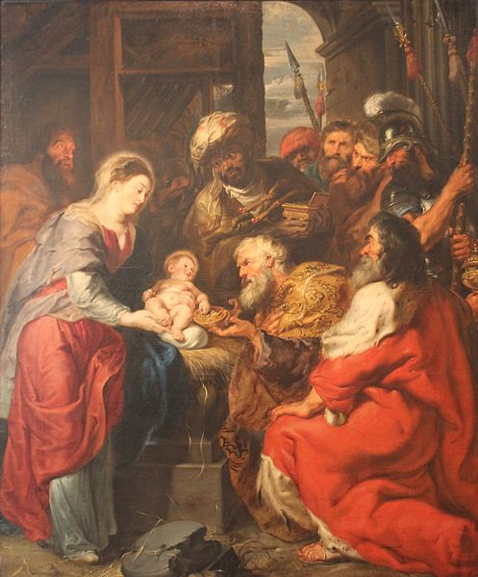
OEDRAN DINIWEIDRWYDD
The Age of Innocence
Astudiaeth gyfeiriol: Gofynnwch i’ch rhieni / neiniau / teidiau / ffrindiau hŷn am eu hatgofion o’u plentyndod.
Beth oedd yn well? Beth oedd yn waeth?
Directed study: Ask your parents/grandparents/older friends about their childhood memories.
What was better? What was worse?

Slide 16
Dimensiynau hanesyddol lluniad cymdeithasol: Atgoffa
Historic dimensions of social construct: Recap

Slide 17
CYFEIRIADAU References
Ariès, P. (1960). Centuries of Childhood. Harmondsworth: Penguin Books.
Children’s Society (2019). The Good Childhood Report. https://www.childrenssociety.org.uk/good-childhood-report
Clarke, J. (date unknown). Histories of Childhood. London Blackwell. http://www.blackwellpublishing.com/content/bpl_images/content_store/sample_chapter/0631233962/wyse%2002chap01.pdf
Cunningham, H. (1991) The Children of the Poor: Representations of Childhood since the Seventeenth Century. Oxford: Blackwell
Geoghegan, T.(2008). Was childhood ever innocent? BBC News (05.03.2008). http://news.bbc.co.uk/1/hi/magazine/7276939.stm
Edwards, P. (2015). Why babies in medieval paintings look like ugly old men. Vox. https://www.vox.com/2015/7/8/8908825/ugly-medieval-babies
Hicks, A. (2010). Child Labor: The Tortured Hands that Modernised the World. https://www.mtholyoke.edu/~hicks22a/classweb/Childlabor/WebsiteChildlabor/index.html
Lawton, G. (2019). The children striking over climate change speak to New Scientist. New Scientist, 15.02.2019 https://www.newscientist.com/article/2194067-the-children-striking-over-climate-change-speak-to-new-scientist/#ixzz5yMWAKwFy
McBlain, S. ; Dunne, J.; Luke, I.; Contemporary Childhood .London: Sage
Palmer, S. (2015). Toxic Childhood. London: Orion
Prout, A. (2005). The future of Childhood. London: Routledge
Ring, E. ;O’Sullivan, L. (2018). Dewey: a panacea for the ‘schoolification’ epidemic, Education 3-13, 46:4, 402-410,
Shahar, S. (1992) Childhood in the Middle Ages. London: Routledge. https://commons.wikimedia.org/wiki/File:Peter_Paul_Rubens_Adoration_of_the_Magi.jpg
Wikimedia (2019). File:Peter Paul Rubens Adoration of the Magi.jpg,
Woodhead, Martin and Moss, Peter eds. (2007). Early Childhood and Primary Education: Transitions in the Lives of Young Children. Early Childhood in Focus (2). Milton Keynes: Open University.

