Slide 1

LCLM4003
Effective Teamwork and Communication
Student Name: Ionut Constantin Teglas
ID: 2411284

Slide 2
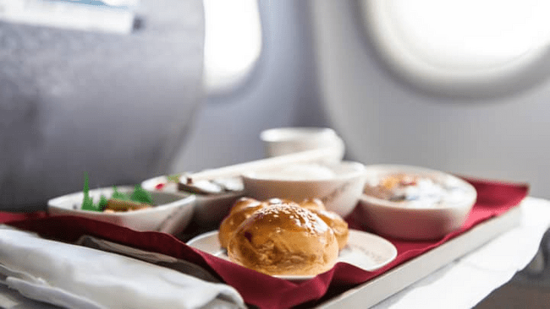
Key Components of the presentation.
Communication Barriers at Flight Foods Ltd.
Impact of Communication Models (Omojuwa, 2025).
Proposed Solutions for Improved Communication.
Leadership and Collaboration
Notes:
This presentation has discussed the communication problems within the Flight Foods Ltd. company, which was grappling with low-quality food materials and customer complaints. It will examine the impact of language barriers, cultural differences, and the absence of formal training on these problems. Based on Shannon and Weaver's, Schramm and Berlo's SMCR communication models, we will point out obstacles that are crucial to effective communication between the floor manager and workers (Omojuwa, 2025). Some of the solutions proposed are improvement of language support, application of visual aids, structured training programmes and increasing the feedback mechanisms. The presentation will also talk about how the leadership of Gary can be used to encourage improved collaboration in the team, as well as the practice of food safety measures.

Slide 3

Flight Foods Ltd. Background.
Quality Issues.
Communication Breakdown on the Factory Floor.
Impact on Business and Reputation(Jainudeen Nawwas, 2025).
Notes:
Flight Foods Ltd. Background.
Flight Foods Ltd. is a medium-sized firm which deals in making ready meals for airlines to meet the unique demand of catering to in-flight food services. Though the company has a niche market, the firm has been unable to gain market share and instead has been experiencing a reduction in business. Airlines have also been complaining of the quality of the food served, including the undercooking, improper packaging, and contamination of the food, including the meat in vegetarian meals (Jainudeen Nawwas, 2025). The crux of the matter is the lack of their communication on the factory floor, where the very diverse non-professional workforce has caused the asymmetrical food safety measures and customer dissatisfaction.

Slide 4

The Communication Problem
Diversity and Language Barrier.
Ineffective Communication Methods (Grace et al., 2019).
Lack of Formal Food Hygiene Training.
Impact on Food Quality and Business
Notes:
The Communication Problem
The Flight Foods Ltd. company has major communication issues on the factory floor, and the main reason is the diversity of the staff with different degrees of English proficiency. This language hurdle does not allow the floor manager, Gary, to pass most of the necessary information about food safety. On-the-job training and the use of written signs to communicate hygiene standards have not worked sufficiently in Gary. A good number of workers, who have minimal knowledge in English, do not stick to instructions and resulting in food safety infractions, such as undercooked foods and improper packaging. As well, the absence of formal food hygiene training worsens the situation since the workers are guided by informal training that is not uniform (Grace et al., 2019). This lack of communication leads to low quality of food, customer complaints and loss of business.

Slide 5
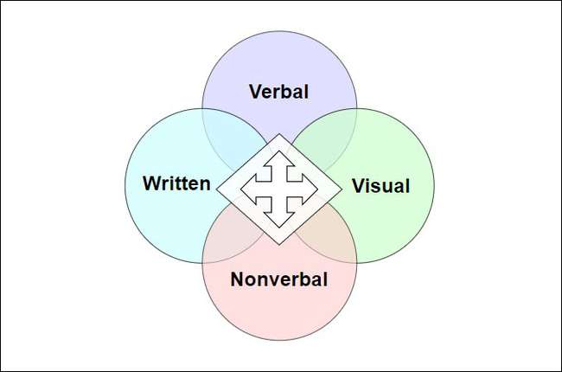
The Communication models
Shannon and Weaver Model: Noise and Message Distortion (Kuznar and Yager, 2020).
Schramm Model: Lack of Mutual Understanding.
Berlo's SMCR Model: Streamlining Communication.
Barriers and Communication Failure
Notes:
The Communication models.
In order to discuss the communication problems in Flight Foods Ltd., we utilise major communication models. The Shannon and Weaver Model emphasise the message distortion due to the noise (language barriers, insufficient training) so that workers cannot comprehend the food safety guidelines. The Schramm Model states that there should be a mutual understanding between the sender (Gary) and the recipient (workers), yet the absence of overlap between their areas of experience contributes to the miscommunication (Kuznar and Yager, 2020). The Berlo SMCR Model also explains how communication should be streamlined to make the message effective through aligning the source (Gary), message (food hygiene instructions), channel (verbal and written), and receiver (workers). These models show how barriers of language and a lack of feedback facilitate the communication failure at Flight Foods Ltd.

Slide 6

Shannon and Weaver Model -Applying to Case Study
Sender and Message.
Noise and Barriers (Onuegwunwoke and Umezuruike, 2025).
Receiver and Misunderstanding.
Feedback and Consequences
Notes:
Shannon and Weaver Model -Applying to Case Study.
The Shannon and Weaver Model of communication depicts the communication failures in Flight Foods Ltd. Gary is the sender in this model, who attempts to share the food safety practices with his workers. The message contains information concerning hygiene, including the use of hairnets and frequent hand washing. But the communication medium, i.e. verbal teaching and signs, is rendered ineffective because of noise, in this instance, the language barrier and cultural differences. The workforce is the receiver, and they find it difficult to comprehend the message because they have very poor English and were not trained on food hygiene (Onuegwunwoke and Umezuruike, 2025). Gary cannot establish whether his instructions are followed or understood due to the lack of clear feedback from the workers. This lack of proper communication translates into handling of food poorly and receiving repeated customer complaints, thus the critical importance of proper and effective communication with regard to monitoring food safety levels.

Slide 7

Schramm Model of Communication
Mutual Interpretation and Communication Gap.
Lack of Overlap in Knowledge.
The Need for Adaptation (Trkovsky, 2017).
Culturally Appropriate Communication Methods
Notes:
Schramm Model of Communication.
The Schramm Model of Communication highlights the aspect of mutual interpretation between the receiver and the sender during the process of communication. Gary, the sender, is highly experienced in terms of food hygiene in this case, yet the workers do not comprehend his message to the full extent. The workers are the receivers whose field of experience is different - different cultural backgrounds, low English proficiency, and lack of training in food safety create a communication gap. According to the model proposed by Schramm, effective communication requires the sender and the receiver to have a common ground or a common understanding. But in the case of Flight Foods, there is no overlap between the knowledge of Gary and that of the workers, leading to miscommunication (Trkovsky, 2017). To address this disparity, Gary would have to adjust his message, which can be done with visual aids or other culturally friendly choices in order to guarantee common food hygiene practice comprehension among all his team of varied people.

Slide 8
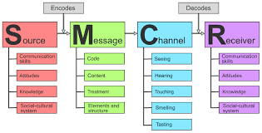
The Berlo SMCR Model
Source and Message.
Channel of Communication.
Receiver and Misinterpretation (Chammem, 2018).
Improving the Communication Process
Notes:
The Berlo SMCR Model
The communication failures at Flight Foods Ltd. can be explained with the help of the Berlo SMCR Model (Source- Message-Channel-Receiver). In the model, Gary is the source, and he knows food hygiene, attempting to transfer knowledge about food safety measures. But the message that he conveys, e.g. hygiene practices are not properly interpreted by the workers. The medium of interaction represents a combination of oral directions and written notes, which cannot be effective among employees with low English skills. The recipients or those who receive the product, the factory workers, are people of different cultural backgrounds and with different understandings of food safety practices (Chammem, 2018). According to the model, the communication breakdown can be explained by the lack of a match between the knowledge of Gary and the little knowledge that the workers have. In order to enhance such a process, a message and channel should be modified with the help of visual helps and more easily multi-lingual directions, which will guarantee the successful communication and implementation of food safety rules.

Slide 9
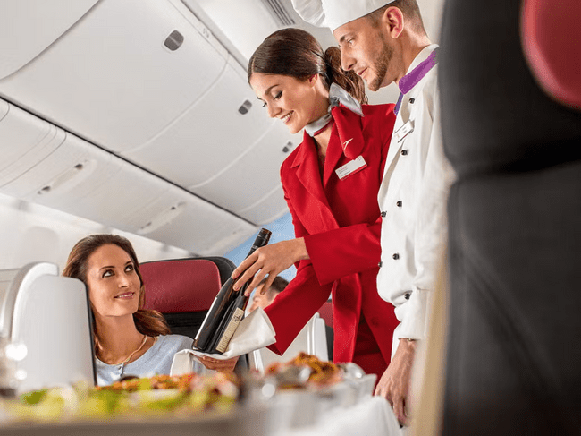
Things in the Way of Communication in Flight Foods Ltd.
Language Barrier.
Cultural Differences.
Lack of Formal Training (World Health Organisation, 2022).
Ineffective Communication Channels
Notes:
Things in the Way of Communication in Flight Foods Ltd.
Flight Foods Ltd. has several major hindrances to communication that restrict the transfer of food safety information. The biggest one is the language barrier, where there are a lot of workers of different languages and very little proficiency in English, which causes misinterpretation of food hygiene regulations. The issue of cultural differences also poses a challenge because the workers with different experiences might lack a comprehensive understanding of the priority of Western food safety practices (World Health Organisation, 2022). Moreover, formal training is also lacking, and workers are not taught proper food hygiene, meaning they have to learn through informal means and in the course of the job. The problem is also further aggravated by ineffective channels of communication, like over-utilisation of verbal communication and written signs. Customer complaints and loss of business, represented by these barriers, lead to poor food handling and non-observation of hygiene protocols.

Slide 10

Minimising Obstacles to Communication.
Addressing the Language Barrier.
Cultural Sensitivity Training (Estala-Gutierrez, 2021).
Use of Visual Aids and Signage.
Formal Training and Feedback Systems
Notes:
In order to minimise the communication barriers at Flight Foods Ltd, there are a number of strategies that can be deployed. To start with, we should improve the language barrier, that is, hiring bilingual managers or a translation service to bridge the gap in communication between Gary and the employees (Estala-Gutierrez, 2021). Training on cultural sensitivity would also enable the workers to familiarise themselves with various food safety standards and practices. The use of visual aids and signage that is easily identifiable through a distinct set of symbols and images would be used in order to overcome the language variations so that key messages will be easily interpreted by the entire workforce. They should also strive to employ formal training programmes in food hygiene in various languages to ensure workers are well-trained on matters related to hygiene. Further, feedback systems should be developed, where Gary can oversee the knowledge of the workers and the compliance with food safety norms. These measures will enhance the exchange of information, decrease misinterpretation, and instil a spirit of adhering to persons' standards of food safety.

Slide 11
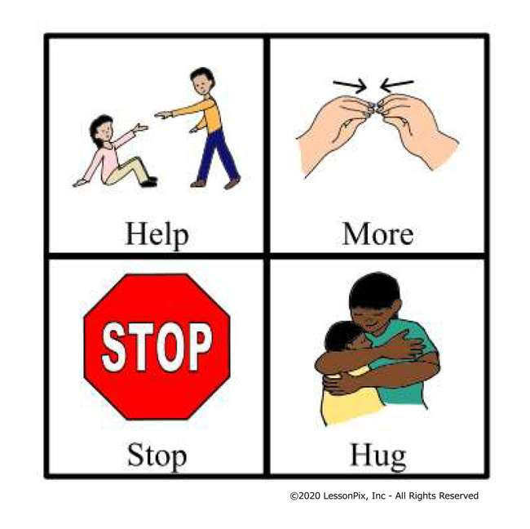
Better Communication: Visual Aids and Signage.
Overcoming Language Barriers.
Strategic Placement of Visual Tools. (Lailiyah et al., 2024)
Colour-Coded Charts and Stepwise Instructions.
Bold, Easy-to-Read Reminders
Notes:
Better Communication: Visual Aids and Signage.
Flight Foods Ltd. needs the use of visual aids and signage to overcome language barriers as well as to reinforce food safety standards in order to enhance communication (Lailiyah et al., 2024). The most important hygiene habits, such as handwashing, hairnet use, and keeping the food at the right temperature, should be reflected using clear and simple pictograms and symbols. These images can be posted in places where the workers regularly spend a lot of time, so that whenever they are on duty, they are able to look at them. As an illustration, workers could be guided better by colour-coded charts that demonstrate the proper storing elevations of various foods or stepwise examples of how to properly handle food. Also, large and easy-to-read posters will serve as a reminder with messages such as "Keep Meat Chilled" or "Wash Your Hands" in bold letters. Through visual communication, Flight Foods is able to guarantee that its workers, despite their language knowledge or otherwise, comply with the important requirements in food safety that enhance the quality of products and the satisfaction of consumers.

Slide 12

Organising a systematic Training Programme.
Formal Training for New Employees.
Tailored Training with Visual and Practical Methods.
Periodic Refresher Courses (Abdelhakim, 2016)
Evaluations and Continuous Improvement
Notes:
Organising a systematic Training Programme.
Simple training is not sufficient because all workers at Flight Foods Ltd. should be trained adequately to meet food hygiene and safety standards. All new employees must be made to go through formal training where emphasis must be placed on some of the essential food safety measures, like proper food storage, food handling, and personal hygiene. In order to suit the various workforces, training ought to be conducted in different languages and with visual materials which incorporate practical demonstrations, visual variables and evaluations. Periodically, the refresher courses would be provided to consolidate the learning and other new procedures or safety updates (Ruttenberg et al., 2020). Further, the workers will be evaluated upon the conclusion of every session to determine the level of understanding and to make sure the workers can put the principles into practice. Through a structured, continuous training course, Flight Foods will be able to increase adherence to hygiene standards, decrease food safety offences (Abdelhakim, 2016), and develop a better-informed and more responsible staff, which will result in elevated product quality and customer satisfaction eventually.

Slide 13

Leadership and Management Strategies by Gary
Implementing a Structured Training Plan.
Adopting a Participative Leadership Style (Garber, 2024).
Delegating Responsibilities to Bilingual Supervisors.
Regular Feedback and Problem-Solving Meetings
Notes:
Leadership and Management Strategies by Gary.
To reduce the communication barriers and enhance food safety at Flight Foods Ltd, Gary, as the floor manager, must use a more organised and effective leadership and management style (Garber, 2024). First, Gary ought to have a better, more formal training plan for all new employees so that before the employees get their jobs, they are well educated on food hygiene practices in a consistent manner. His leadership approach must change to a participative one where open communication and feedback by workers are promoted so that they can know and adhere to safety practices. Gary can also delegate the work to the bilingual supervisors or the senior workers to assist in communication and can lessen the number of his workload. Feedback meetings held regularly should be provided, and Gary would just have to determine whether workers are conversant with the food safety guidelines and provide solutions to any problems or misconceptions. Gary can enhance worker engagement and compliance with safety standards by encouraging a more inclusive, supportive, and organised type of leadership, which will eventually lead to an increase in the quality of produced food.

Slide 14
Conclusion
To sum up, communication issues in Flight Foods Ltd. are caused by various barriers, such as language obstacles, cultural misunderstandings, and the absence of formal training. Poor food safety and complaints by customers have been part of these problems, which have caused a deterioration of business. Using the models of communication, which include Shannon and Weaver, Schramm, and Berlos SMCR, we can see that to resolve these issues, there is a need to enhance communication between Gary and his diverse workforce. Solutions (such as visual aids, organised training programmes, more effective leadership strategies, etc.) will be suggested to minimise misunderstandings, improve food safety compliance and regain customer satisfaction. Through these changes, Flight Foods can enhance internal communication, food safety, and recover its market share, and this will lead to its long-term success.
Notes:
Conclusion
To sum up, communication issues in Flight Foods Ltd. are caused by various barriers, such as language obstacles, cultural misunderstandings, and the absence of formal training. Poor food safety and complaints by customers have been part of these problems, which have caused a deterioration of business. Using the models of communication, which include Shannon and Weaver, Schramm, and Berlos SMCR, we can see that to resolve these issues, there is a need to enhance communication between Gary and his diverse workforce. Solutions (such as visual aids, organised training programmes, more effective leadership strategies, etc.) will be suggested to minimise misunderstandings, improve food safety compliance and regain customer satisfaction. Through these changes, Flight Foods can enhance internal communication, food safety, and recover its market share, and this will lead to its long-term success.

Slide 15
References
References
Abdelhakim, A.S.F., 2016. Cabin crew food safety training: an exploratory study (Doctoral dissertation, Cardiff Metropolitan University).
Chammem, N., Issaoui, M., De Almeida, A.I.D. and Delgado, A.M., 2018. Food crises and food safety incidents in European Union, United States, and Maghreb Area: current risk communication strategies and new approaches. Journal of AOAC International, 101(4), pp.923-938.
Estala-Gutierrez, V.Y., 2021. Barriers to Employment as Experienced by Hispanics with Physical Disability and Limited English Proficiency. The University of Wisconsin-Madison.
Garber, P.R., 2024. Identifying Management Styles. In Managing by Remote Control (pp. 79-104). CRC Press.
Grace, D., Dipeolu, M. and Alonso, S., 2019. Improving food safety in the informal sector: nine years later. Infection ecology & epidemiology, 9(1), p.1579613.
Jainudeen Nawas, M., 2025. Optimizing In-Flight Catering: Balance passenger expectation, Operational Efficiency and sustainability.
Kuznar, L.A. and Yager, M., 2020. The Development of Communication Models, Quick Look.
Lailiyah, N., Sanjaya, A. and Wulansari, W., 2024. Communication Without Borders: Integrating Sign Language in Restaurants for Maximum Inclusivity. ASA Jurnal Penelitian Pendidikan dan Pembelajaran, 1(1), pp.71-80.
Omojuwa, B.A., 2025. Exploring the Communication Process Model (Doctoral dissertation, Mount Saint Vincent University).
Onuegwunwoke, C.A. and Umezuruike, K.C., 2025. THE ROLE OF ENGLISH LANGUAGE PROFICIENCY IN PROMTING AWARENESS OF MICROBIOLOGICAL FACTORS IN FOOD INSECURITY IN IMO STATE. IDEAL INTERNATIONAL JOURNAL, 18(1).
Ruttenberg, R., Raynor, P.C., Tobey, S. and Rice, C., 2020. Perception of impact of frequent short training as an enhancement of annual refresher training. NEW SOLUTIONS: A Journal of Environmental and Occupational Health Policy, 30(2), pp.102-110.
Trkovsky, J., 2017. Improved flight safety through effective communication among multicultural flight crew (Doctoral dissertation, Northcentral University).
World Health Organization, 2022. WHO global strategy for food safety 2022-2030: towards stronger food safety systems and global cooperation. World Health Organization.
Notes:
References
Abdelhakim, A.S.F., 2016. Cabin crew food safety training: an exploratory study (Doctoral dissertation, Cardiff Metropolitan University).
Chammem, N., Issaoui, M., De Almeida, A.I.D. and Delgado, A.M., 2018. Food crises and food safety incidents in European Union, United States, and Maghreb Area: current risk communication strategies and new approaches. Journal of AOAC International, 101(4), pp.923-938.
Estala-Gutierrez, V.Y., 2021. Barriers to Employment as Experienced by Hispanics with Physical Disability and Limited English Proficiency. The University of Wisconsin-Madison.
Garber, P.R., 2024. Identifying Management Styles. In Managing by Remote Control (pp. 79-104). CRC Press.
Grace, D., Dipeolu, M. and Alonso, S., 2019. Improving food safety in the informal sector: nine years later. Infection ecology & epidemiology, 9(1), p.1579613.
Jainudeen Nawas, M., 2025. Optimizing In-Flight Catering: Balance passenger expectation, Operational Efficiency and sustainability.
Kuznar, L.A. and Yager, M., 2020. The Development of Communication Models, Quick Look.
Lailiyah, N., Sanjaya, A. and Wulansari, W., 2024. Communication Without Borders: Integrating Sign Language in Restaurants for Maximum Inclusivity. ASA Jurnal Penelitian Pendidikan dan Pembelajaran, 1(1), pp.71-80.
Omojuwa, B.A., 2025. Exploring the Communication Process Model (Doctoral dissertation, Mount Saint Vincent University).
Onuegwunwoke, C.A. and Umezuruike, K.C., 2025. THE ROLE OF ENGLISH LANGUAGE PROFICIENCY IN PROMTING AWARENESS OF MICROBIOLOGICAL FACTORS IN FOOD INSECURITY IN IMO STATE. IDEAL INTERNATIONAL JOURNAL, 18(1).
Ruttenberg, R., Raynor, P.C., Tobey, S. and Rice, C., 2020. Perception of impact of frequent short training as an enhancement of annual refresher training. NEW SOLUTIONS: A Journal of Environmental and Occupational Health Policy, 30(2), pp.102-110.
Trkovsky, J., 2017. Improved flight safety through effective communication among multicultural flight crew (Doctoral dissertation, Northcentral University).
World Health Organization, 2022. WHO global strategy for food safety 2022-2030: towards stronger food safety systems and global cooperation. World Health Organization.

