Slide 1

ECES6021/C
Lles mewn Addysg
Well-being in Education
Sesiwn 2 / Session 2
Iechyd a Lles
Health and Wellbeing

Slide 2

Taith llesol / Well-being walk
Mae'r ymarfer saffari yma yn ffordd dda i helpu plant i ddysgu am feddwl hunan-ymwybyddiaeth ofalgar. Mae'r gweithgaredd yn troi taith bob dydd yn antur newydd gyffrous.
Y nod yw i sylwi ar gymaint o adar, trychfilod, pryfed ac unryw anifeiliaid eraill y gallant weld. Mae unrhyw beth sy'n cerdded, cropian, nofio neu hedfan o ddiddordeb, a bydd angen defnyddio eich holl synhwyrau i'w darganfod, yn enwedig y rhai bychan. (Karen Young, 2017).
Mae'r gweithgaredd yma yn procio'r un ymateb mewn plant ag y mae mynd am dro ymwybodol ('mindful') yn cael ar oedolion sef ymwyddiaeth a sylfaen yn y presennol.
The Safari exercise is a great way to help children learn mindfulness. This activity turns an average, everyday walk into an exciting new adventure.
Tell your pupils that you will be going on a safari: their goal is to notice as many birds, bugs, creepy-crawlies, and any other animals as they can. Anything that walks, crawls, swims, or flies is of interest, and they’ll need to focus all of their senses to find them, especially the little ones (Karen Young, 2017).
This exercise provokes the same response in children that a mindful walk elicits in adults: a state of awareness and grounding in the present.

Slide 3

Nod y Modiwl / Module Aim
Datblygu dealltwriaeth feirniadol o rôl ac effaith llesiant mewn addysg a dadansoddi’n feirniadol yr arferion a’r dulliau sy’n cefnogi hyn.
To develop a critical understanding of the role and impact of well-being in education and critically analyse the practices and approaches which support this.

Slide 4

Deilliannau Dysgu / Learning Outcomes
Archwilio’n feirniadol effaith deddfwriaeth a pholisi ar yr agenda llesiant yn y Deyrnas Unedig o ran addysg.
Critically examine the impact of legislation and policy on the well-being agenda in the UK in relation to education.

Slide 5

Deilliannau Dysgu / Learning Outcomes
Adfyfyrio’n feirniadol ar rôl ac effaith hunanofal i staff, plant a phobl ifanc wrth gyflawni nodau llesiant ehangach.
Critically reflect on the role and impact of self-care for staff, children and young people in achieving wider well-being goals.

Slide 6
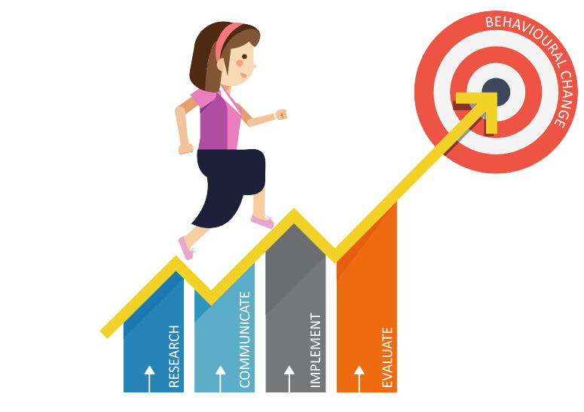
Deilliannau Dysgu / Learning Outcomes
Dadansoddi’n feirniadol ffyrdd o hyrwyddo llesiant cynaliadwy a gwerthuso deilliannau mewn amgylchedd sy’n seiliedig ar addysg.
Critically analyse ways of promoting sustainable well-being and evaluating outcomes in an education-based environment.

Slide 7

Model Bioecolegol Bronfenbrenner (1979)
Bronfenbrenner's Bioecological Model (1979)
Yn ffocysu ar ansawdd a chyd-destun amgylchedd plentyn
System Meicro – amgylchedd agosaf
System Meso – perthnasau/ ymdeimlad o gysylltiad
Yr Ecsosystem – dylanwadau anuniongyrchol
System Macro system—dylanwadau diwylliannol
Focuses on the quality and context of a child’s environment
Micro system – immediate environment
Meso system – relationships/ connectedness
Exosystem – indirect influences
Macro system—cultural influences

Slide 8
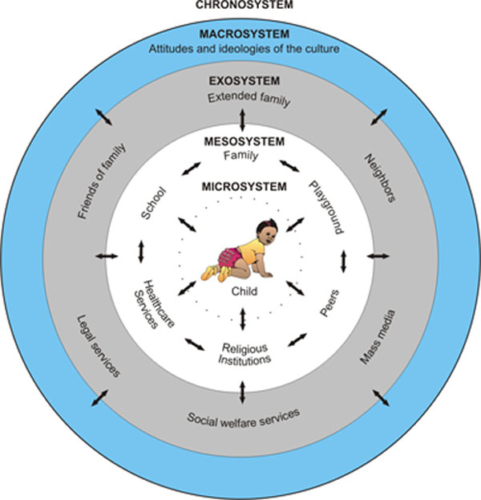

Slide 9
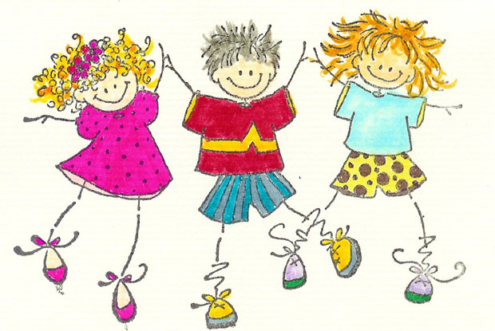
System Meicro/Microsystem
Mae'r system hon yn cynnwys yr elfennau sydd agosaf at y plentyn ac sydd â'r dylanwad mwyaf uniongyrchol.
Pan fo'r berthynas rhwng gwahanol feicrosystemau yn un gydnaws,
datblygiad yn mynd rhagddo'n fwy llyfn
= llesiant.
Er enghraifft: perthynas gadarnhaol rhwng y cartref a'r ysgol. Pan fydd disgwyliadau'n debyg yn y ddau leoliad (triwch eich gorau, gwnewch eich gwaith eich hun, byddwch ar amser) mae plant yn perfformio'n well nag os yw disgwyliadau rôl yn wahanol rhwng y ddau leoliad.
This system is made up of the elements that are closest to the child and have the most direct influence.
When the relation between different microsystems is a compatible one,
development progresses more smoothly
= well-being.
For example: positive relationships between home and school. When expectations are similar in both settings (try your hardest, do your own work, be on time) children perform better than if role expectations differ between the two settings.

Slide 10
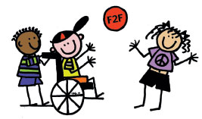
System Meso / Mesosystem
Mae'r canlyniadau mwyaf cadarnhaol yn digwydd pan fydd pob elfen o fewn y system yn gefnogol i'w gilydd.
Mae cymdogaethau sy'n gefnogol i'w hysgolion yn debygol o fod ag amgylchedd academaidd mwy cadarnhaol.
Mae cyfathrebu effeithiol rhwng rhieni ac athrawon am brofiadau a chynnydd plentyn yn cefnogi ac yn gwella twf a datblygiad y plentyn hwnnw.
The most positive outcomes occur when all elements within the system are supportive of each other.
Neighbourhoods that are supportive of their schools are likely to have a more positive academic environment.
Effective communication between parents and teachers about a child's experiences and progress supports and enhances that child's growth and development.

Slide 11

Yr Ecsosystem / Exosystem
Mae'r strwythurau o fewn y system hon yn cael dylanwad anuniongyrchol ar y plentyn
Yn cynnwys:
Adnoddau cymunedol fel gwasanaethau iechyd cymunedol.
System cymorth cymdeithasol anffurfiol fel ffrindiau a pherthnasoedd teuluol estynedig
Mae gan deuluoedd heb rwydwaith cymorth cymdeithasol lai o adnoddau i'w defnyddio ac mae hyn yn cael effaith negyddol ar y plentyn yn ystod cyfnodau anodd.
Mae amgylcheddau gwaith sy'n cefnogi cyfrifoldebau rhianta yn cael effaith gadarnhaol ar ddatblygiad plant heb ryngweithio'n uniongyrchol â'r plentyn.
The structures within this system have an indirect influence on the child
This includes:
Community resources such as community health services.
Informal social support system such as friends and extended family relationships
Families without a social support network have fewer resources to draw upon and this has a negative impact on the child during difficult times.
Working environments that are supportive of parenting responsibilities have a positive impact on child development without direct interaction with the child.

Slide 12

Esiamplau o’r Ecsosystem a Lles Plant
Examples of the Exosystem and Children’s Wellbeing
Digwyddiadau sy'n digwydd yn lle cyflogaeth y rhiant - er enghraifft, os yw'r rhiant yn cael diwrnod gwael yn y gwaith, neu’n colli ei swydd, neu yn cael dychafiad, neu'n gorfod gweithio oriau ychwanegol - effaith ar blant.
Gall cyfleuster hamdden newydd sy'n agor yn y gymdogaeth sy'n rhoi lle i blant chwarae a bod gyda ffrindiau a theulu wella datblygiad plant.
Gall cynnydd mewn cymhwysedd, hunangynhaliaeth a hunan-barch rhiant drwy raglen hyfforddiant swydd gael effaith gadarnhaol ar ddatblygiad plentyn.
Mae ysgol yn canolbwyntio ar les ac yn rhoi hyfforddiant i staff, gwell cyfleusterau chwarae awyr agored, ac yn gwella cyfranogiad rhieni
Events which occur at the parent’s place of employment -for example, if the parent has a bad day at work, or is laid off, or promoted, or has to work overtime-impact upon children.
A new recreational facility opening in the neighborhood providing children with a place to play and be with friends and family can enhance children's development.
A parent’s gaining increased competence, self-sufficiency and self respect through a job training program can positively impact on a child's development.
A school focuses on wellbeing and provides staff with training, better outdoor play facilities, and improves parental involvement

Slide 13
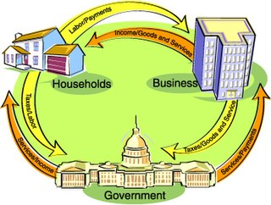
Y System Macro / Macrosystem
Yn cynnwys gwerthoedd diwylliannol, arferion, cyfreithiau a pholisi e.e. Llywodraeth Cymru
Y sbardun y tu ôl i sefydlu amgylchedd sy'n cefnogi lles cyffredinol y plentyn.
Mae blaenoriaethau'r system macro yn dystiolaeth o'r gwerth a roddir ar gwrdd ag anghenion plentyn sy'n datblygu.
Mae systemau macro sy'n gwerthfawrogi'r plentyn yn rhoi strwythurau ar waith i gefnogi rhieni a theuluoedd fel y gallant gwrdd a’u cyfrifoldebau o fagu plant iach.
Consists of cultural values, customs, laws and policy e.g. Welsh Government
The driving force behind establishing an environment that supports the overall well-being of the child.
The priorities of the macrosystem are evidence of the value placed upon tending to the needs of a developing child.
Macrosystems that value the child put structures in place to support parents and families so that they can attend to the responsibilities of raising healthy children.

Slide 14

Cefnogaeth ar gyfer iechyd meddwl iach a lles
Support for positive mental health and well-being
Mae dull Bronfenbrenner yn awgrymu bod angen i gymunedau a sefydliadau cymdeithasol weithio i ddatblygu cysylltiadau rhwng y systemau i sicrhau bod cefnogaeth a dylanwadau cadarnhaol ar blant a theuluoedd.
Disgrifir hyn yn aml fel datblygu 'cyfalaf cymdeithasol' a'r 'glud cymdeithasol' sy'n rhwymo cymunedau ac yn cefnogi iechyd meddwl a lles eu haelodau
Giddens, (1998)
Bronfenbrenner’s approach suggests that communities and social institutions need to work to develop connections between the systems to make sure there is support and positive influences on children and families.
This is often described as developing ‘social capital’ and the ‘social glue’ which binds communities and supports the mental health and wellbeing of its members
Giddens, (1998)

Slide 15
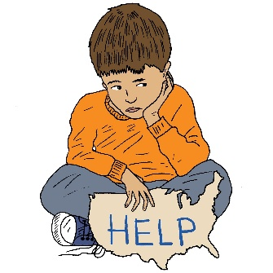
Sut mae rhai plant yn cael eu heffeithio os oes ganddynt iechyd meddwl a lles gwael?
How are some children affected if they have poor mental health and well-being?
Mwy o ddagrau – crio heb unrhyw reswm amlwg
Anniddigrwydd
Ymddygiad ymosodol
Ymddygiad hunan-niweidiol
Difrod i eiddo
Aflonyddwch cysgu difrifol – anhawster cysgu neu ddeffro'n rhy gynnar yn y bore
Colli pwysau/ennill pwysau
Tynnu'n ôl yn llwyr yn gymdeithasol
Amharodrwydd i ddefnyddio lleferydd
Arafwch mewn meddwl a symudiad
Dirywiad mewn sgiliau cymdeithasol a hunangymorth
Increased tearfulness – crying without any apparent reason
Irritability
Aggression
Self-harming behaviour
Property damage
Severe sleep disturbance – difficulty sleeping or waking up too early in the morning
Weight loss/weight gain
Total social withdrawal
Unwillingness to use speech
Slowness in thought and movement
Deterioration in social and self-help skills

Slide 16
Dangosyddion lles plentyn ar gyfer addysg
Child well-being indicators for education
Presenoldeb yn yr ysgol
Cofrestru mewn gofal ac addysg plentyndod
Cofrestru mewn addysg/cwblhau'r ysgol
Lefel addysg rhieni a gyrhaeddwyd
Ansawdd gofal plentyndod
Attendance at school
Enrolment in childhood care and education
Enrolment in education/completion of school
Parental education level attained
Quality of childhood care

Slide 17

Ymddieithrio o Addysg/ Education disengagement
Mae lleiafrif o blant wedi ymddieithrio neu'n ei chael yn anodd cymryd rhan lawn mewn addysg.
Gall ymddieithiad arwain at:
Triwantiaeth
Allgáu
Pobl ifanc nad ydynt mewn addysg na hyfforddiant (NEET)
ADY
Ymddygiad
A minority of children are disengaged or have difficulty in fully engaging in education.
Disaffection can result in:
Truancy
Exclusion
Young people not in education or training (NEET)
ALN
Behaviour

Slide 18
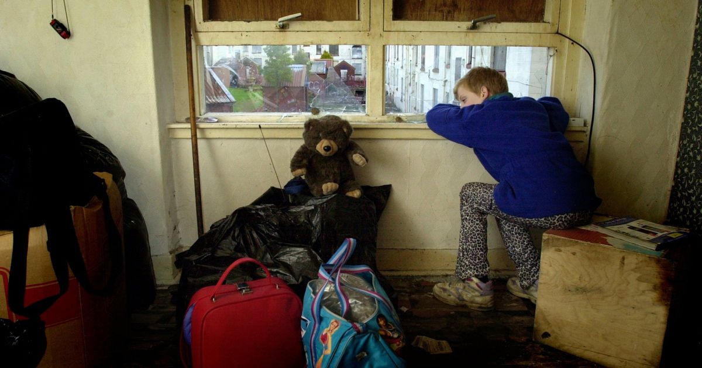
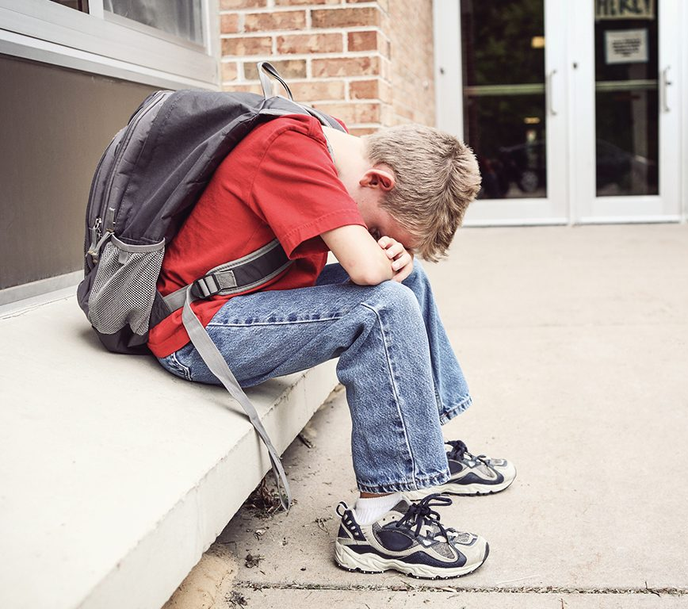
Bet arall sy'n gallu effeithio ar les plant?
What else affects a child’s well-being?
Cartrefi gwael
Digartrefedd
Tlodi
TASG YMCHWIL:
Sut mae'r ffactorau yma yn effeithio plant?
Beth mae ystadegau yndangos am yr effaith ar blant?
Poor housing
Homelessness
Poverty
RESEARCH TASK:
How do you think these factors affect a child?
What do statistics show us about the impact?

Slide 19

Ystadegau Iechyd Meddwl a Lles
Mental health and wellbeing statistics
'One in six children aged five to 16 were identified as having a probable mental health problem in July 2020, a huge increase from one in nine in 2017. That’s five children in every classroom.'
'80% of young people with mental health needs agreed that the coronavirus pandemic had made their mental health worse.'
'Suicide was the leading cause of death for males and females aged between five to 34 in 2019.'
'Nearly half of 17-19 year-olds with a diagnosable mental health disorder has self-harmed or attempted suicide at some point, rising to 52.7% for young women.'
Youngminds (2022)

Slide 20

Layard and Hagell, 2015
Mae ymyrraeth gynnar yn hanfodol.
Mae angen mynd i'r afael â phroblemau iechyd meddwl pan fyddant yn ymddangos gyntaf.
Mae angen iddynt gael eu hadnabod gan rieni, meddygon ac athrawon, ac mae angen i'n cymdeithas gyfan ddod yn llawer mwy agored a mater o ffaith am yr hyn sy'n rhan gyffredin o fywyd.
Mae angen i'n hysgolion fabwysiadu lles plant fel un o'u prif amcanion – yn eu hethos a'u haddysgu.
Gellir ac y dylid addysgu sgiliau bywyd mor broffesiynol â mathemateg neu lenyddiaeth.
Early intervention is crucial.
Mental health problems need to be tackled when they first appear.
They need to be recognized by parents, doctors and teachers, and our whole society needs to become much more open and matter-of-fact about what is a common part of life.
Our schools need to adopt children’s wellbeing as one of their major objectives – both in their ethos and their teaching.
Life skills can and should be taught as professionally as mathematics or literature.

Slide 21

Beth all ysgolion cynradd wneud?
What can primary schools do?
Mae strategaethau gwydnwch effeithiol ar gyfer plant yn cynnwys:
cael ymdeimlad o berthyn yn eu hysgol a'u cymuned
bod mewn iechyd corfforol da
cael amser a'r rhyddid i chwarae, dan do ac yn yr awyr agored
bwyta deiet cytbwys a chael ymarfer corff rheolaidd
bod yn rhan o deulu sy'n cyd-dynnu'n dda y rhan fwyaf o'r amser
mynd i ysgol sy'n gofalu am les ei holl ddisgyblion
cymryd rhan mewn gweithgareddau lleol i bobl ifanc
CDU
Effective resilience strategies for children include:
having a sense of belonging in their school and community
being in good physical health
having time and the freedom to play, indoors and outdoors
eating a balanced diet and getting regular exercise
being part of a family that gets along well most of the time
going to a school that looks after the well-being of all its pupils
taking part in local activities for young people
IDPs

Slide 22
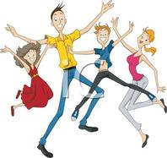
Beth all ysgolion uwchradd/colegauwneud?
What can secondary schools/colleges do?
Effective resilience strategies for
adolescents include:
strong social support networks
positive school experiences,
a sense of being in control of decisions that affect them
participation in extra-curricular activities
the ability to help others and ‘make a difference’
not being sheltered from challenging situations
person centred planning
Strategaethau gwydnwch effeithiol ar gyfer
glasoed yn cynnwys:
rhwydweithiau cymorth cymdeithasol cryf
profiadau ysgol cadarnhaol,
ymdeimlad o fod mewn rheolaeth dros benderfyniadau sy'n effeithio arnynt
cymryd rhan mewn gweithgareddau allgyrsiol
y gallu i helpu eraill a 'gwneud gwahaniaeth'
peidio â chael eich gwarchod rhag sefyllfaoedd heriol
cynllunio sy'n canolbwyntio ar yr unigolyn

Slide 23

Esiamplau o Arfer Orau
Best Practice Examples
Healthy and Happy - school impact on pupils' health and wellbeing
Other useful reports?
Iachus a Hapus - effaith yr ysgol ar lesiant a iechyd disgyblion ​
adroddiadau eraill defnyddiol?

Slide 24
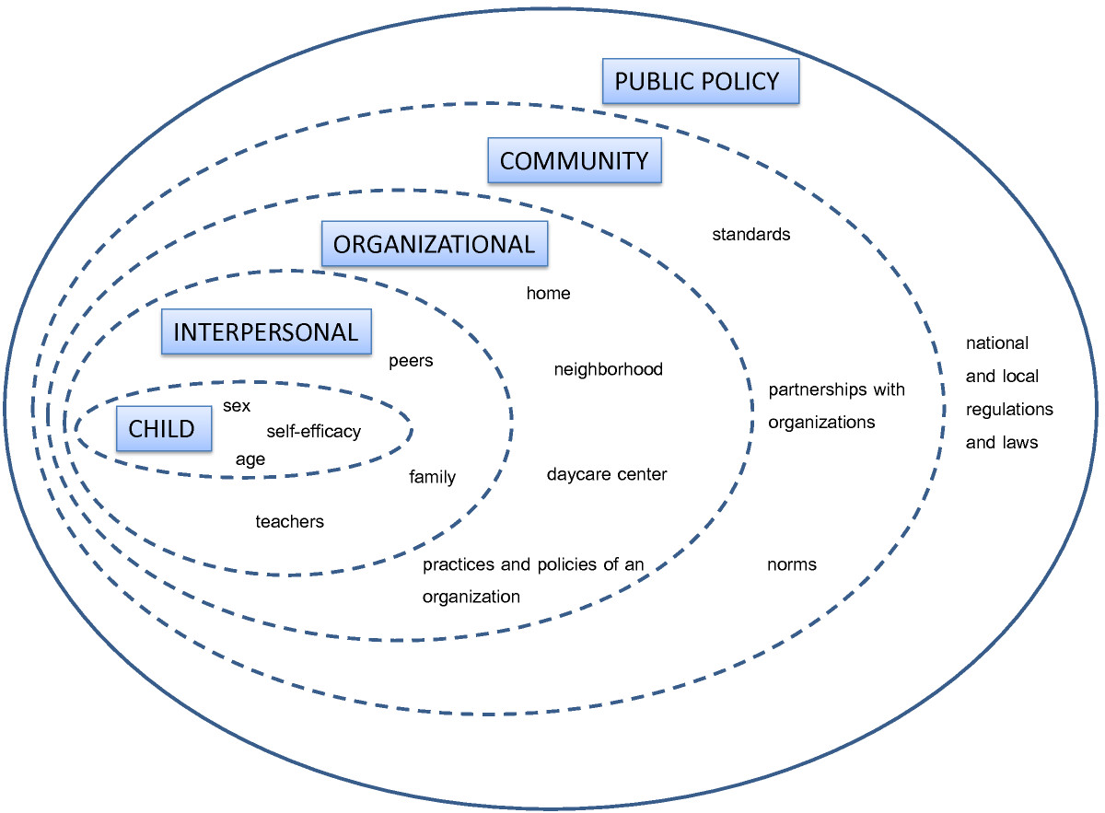
Cofiwch Ddamcanaeth Ecolegol Bronfenrenner
Remember Bronfenbrenner’s Ecological Theory
Ymyrraeth gynnar!
Intervene Earlier!

Slide 25
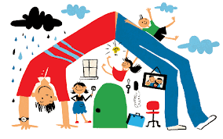
Layard & Hagell (2015)
‘… if we care about wellbeing, the wellbeing of children must be a top policy priority for communities and families, healthcare systems and schools. This is a matter of basic human rights, as set out in the United Nations Convention on the Rights of the Child. And we must talk about mental health issues much more openly and destigmatize the issue. Second, if we do all of this, we shall certainly incur costs but we will also save huge expense in future.’

Slide 26
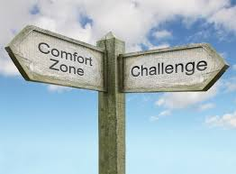
Heriau allweddol i ddatblygu iechyd meddwl iach a lles
Key challenges in developing good mental health and wellbeing
Discussion: what are the
challenges for schools?
Trafodaeth: beth yw’r
heriau i ysgolion?

Slide 27
Heriau allweddol i weithredu iechyd meddwl iach a lles
Key challenges in developing good mental health and wellbeing
Llymder a thoriadau mewn gwariant
Diwygiadau Lles/Toriadau budd-daliadau
Gwireddu gwelliant cynaliadwy ar raddfa fawr a
gwireddu rhwydwaith gofal cwbl Integredig
Problem cyrhaeddiad ar draws system gymhleth
Integreiddio iechyd corfforol a meddyliol
Sicrhau newid ar raddfa fawr
Poblogaeth sy'n heneiddio
Dylanwadu ar asiantaethau eraill
Dirwasgiad
Perthnasol i waith Bronfenbrenner?
Iechyd Cyhoeddus Cymru (2012)
Austerity and spending cuts
Welfare Reforms/Benefit cuts
Realising large scale sustainable improvement
and realisation of fully Integrated network of care
Problem of reach across a complex system
Integration of physical and mental health
Bringing about large scale change
An ageing population
Influencing other agencies
Recession
Related to Bronfenbrenner?
Public Health Wales, (2012)

Slide 28
Cyfeirnodau / References
Bronfenbrenner Bioecological Model. Available at http://nacce.org/ecological-theory-of-bronfenbrenner/ (Accessed 31.10.19)
CAMHS (2015). Available at http://www.youngminds.org.uk/for_parents/services_children_young_people/camhs (Accessed 28.10.19)
Giddens, A. (1998) The Third Way: The Renewal of Social Democracy. Cambridge: Polity Press
Mehtala MA, Saakslahti AK, Inkinen ME, Poskiparta ME. A socio-ecological approach to physical activity interventions in childcare: a systematic review. International Journal of Behavioral Nutrition and Physical Activity 2014; 11(1): 22. https://www.ncbi.nlm.nih.gov/pmc/articles/PMC3936868/
Mental Health data. Available at http://mentalhealth.org.uk/ (Accessed 28.10.19)
Office for National Statistics: Insights into children's mental health and well-being (2015) Available at http://backup.ons.gov.uk/2015/10/20/insights-into-childrens-mental-health-and-well-being/ (Accessed 28.10.19)
Weare, 2015. Available at http://www.ncb.org.uk/media/1197143/ncb_framework_for_promoting_well-being_and_responding_to_mental_health_in_schools.pdf (Accessed 31.10.19)
Youngminds (2015) Available at http://www.youngminds.org.uk/ (Accessed 31.10.19)

