Slide 1

Semiotics

Slide 2
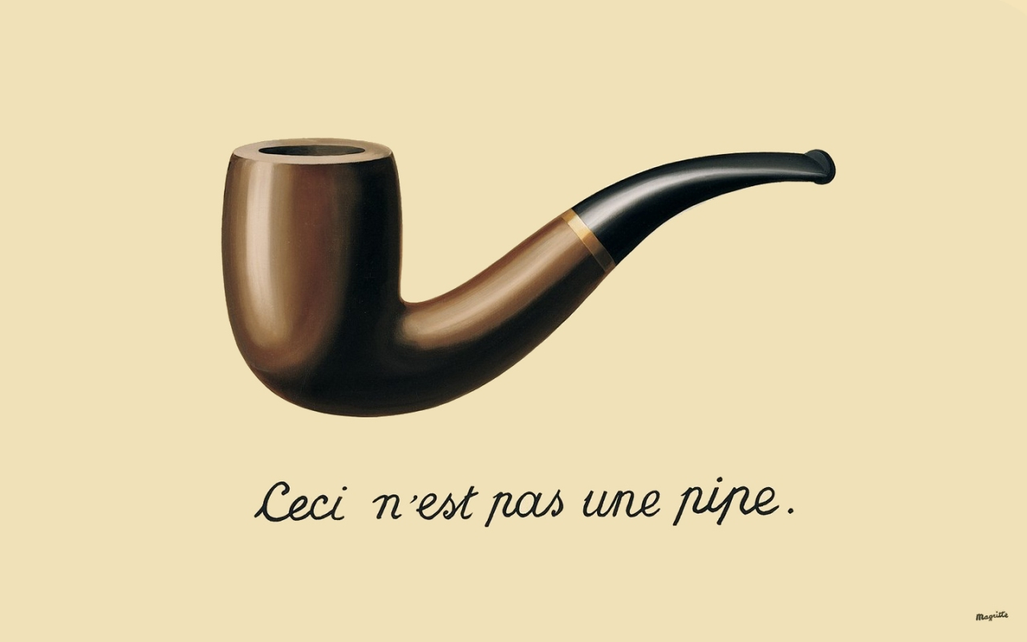
Semiology
'A science that studies the life of signs within society is conceivable...I shall call it semiology (it will)...show what constitutes signs, what laws govern them' (Saussure 1974: 16).
French linguistic Ferdinand de Saussure, his study, Course in General Linguistics (1974)

Slide 3
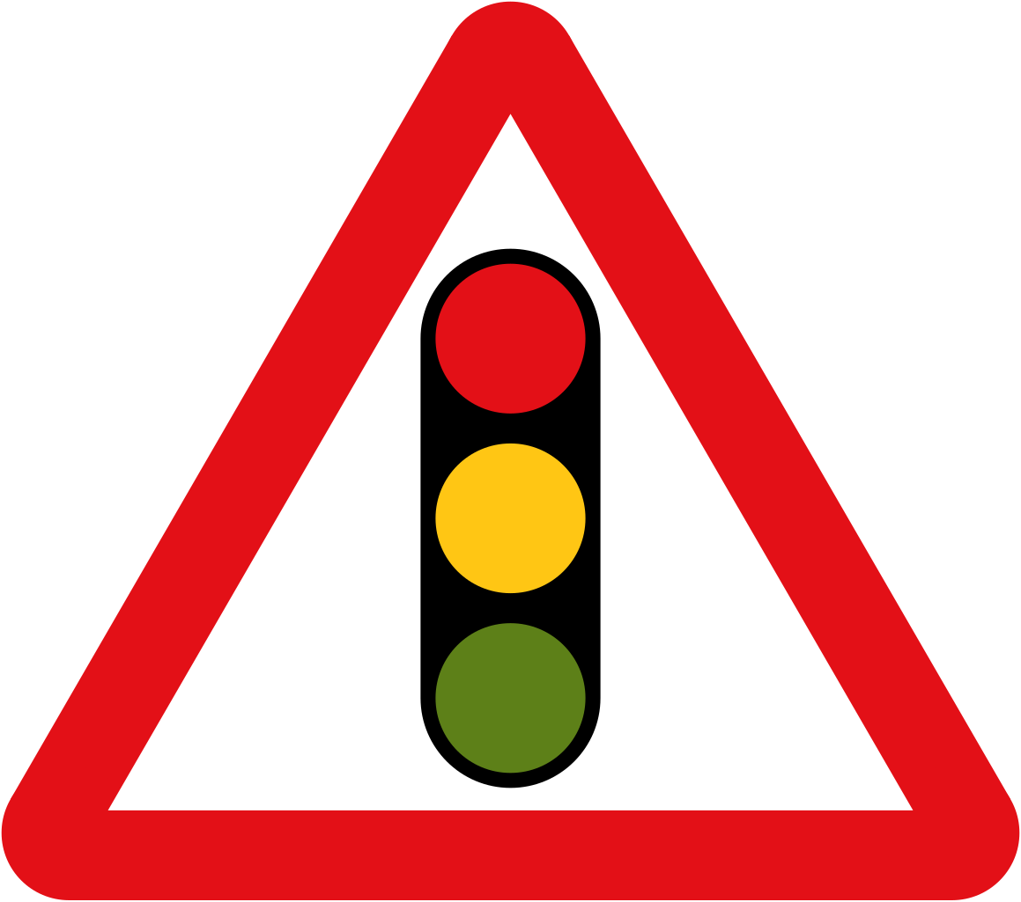

Signs
'A sign or representamen, is something which stands to somebody for something in some respect or capacity. It addresses somebody, that is, creates in the mind of that person an equivalent sign, or perhaps a more developed sign. That sign which it creates I call the interpretant of the first sign. The sign stands for something, its object. It stands for that object, not in all respects, but in reference to a sort of idea, which I have sometimes called the ground of representamen' (Pierce 1955: 99).
This Photo by Unknown Author is licensed under CC BY-SA
This Photo by Unknown Author is licensed under CC BY-SA

Slide 4
Signifier
FOX
The stimulus that conveys meaning

Slide 5


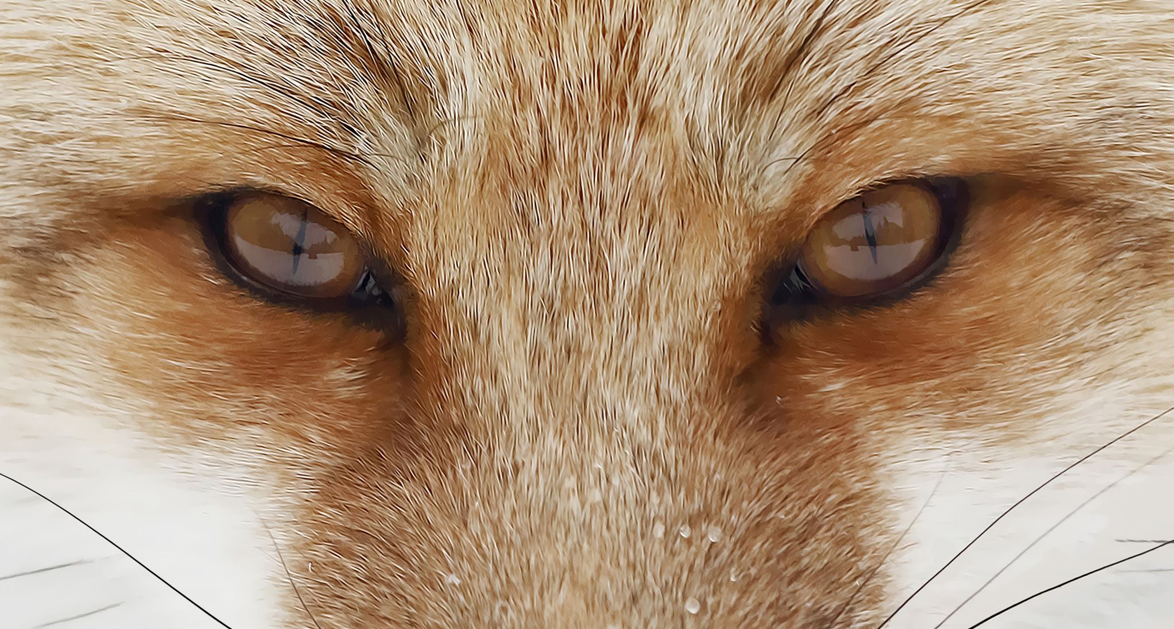
Denotation

Slide 6
Signified
The concept that a signifier refers to

Slide 7

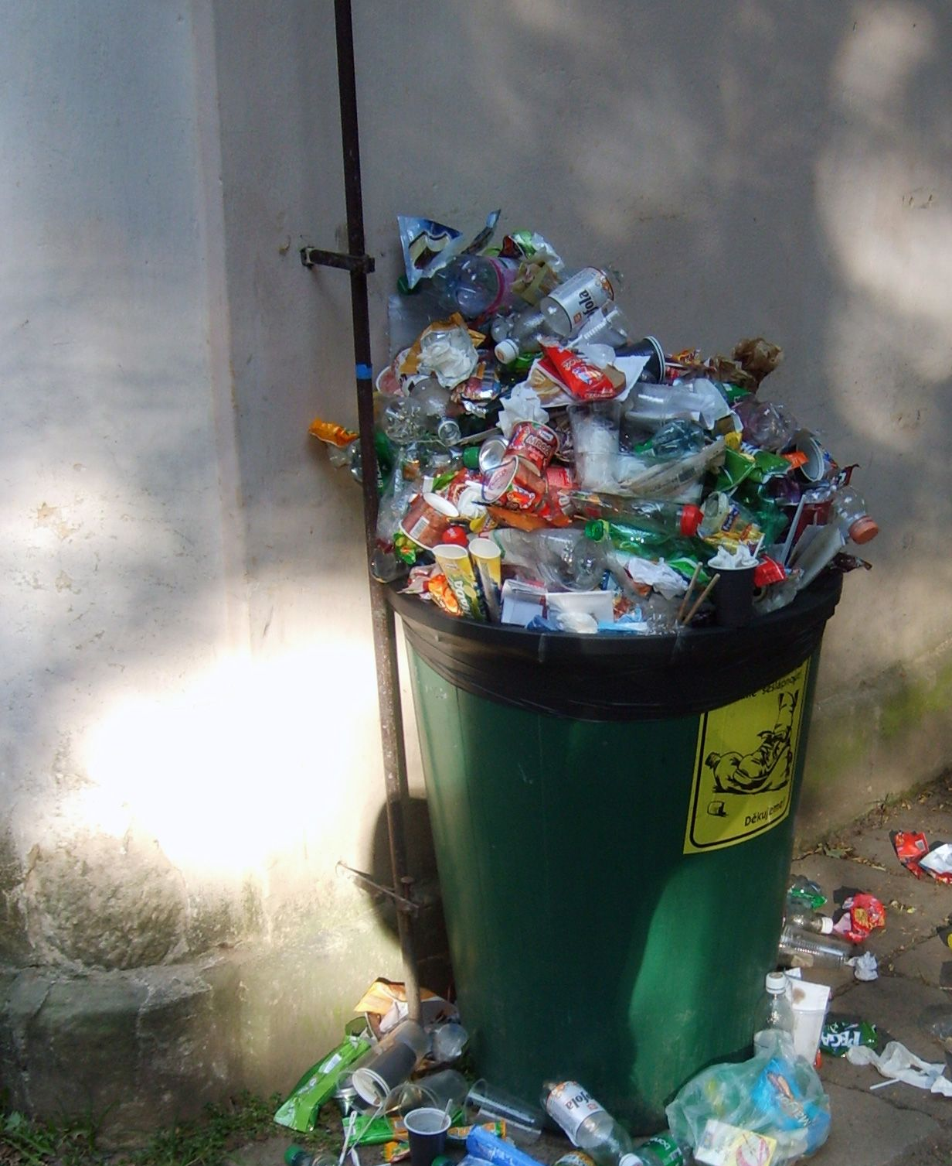
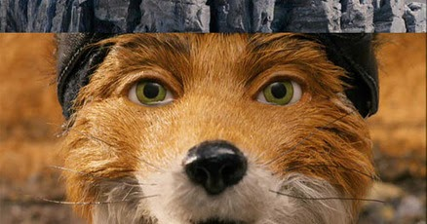
Connotation
The feeling, ideas, and cultural meaning
This Photo by Unknown Author is licensed under CC BY-SA-NC

Slide 8


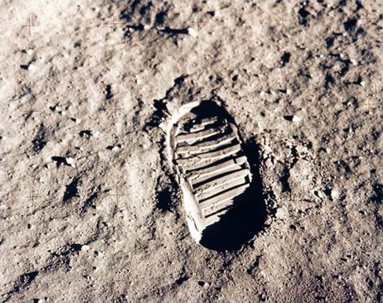
Icons, Symbols, Indexes
This Photo by Unknown Author is licensed under CC BY

Slide 9
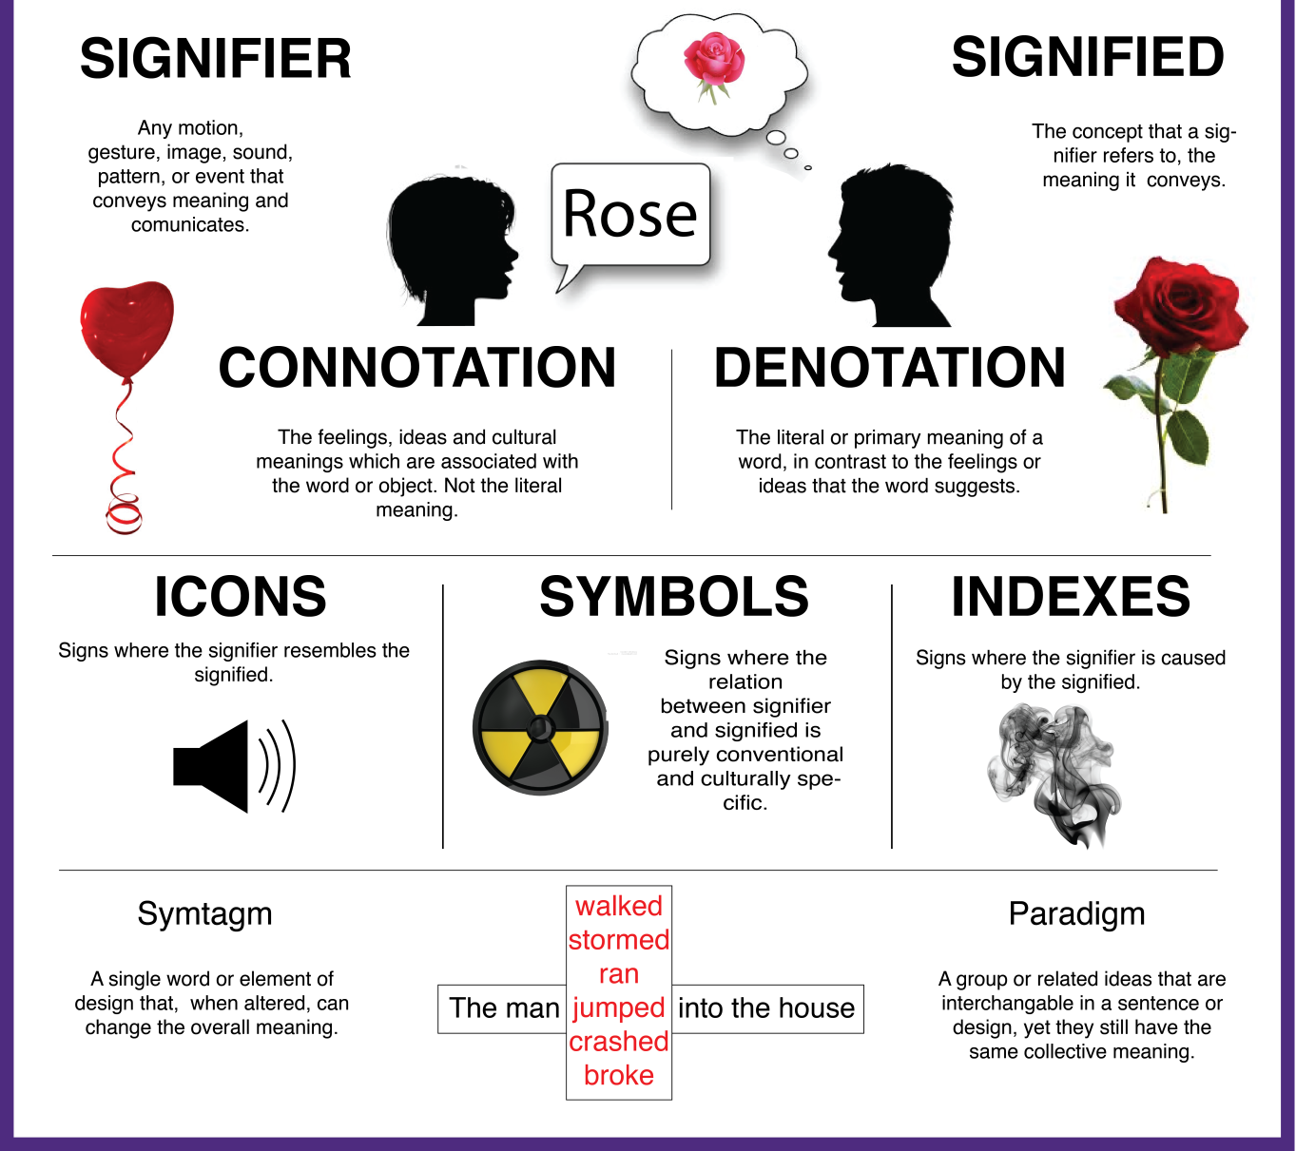
https://hiltondesignblog.wordpress.com/2015/11/05/introduction-to-semiotics/

Slide 10
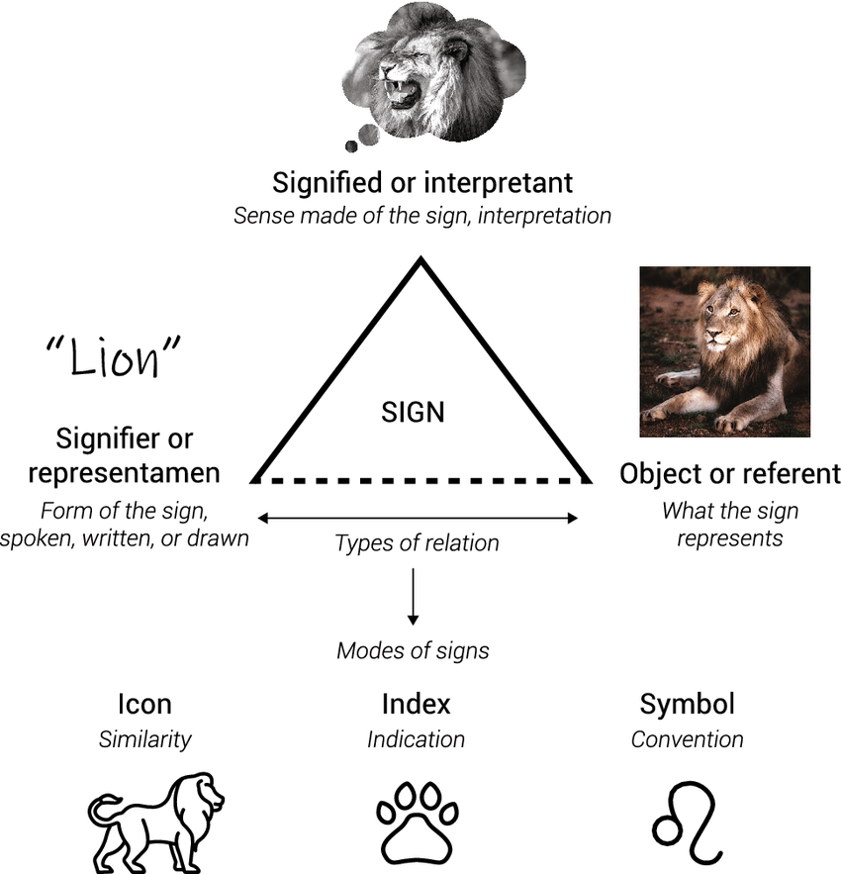
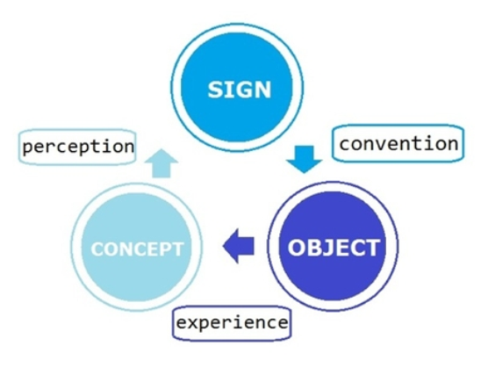
An understandable learnt/agreed visual language

Slide 11


