Slide 1
Cardiff Airport Case Study Analysis
Bethan Evans-Phillips
1802110

Slide 2

Introduction to Cardiff Airport
Only Airport in Wales.
Airport was taken over by the Government in 2013 for £52 million.
65% rise in Passenger numbers since 2013.
Fig 1. Cardiff Airport (International Airport Review, 2019)

Slide 3
PESTEL
“PESTEL analysis is a technique for identifying and listing the political, economic, social, technological, environmental and legal factors in the general environment most relevant to an organisation” David Boddy.
Political Economical Social
Technological Environmental
Legal

Slide 4
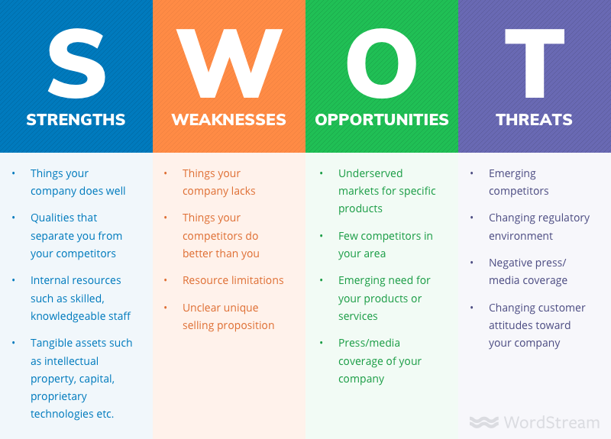
SWOT
Strengths- Helps to bring in money to the Welsh economy.
Weaknesses – The airport has to request more loans from the government.
Opportunities – New international destinations from the airport.
Threats – Two major threats to the future of the airport is the Coronavirus and Brexit.
Fig 2. SWOT analysis (WordStream, 2020)

Slide 5

Performance Audit
Swissport in the Airport.
Improvements in and around the airport.
Selection and Recruitment at Cardiff Airport.
Equality in the workplace.
Fig 3. Swissport (Swissport, 2020)

Slide 6
Key Performance Indicators
Importance of Key Performance Indicators for Stakeholders.
Decision-making tool.
Ratios as guidance for managers to focus on their Strategies.

Slide 7
Conclusion
Financial Ratio
Collapse of Thomas Cook and Flybe
Master Plan 2040

Slide 8
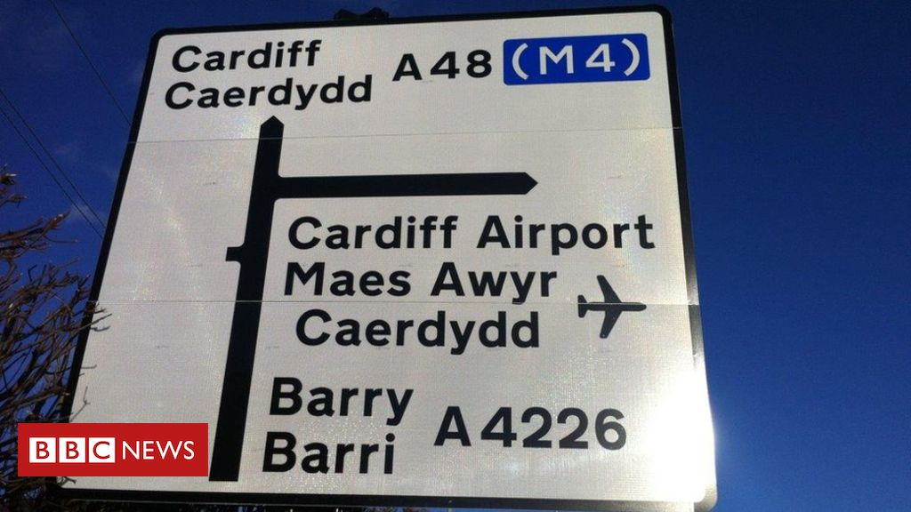
Recommendations
Signage and travel to Cardiff Airport
Improvements to be made at Cardiff Airport
Improve the links and road surfaces to Cardiff Airport
Fig 4. Cardiff Airport sign (BBC, 2018)

Slide 9
Thank you for Listening.

Slide 10
Bibliography
Airport Technology. (2019), Cardiff Airport to receive £21.2m Welsh Government loan, [Online] Available: https://www.airport-technology.com/news/cardiff-airport-welsh-government-loan/ (Accessed:28th March 2020).
Armstrong, M. & Baron, A., 2005. Managing Performance: Performance Management in Action. London: Chartered Institute of Personal Development. (Accessed: 27th April 2020).
Barry, S. (2019), Business Live, How many people are flying on Qatar Airways Cardiff to Doha route?, [Online] Available: https://www.business-live.co.uk/economic-development/how-many-people-flying-qatar-17396007 (Accessed: 24th April 2020).
BBC News. (2013), Cardiff Airport is sold to the Welsh government for £52m, [Online] Available:
https://www.bbc.co.uk/news/uk-wales-21952079 (Accessed:28th March 2020).
BBC News. (2020), Coronavirus: Cardiff Airport ‘needs more money from UK government’, [Online] Available: https://www.bbc.co.uk/news/uk-wales-52156482 (Accessed: 4th April 2020).
BBC News. (2019), Flight taxes will not be devolved to Wales, say UK Ministers, [Online] Available: https://www.bbc.co.uk/news/uk-wales-politics-49599261 (Accessed: 1st April 2020).
BBC News (2019) ‘Gatwick Airport commits to facial recognition tech at boarding’ [Online] Available: https://www.bbc.co.uk/news/technology-49728301 (Accessed: 26th April 2020).
BBC News (2019) ‘Thomas Cook holidaymakers start to return to Cardiff airport’ [Online] Available: https://www.bbc.co.uk/news/uk-wales-49794767 (Accessed: 25th April 2020).
BBC News (2018) Vale of Glamorgan routes for Cardiff Airport link revealed [Online] Available: https://www.bbc.co.uk/news/uk-wales-43796987 (Accessed: 1st May 2020).
Baggio, R. ,Mariani, M ,M. & Czakon, W. 2014. Managing Tourism in a Changing World: Issues and Cases. Oxon: Routledge. (Accessed: 1st May 2020).
Boddy, D., 2017. Management: an introduction / David Boddy. 7th ed. Harlow: Pearson Education Limited. (Accessed: 26th April 2020).
CAA. (2015), Regulation and enforcement, [Online] Available: https://www.caa.co.uk/Our-work/About-us/Regulation-and-enforcement/ (Accessed:6th April 2020).
Cardiff Airport (2020) By Rail [Online] Available: https://www.cardiff-airport.com/by-rail/ (Accessed: 1st May 2020).
Cardiff Airport (2017) Candidate Briefing Pack: Director of Airport Planning and Development [Online] Available: https://www.cardiff-airport.com/uploads/Director%20Planning%20Development%20Candidate%20Pack%20Jan%202017.pdf (Accessed: 27th April 2020).
Cardiff Airport. (2019), Cardiff Airport unveils its environmental flight path, [Online] Available: https://www.cardiff-airport.com/news/2019/09/20/cardiff-airport-unveils-its-environmental-flight-path/ (Accessed:6th April 2020).
Cardiff Airport, (2019). Cardiff Airport unveils draft Masterplan for development [Online] Available: https://www.internationalairportreview.com/news/80623/cardiff-airport-unveils-draft-masterplan-for-development/ (Accessed: 8th May 2020).
Cardiff Airport. (2019), Gender Pay Gap Report, [Online] Available: https://www.cardiff-airport.com/uploads/Cardiff%20Airport%20Gender%20Pay%20Gap%20Report.pdf (Accessed: 22nd April 2020).
Cardiff Airport. (2019), Qatar Airways celebrates First Anniversary at Cardiff Airport, [Online] Available: https://www.cardiff-airport.com/news/2019/05/07/qatar-airways-celebrates-first-anniversary-at-cardiff-airport/ (Accessed: 24th April 2020).
Cardiff Airport (2020) Flybe - Cardiff Airport statement [Online] Available: https://www.cardiff-airport.com/news/2020/03/05/flybe-cardiff-airport-statement/ (Accessed: 6th May 2020).
Cardiff Airport sign, (2018) Vale of Glamorgan routes for Cardiff Airport link revealed [Online] Available: https://www.bbc.co.uk/news/uk-wales-43796987 (Accessed: 8th May 2020).

Slide 11
Collinson, P. (2017), The Guardian, UK attracts record overseas tourists after pound’s Brexit slide, [Online] Available: https://www.theguardian.com/travel/2017/jun/16/uk-tourists-pound-brexit-us-holiday-exchange-rates (Accessed:2nd April 2020).
Elearn. 2009. Recruitment and Selection. Oxford: Elsevier Ltd. (Accessed: 29th April 2020).
ITV. (2020), Cardiff Airport appears eerily quiet as people urged not to travel amid coronavirus outbreak, [Online] Available:
https://www.itv.com/news/wales/2020-03-17/cardiff-airport-appears-eerily-quiet-as-people-urged-not-to-travel-amidst-coronavirus-outbreak/ (Accessed:2nd April 2020).
Marr, B. (2012), Key Performance Indicators 75 Measures every Manager needs to Know, UK: Pearson (Accessed:28th March 2020).
Simplexity Travel Management (2020) ‘How Will the National Living Wage Affect the UK Travel and Hospitality Industry?’ [Online] Available:
https://simplexitytravel.com/inspiration/how-will-the-national-living-wage-affect-the-uk-travel-and-hospitality-industry (Accessed: 26th April 2020).
Swissport, (2020) THE SWISSPORT PROFILE [Online] Available:
https://www.swissport.com/nc/corporate/corporate-profile/ (Accessed: 8th May 2020).
SWOT Analysis, (2020). How to Do a SWOT Analysis for Your Small Business (with Examples) [Online] Available:
https://www.wordstream.com/blog/ws/2017/12/20/swot-analysis (Accessed: 8th May 2020).
Walsh, C. (2008), Key Management Ratios the 100+ ratios every manager needs to know, UK: Pearson (Accessed:29th March 2020).

