Slide 1
EMPLOYEE ENGAGEMENT
Student name : Raul Dobrican
Student Id No. : 2119259
Module name : BMIH4006
Lecturer name : Tristan Hawkins

Slide 2
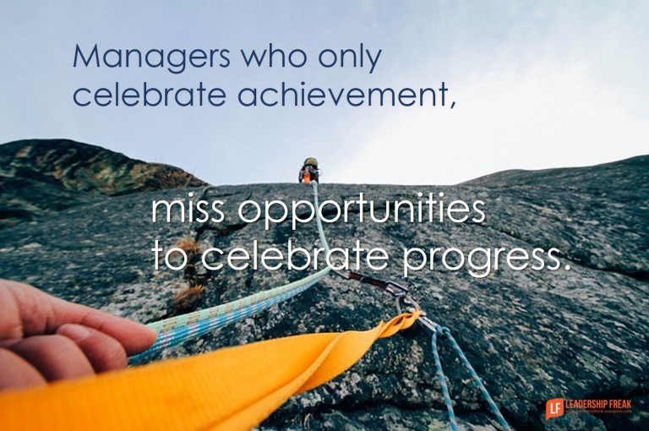
Introduction
If an organization wants company employees to give their all every day and remain committed to the organization's mission, they need to create a working environment that inspires them to contribute to their leaders' successes and gives them a sense of personal fulfilment.
Notes:
A lot of weight was placed on the quality of services and accomplishments in the hospitality business. The hotel business is dedicated to increasing productivity in its workforce through boosting morale and productivity. When workers are engaged, they bring their whole self to their jobs and use their entire range of emotional, cognitive, and physical abilities to complete their assignments. Those sectors that have increased employee engagement have seen increases in customer loyalty, “customer happiness, profitability, productivity, and reduced employee turnover” in the past.

Slide 3

Importance of employee engagement
It's crucial for a company's performance in the market that every worker has a firm grasp of the business strategies articulated in the company's “branding, mission statement, vision, and values”.
The engagement itself must be founded on solid diagnostics, be capable of being carried out with laser-like precision, and have methods that can be shown to have had a positive effect on the company (Sun, and Bunchapattanasakda, 2019).
In order to prove their worth, workers must be aware of the unique skills and experiences they bring to the table each day.
Notes:
Therefore, it is essential that all levels of hotel management value participation from their workers. Nonetheless, contemporary difficulties in the hotel industry include intense levels of competition, tight criteria for “maintaining a healthy profit margin”, and elevated client expectations. Therefore, hotels need to develop novel approaches to energising their workforce and boosting their productivity and performance to meet the new demands. Therefore, the purpose of this study is to learn how the hospitality industry may encourage strong employee engagement and grow a skilled and imaginative workforce.
Therefore, hotels that spend money on HR software that puts their employees' needs first may keep them fully interested in their job. Managers can see when employees clock in and out of the office with the help of human resources software. This allows higher management to monitor struggling divisions and pinpoint locations where further support is required to boost employee morale and job satisfaction. Staff members are more likely to feel involved in their work and to deliver better outcomes because of the software's ability to help them prepare for and execute unanticipated adjustments in response to anticipated spikes in demand.

Slide 4

4
Employee engagement in daily life
"Employee engagement," as defined by Forbes, "is an employee's emotional commitment to working toward the goals of the organisation they are employed by."
The worker will miss fewer days of work as a result.
As a result, profits rise (Kwon and Kim, 2020).
More effective measures for worker safety are made available.
The hotel's output has increased thanks to the enthusiasm of its staff.
Notes:
The hospitality industry's upper echelons should have a firm grasp on what its staff members need and how to keep them interested and productive. For starters, upper management should learn about burnout and its causes. Exhaustion, a lack of motivation, and cynicism are the hallmarks of employee burnout. When the emotional demands of the job start to weigh too heavily on an employee, exhaustion is a common result. Because of this, workers often emotionally and mentally disengage from their job in order to get through their days. Therefore, this research aims to discover how the hospitality sector may attain high levels of employee engagement and nurture a competent and creative labour force.

Slide 5
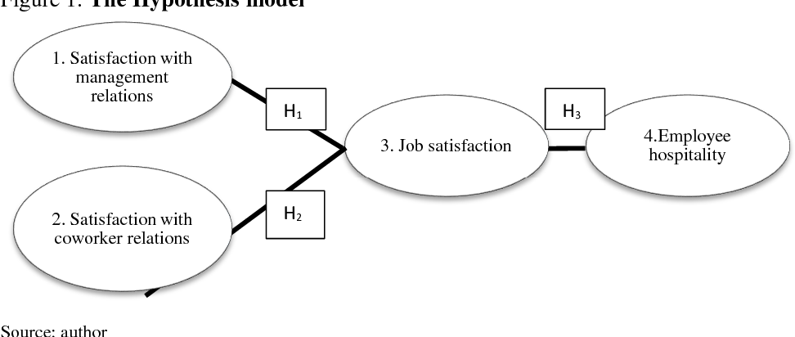
Model of Employee Engagement
Engaged workers consistently outperform their non-engaged counterparts.
This is because their efforts are not only more fruitful but also more efficient and effective.
Because of this, they'll have a better chance at a higher salary, a quicker promotion, and a more desirable job offer (Lee et al. 2020).
Notes:
Organizations should prioritise employee engagement, which is defined as "the degree, to which an employee feels a strong emotional connection to, and commitment to, the organisation for which they work." Which usually has an effect on their actions and the amount of effort they put into their work-related tasks? When staff are cynical, they treat consumers like numbers, ignore their demands, and provide impersonal service. When workers lack enthusiasm for their jobs and so fail to complete their duties, this is known as inefficacy.
However, modern challenges in the hospitality sector include rising levels of competition, stringent requirements for maintaining a healthy profit margin, and heightened client expectations. To stay competitive, hotels need to discover novel approaches to staff motivation and performance enhancement to keep up with rising customer expectations.

Slide 6
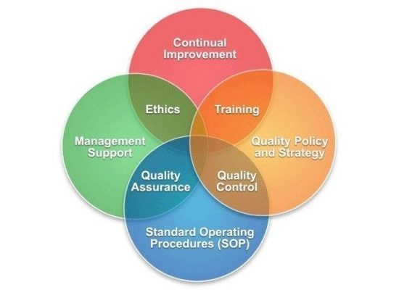
Employee Engagement in Workplace
If a corporation isn't engaged, this should reveal that employees aren't pleased at home and in the workplace since they take their sentiments home (Chanana et al. 2021).
Now, if workers are always involved in their job, it states the fact that they are engaged workers.
These are the four gains that workers may anticipate from being actively involved in their workplace.
Studies have shown that engaged workers not only perform better on the job but are also happier overall.
Notes:
“Reducing employee workload, managing employee activities, rewarding and recognising great performance, participating in social and government involvement”, and strengthening fairness and values within the business are all solid practises that may help decrease job burnout and raise their level of engagement (Shrotryia, and Dhanda, 2019). Employee satisfaction behaviour is affected by the practises, which in turn affects employee engagement. It is true that investing in training services for company staff may help them become more proficient in their work.
Providing a pleasant place to work is another way to boost morale and motivation. Job requirements and available resources are two essential components of a conducive work setting.

Slide 7

Dynamics of Employee Participation
Priority Level – An individual will analyse the institution's data to find out which factors are most influencing employee engagement across all age and gender subsets.
Virtual focus groups - at the conclusion of each survey, staff members will be asked to elaborate on their responses by providing specific instances of the issues they've encountered and suggestions for how these issues should be resolved (Saks 2022).
Notes:
The first stage is determining whether or not your staff is actively involved in their work. So, it's crucial that individuals have access to the primary driver of motivation for participation. An employee's performance on the job may need them to use their hearts and minds. The pressure to perform well on the job and help the company reach its goals and targets might be overwhelming for those who aren't fully invested in their work there. Alternatively, employment resources might come from both within and outside the organisation. Staff may have to pull back and disengage if their employer fails to strike a fair balance between staffing needs and available resources.

Slide 8
Recommendations in Employee Engagements in Hotel Industry
Employees that suggest changes to their employers do so in their best interests.
Earnings increases,
Superior prospects, in other words.
Workers want the ability to create strategies and track their own progress toward a better performance review (Men et al. 2020).
Incorporating even a basic system for assessing employees' performance can boost productivity in the workplace.
How workers are evaluated depends on their performance, which may be measured in a variety of ways.
Notes:
Customer satisfaction in the hospitality company is greatly impacted by frontline staff' attention to their profession and their personal adherence to ethical standards. Employees need to recognise that consumers can never be entirely delighted with intangible services like a pleasant hotel or tasty food. But rather, client satisfaction may be obtained when personnel fulfil their perceived level of care when they communicate with them. The 'moment of truth' which encompasses the period when a customer interacts with the employees is the critical moment that will determine the satisfaction level of the customers. If a consumer believes an employee to be behaving unethically at this point, their level of satisfaction will plummet instantly. Overcharging, piling on unexpected costs, charging for unused services, and forcing visitors to use items they do not want are all habits that stand out to consumers in the hotel sector (Wang et al. 2020). These unethical practises will undoubtedly lead to a decline in revenue as customers lose trust in the company's advertised prices and levels of service.

Slide 9
Conclusion
More chances for experiential and apprenticeship training programmes should be made available to schools and organisations that teach about the hospitality sector. Unlike other businesses, the hotel industry seldom gives students the chance to participate in internships or get practical experience. As a result, rather of participating in hands-on learning experiences that might help them develop their talents, students focus on finding employment. Employees often don't provide such chances since they aren't in their best interest at the time and because they don't anticipate the need for replacement workers when current workers retire.

Slide 10
Reference List
Chanana, N., 2021. Employee engagement practices during COVID‐19 lockdown. Journal of public affairs, 21(4), p.e2508.
Kwon, K. and Kim, T., 2020. An integrative literature review of employee engagement and innovative behavior: Revisiting the JD-R model. Human Resource Management Review, 30(2), p.100704.
Lee, J.Y., Rocco, T.S. and Shuck, B., 2020. What is a resource: Toward a taxonomy of resources for employee engagement. Human Resource Development Review, 19(1), pp.5-38.
Men, L.R., O’Neil, J. and Ewing, M., 2020. Examining the effects of internal social media usage on employee engagement. Public Relations Review, 46(2), p.101880.
Saks, A.M., 2022. Caring human resources management and employee engagement. Human Resource Management Review, 32(3), p.100835.
Shrotryia, V.K. and Dhanda, U., 2019. Content validity of assessment instrument for employee engagement. Sage Open, 9(1), p.2158244018821751.
Sun, L. and Bunchapattanasakda, C., 2019. Employee engagement: A literature review. International Journal of Human Resource Studies, 9(1), pp.63-80.
Wang, C., Xu, J., Zhang, T.C. and Li, Q.M., 2020. Effects of professional identity on turnover intention in China's hotel employees: The mediating role of employee engagement and job satisfaction. Journal of Hospitality and Tourism Management, 45, pp.10-22.

Slide 11
THANK YOU

