Slide 1
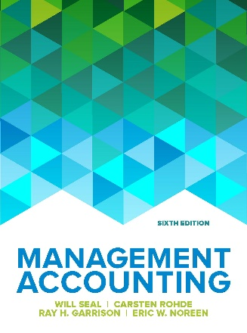
﻿LCBB5002
Management Accounting
Week 1
Management accounting and the business environment

Slide 2


LEARNING ACTIVITIES
Lectures via Microsoft teams (2hours)
Seminars via Microsoft teams (2hours)
  No Recording
Office hours by appointment
Individual work
  Text book
  Moodle
  Further reading

Slide 3
Learning Outcomes; by the end of this session you should be able to:
Identify the role of a management accountant
Recall differences between management and financial information
Discuss the relationship between management accounting and the internal and external environment
McGraw-Hill Education | Seal & Rohde Management Accounting 6th edition © 2018

Slide 4
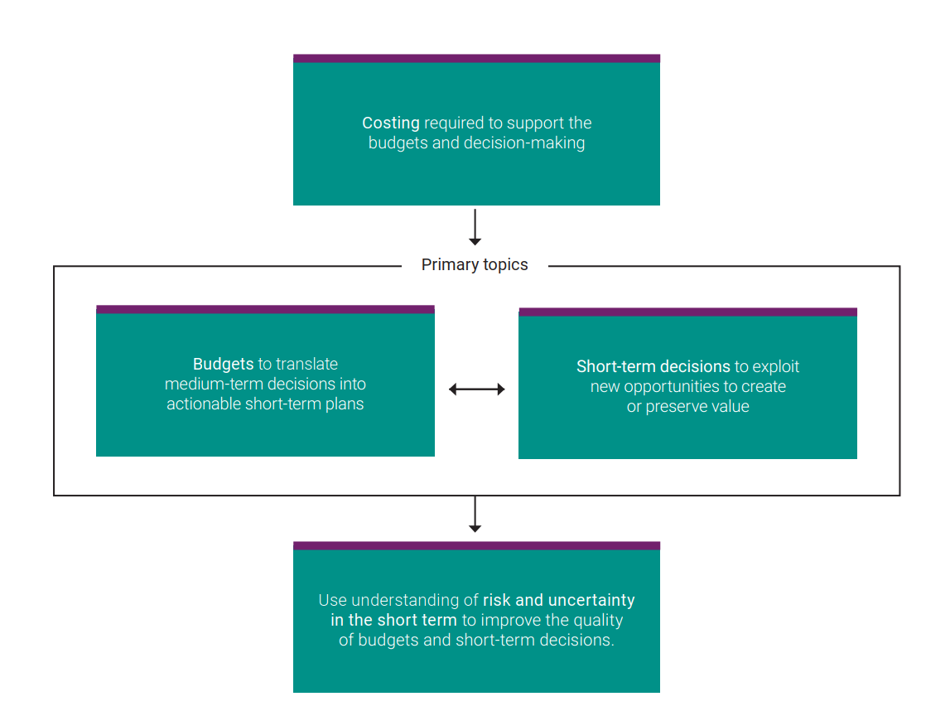
Components of management accounting
Costing
Budgets
Short term decision making
Risk and uncertainty
Introductory video

Slide 5
Management Accounting and Financial Accounting
Management accounting
provides information
for managers of an
organization who
direct and control
its operations.
Financial accounting
provides information
to shareholders,
accounts payable and
others who are outside
the organization.

Slide 6
Work of Management
Planning: costing and budgeting
Directing and motivating: performance measurement
Decision making: short term decision making
Controlling: Assessing risk

Slide 7
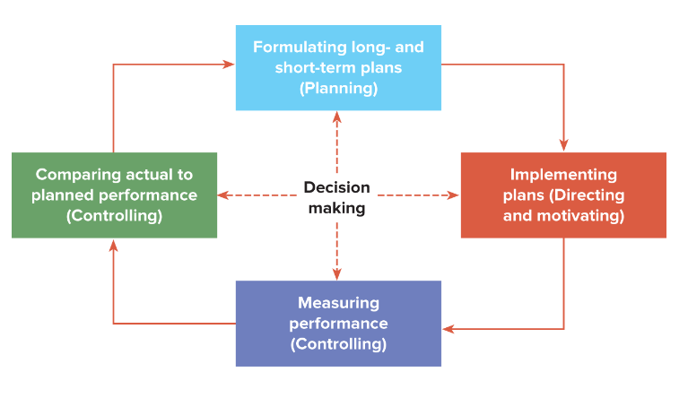
Planning and Control Cycle

Slide 8
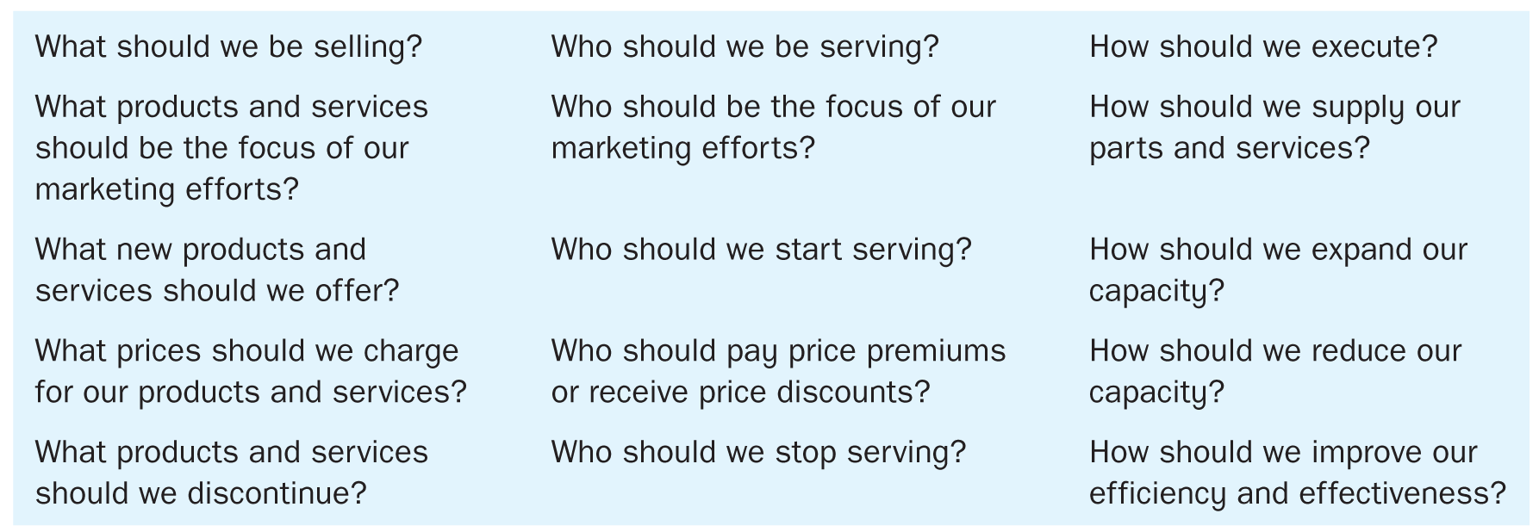
Examples of Decisions

Slide 9
Differences Between Financial and Management Accounting

Slide 10
Basic Organizational Structure
Decentralization
Line and staff relationships

Slide 11
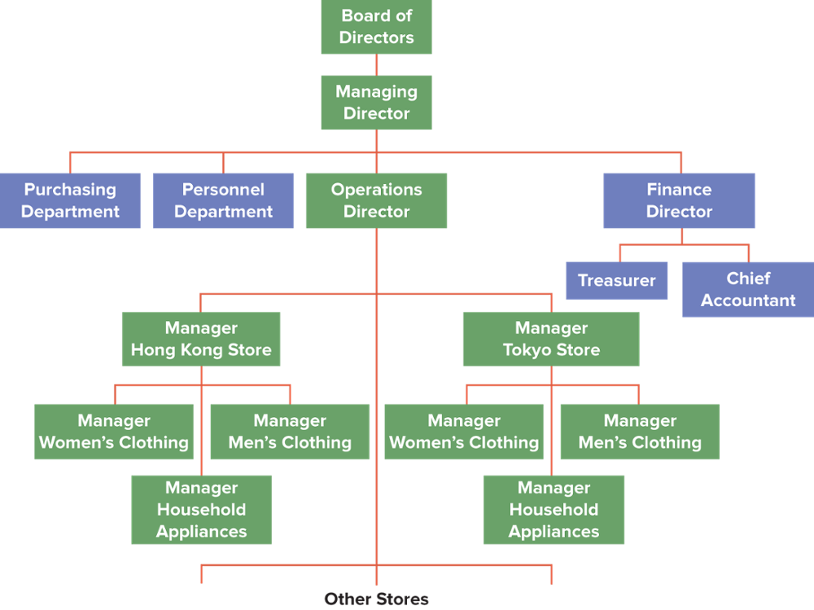
Organization Chart

Slide 12
Expanding Role of Management Accounting
Increasing complexity and
size of organizations
Regulatory
environment
Factors that
increase the need for
management accounting
information
Increased
emphasis
on quality
World-wide
competition
Rapid development and
implementation of technology

Slide 13
Globalization and International Competition
Meeting world-class competition demands a world-class management accounting system.
Managers must make decisions to plan, direct, and control a world-class organization.
This entails understanding how the internal and external environment of the business can affect its success.

Slide 14
The Changing Business Environment
  A more competitive environment emphasizing:
  Global competition
  New management tools
  New technology and business process
Business environment changes in the past twenty years

Slide 15
The Changing Business Environment
  ERP
  Just-In-Time
  Total Quality Management
  Theory of Constraints
New tools for managers!

Slide 16
Increased importance of service industry and non-tangible assets
Traditional costing derived from manufacturing industry.
Services now more important in many economies.
Service industries provide new challenges and opportunities
Competitive success related to intellectual assets and customer relations.

Slide 17
Increased importance of service industry and non-tangible assets
Service activities are subject to reorganization
Shared service centres – centralization of services such as accounting
Increased use of outsourcing
Changes in Public Sector Management
Governments demand new measures of performance in the public sector (NPM)

Slide 18
Value Management and Environmental Sustainability
Managing for value
  Awareness of shareholders value
  Shareholders value and customer value
  Understanding the cause and effect relationship
Managing for environmental sustainability
  Understanding environmental sustainability issues
  Understanding the three motives of environmental sustainability as; compliance motive, eco-efficiency motive and strategic motive

Slide 19
Emphasis on Corporate Governance and Business Ethics
Corporate governance and the consequences of corporate governance failure.
Understanding technical competence and adherence to a code of ethics as the two parts of professionalism.
Many companies and professional organizations, such as the Chartered Institute of Management Accountants (CIMA), have written codes of ethics which serve as guides for employees.

Slide 20
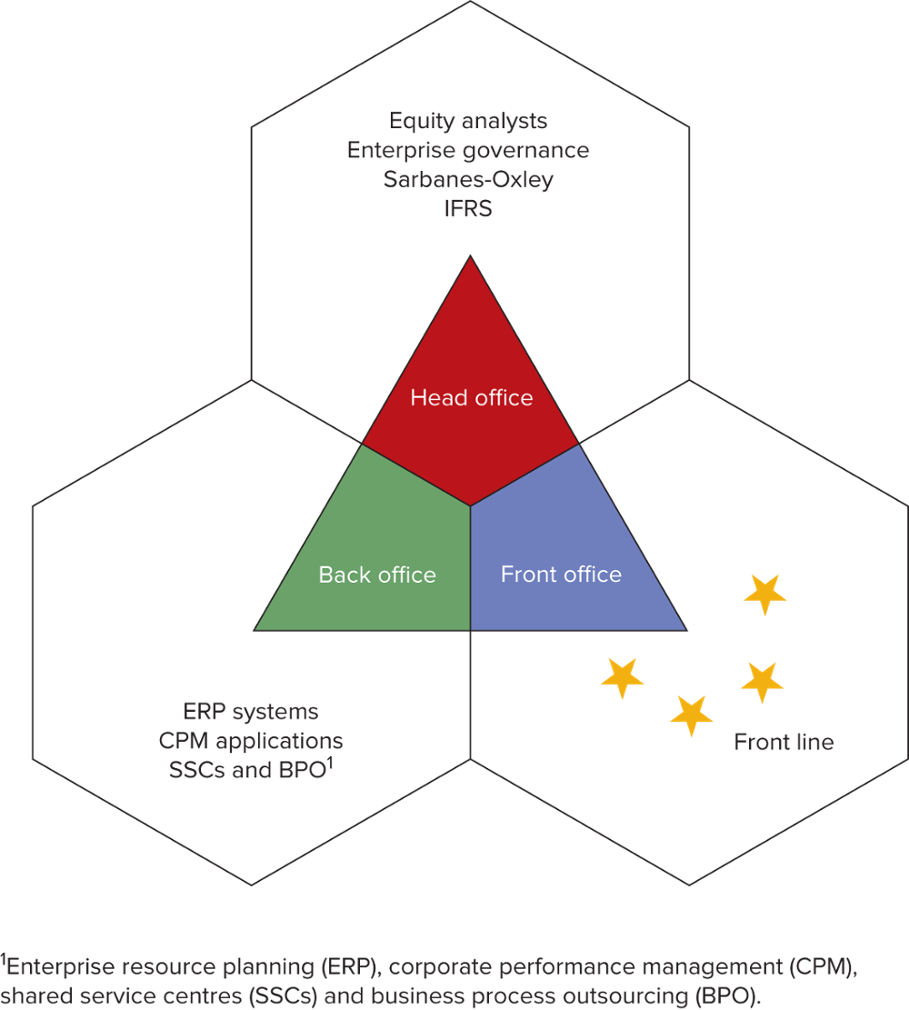
The Diverse Roles of Management Accountants within Large Corporations

Slide 21
References
Rhode, S. and Garrison, N. (2019) Management Accounting. Sixth edition. London, England: McGraw Hill
KnowledgEquity – Support for CPA (2016) Understanding value and its relevance to management accounting. Available at: https://youtu.be/u1dim7U1VRs (Accessed: 8th Feb 2021)

