Slide 1
International Entrepreneurship
How the culture affects entrepreneurship

Slide 2
What is the Entrepreneurship
"Entrepreneurship" refers to a person's pursuit of opportunity without considering control resources. (Eisenmann, 2013) For entrepreneurs, starting a business is about finding opportunities that others can't find, satisfying other people's unmet conditions, and doing business through their own efforts.

Slide 3
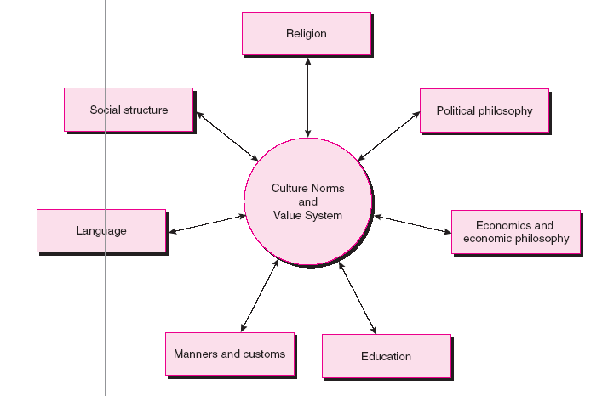
The Culture Framework

Slide 4
China(own country)
China is a country in Asia with a population of 135.7 million. The main economic form is the efficiency-driven economy. GDP per capita is $7,990, ranking 70th in the world. China is a socialist country with a history of 5,000 years. Therefore, China also retains a lot of ideas from ancient times in culture. This will have some impact on China's entrepreneurship.

Slide 5
Religion
China is a country of many religions. The main religions in China are Buddhism, Taoism, Islam, Catholicism and Christianity. Chinese citizens are free to choose, express their beliefs and show their religious identity. In China, all religions have equal status and coexist in harmony without religious disputes. Religious and non-religious citizens also respect each other and unite in harmony. It is because of the long-standing Chinese traditional ideology and culture, the influence of the spirit of tolerance and compatibility, but also because after the founding of the People's Republic of China, the Chinese government formulated and implemented the policy on freedom of religious belief, set up in accordance with the situation of the relationship between church and state.

Slide 6
Political philosophy
China's political philosophy emphasizes that only when the communist party is firmly in control of China can China achieve its strong and unified goal. As a result, China's political philosophy actually regulates all areas of China for the government. The emergence of Chinese entrepreneurship also comes from the government's demand.

Slide 7
Economics and economic philosophy
Pay attention to symmetry, Chinese economics is to subject dialectics of symmetric and asymmetric economics on the basis of theory, with people benefit maximization principle as the theoretical starting point, owned as economic basis, the value system as the core of market mechanism, the cooperation the fundamental power of economic development, the fundamental way of economic development of the economy as a harmonious, in order to maximize the happiness of the people as the ultimate goal, with symmetrical mode of thinking and holistic thinking method as methodology characteristics, good at five dimensional analysis of the basic model of economics, the basic structure and basic functions. Symmetry, concreteness and comprehensiveness are the core theories of Chinese economics.

Slide 8
Education
The Chinese government advocates education curriculum to implement innovative undertaking and shall establish and improve the innovation entrepreneurship education course system, construction, in turn, progressive, organic link, scientific and rational innovation entrepreneurship education specialized courses. But courses alone are not enough. It should also explore diversified innovation and entrepreneurship education mode, and carry out diversified innovation and entrepreneurship education activities. Innovation and entrepreneurship education curriculum should be based on the discipline curriculum, and should be based on the practice of the activity curriculum. The practicality of innovation and entrepreneurship education determines that it is not only the school thing, but also needs the support of the whole society. (gov.cn)

Slide 9
Manners and Customs
Since the founding of new China, self-reliance and hard work have become the credo of the Chinese people. China advocates an entrepreneurship that does not give up. Both investors and entrepreneurs should be patient. Entrepreneurship should not be abandoned or abandoned.

Slide 10
Language
Language is a way of spreading entrepreneurship. China's entrepreneurial spirit is insistent, and this is a common refrain from every Chinese learning Chinese book. Therefore, Chinese language is also the cradle of entrepreneurship.

Slide 11
Social structure
China's composition is divided into: official, celebrity, middle class and poor. Until 2018, with the government's support for entrepreneurship, the middle class (including private entrepreneurs) grew substantially, unemployment fell sharply, and the number of poor people fell sharply.

Slide 12
Culture norms and value system
Generally speaking, in China, the official system is widely regarded as the best employment outlet in China. But with the government's support for entrepreneurship, the number of Chinese entrepreneurs is growing. According to Chinese contemporary values, entrepreneurship is also becoming increasingly popular in China.

Slide 13
The United Kindom
The UK is a European country with a population of 65.1 million. Britain's per capita GDP is $43,771, ranking 13th in the world.

Slide 14
Religion
Religions in the UK:
Christians: 2010: 64%, 2050: 45%
Muslims: 2010: 5%, 2050: 11%
Hindus: 2010: 1.4%, 2050: 2%
Jews: 2010: 0.5%, 2050: 0.3%
Buddhists: 2010: 0.4%, 2050: 0.9%
Folk religions: 2010: 0.1%, 2050: 0.3%
No religion: 2010: 28%, 2050: 39% (BBC NEWS, 2015)

Slide 15
Political philosophy
In the UK, the Prime Minister leads the government with the support of the Cabinet and ministers.
In Scotland, Wales and Northern Ireland, devolved administrations are responsible for many domestic policy issues, and their Parliaments/Assemblies have law-making powers for those areas.
Areas the Scottish Government, Welsh Government, and the Northern Ireland Executive are responsible for, include:
health
education
culture
the environment
transport

Slide 16
Economics and Economic philosophy
The UK is an innovation-driven economy. In recent years, political and legal support for small and medium-sized enterprises has never been interrupted. Moreover, the UK's per capita GDP is the 13th in the world, which indicates that small and medium-sized enterprises have contributed greatly to the national economy. In such an economic environment, it can be seen that the innovation-driven economy is of great help to entrepreneurship.

Slide 17
Manners and Customs
The UK has a mature etiquette and customs in business. This means that commercial interests and customs have a long lasting impact on citizens, and may even be conducive to the cultivation of their entrepreneurship.

Slide 18
Language and Education
There are many words about business and entrepreneurship in English. English speakers are more or less affected by these words. Language is the quickest way for a person to come into contact with fresh food and develop an interest.

Slide 19
Social structure
Elite - the most privileged group in the UK, distinct from the other six classes through its wealth. This group has the highest levels of all three capitals
Established middle class - the second wealthiest, scoring highly on all three capitals. The largest and most gregarious group, scoring second highest for cultural capital
Technical middle class - a small, distinctive new class group which is prosperous but scores low for social and cultural capital. Distinguished by its social isolation and cultural apathy
New affluent workers - a young class group which is socially and culturally active, with middling levels of economic capital
Traditional working class - scores low on all forms of capital, but is not completely deprived. Its members have reasonably high house values, explained by this group having the oldest average age at 66
Emergent service workers - a new, young, urban group which is relatively poor but has high social and cultural capital
Precariat, or precarious proletariat - the poorest, most deprived class, scoring low for social and cultural capital

Slide 20
Culture norms and value system
In the UK, becoming a rich man is the goal of citizens, and entrepreneurship can help citizens achieve that goal. Therefore, the social culture greatly improves the entrepreneurship in the UK.

Slide 21
Conclusion
To compare with that two countries above, the influence between culture and entrepreneurship is essential. People got the information of entrepreneurship from their culture(Religion, language, customs and et al) In conclusion, the culture carries entrepreneurship and spread to people.

