Slide 1

Harvard Referencing: the basics
Connie Davage
Academic Liaison Librarian
IMH, Carmarthen

Slide 2
Background
You should already have a basic understanding of referencing and its importance if you have completed the following Library Infoskills Units:
Academic Integrity & Plagiarism.
Referencing: The Basics
It is strongly advised you complete both these units if you have not done so already. These will help you develop the academic skills required in identifying sources and referencing correctly.

Slide 3
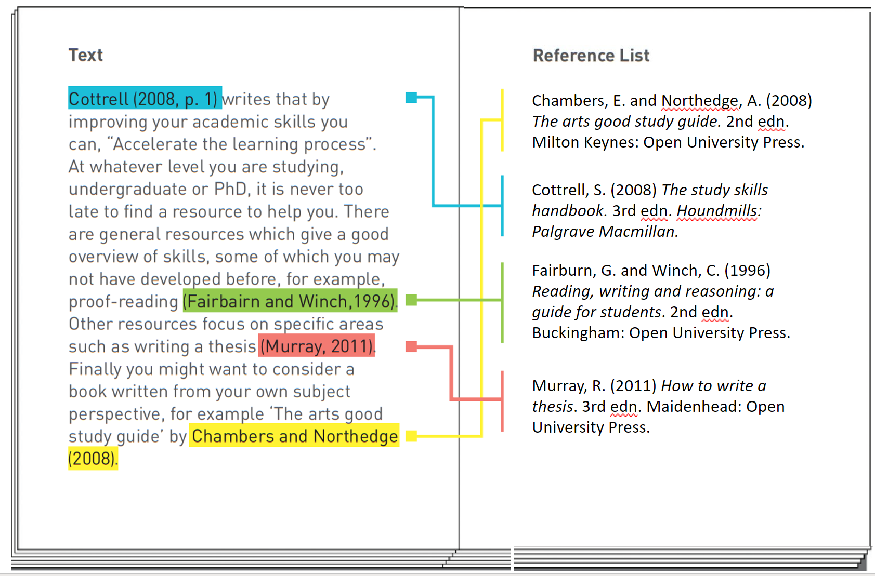
2 parts to Harvard Referencing:
1. In-text citation
2. Full reference list
This work is adapted and licensed under a Creative Commons Attribution 4.0 International License. Attribution: Leeds Beckett University Library.

Slide 4




Referencing your work using Treasure Hunt for Knowledge as an analogy

Slide 5

Finding Sources
Before you start your journey, you need to gather clues (sources).
Where will you look?
Are the clues reliable?

Slide 6
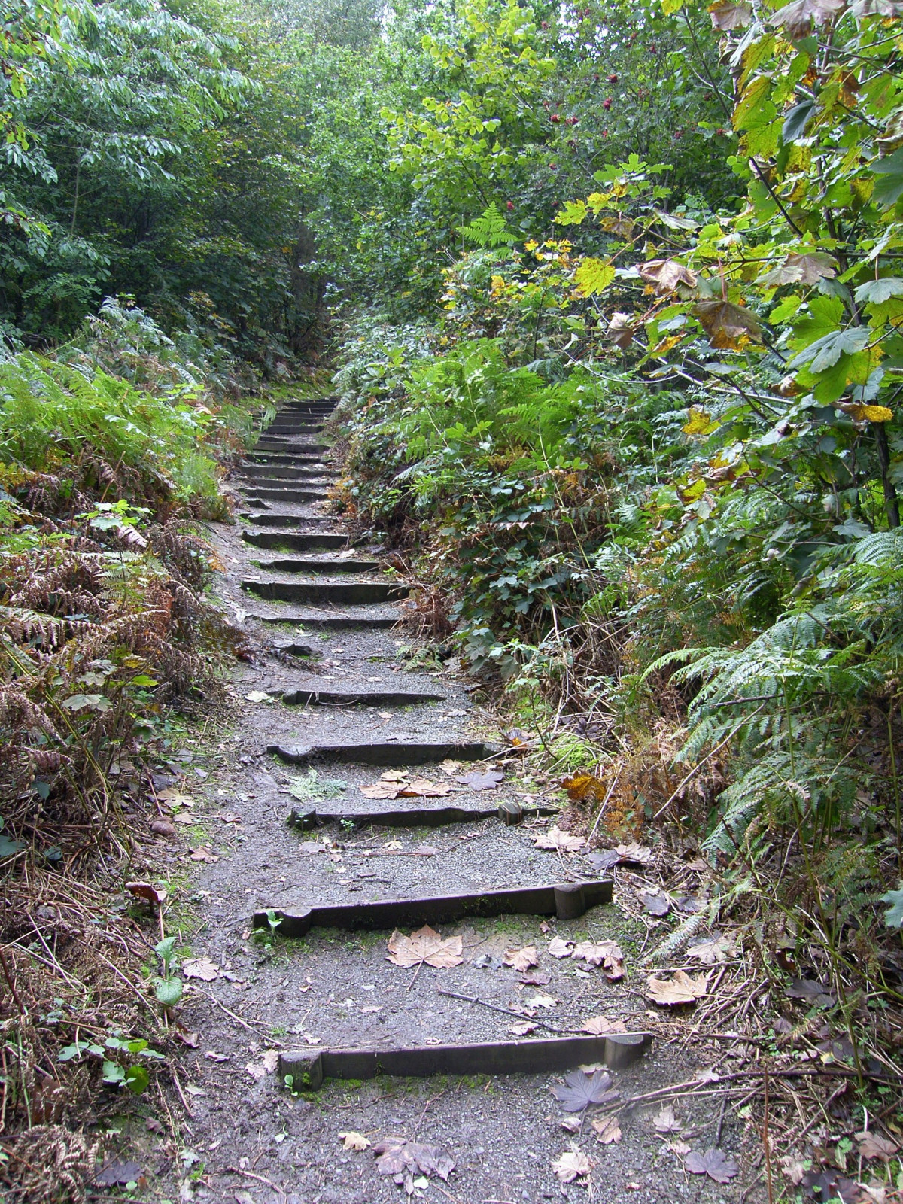
In-text citation
Signpost others can follow your path.
Citations act as markers.
They provide you’re not making things up and let others explore your sources.

Slide 7

Reference List
At the end of the hunt, you draw a complete map (reference list). So other can retrace your steps.
A full reference list helps your reader verify your sources.

Slide 8
Writing your references
The in-text citation: (A brief acknowledgement of your source in the body of your work.)
The reference list: (Providing your reader with the full reference details at the end of your work.)

Slide 9
Integrating sources into your work
In-text citation...
Used to let your reader know when you have used the ideas or words of another.
Allows you to acknowledge and discuss their work in your text, by quoting, paraphrasing, or summarising.
Forms part of your word count therefore, is brief.
It contains the following information only:
  Author / editor’s surname.
  Year of publication.
  Page numbers (if quoting or referring to a specific part or idea).

Slide 10

Quoting v Paraphrasing
Quoting: copying someone else’s words exactly as they appear in the original text.
Paraphrasing: using someone else’s words or ideas and writing in your own words.
Summarising: writing a brief overview of someone else's idea in your own words. Example: writing the findings of a research article in a journal in a few sentences.

Slide 11

Example
A recent study (Hughes, 2023) suggests students struggle to correctly reference their work. To ensure they do not accidently plagiarise, “students should record their sources as they use them” (Williams, 2024, p. 17).

Slide 12
Parenthetical citation
Author’s (Surname, year) in brackets.
  Effective communication is crucial for team success (Smith, 2020).
The sentence is focusing on the idea, rather than who wrote it.
Easy to integrate into your writing and synthesise from multiple sources.
Example: (Smith, 2020; Thomas, 2021; Williams, 2024).

Slide 13
Narrative citation
Author's Surname, (year) in brackets.
  According to Smith (2020), effective communication is crucial for team success.
Focus is on the author’s view or opinion.
Difficult to synthesise multiple opinions and sources.
Overuse can disrupt flow of your writing.

Slide 14
Example:
Parenthetical citation.
When writing assignments, the aim should always be to reference reliable sources of information (Pears and Shields, 2016).
Narrative citation.
According to Pears and Shields (2016) when writing assignments, the aim should always be to reference reliable sources of information.
Lack of quotation marks and page numbers indicate to your reader you have paraphrased, not quoted the ideas of the author cited in the sentence.

Slide 15
Quoting
Quoting is acceptable (if referenced correctly) but does not show your understanding of what you have read.
Wherever possible, you should paraphrase. Whichever you do, you must give appropriate acknowledgement.
If using a short quote (less than 30 words), ensure you:
Use “quotation marks”.
Show page number, (location, or paragraph number, if not possible).
For longer quotations, please refer to the referencing handbook.

Slide 16
Examples: Direct (short) quote
Parenthetical quotation.
When writing assignments, the “aim should always be to reference reliable sources of information” (Pears and Shields, 2016, p. 2).
Narrative quotation.
According to Pears and Shields (2016, p. 2) when writing assignments, the “aim should always be to reference reliable sources of information”.
Use of quotation marks and page numbers show your reader, you have used the exact words of the author cited in the sentence.

Slide 17
Which in-text citation is correct?
(Laura Smith, 2020)
Smith, L. (2020, p. 19)
Laura Smith (2020)
(Smith, 2020)
Smith et al. (2020)
(Smith, L. 2020)
(How to write an essay by Smith, 2020)
(Smith, 2020, p. 19).

Slide 18



Which citation is correct?
(Laura Smith, 2020)
Smith, L. (2020, p. 19)
Laura Smith (2020)
(Smith, 2020)
Smith (2020)
(Smith, L. 2020)
(How to write an essay by Smith, 2020)
(Smith, 2020, p. 19).
We do not use first names.
We do not include initials.
We do not use first names.
A parenthetical citation.
A narrative citation with 4 or more authors.
We do not include initials.
We do not include title, unless no author.
A parenthetical citation.
Notes:
No. 4 5 and 8 are the correct ones. we don’t use the first name in the intext citation, no initials either.

Slide 19
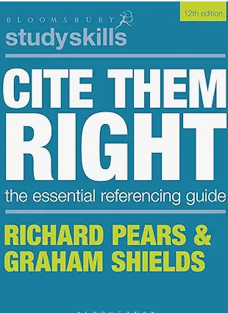
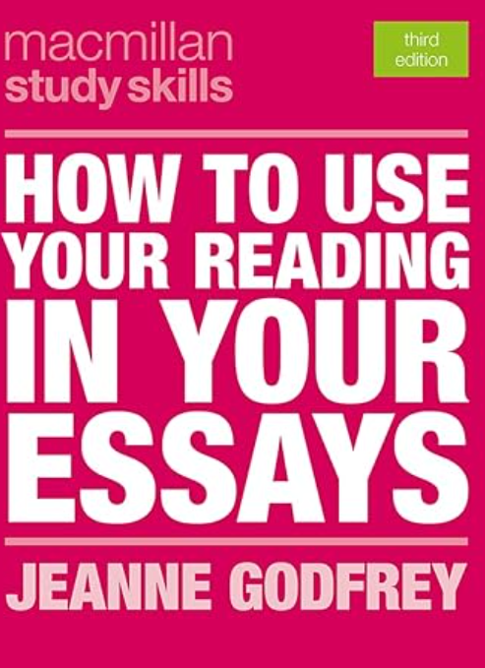
Useful Resources
How to use your reading in your essays.
Cite Them Right: Setting out citations.
Harvard Referencing: The Mechanics (infoskills).

Slide 20




What information makes up a reference?
WHO
Produced or created the source.
WHEN
It was published or created (year).
WHAT
It is called – the title
WHERE
It was published produced, accessed.

Slide 21
Full reference
Who?
Author’s surname, initals.
What?
Title in italics and edition if not the 1st.
Cottrell, S. (2019) The study skills handbook. 5th edn. London: Red Globes Press.
When?
Year of publication in round brackets.
Where?
Place of publication, and Publisher.

Slide 22
Harvard referencing: books
Print / print and electronic
Marchington, M., Wilkinson, A., Donnelly, R. and Kynighou, A.
(2021) Human resource management at work: the definitive guide. 7thedn.
London: Kogan Page.
Note: For books with four or more authors, use of the abbreviation “et al.” in the in-text citation only. All authors should be listed in your full reference list.
Marchington et al. (2021) or (Marchington et al., 2021)

Slide 23
Harvard referencing: books
Electronic only
Kirkwood, L., Harper, S. and Jones, T. (2015) The DIY culture in Britain: costs for homes and the nation. Available at: http://amazon.co.uk/kindle-ebooks (Accessed: 18 August 2018).

Slide 24
Harvard referencing: journal article
Who? Author’s surname, initials
When? Year of publication in round brackets
What? Title of article in single quotation marks
Thompson, P. (2007) ‘Communication technology use and study skills’, Active Learning in Higher Education, 18(3), pp. 257-270. Available at: https://doi.org/10.1177.1469787417715024
Available at:
Where? Name of journal in italics, , volume, issue/part, page range of whole article. DOI if accessed electronically (or URL and date accessed)
N.B. In case of journal articles accessed in hard copy, you can leave the ‘Where’ part, finish the reference with the pagination. However, it is a good practice to add the DOI if you can find one.

Slide 25
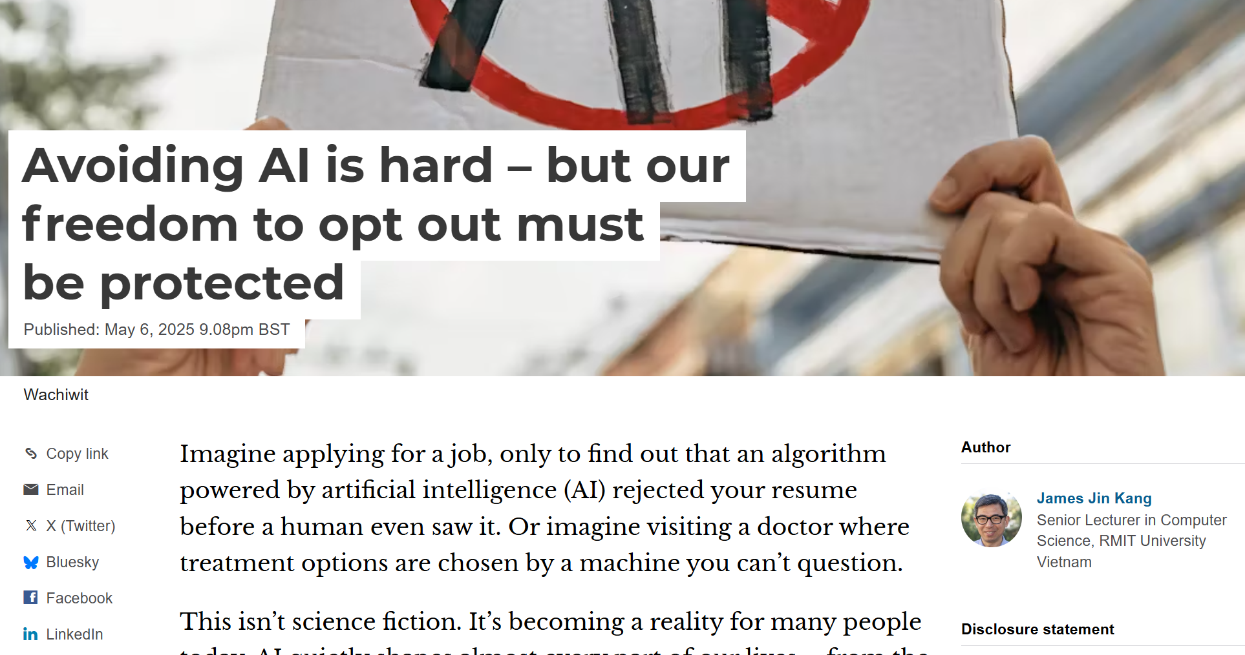
Harvard reference: web page
The Conversation.com

Slide 26
Harvard reference: web page
Who? Author's surname and initials
When? Date in round brackets
What? Title of webpage in italics
Kang, J.J. (2025) Avoiding AI is hard – but our freedom to opt out must be protected. Available at: https://theconversation.com/avoiding-ai-is-hard-but-our-freedom-to-opt-out-must-be-protected-255873?utm_source=clipboard&utm_medium=bylinecopy_url_button (Accessed: 6 May 2025).
Where? URL and date accessed (in round brackets).
Notes:
URL / Full Name
Uniform resource locator

Slide 27
Harvard reference: web page
…with organisational author.
CIPD (2023) What is wellbeing at work. Available at: https://www.cipd.org/en/knowledge/factsheets/well-being-factsheet/#what-is-wellbeing-at-work (Accessed: 30 April 2024).
Who
When
What
Where
The internet hosts a vast range of materials. Ask yourself, what type of work is this? and reference accordingly. If no author or title, you may use the URL and accession date… you may also want to question whether it is suitable to include in an academic assignment.
Notes:
‘no date’

Slide 28
Harvard referencing: what's wrong?
Parry, E., Morley, M.J., Brewster, C. (editors) (2021) The Oxford handbook of contextual approaches to human resource management. 1st edition. Oxford: Oxford University Press.
Parry, E., Morley, M.J., Brewster, C. (editors) (2021) The Oxford handbook of contextual approaches to human resource management. 1st edition. Oxford: Oxford University Press.
Parry, E., Morley, M.J. and Brewster, C. (eds.) (2021) The Oxford handbook of contextual approaches to human resource management. Oxford: Oxford University Press.

Slide 29
Harvard referencing: what's wrong?
Shore, L.M., Cleveland, J.N. and Sanchez, D. (2018) “Inclusive workplaces: a review and model” in Human resource management review 28, p.176-189. Available at: https://doi.org/10.1016/j.hrmr.2017.07.003 (Accessed: 12 April 2024).
Shore, L.M., Cleveland, J.N. and Sanchez, D. (2018) “Inclusive workplaces: a review and model”, in human resource management Review 28, p.176-189. Available at: https://doi.org/10.1016/j.hrmr.2017.07.003 (Accessed: 12 April 2024).
Shore, L.M., Cleveland, J.N. and Sanchez, D. (2018) ‘Inclusive workplaces: a review and model’, Human Resource Management Review 28, pp.176-189. Available at: https://doi.org/10.1016/j.hrmr.2017.07.003

Slide 30
Harvard referencing: what's wrong?
Holly, G.H. (2020). Can dogs help to reduce stress? Retrieved from:
www.bbc.com/bitesize/articles/z3bqfcw Accessed: 30th January 2021.
Holly, G.H. (2020). Can dogs help to reduce stress? Retrieved from: www.
bbc.com/bitesize/articles/z3bqfcw Accessed: 30th January 2021.
Holly, G.H. (2020) Can dogs help to reduce stress? Available at: https://
www.bbc.com/bitesize/articles/z3bqfcw (Accessed: 30 January 2021).
Notes:
G.H. no space between initials

Slide 31
Where to find the information you need
Print books.
Title page.
Back of title page (verso).
Printed journal articles.
Beginning of the article.
Table of contents.
Electronic journal articles.
Top of first page (before or after article title).
Web pages.
Top / bottom of first page.
Logos.
URL = address bar at top of screen.
Tip.
Right click – Properties. This may display when the page was last modified.

Slide 32
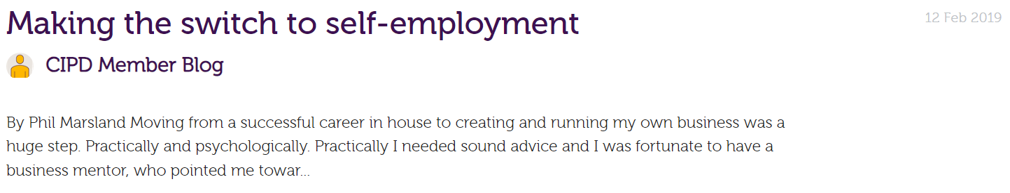
Exercise: blog
Marsland, C. (2019) ‘Making the switch to self-employment’, CIPD Member Blog, 12 February. Available at: https://community.cipd.co.uk/cipd-blogs/b/cipd_member_blog/posts/making-the-switch-to-self-employment (Accessed: 2 September 2024).

Slide 33
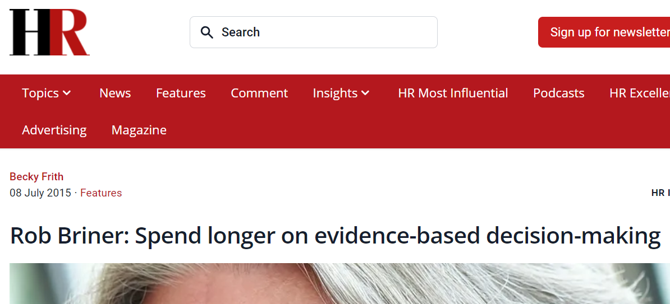
Exercise: magazine
Frith, B. (2015) 'Rob Briner: spend longer on evidence-based decision-making', HR Magazine, 8 July. Available at: https://www.hrmagazine.co.uk/content/features/rob-briner-spend-longer-on-evidence-based-decision-making (Accessed: 10 October 2024).
Notes:
Need page information if accessed via a print copy.

Slide 34

Exercise: podcast
D'Souza, D. (2024) HR People Pod – Ep 3: a new UK government and a ‘new deal for working people' [Podcast]. 5 July. Available at: https://soundcloud.com/cipd/hr-people-pod-episode-three (Accessed: 10 October 2024).
https://www.cipd.org/uk/knowledge/podcasts/hr-people-pod/

Slide 35
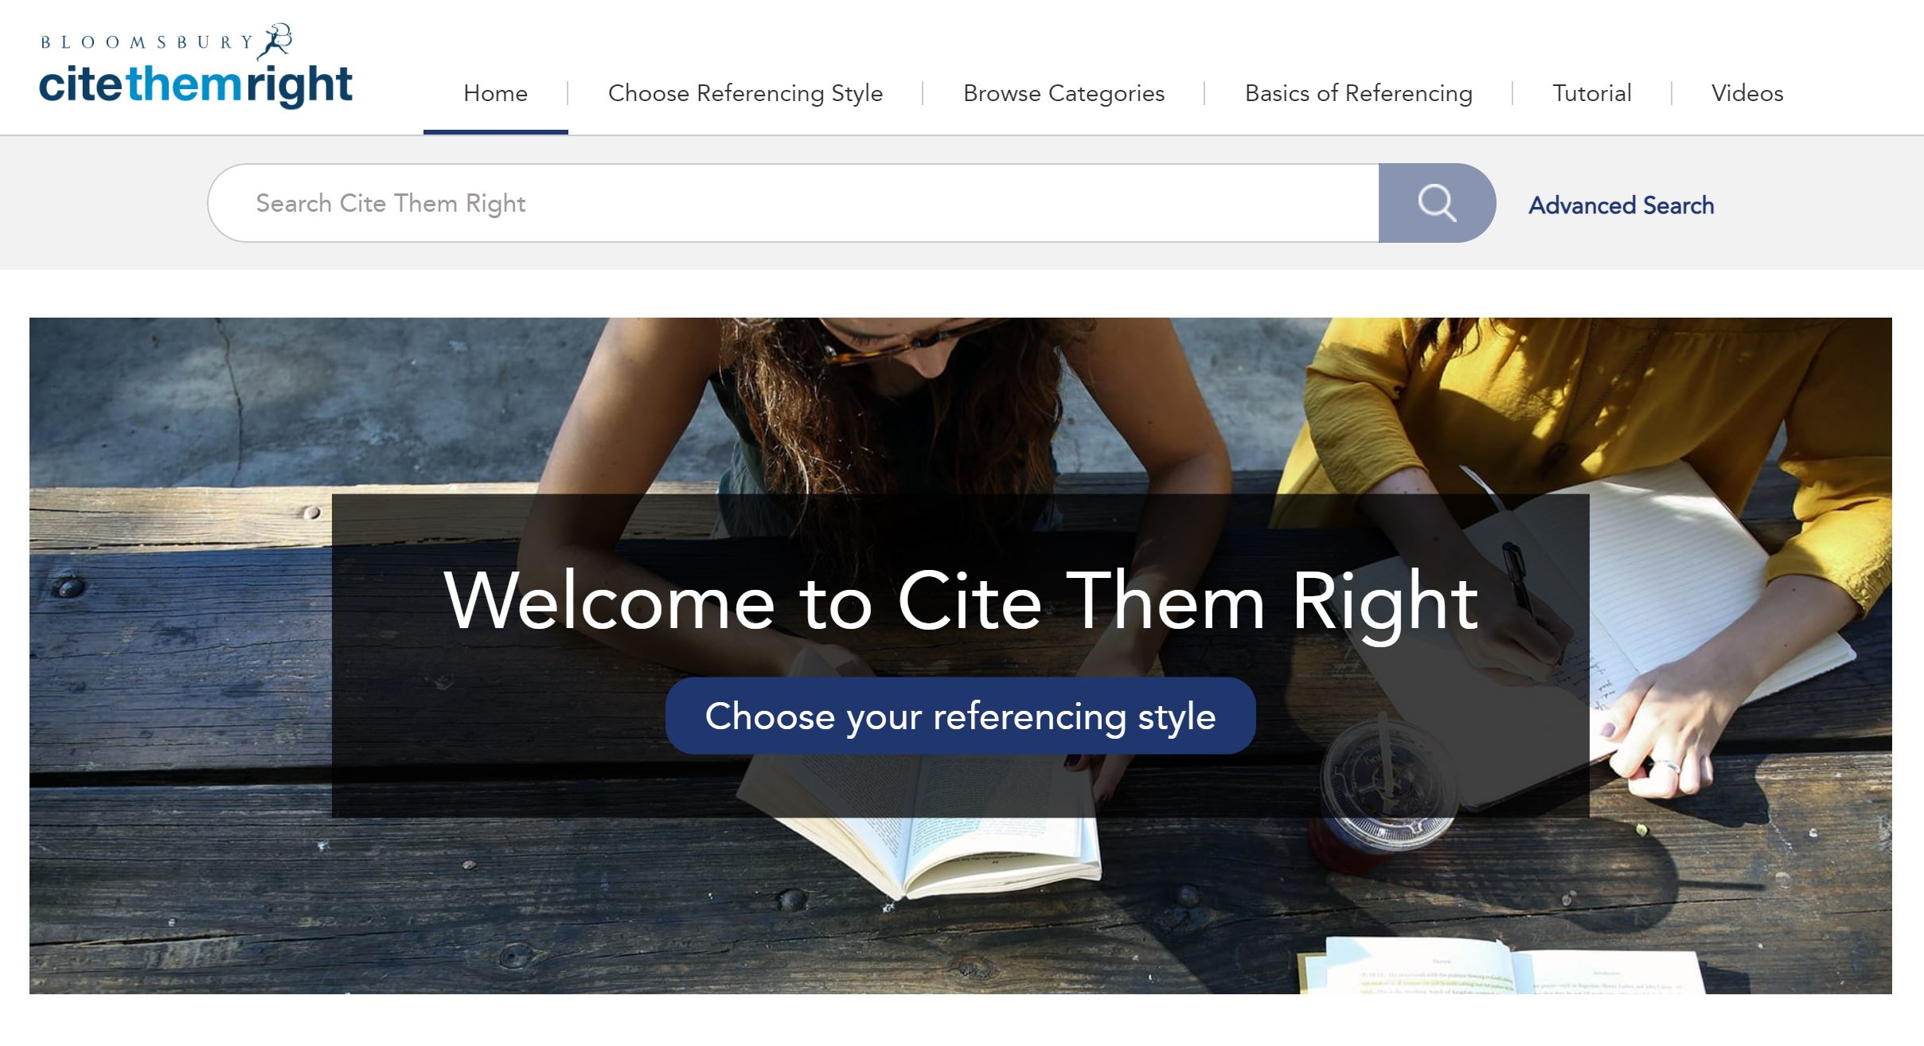
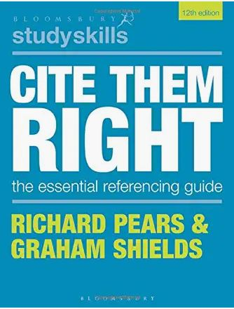
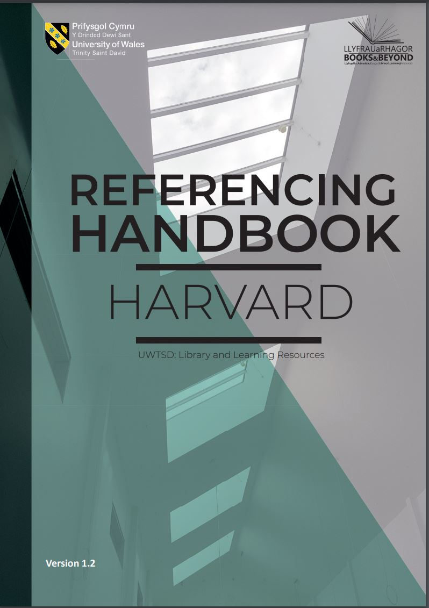
Referencing Help
Library catalogue – Database Search tab – Cite them right: the essential referencing guide.
12th edition (2022).
Cite them Right database
12th edition (2022).
Cite them Right print book
Referencing handbook: Harvard
Notes:
How to use the database

Slide 36
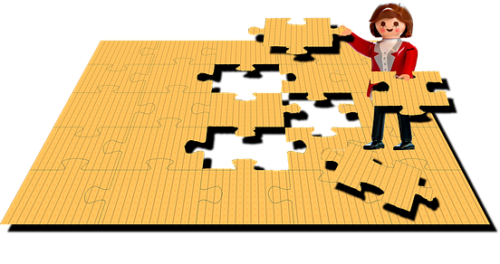
When creating a reference ...
Find an example which matches your source. If you cannot find an exact match, choose the example most like it and follow the format.
By putting together the different parts an elements, you can construct a citation and reference for any type of work.
Be consistent.
Watch the detail - capitalisation, punctuation and typeface are important.
Notes:
When you try to create a reference – have a copy of example from book or Cite them right: find a match, or a close example. If not, you can construct one by using who-when-what-and where elements
Be consistent, watch out the detail – capitalisation, punctuation etc, down to attention to detail

Slide 37

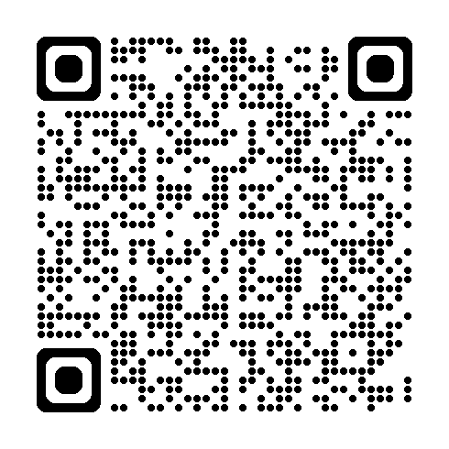
RefWorks
An online referencing management service.
Supported by the library.
Import references into a personal database.
Manage, store, and share references.
Insert references into assignments.
Generate formatted bibliographies.
RefWorks
Online tutorial -

Slide 38


Tips to improve your referencing
When used properly, references strengthen and enhance your work.
Understand the basics before you begin.
Keep a record of all sources as you use them.
Be consistent in the records you keep and in the way you reference.
Check your references before submitting your assignment.
Ask for help if you need it – your librarian, course tutor or student services can advise.

Slide 39

Help is always available
Connie Davage
Academic Liaison Librarian
c.davage@uwtsd.ac.uk
infoskills@uwtsd.ac.uk

Slide 40
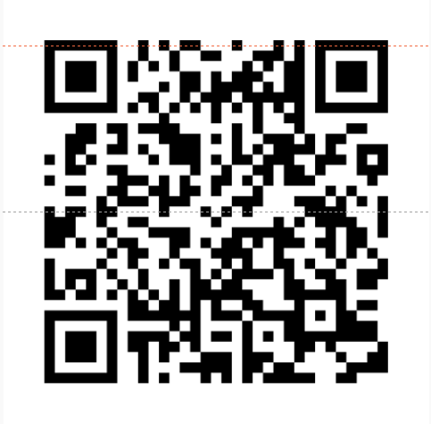
Let us know how we did.
If you have 5 minutes, please scan the QR code and fill out our feedback form.

