Slide 1
DS3
Digital Portfolio
and Reflection
A personal learning journey through Digital Skills
Viorica Dronea
Student ID: 2539443
UWTSD Digital Skills
Notes:
Hello, my name is Viorica Dronea. This is my DS3 Digital Skills portfolio. In this reflection, I will talk through the work I selected from the module and explain what it shows about my learning. I will also explain what was difficult at the beginning, what I can now do more independently, and how these skills can help me in university, work and daily life.

Slide 2
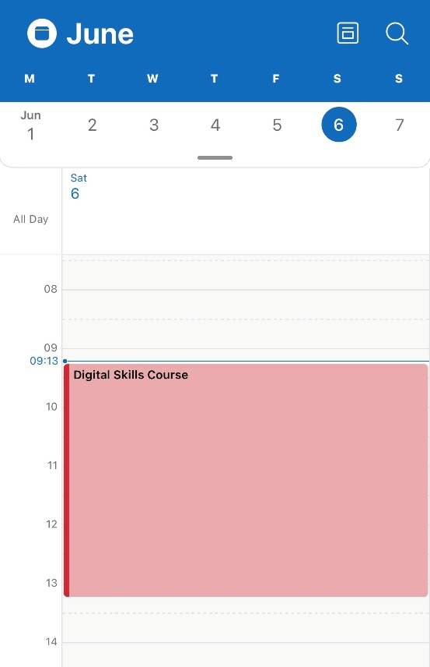
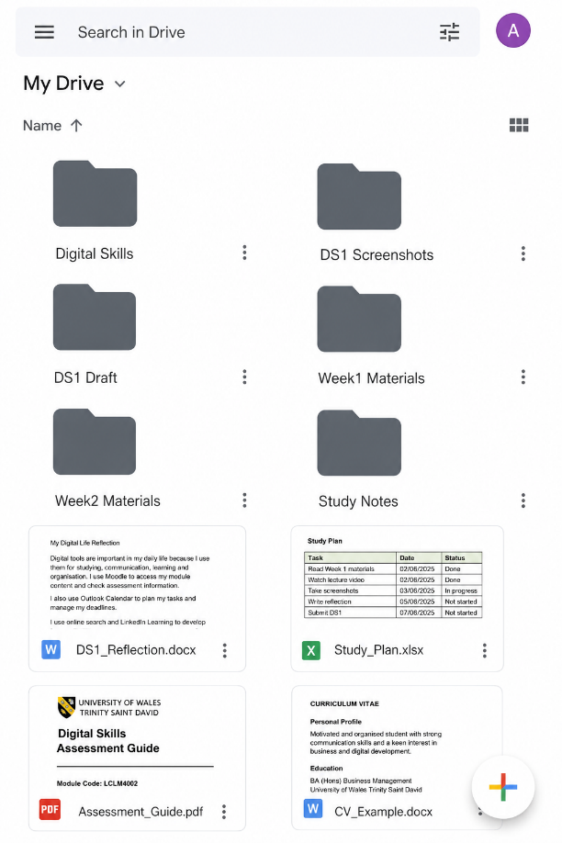
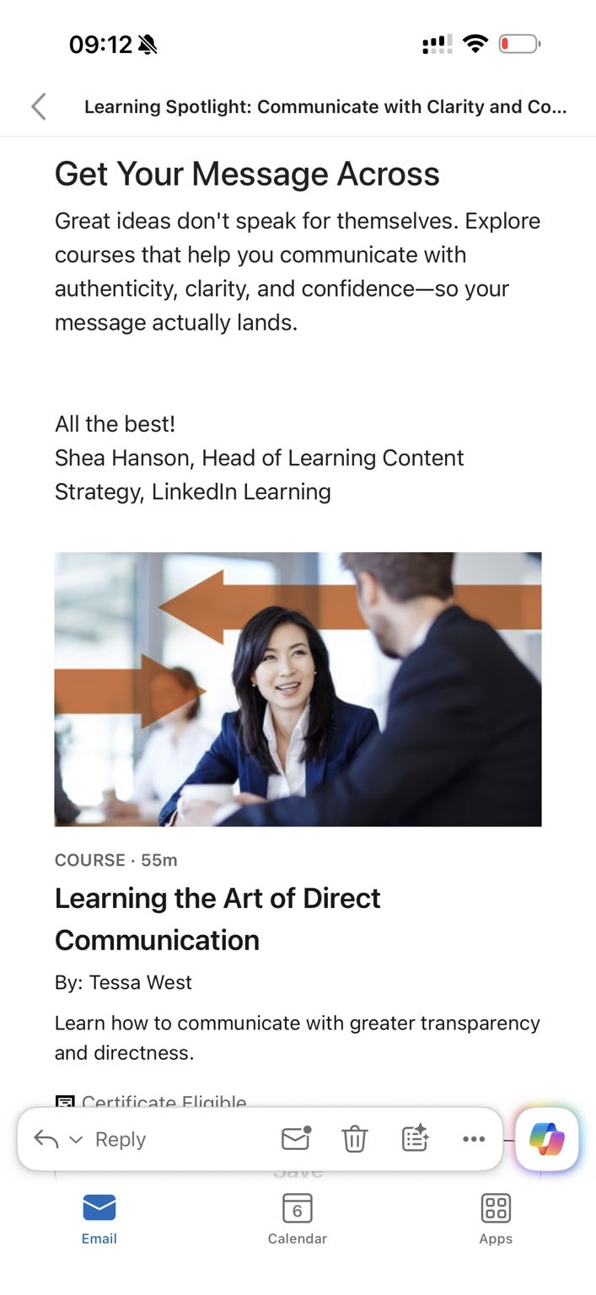
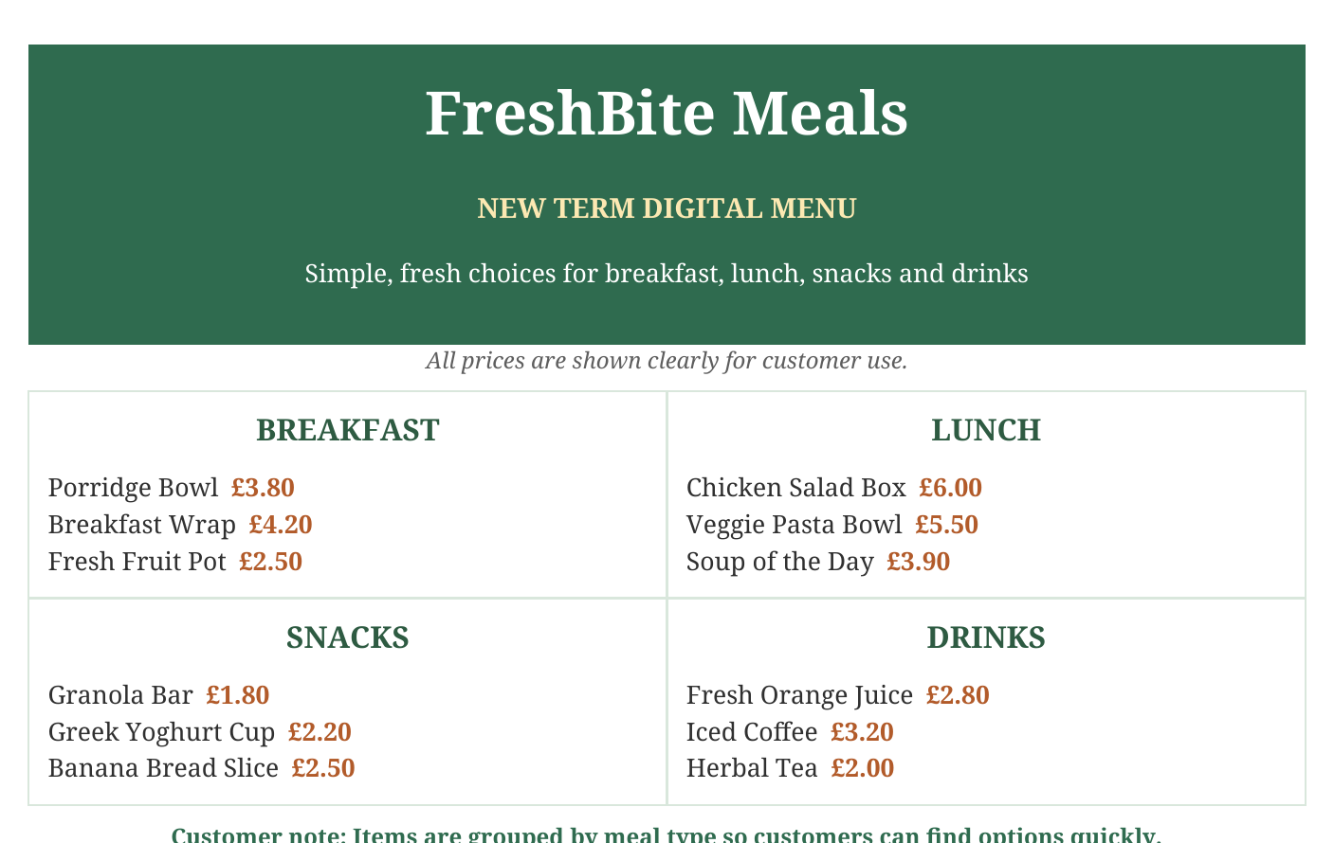
PORTFOLIO OVERVIEW
Evidence of my progress
I chose items that show organisation, learning and a business outcome.
5
portfolio items
2
module tasks used
1
clear learning story
DS1 shows everyday digital study habits.
DS2 shows a finished customer-facing menu.
Together, they show movement from using tools to creating useful digital work.
Viorica Dronea | Digital Skills DS3
01
Notes:
For this portfolio, I chose five pieces of work. I did not choose them because they are perfect. I chose them because they show different parts of my progress. DS1 shows how I used digital tools for study, such as Moodle, Calendar, Notes and folders. DS2 shows how I used Microsoft Word to create a finished menu for a business scenario. Together, the examples show that I can use digital tools with more purpose than before.

Slide 3
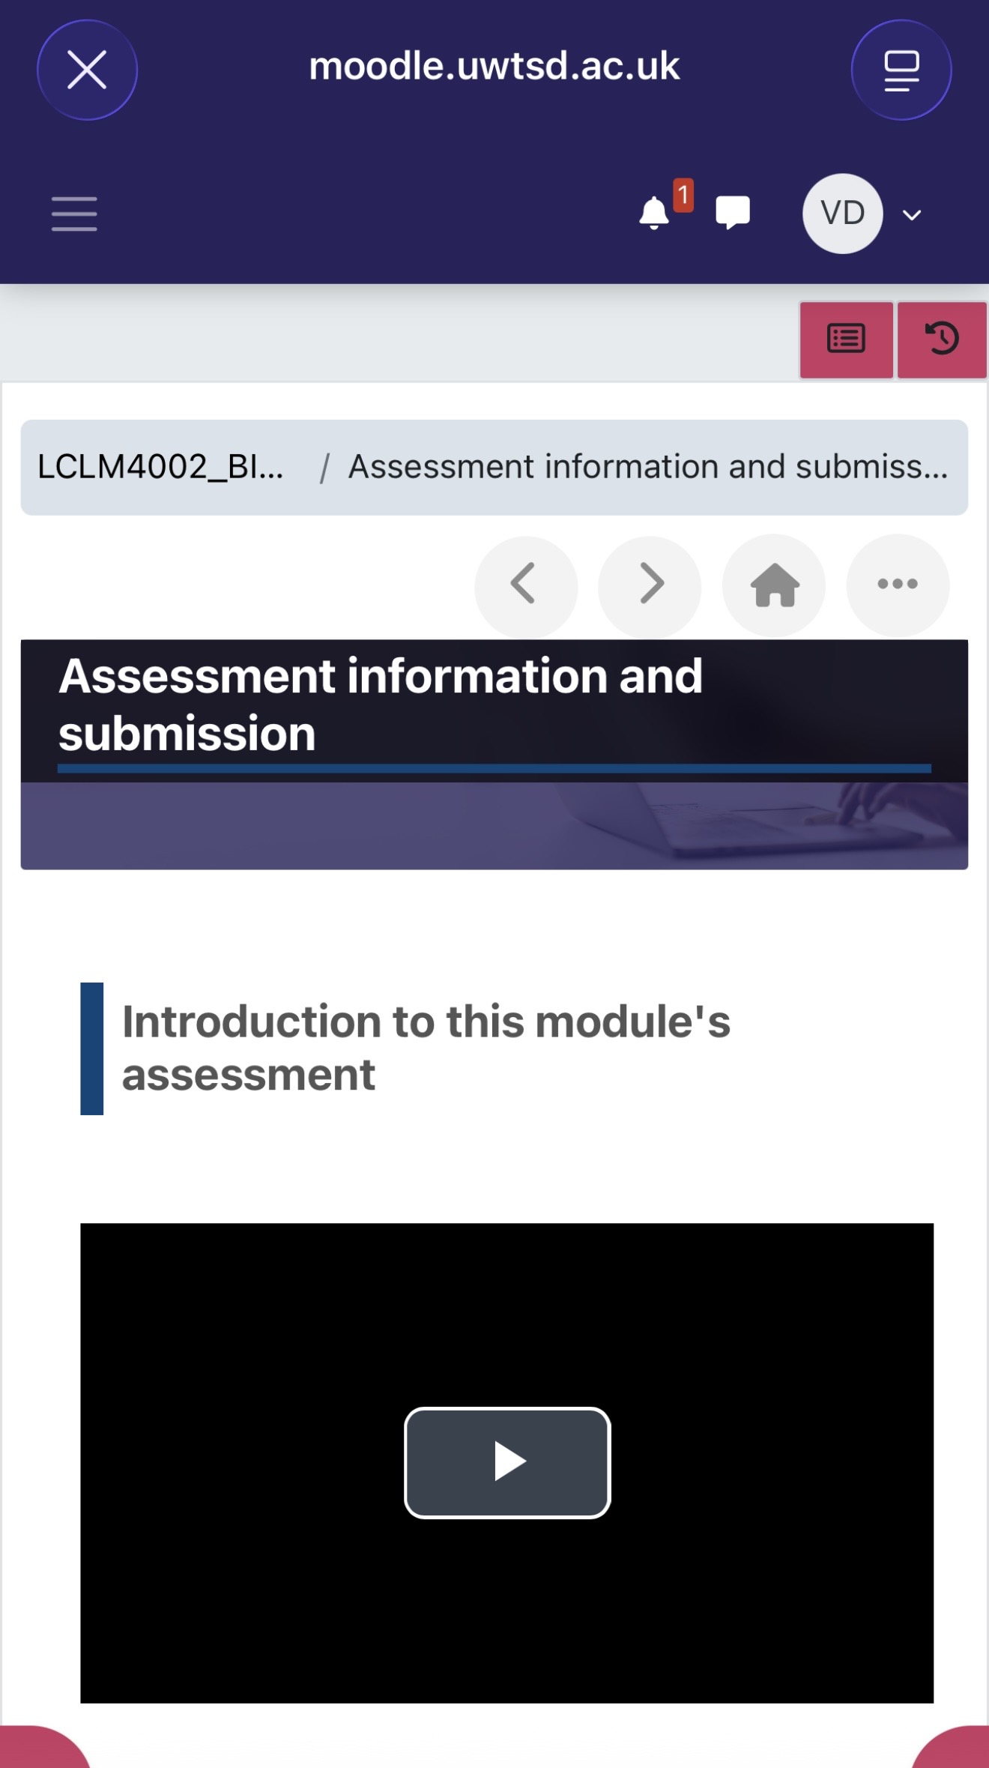
STAGE 1: UNDERSTANDING THE TASK
Using Moodle to know what to do
The first skill was finding the assessment information.
What this shows
I used Moodle to open the Digital Skills assessment area.
I checked the instructions and the submission information before starting.
This helped me understand the task instead of guessing what was needed.
This example is simple, but important: good digital work starts with finding the correct instructions.
Viorica Dronea | Digital Skills DS3
02
Notes:
The first piece of evidence is my Moodle assessment page. I used Moodle to find the Digital Skills assessment information, watch module materials and check where work needed to be submitted. This mattered because it helped me start with the correct instructions. At first, I could feel unsure about where to find things online, but using Moodle made the task clearer and helped me work more independently.

Slide 4
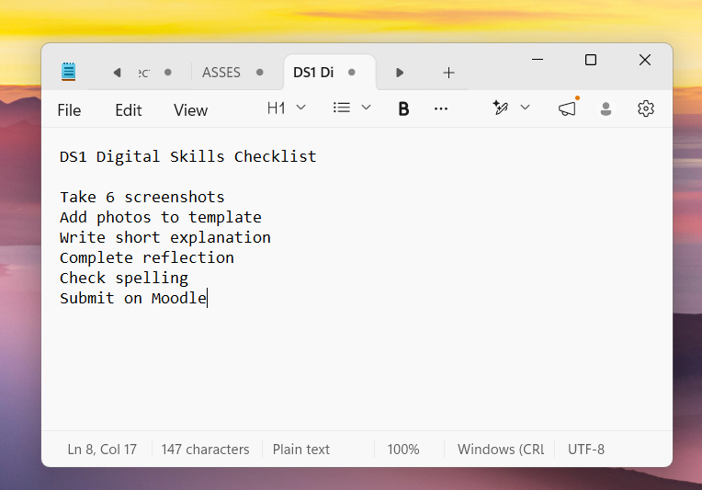
STAGE 2: PLANNING THE WORK
Turning deadlines into small actions
Calendar and Notes helped me manage the work step by step.
Why it helped
Calendar reminded me of course sessions and assessment dates.
Notes made the DS1 task easier by breaking it into a checklist.
This reduced stress because I could see the next step clearly.
The main improvement here was moving from remembering tasks in my head to using digital planning tools.
Viorica Dronea | Digital Skills DS3
03
Notes:
The next part of my portfolio is planning. I used Outlook Calendar to add my Digital Skills course and important assessment dates. I also used the Notes app to make a checklist for DS1. This helped because the assignment felt easier when it was divided into smaller actions, such as taking screenshots, writing short explanations and checking the file before submission. I can now use these tools to organise work without relying only on memory.

Slide 5
STAGE 3: KEEPING WORK ORGANISED
Building a clearer file system
This was one of the areas I wanted to improve.
Before
Files could be saved in different places.
It was easy to waste time searching.
Now
I use folders for drafts, screenshots and weekly materials.
I can find evidence faster when preparing work.
File organisation is a basic skill, but it affects every assignment because it keeps evidence easy to find.
Viorica Dronea | Digital Skills DS3
04
Notes:
This slide shows my digital folders. In DS1, I said that I wanted to improve how I organised files. This portfolio shows that progress. I created folders for Digital Skills, DS1 screenshots, drafts, weekly materials and notes. This is not a complicated tool, but it makes a big difference. I can find work faster, keep evidence together and avoid confusion before submission.

Slide 6
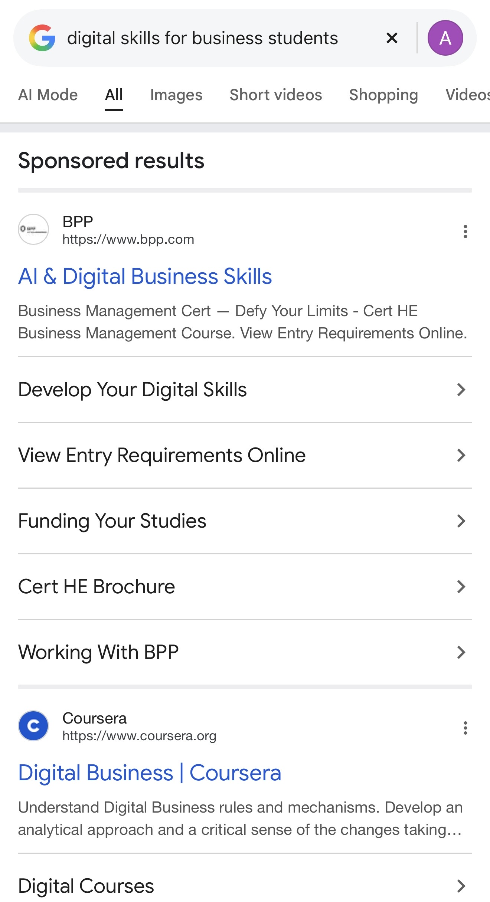
STAGE 4: LEARNING ONLINE
Finding useful information
Search and LinkedIn Learning supported my development.
Skills practised
Using clearer keywords instead of very long questions.
Choosing information that connects to university work.
Using online learning to build professional skills, such as communication.
This helped me see digital skills as part of learning, not only as a way to submit work.
Viorica Dronea | Digital Skills DS3
05
Notes:
Another part of my portfolio is online learning and search. I used online search to find information connected to digital skills, and I used LinkedIn Learning to look at communication skills. This helped me understand that digital skills are also about learning how to learn. I practised using clearer keywords and choosing information that is useful for university or future work.

Slide 7
STAGE 5: CREATING A DIGITAL ARTEFACT
FreshBite Meals: a customer-ready menu
DS2 moved from study organisation to business communication.
Design decisions
I used Microsoft Word because the task was a clear one-page document.
I grouped the menu by Breakfast, Lunch, Snacks and Drinks.
I kept prices visible so customers would not have to search for them.
I used a simple fresh colour style instead of adding too many decorations.
Viorica Dronea | Digital Skills DS3
06
Notes:
The strongest finished artefact in this portfolio is my DS2 FreshBite Meals menu. I created a one-page digital menu in Microsoft Word. I chose Word because the work needed headings, spacing and clear text more than calculations. I grouped the items into Breakfast, Lunch, Snacks and Drinks, and I kept the prices easy to see. This made the menu more useful for customers and more suitable for a small business.

Slide 8
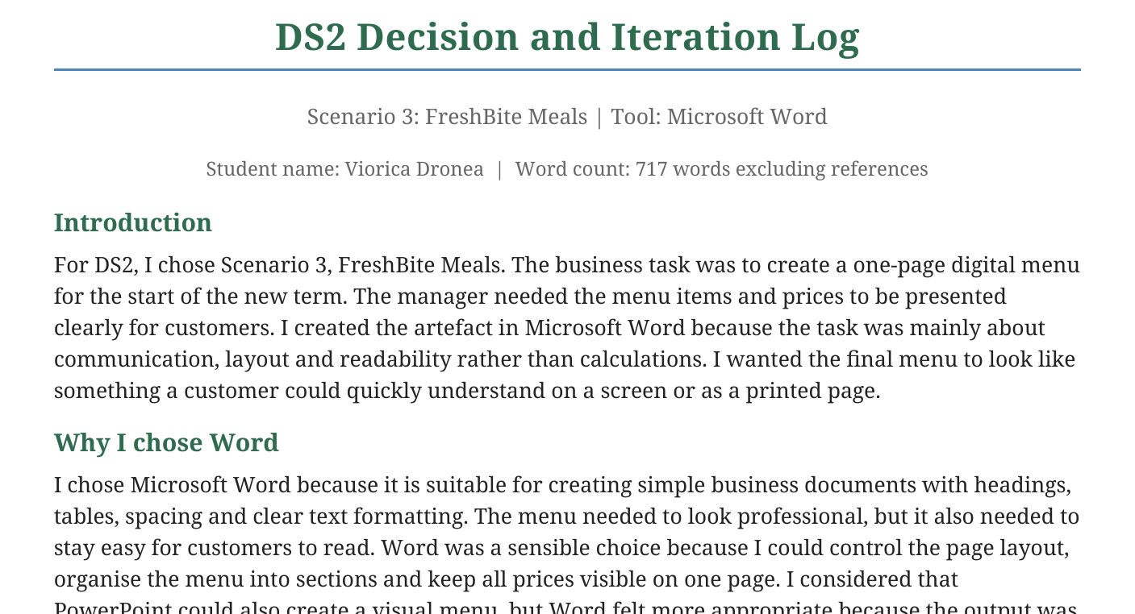
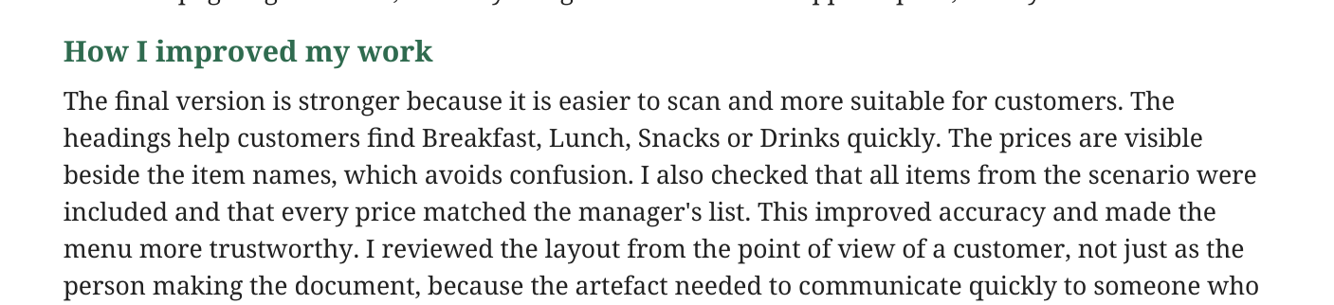
REFLECTION ON IMPROVEMENT
What changed after feedback and checking
The menu became clearer because I reviewed it from the customer’s point of view.
Improved choices
The first version was accurate but looked like a basic list.
I added clearer section headings and more spacing.
I kept the menu to one page, as the scenario required.
I checked the items and prices against the scenario to avoid mistakes.
The main learning point was that digital work must be accurate, but it also has to be easy for the reader to use.
Viorica Dronea | Digital Skills DS3
07
Notes:
I also included the decision and evaluation part of DS2 because it shows how I improved the work. The first draft had the correct menu information, but it looked too plain. I improved it by adding stronger headings, clearer spacing and a simple colour style. I checked that all items and prices matched the scenario, because accuracy is important in a business document. This taught me to think about the person who will read the work, not only about completing the task.

Slide 9
FINAL REFLECTION
What I can now do more independently
The module helped me build practical habits I can use again.
Now I can...
Sources that supported me
find assessment information on Moodle;
UWTSD Moodle Digital Skills materials
plan tasks with Calendar and Notes;
FreshBite Meals DS2 scenario
organise files and evidence in folders;
Microsoft Support guidance for Word tables and accessibility
search for learning materials more carefully;
LinkedIn Learning communication skills course
create a simple digital menu for a business purpose.
Overall, my confidence has improved because I can now choose a suitable tool, complete a digital task and explain why I made certain choices.
Viorica Dronea | Digital Skills DS3
08
Notes:
Overall, this portfolio shows practical progress. I can now find assessment information, plan tasks, organise files, search for learning materials and create a simple business document with more independence. These skills help me in university because I can manage assignments more clearly. They can also help me at work because I can prepare simple documents and communicate information better. In daily life, I can use the same skills for planning, saving files and checking information online. Thank you for listening.

