Slide 1
Bridging: your experiences in
3-2-1
Three things you observed
Two things that surprised you
One question

Slide 2

Aseiniad / Assignment
M6X001438/C

Slide 3
TITLE:
‘Describe a learning event which has happened during your classroom observation.
Reflect upon what took place, connecting events to theories of learning and teaching.
Make recommendations about how you could improve your own practice in the light of this, and produce a digital poster to illustrate how you would use all of this information to develop the elements of an effective learning environment.’

Slide 4
What is a learning event?

Slide 5
Introduction and conclusions
Include BRIEF introduction and conclusions where you outline the context in which you carried out your observation – showing an awareness of ethical issues you have considered eg anonymity. When you conclude, summarise the key points that you wish the reader to be aware of (approx. 500 words).

Slide 6
Part 1: OBSERVE
Complete a vignette (a retelling of something that happened) to describe a learning experience, behavioural incident or social interaction that took place during your classroom observation. Explain why you selected this as a significant event, relating to module content eg exploratory talk; metacognition; inclusive practices (approx. 1500 words).

Slide 7
Part 2: CONNECT
Using the lens of a particular learning theory or theories, explain how consideration of these has helped you to understand what went on during this event, and how this could impact on outcomes for pupils in your future practice (approx 1500 words).

Slide 8
Part 3: REFLECT & INNOVATE
Create a digital poster that exemplifies your ideal learning environment, and submit a commentary to explain and justify the pedagogical principles underpinning this provision (equivalent to 1500 words).

Slide 9
WORD COUNT
5,000 words including 1,500 word equivalence for the digital poster and commentary. This means that the written assignment should be 3,500 words (or 10% above or below) and the digital poster and commentary should be 1,500 or equivalent.

Slide 10
POSTER
Producing an Academic Poster can be a great way of presenting research in a concise and powerful manner.
The best Academic Posters are those which can effectively summarise the important aspects of a given research topic, are easy to read and understand, and are visually appealing.

Slide 11
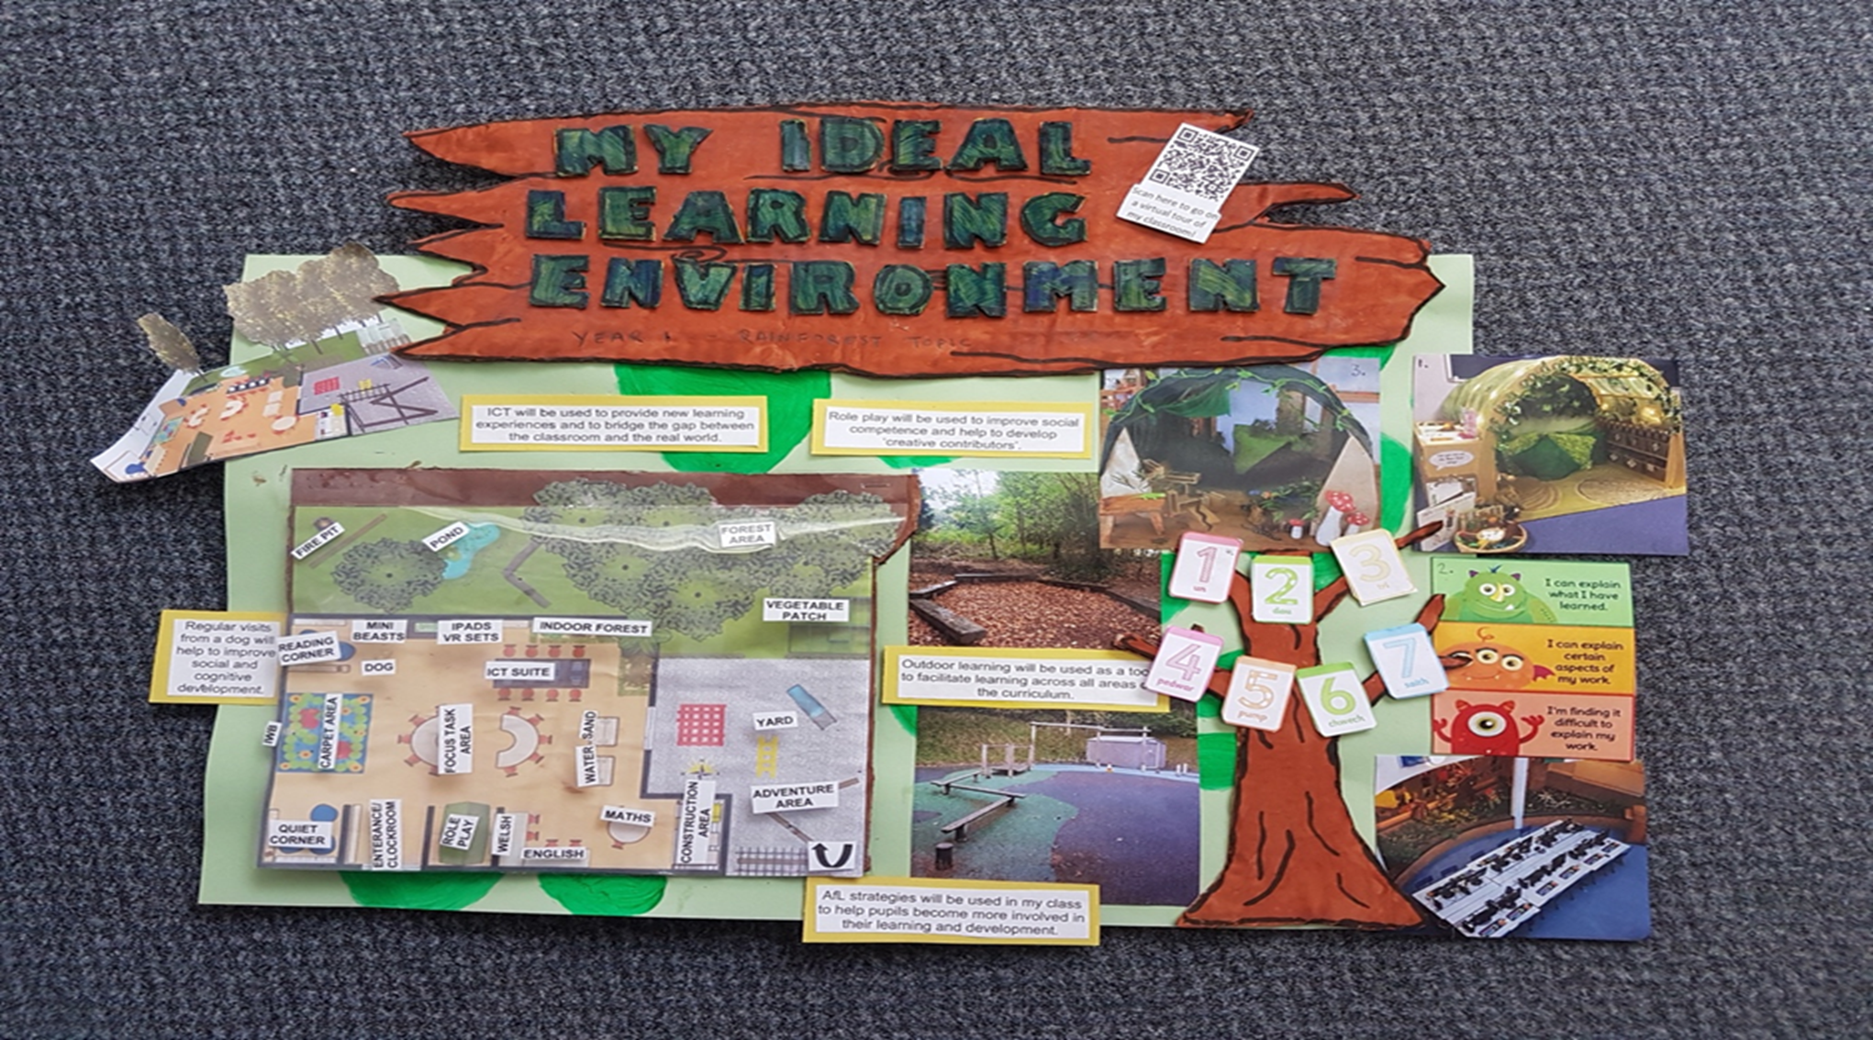

Slide 12
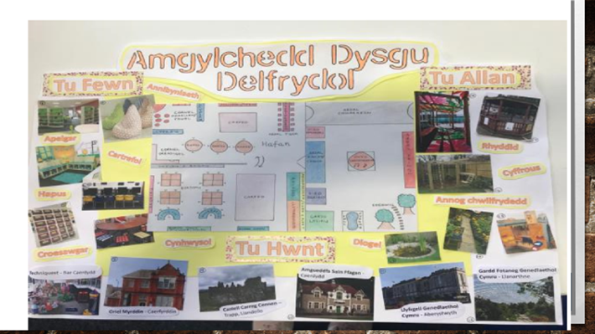

Slide 13

PLAGIARISM
.

Slide 14
PRACTICAL POINTS
Submission date:
Wednesday 17/10/18
23.59
Attach the Assessment Specification sheet (APPENDIX GA36c) at the front
.

Slide 15
ADMIN
Directed Tasks (Attachment) for afternoon of Tues 25/09/18
Wed 26/09/19 – 2nd Bridging
Thursday 27/09/18: no POP!
Friday 28/09/18: Book an assignment session (not obligatory)
Directed Tasks – read links on Multiculturalism & Diversity
.

Slide 16
Study Skills:
Becoming an
Academic Writer

Slide 17
Workshop Overview
How can we develop our writing in order to write more academically?
What is ‘analytical’ thinking and writing, and how can we evidence this?
How can we prepare for our POP submission effectively?

Slide 18
Critical, analytical thinking
Examine in detail from different angles eg from different author viewpoints
Consider why these may differ eg historical, political reasons
Examine parts and relate these to the whole idea
Check accuracy
Look for flaws in reasoning, evidence or conclusions
Argue why one argument is preferable to another’s

Slide 19
READING Wisely
Using suitable material
What makes the information that you find reliable?
Reputable sources:
Reputable series, peer-reviewed journal or academic publisher? Number and quality of references they cite.
Up-to-date? Evidence-based? Transparent?

Slide 20
Reading actively - tips
Sum up what has been read eg in a sentence; a headline; using PMI (plus, minus, interesting)
Set specific questions before reading and find the answers
Re-read and read aloud
Highlight key words and phrases, or colour code emerging themes
Recall and review
Identify a line of reasoning in the text and examine this

Slide 21
Writing Academically
Discussion Point
What do you find hard about writing in general?
What do you find hard about writing for an assignment?
What do you think about yourself as a writer?
Are you aware of the way you write – your own writing process?
Do you have any strategies which help you write?

Slide 22
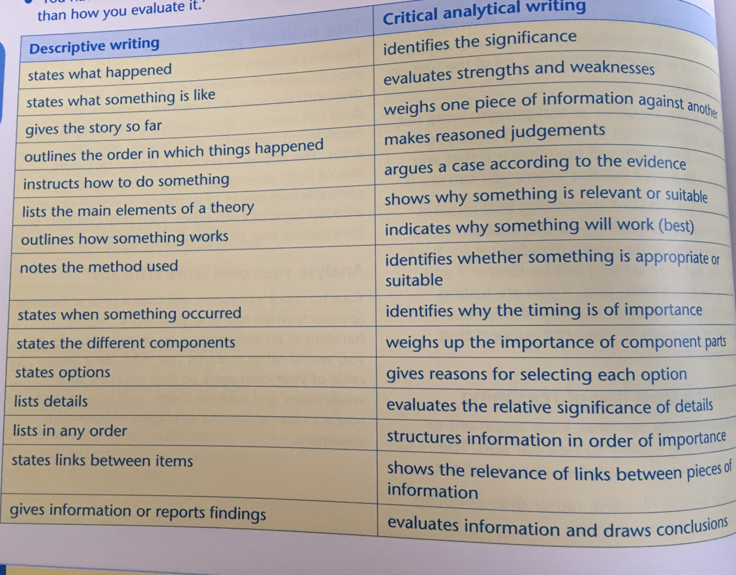
Critical vs Descriptive Writing

Slide 23
Analytical Writing: a synthesis
A good analysis:
identifies the key parts of a topic and discusses their meaning, qualities and inter-relationships in order to be able to discuss the topic as a whole;
presents a reasoned response or argument;
compares and contrasts, presents arguments and makes judgments;
Is detached and objective, but able to demonstrate a personal response;
explains and elaborates arguments;
justifies them with textual evidence through quotation or paraphrase;
is clear, well-balanced and carefully-evidenced.

Slide 24
Avoid plagarising
Use quotations sparingly
Keep these brief
Write all notes in your own words
Note exactly where you found information and cite sources of ideas that are not your own original ones

Slide 25
THE BIG PICTURE:
Coherence and Organisation

Slide 26

The Golden Thread
The whole assignment is the development of an argument;
You need to keep your big picture argument at the forefront of your thinking throughout;
It is your golden thread uniting each section;
Sewing a golden thread through your writing requires thinking skills and writing skills;

Slide 27
Your Golden Thread
Introduction: framing the assignment
Section 1: the observation presenting a description and analysis of your findings, explaining and justifying your choice of methods
Section 2: reviewing the existing knowledge base and establishing the connection to your observations
Discussion/ Section 3: presenting an argument that signals the significance of your findings and which justifies your design of an environment and your choice of observation tool
Conclusion: summarising section with implications for further research, policy and/or practice

Slide 28
Signposting at Paragraph Level
Topic sentences are usually the first sentence in a paragraph, but this is a tendency not a rule. Sophisticated writing sometimes has the topic sentence second, or even later.
Topic sentences are critical in signposting to the reader the developing argument.
Topic sentences make clear what ideas are about to be developed in the paragraph.
Topic sentences are highly relevant to signposting in analytical writing.
(if you know this is a weakness, make all your first sentences in each paragraph red and then review whether they are topic sentences)

Slide 29
POINT
What is the topic of this paragraph? The key idea or argument?
SUPPORTING EVIDENCE
How can you help your reader understand your argument?
Supporting evidence; explanations and elaborations; counterpointing evidence; statements;
SUMMARY/COMMENT
End with a summary of the key point in paraphrase’ an analytical comment on the topic, or a forward-pointing statement

Slide 30
Signposting vocabulary
ADDING in addition; also; moreover; indeed; furthermore; additionally; | CONTRASTING on the contrary; yet; whereas; alternatively; instead of; otherwise; unlike; on the other hand; nevertheless; however; even so; nonetheless | COMPARING similarly; equally; likewise; in the same way; | EXPLAINING for example; for instance; in other words; that is to say | SUMMING UP in conclusion; to sum up;
INDICATING RESULT therefore; as a result; consequently; hence; thus; so; accordingly | LISTING to begin with; next; firstly; secondly; finally | EMPHASISING besides; after all; above all; notably; in fact | INDICATING TIME meanwhile; finally; lastly; next; initially; subsequently; eventually; in the end; afterwards | ? notwithstanding

Slide 31
Personal Reflection
Thinking about your own academic writing, and reflecting on the input in this workshop, what aspects of your own academic writing might need more attention?
Are there aspects of academic writing about which you now need to find out more?

Slide 32
Activity
You will now see some examples of assignments
Consider these in terms of structure, content and whether you feel these are examples of analytical writing.
How well do these fit the assessment brief?
NB DO NOT PHOTOGRAPH/TAKE DETAILED NOTES of this work!!

Slide 33
Be a critical friend!

Slide 34
Task
Download 2x assignments from Moodle
You CANNOT use any parts of these assignments in your own work!
Download marking criteria
Decide on a grade for each assignment within your groups

Slide 35
Summary
Read the assignment brief – then
Decide on your golden thread
Draw on good source material
Compare and contrast
Show awareness of complexities in the literature
Provide a well-structured argument
Synthesise
Follow a structure
Be ‘discursive’
Be emotionally neutral
Materials derived from:
Cottrell, S. (2013) The Study Skills Handbook London: Palgrave MacMillan
Professor Debra Myhill, Exeter University, presentation JURE 2017

