Slide 1
Key Challenges Facing The Home Office And National Crime Agency When Responding To Serious And Organised Crime Within The UK.

Slide 2

SOC impacts more UK citizens and happens more frequently than other national security issues. Conservative estimations predict a £37 billion annual cost to the UK economy. Criminals that harm people, businesses, and communities across the UK in subtle and devastating ways frequently use threats of this kind (NCA, 2021).
In the UK, serious and organized crime is pervasive, destructive, and on a truly staggering scale. Each year, it claims more lives than terrorism, war, and all natural catastrophes put together (NCA, 2019).

Slide 3
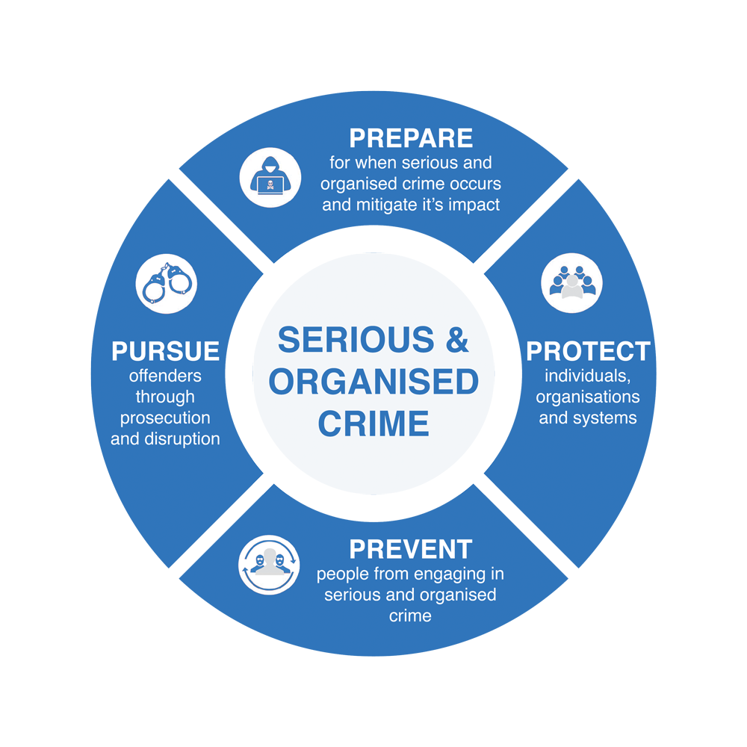
In order to more effectively manage a national effort to reduce the amount of serious and organized crime harming the UK and local communities, the government unveiled a new serious and Organized Crime plan in 2013.
The national plan comprises four thematic pillars, sometimes known as the "4Ps," and utilizes the structure created for national counterterrorism activity.

Slide 4

The four thematic pillars of the national strategy are:
Protect - To protect means putting the proper procedures in place to keep communities safe, and making sure that these groups have access to the knowledge they need to defend themselves.
Prevent - stopping individuals from partaking in this behavior. This calls for a variety of local approaches and interventions, including the development of new interventions, the use of already-existing services, and promoting community awareness of the reality and consequences of affiliation with organized criminal organizations.
Pursue - bringing cases against and obstructing those involved in serious and organized crime. On a local level this involves developing solid, efficient, and cooperative alliances to gather and exchange information
Prepare - minimizing the effects of this criminality in the areas where it occurs. This entails having the ability to respond promptly to large situations involving organized crime in order to assist affected communities, victims, and witnesses in recovering fast and successfully.

Slide 5
When the Department evaluated the 2013 plan in 2017, it found some serious problems and determined that the strategy had not been developed to sufficiently address the expanding complexity and nature of serious and organized crime. In 2018, the Home Office unveiled a revised plan that maintained the "4P" strategy.
The 2013 strategy brought up a number of issues that the new strategy aimed to address, including stepping up measures to discourage people from engaging in serious and organized crime as well as growing public intolerance of it. By enhancing NCA's capacity to use data, it also sought to strengthen the government's awareness of serious and organized crime (HOC, 2019).

Slide 6

Advances in Technology
Online exploitation has been shown to enable offending in the real world, with the online grooming of children leading to physical abuse and the large-scale of blackmailing of children to abuse themselves. Despite extensive operational and policy safeguards, there is still an increasing risk of child sexual abuse, which is made worse by a rise in internet usage.
On the dark web, there are still many criminals who deal in illegal commodities like drugs and weapons. To hide their communications, these criminals are increasingly turning to both specialized and widely available encryption software. Criminals began to use bitcoin more frequently to facilitate money laundering, partly as a result of the pandemic, which made it more challenging to move money.
According to NCA Director General Dame Lynne Owens, the most recent national strategic assessment demonstrates how illegal use of technology is at the heart of the threat. The frontline for law enforcement must now be both online and on our streets (NCA, 2021).

Slide 7
Technology advancements are not only beneficial to criminals who commit direct online crimes like phishing, fraud, identity theft, and financial crime. In reality, using technology has helped both traditional organized crime groups and terrorist organizations to up their game.
Crimes such as human trafficking, for instance, are more likely due to technology. According to the Global Initiative Against Transnational Organized Crime (2020), technological developments have changed every stage of the human trafficking operation, including preparation, victim recruitment and abuse, transactions, and money laundering.
Beyond the general public and government security organizations, the issue of rising security risks affects other groups as well. Businesses have to deal with more complex threats, like interruptions in operational dependability, exploitation of intellectual property that could bankrupt them, and theft of sensitive consumer data.

Slide 8

The development of new criminal industries is made feasible by technology. 2017 saw a record-breaking 3.4 million thefts reaching £193 billion in fraud, the majority of which occurred online.
Other cybercrimes include Wannacry, a ransomware attack from North Korea in May 2017 that paralyzed the healthcare system for four days, as well as child sex abuse, which soared by 700% between 2014 and 2017 and had 80,000 UK viewers.

Slide 9

Differentiating between online criminals and offline criminals today, as well as among crimes committed online and crimes done offline, is becoming more and more difficult. The two worlds are intertwining even more. People are altering their everyday lives and physical habits to fit into the digital culture (Di Nicola. A, 2020).
Online criminals will go to great lengths to hide their identity and location. They commonly conduct business on the dark web and employ online identities, making it challenging to identify them. Additionally, they might use proxies and VPNs to mask their real IP address, making it very difficult for law enforcement to pinpoint their exact location.

Slide 10

What more could be done to tackle SOC in the UK?
All police forces in England and Wales will implement a new strategy to combat serious and organized crime after positive initial results from forces who are currently testing the idea.
A multi-agency collaboration strategy called "Clear, Hold, Build" was developed by the Home Office and approved by the Policing Inspectorate to help parts of the nation most affected by serious organized crime (Braverman KC MP, T.R.H.S. 2023).
The government has also begun a consultation process for potential new laws which would render it unlawful to produce, supply, and own items that are very likely to be used in the carrying out of serious crimes, such as advanced encrypted communication equipment, pill presses, and digital templates for 3D printing firearms components.

Slide 11
Suella Braverman, the home secretary, stated that Clear, Hold, Build is a pragmatic police strategy. Eliminating these gangs will reduce disruptive conduct, stop the supply of dangerous substances contaminating communities, and stop violence. Young people in those places will thereafter have a better future as a result of this.
Since 2020, seven police forces have successfully implemented the programme. As a result, community resistance to serious and organized crime has increased, and the program's capacity to have a broader impact on crime reduction has also been shown.
Graeme Biggar, director general of the National Crime Agency, said The UK's response must develop as the threat posed by criminals rises and changes. The NCA works tirelessly to safeguard the public from the worst criminals. From that he also states that the NCA welcomes the consultation and invites partners to share their perspectives.

Slide 12

The government faces a tremendous task in addressing this complex, constantly changing threat, according to Gareth Davies, head of the National Audit Office. It was also said In order to properly implement its new strategy, the government must improve its comprehension of these crimes, more effectively align resources to its priorities, and ensure that governance and finance line with its objectives.
The NCA continues to see significant demand, according to Lynne Owens, director general of the NCA. However, SOC has never had a specific funding source, and the NAO's acknowledgement that funding arrangements need to be significantly improved is appreciated.
These would allow the NCA to develop their capabilities in fields like financial investigations, covert surveillance, and digital forensics. The NCA must have the appropriate skills at the appropriate time in order to have the greatest impact.

Slide 13

Police Federation chairman John Apter claimed that policing budget cuts by the government of about 19%, had aided in the growth of serious and organized crime.
He also stated that The NCA is correct to claim that significant investment is required; this is the reality of years of cutbacks, which have resulted in the loss of over 22,000 police personnel as the quantity of organized criminals has risen.

Slide 14
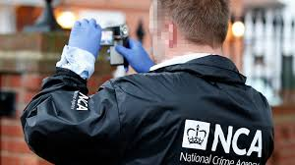
The general public and Police and Crime Commissioners anticipate that police forces will give priority to the most apparent crimes, such as speeding and antisocial behavior. Police departments admit that their resources are insufficient. Violent and serious organized crime, that could resemble "unseen policing" above all else, may suffer as a result (HOC, 2019).
Since funding is authorized on an annual basis and comes from a variety of sources of funding, it is challenging for forces to forecast their financial needs and develop effective spending strategies. Multi-year efforts are frequently necessary when combating serious and organized crime

Slide 15
Thank You

Slide 16
Reference list
Anthony (2020). Why Is It So Hard To Catch Cybercriminals? [online] blog.tmb.co.uk. Available at: https://blog.tmb.co.uk/why-is-it-so-hard-to-catch-cyber-criminals#:~:text=Jurisdiction [Accessed 2 May 2023].
Association, L.G. (2015). Tackling serious and organised crime a local response Report. [online] Available at: https://www.local.gov.uk/sites/default/files/documents/tackling-serious-and-orga-44a.pdf [Accessed 1 May 2023].
Brady, D. (2019). Government spending on organised crime ‘not enough’ | Public Finance. [online] www.publicfinance.co.uk. Available at: https://www.publicfinance.co.uk/news/2019/06/government-spending-organised-crime-not-enough [Accessed 2 May 2023].
Braverman KC MP, T.R.H.S. (2023). Government announces crackdown against organised criminal gangs. [online] GOV.UK. Available at: https://www.gov.uk/government/news/government-announces-crackdown-against-organised-criminal-gangs [Accessed 1 May 2023].
Commons, H. of (2019). Serious and Organised Crime One Hundred and Nineteenth Report of Session 2017-19 Report, together with formal minutes relating to the report. [online] Available at: https://publications.parliament.uk/pa/cm201719/cmselect/cmpubacc/2049/2049.pdf [Accessed 1 May 2023].
Di Nicola, A. (2022). Towards digital organized crime and digital sociology of organized crime. Trends in Organized Crime. doi:https://doi.org/10.1007/s12117-022-09457-y.

Slide 17
Dodd, V., Police, V.D. and correspondent, crime (2019). Spend £2.7bn more to tackle organised crime, says NCA chief. The Guardian. [online] 13 May. Available at: https://www.theguardian.com/uk-news/2019/may/14/spend-27bn-more-to-tackle-organised-says-nca-chief [Accessed 2 May 2023].
Manager, Y.M., Product Marketing (2021). Digital Transformation’s Impact on Crime & Terror. [online] Cognyte. Available at: https://www.cognyte.com/blog/how-digital-transformation-is-giving-serious-crime-and-terror-a-high-tech-makeover/#:~:text=A%20High%2DTech%20Makeover%20for [Accessed 1 May 2023].
National Crime Agency (2021a). Online is the new frontline in fight against organised crime– says NCA on publication of annual threat assessment. [online] www.nationalcrimeagency.gov.uk. Available at: https://www.nationalcrimeagency.gov.uk/news/online-is-the-new-frontline-in-fight-against-organised-crime-says-national-crime-agency-on-publication-of-annual-threat-assessment [Accessed 1 May 2023].
National Crime Agency (2021b). PCC Briefing. [online] nationalcrimeagency.gov.uk. Available at: https://nationalcrimeagency.gov.uk/pcc-briefing [Accessed 1 May 2023].
Perry, A. (2018). Organised crime in the UK is bigger than ever before. Can the police catch up? [online] the Guardian. Available at: https://www.theguardian.com/uk-news/2018/nov/22/uk-organised-crime-can-police-catch-up-national-crime-agency-lynne-owens [Accessed 1 May 2023].
Winchester, N. (2020). Library Briefing. [online] Available at: https://researchbriefings.files.parliament.uk/documents/LLN-2020-0016/LLN-2020-0016.pdf [Accessed 2 May 2023].

