Slide 1
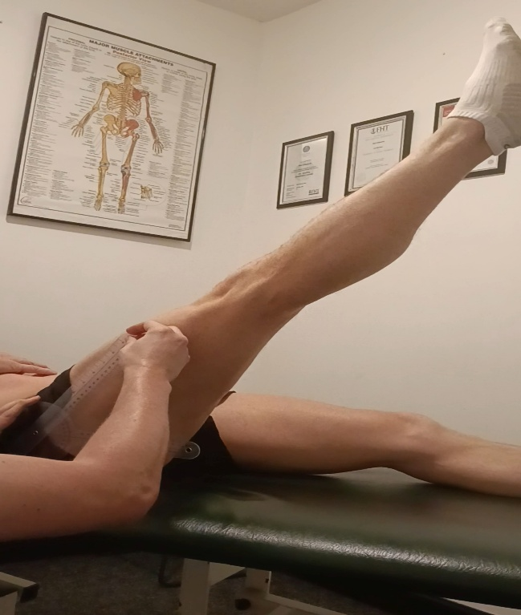
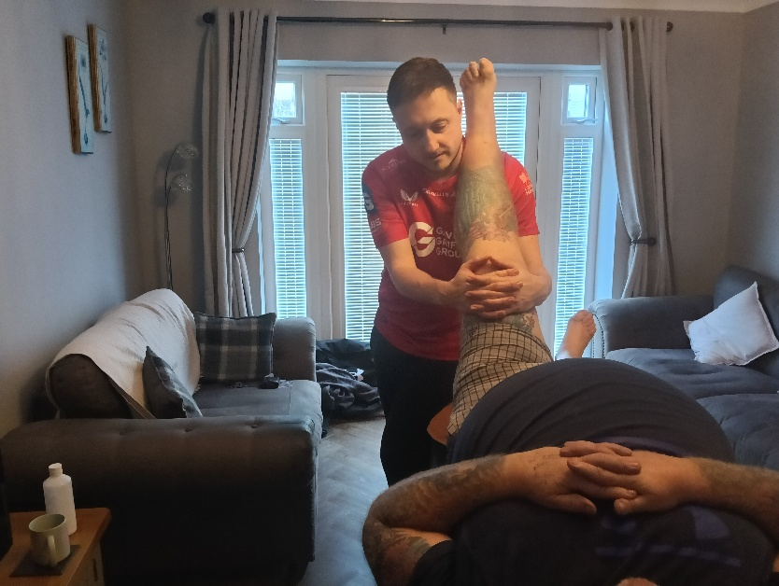
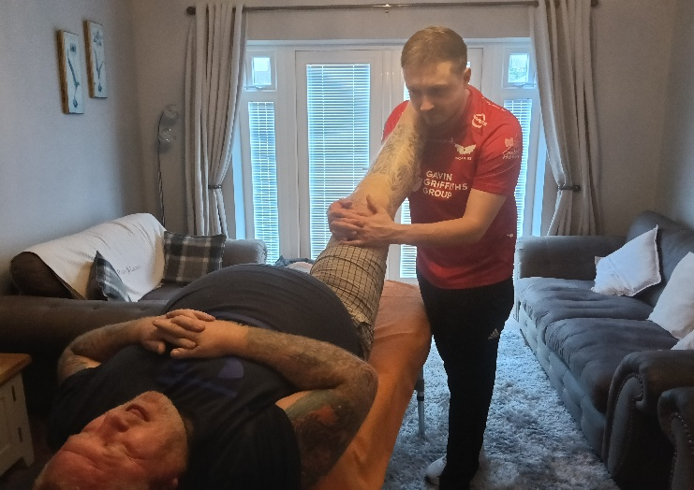
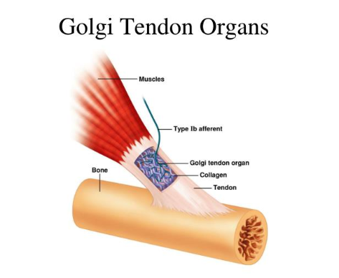
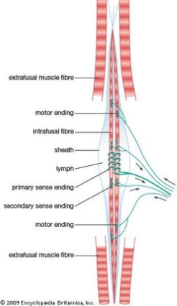
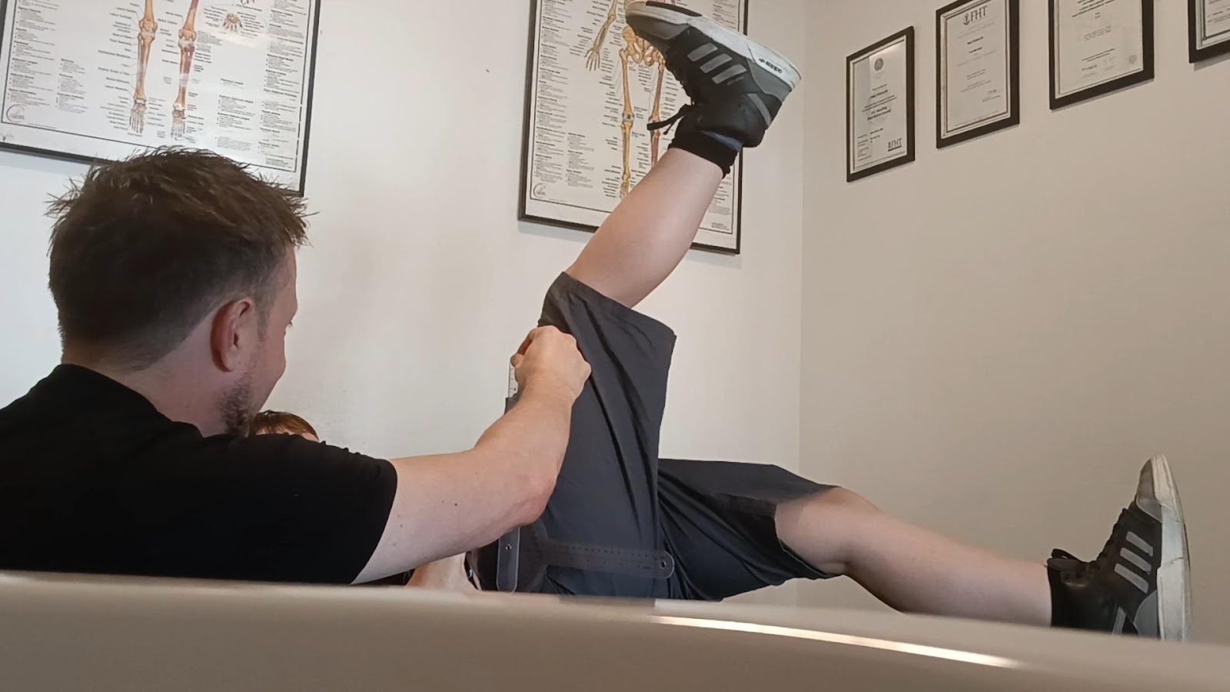
A comparison of post isometric relaxation and reciprocal inhibition, which is the most effective in improving range of movement at the hip?
Introduction
In 1948 Fred Mitchell introduced muscle energy techniques to treat issues at the pelvis using isometric contractions within the hip. Muscle energy techniques take the tendons beyond the point of bind, stretching tissue to a new range increasing the subjects’ range of movement (Atchison, Tolchin, Ross, and Eubanks, 2021).
There are two techniques used in muscle energy techniques, post isometric relaxation (PIR) and reciprocal inhibition (RI). PIR is where the problem tissue is contracted to illicit relaxation, RI is where the antagonist muscle is engaged to relax the opposite muscle. This study compared the two techniques and their effectiveness in treating muscle tightness. It is used by many professions, such as; osteopathy, physiotherapy and sports therapy (Nambi, 2018).
Results
The results showed that there was no difference in efficacy between post isometric relaxation and reciprocal inhibition, both being as effective in improving hamstring flexibility at the hip.
With PIR there showed an improvement in ROM in the left hip by 7.5% from 77.8 degrees to 83.6 degrees and the right hip by 7% from 72.7 degrees to 77.7 degrees as a result of post isometric relaxation (PIR)
With RI a greater effect was shown on the left hip as there was an increase from 75.1% to 86.8 degrees overall. However, there were similar effects between PIR and RI on the right hip as there was a 7.5% increase post intervention of reciprocal inhibition (RI) increasing 73.8 degrees to 79.5 degrees.
A paired sample t-test confirmed both PIR and RI had a significant impact on range of motion at the hip. An independent t-test showed no significant difference between PIR and RI in its efficacy. There were only slight differences with PIR being more consistent than RI but there was no superior technique as there was ‘no significance’ in the findings between the two.
PIR and RI both effectively increased movements of the hip and showed a significant difference between pre and post treatment, this shows both are effective tools in the world of sports therapy.
Discussion
It should be considered that the sample size for this study was small in comparison to other studies on this subject. Long term effects were also not studied here but only the short-term effects. PIR is used for muscle tightness without pain as it stretches affected tissue (Naweed et al, 2020), RI is recommended when the pain prevents the patient engaging problem tissue that needs to be stretched (Lepley and Lepley 2021). Both techniques can help reduce the workload for the NHS by utilising private clinics to take pressure off physiotherapists in the NHS (Sheaff et al, 2019).
Only single-session treatments were given therefore this research did not consider the long term effects of this treatment. Using younger fitter adults could be considered for future research, choice of clothing is another limitation in this study as some wore tight clothing. Using the sit and reach box and tape measure are other ways the hamstring over the hip could be measured. Involving other forms of treatment could also benefit future studies and comparing other forms of treatment with muscle energy techniques.
Reflection
Using tools such as PubMed, Google scholar and SportDiscuss were useful in my research, utilising the university library is also another useful way to engage in research, there is a library database online that can be accessed to find useful journals and specific research narrows your findings down.
Aims and Method
To evaluate the effectiveness of post isometric relaxation and reciprocal inhibition in increasing range of movement at the hip in healthy adults, and understanding which treatment is the better option for use in a clinical setting, using SPSS to determine which treatment was more effective.
12 adults were selected between 18 and 63 with no injuries. Two different interventions were used. Six participants were chosen to be assessed using PIR and six were selected for RI. They were swapped a week later and both groups took part again with opposite interventions applied. Written consent and approval was carried out for the study. Each participant had to take a brisk walk before taking part. Hip range of motion was measured before and after treatment using a goniometer.
PIR treatment involved the participant pushing against the therapist with 20% effort for 10 seconds and the therapist then moving the patient into a further stretch and hold for 20 seconds, this was then repeated 3 times.
RI treatment involved the participant pulling the leg away from the therapist while the therapist resisted. The participant again used 20% effort with therapist moving the patient to a new range and holding for 20 seconds, this was then repeated 3 times.
It was all recorded using Microsoft Excel and analysed using SPSS, version 24. SPSS was used for paired and independent t-tests with Cohen’s-d used for effect sizes. Statistical significance was set at p<.05.
 | PIR (ROM ⁰) | RI (ROM ⁰) | T | df | Sig | Cohen’s-d
Left before | 77.8 ± 13.1 | 75.1± 15.0 | -2.776 | 11 | .018 | -.195
Right before | 72.7± 12.2 | 73.8 ±15.4 | -2.209 | 11 | .049 | -.275
Left after | 83.6 ± 12.3 | 86.8 ± 10.9 | -5.278 | 11 | <.001 | -.299
Right after | 77.7 ± 13.2 | 79.5 ± 11.2 | -2.915 | 11 | .014 | -.150
References
Antouri, J. (2023) Golgi Tendon Organ and Functions. Available at: https://propta.com/edu-blog/golgi-tendon-organ-and-functions/ (Accessed: 7 April 2025).
Atchison, J.W., Tolchin, R.B., Ross, B.S. and Eubanks, J.E., 2021. Manipulation, traction, and massage. In Braddom's physical medicine and rehabilitation (pp. 316-337). Elsevier.
Britannica (2016) Muscle Spindle. Available at: https://www.britannica.com/science/muscle-spindle (Accessed; 7 April 2025).
Lepley, A.S. and Lepley, L.K., 2021. Mechanisms of arthrogenic muscle inhibition. Journal of sport rehabilitation, 31(6), pp.707-716.
Nambi, G., 2018. Effect of reciprocal inhibition and post isometric relaxation; types of muscle energy technique in piriformis syndrome–a comparative study. Phys Med Rehab Res, 3(1), pp.1-5.
Naweed, J., Razzaq, M., Sheraz, S., Anwar, N., Sadiq, N. and Naweed, S., 2020. Comparison of active isolated stretch and post isometric relaxation for improving hamstring flexibility in young healthy adults. Pakistan Armed Forces Medical Journal, (3), p.770.
Sheaff, R., Halliday, J., Exworthy, M., Gibson, A., Allen, P.W., Clark, J., Asthana, S. and Mannion, R., 2019. Repositioning the boundaries between public and private healthcare providers in the English NHS. Journal of Health Organization and Management, 33(7/8), pp.776-790.

