Slide 1
ECES6008/C
Radical Education / Addysg Radical
Sesiwn 6 / Session 6

Slide 2

Learning Outcomes
Deilliannau Dysgu
Gynnig beirniadaeth eang o strwythurau addysgol traddodiadol (yn cynnwys addysg, cwricwlwm, asesu, addysgeg).
Offer a broad critique of traditional educational structures (including schooling, curriculum, assessment, pedagogy).

Slide 3

Learning Outcomes
Deilliannau Dysgu
Dangos ymwybyddiaeth feirniadol o ddamcaniaethau radical allweddol, dulliau o gysyniadoli a gweledigaethau o addysg (yn enwedig addysgeg feirniadol)
Demonstrate a critical awareness of key radical theories, conceptualizations and visions of education (in particular critical pedagogy)

Slide 4

Learning Outcomes
Deilliannau Dysgu
Datblygu ymagweddau dychmygus ac arloesol ar addysg, cwricwlwm, asesu, y dosbarth a deunyddiau dysgu ac addysgu eraill
Develop imaginative and innovative approaches to schooling, curriculum, assessment, the classroom and other learning and teaching materials

Slide 5


Learning Outcomes
Deilliannau Dysgu
Trefnu eu gwybodaeth a’r hyn y maent wedi’i ddysgu drwy ddefnyddio amrywiaeth o ffynonellau gwybodaeth, gan gynnwys TGCh, a chyflwyno’u gwaith ar y lefel briodol
Organize their knowledge and learning through the use of a range of information sources, including ICT and present their work at the appropriate level.

Slide 6

Pwrpas Ysgol
The Purpose of School
Mewn pârau, ysgrifennwch restr o resymau pam mae angen ysgolion.
In pairs, write a list of reasons for why we need schools.

Slide 7
Knowledge, Power and Foucault
“Ask not what the world is made of but rather why we view it in the way we do”
(Kant cited in MacBlain, 2014, p5).
Roedd Nietzche yn dadlau fod gwybodaeth a’r gwir yn cael eu creu gan sefydliadau, a bod disgyblaethau proffesiynol yn cael eu cynnig fel petaent yn gyflawn ac yn gyson trwy amser.
“Ask not what the world is made of but rather why we view it in the way we do”
(Kant cited in MacBlain, 2014, p5).
Nietzche argued that knowledge and truth is created by, and between, establishments and professional disciplines are offered as though they are timeless and complete.
(Cited in Aubrey and Riley, 2017).

Slide 8
Syniadau Foucault
Foucault’s Ideas
Pwer disgwrs
Disgyblaeth
  Cyrff dof
  Arsylwi hierarchaidd
  Normaleiddio
  Arholi
Panopticon
Aubrey and Riley,2017
The power of discourse
Discipline
  Docile bodies
  Hierarchical observation
  Normalisation
  Examination
Panopticon
Aubrey and Riley,2017

Slide 9
Y Ddadl yn Erbyn Ysgolion
The Argument against Schools
Mae ysgolion yn ffurf o reolaeth wladwriaethol:
  “Education systems within capitalist societies are a form of ‘ideological state apparatus’ designed as a means of social control” (Althusser, 1971 yn Pollard et al, 2008).
Mae pwyslais ar reoli dosbarth mwy i ymwneud â disgyblaeth nag â dysgu. Mae’n ffordd o greu disgyblion sy’n cydymffurfio i ddisgwyliadau cymdeithas.
Schools are state mechanisms for control:
  “Education systems within capitalist societies are a form of ‘ideological state apparatus’ designed as a means of social control” (Althusser, 1971 cited in Pollard et al, 2008).
Emphasis in schools on ‘classroom management’ is more about discipline and less about learning. It’s a way of getting students to conform to society’s expectations.

Slide 10
Strwythurau hierarchaidd
Mae’n bosib arsylwi pob darn bach o’r diwrnod ysgol
Mae adeiladau wedi ei cynllunio er mwyn galluogi goruwchwyliaeth. (Schwan a Shapiro, 2011 yn Aubrey and Riley, 2017).
Hierarchical power structures
Each aspect of the school day can be observed in minute detail
School buildings are built to create ‘space in ways that allow for total supervision’ (Schwan and Shapiro, 2011 cited in Aubrey and Riley, 2017).
“Schools are broken down into houses, the school day into a timetable and a curriculum (a serial space of serial knowledges) and into specialist locations; pupil movements are broken down within and into lessons, they are allocated to seats, organised onto tables or in rows, labelled, tested, measured and calculated by the techniques of examination”
(Ball, 2013, p46 cited in Aubrey and Riley, 2017).

Slide 11
Gwybodaeth a’r Cwricwlwm
Knowledge and the Curriculum
Mae’r cwricwlwm yn cynrychioli gwybodaeth ‘gwir’ pwnc
  Pwy sy’n penderfynu ar y cynnwys?
Y cwricwlwm cudd – cydymffurfio cymdeithasol?
Mae Bowles a Gintis (1976) yn dadlau fod prosesau ysgolion yn creu disgyblion goddefol sy’n derbyn awdurdod
Maent hefyd yn dadlau bod pwrpas dysgu llai pwysig na safon y gwaith
Pollard et al, 2008
Curriculum – prescribed knowledge which is the accepted ‘truth’ of a subject
  Who decides what should be included?
The ‘hidden curriculum’ – reproducing social conformity?
Bowles and Gintis (1976) argued school processes tend to induce passivity and the acceptance of authority.
They also argued that there’s more of a concern about the quantity and quality of work irrespective of purpose.
Pollard et al, 2008

Slide 12
Sesiwn Heddiw
What’s the alternative?
Ysgolion…ond yn wahanol!
Sut gall model seiliedig ar ysgol ddarparu gwahanol fathau o brofiadau dysgu i blant?
Sut fedr ‘ysgolion radicalaidd’ edrych ?
Schools… but not as we may know them!
How can the school-based model of education be used to provide a different type of learning experience for children?
What might ‘radical schools’ look like? How can schools overcome the previous criticisms?

Slide 13
Y Sector Annibynnol
The Independent Sector
Mae yna 625,000 o blant yn cael eu haddysgu mewn tua 2600 o ysgolion annibynnol.
Mae hyn yn cyfateb i 6.5% o blant ym Mhrydain (a dros 7% o blant yn Lloegr) gyda’r ffigwr yn codi i 18% dros 16 oed.
Mae tua 65 ysgol annibynnol ar draws Cymru.
The UK independent sector as a whole educates around 625,000 children in around 2,600 schools.
The independent sector educates around 6.5% of the total number of school children in the UK (and over 7% of the total number of school children in England) with the figure rising to more than 18% of pupils over the age of 16. (Independent Schools Council, 2017).
There are approximately 65 independent schools across Wales (Welsh Government, 2011).

Slide 14
Y Sector Annibynnol
The Independent Sector
Mae nifer o wahanol fathau - preifat, preswyl, cyhoeddus
Mae angen talu ffioedd fel arfer
Yn aml mae ysgolion yn cynnig opsiwn ‘preswyl’
Nid ydynt yn cael eu ariannu gan y llywodraeth (er maent â statws elusennol)
Nid oes rhaid dysgu’r cwricwlwm cenedlaethol na chymwysterau penodol
Different types - private schools, boarding schools, prep/public schools
Usually require fees to attend
Often offer residential (or ‘boarding’) facilities
Not government-funded (though they do have ‘charitable status’)
Do not have to teach the state prescribed national curriculum and/or required qualification syllabi

Slide 15
Manteision ac Anfanteision
Benefits and Drawbacks
Mewn pâr, trafodwch:
  Beth yw manteision ysgolion annibynnol?
  Beth yw anfanteision ysgolion annibynnol?
In pairs, discuss:
  What are the possible benefits of an independent school sector?
  What are the possible drawbacks of an independent school sector?

Slide 16
Rhyddid o’r Cwricwlwm
Freedom from Curriculum Constraints
Mae rhyddid gan ysgolion i ddewis eu athroniaeth eu hun tuag at addysg
Nid oes rhaid dysgu’r cwricwlwm
Yn aml yn cael ei rhedeg gan rieni sy’n chwilio am ddewis arall i addysg wladwriaethol – ffocws sesiwn heddiw
Independent schools, free schools and academies are free to choose their own philosophical approaches to education
Not required to teach the national curriculum
May be run by parents or interest groups who are seeking a particular alternative to state education

Slide 17
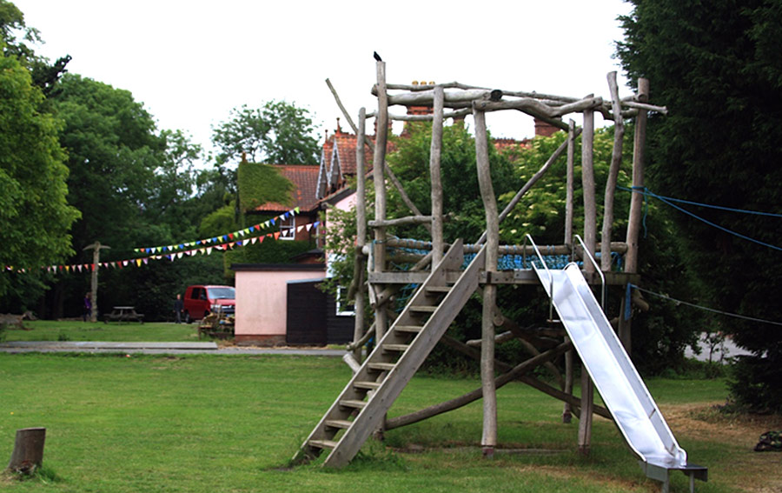
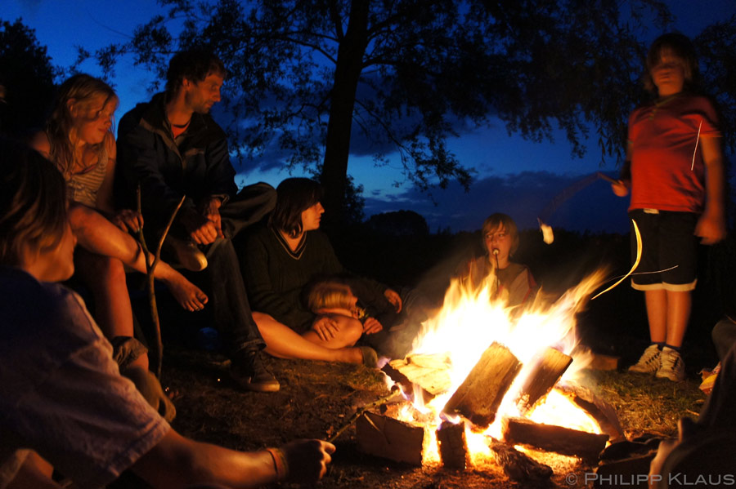
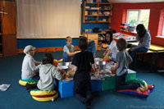
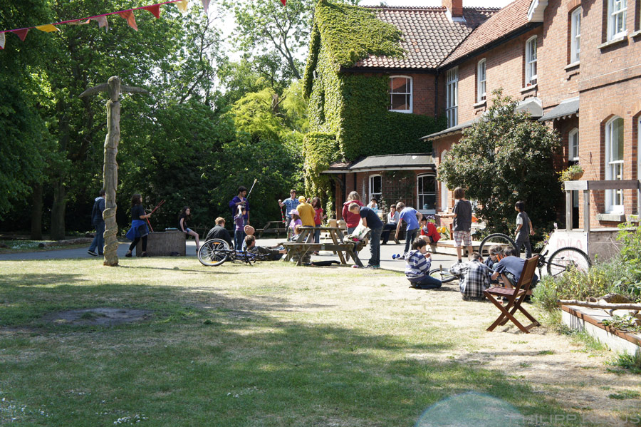
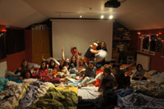
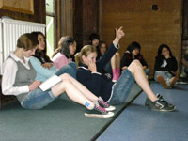
Pa fath o addysg a awgrymir gan y lluniau yma?
What kind of education is suggested by these images?

Slide 18
A.S Neill
Cred fod y plentyn yn dda
Pwrpas addysg yw darganfod hapusrwydd
Dylai addysg ddatblygu plant yn wybyddol ac yn emosiynol
Mae disgyblaeth a chosb yn niweidiol i blant
Mae rhyddid a thrwydded yn wahanol – mae angen parch cilyddol
Dylai dysgu fod yn rhydd o euogrwydd
A faith in the goodness of the child
Aim of education is to work joyfully and find happiness
Education is about both intellectual and emotional development
Discipline and punishment is harmful to child development
Freedom doesn’t mean licence – respect is a two way process
Learning and development needs to be free from guilt
Aubrey and Riley 2017

Slide 19
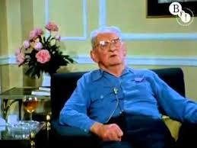
A.S. Neill
Gwyliwch y fideo o A.S. Neill yn trafod addysg.
Nodwch brif gredoau Neill.
Watch the following video of A.S. Neill discussing his philosophy of education.
Make a note of Neill’s key beliefs.

Slide 20
A.S. Neill
Crewr ysgol Summerhill
Wedi cael ei ddylanwadu gan ddyneiddiaeth
Yn credu bod plant yn naturiol dda
Mae angen gwir ddiddordeb ar gyfer dysgu
Rhyddid – cyn belled ag ei fod ddim yn effeithio ar ryddid eraill
Hawl i’r plentyn rheoli ei hun
Mae hapusrwydd mwy pwysig na datblygiad deallusol
Founder of Summerhill School
Influenced by Humanistic and Freudian schools of thought
Importance of nature
Children are innately good
Genuine interest is a prerequisite for learning
Freedom – as long as it does not encroach on another’s freedom
Children should be allowed to self-govern – role of self-determination
Happiness is just as important as intellectual development
Links to theorists?
Damcaniaethau arall?

Slide 21
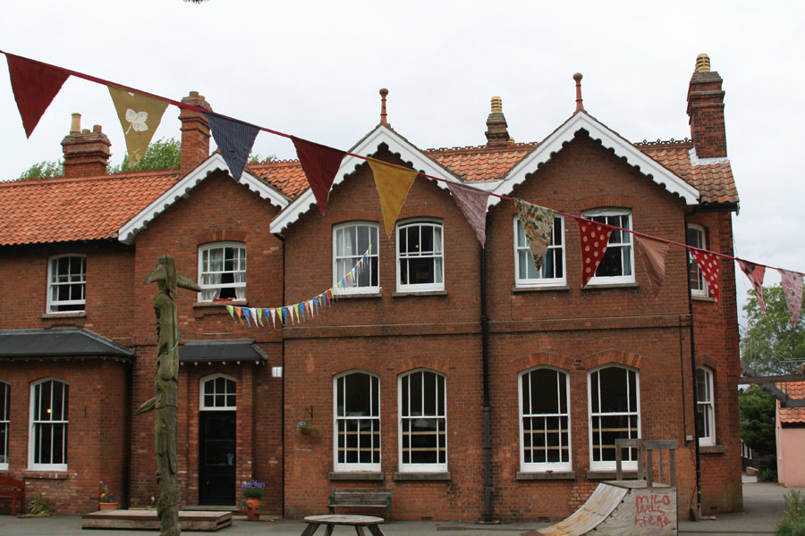
Ysgol Summerhill
Summerhill School
(A.S.Neill)
Democrataidd – ysgol hunain-arweiniol
Mae gan oedolion a phlant yr un statws hafal
Awyrgylch anffurfiol. Enwau cyntaf yn unig.
Mae plant yn dewis eu llwybr eu hunain mewn bywyd – yn cynnwys gwersi.
Mae dysgu yn cymryd lle tu allan i ystafell dosbarth traddodiadol ac o fewn awyrgylch anffurfiol.
Cyfleodd di-diwedd i chwarae (gan mae dyma sut mae plant yn dysgu’n orau).
Democratic, self-governing school.
Adults and children have equal status.
Informal environment. First names only.
Children can choose their own path in life – including lessons.
Learning takes place outside class in a casual environment.
Unlimited opportunities for play (which is believed is how children learn best).

Slide 22
Tasg
Task
Ewch i safle we Summerhill.
  Beth ydych chi’n sylwi am gredoau’r ysgol ynglŷn â dysgu?
  Nodwch syniadau a chredoau cryfaf yr ysgol.
  Beth yw manteision hyn?
  Beth yw’r anfanteision?
  Beth sy’n gwneud yr ysgol yma yn ‘radical’?
Go to the About Summerhill webpage.
  What do you notice about the school’s beliefs about learning?
  Identify some of the school’s strongest beliefs or principles.
  What are the benefits of this approach?
  What are the drawbacks of this approach?
  What makes this a ‘radical’ school?

Slide 23
Rhy radical am ysgolion prif-ffrwd?
Too radical for mainstream school?
Parchu plant
Diddordebau’r plentyn yn ganolog
Llais y plentyn
Dysgu plentyn-canolog
Creadigrwydd
Chwarae
Dulliau actif
Respect for children
Placing children’s interests at the heart of learning
The voice of the child (‘student voice’)
Pupil-centred learning
Creativity and creative thinking
Role of play in learning
Active approaches to learning

Slide 24
Beirniadaeth Posib
Possible Criticisms
Gellid herio syniadau Neil:
  Ydy plant gwir yn gwybod beth sy’n well iddynt yn gymdeithasol ac yn addysgol?
  A ddylai addysg ganolbwyntio mwy ar faterion ymarferol nag ar faterion deallusol?
Sail ei waith yw profiadau ac arsylwadau ei hunan, yn hytrach na chredoau sefydledig
Possible to question his thinking:
  Do children actually know what is best for them socially and educationally?
  Should education be centred on practical rather than intellectual matters?
Most of his work based on his own experiences and observations, not established systems of belief.

Slide 25
Beirniadaeth Posib
Possible Criticisms
Mae ei waith yn gyffredinol ac nid oes sail ddamcaniaethol am ei sail rhesymegol
Rhoddid y bai ar fywyd cynnar plant Summerhill os nad oeddent yn ymddwyn yn addas
Nid yw’r syniadau yma bellach yn ‘radical ‘ rydym eisoes yn paratoi plant yn wahanol am fywyd a gwaith.
Generalises too much and doesn’t explore in depth the philosophical rationale for his ideas.
Children who presented with bad behaviour at Summerhill were said to have been affected by their early upbringing.
No longer relevant in a modern and diverse society – education is preparing children differently now for work and life.
Aubrey and Riley, 2017

Slide 26
Ysgol Sunrise
Sunrise School
Ysgol ar gyfer plant oed 2 – 11;
Dysgu cwricwlwm wedi seilio ar ‘synthesis of UK National Curriculum, Montessori and Neo-Humanist approaches’;
Rhoi ffocws ar ddysgu sydd wedi’i hunain-arwain;
Yn cynnwys yoga, myfyrio a garddio fel rhan o arferion rheolaidd.
School which caters for 2-11 year olds;
Neo-humanist school;
Teaches a curriculum described as a ‘synthesis of UK National Curriculum, Montessori and Neo-Humanist approaches’;
Places a focus on self-directed learning;
Includes yoga, meditation and gardening as part of normal routines.

Slide 27
Neo-Humanist Education
Gwyliwch y fidio ynglŷn ag addysg neo-ddyneiddiwr.
Ysgrifennwch restr o 3 – 5 cred sy’n tanategu dull neo-dyneiddiwr o addysg.
Watch this short video about neo-humanist approaches to education.
Write a list of 3 -5 key beliefs which inform a neo-humanist approach.

Slide 28
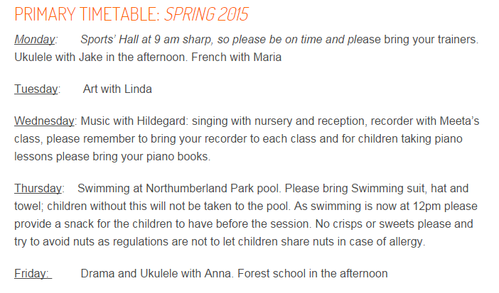
Esiampl: Cwricwlwm Cynradd
Example: Primary Curriculum
Thoughts and comments?
Sylwadau?

Slide 29
Beth yw addysg ‘radical’?
What is ‘radical’ education?
Mewn grŵp, trafodwch beth yw ystyr ‘addysg radical’.
Edrychwch ar y darn darllen ar Moodle i gefnogi eich trafodaeth.
In small groups, discuss a possible definition of the term ‘radical education’.
Refer to the chapter on Moodle to further support your discussion.

Slide 30
“A radical ideology thus attempts to go to the root of things, to question the fundamental premises of dominant beliefs. Radical ideology comes into existence when a group begins to challenge the status quo in society, e.g. in relation to politics, economics, religion, race, gender, education.
A radical ideology is defined by what it is against as well as what it stands for. Radicals are driven by their vision of what a better society could look like and the need to act in order to bring this about. They oppose injustice and inequality and abuse of power and privilege. They challenge all forms of disempowerment (lack of control over one’s life chances) and seek to promote empowerment (being fully responsible for one’s life chances).
Adherents to the dominant ideology will always see radicalism as dangerous but over a period of time radical ideas and demands often become incorporated into the dominant ideology, e.g. the abolition of slavery, the establishment of votes for women.”
Hicks in Ward, 2004

Slide 31
Adlewyrchu
Reflection
Adlewyrchwch ar syniadau heddiw.
  Ym mha ffordd gall y syniadau yma gael eu hystyried yn ‘radical’?
  Oes yna unrhyw fanteision gall ysgolion prif-ffrwd ddysgu ohono?
  Beth yw eich beirniadaeth fwyaf cryf ynglŷn â syniadau heddiw?
Reflect on some of the ideas we have considered today.
  In what way could these ideas be considered radical?
  Are there any major benefits or advantages which you believe could be incorporated into mainstream ideas about education?
  What are your strongest criticisms of some of the ideas we have encountered today?

Slide 32
Llyfryddiaeth
Bibliography
Aubrey, K. & Riley, A. ( 2017) Understanding and Using Challenging Educational Theories, London: SAGE.
A.S.Neil Founder of Summerhill School – 1964. Available at: https://www.youtube.com/watch?v=4-C2i9Iq9vY
Hicks, D. (N.D.) ‘Radical Education’ in Ward, S. ed. (2004) Education Studies: A Student Guide, RoutledgeFalmer.
Independent Schools Council (2017) Research. Available at: https://www.isc.co.uk/research/ [Accessed 13/02/17].
Nant-y-Cwm (2016) What is a Steiner School? http://www.nant-y-cwm.co.uk/education/ (Accessed: 3.3.16).
Neo-Humanist Education. Available at: https://www.youtube.com/watch?v=FX7JKgFWRE4
Pollard, A., Anderson, J., Swaffield, S., Swann, M., Warin, J. & Warwick, P. (2008) Reflective Teaching (3rd ed.), London: Continuum.
Summerhill School (2016) About Summerhill. http://www.summerhillschool.co.uk/about.php (Accessed: 3.3.16).
Sunrise Primary and Nursery School (2016) About. http://sunrise.org.uk/about-2 (Accessed: 3.3.16).

