Slide 1
FEMALE REPRODUCTIVE SYSTEM
Student name: unsa pal
Student number: 1918294
Module code: BMHP5003_BIRM
Module: introduction to physiology
Lecturer: mumtaz goolam
Due date: 18th march 2022

Slide 2
WHAT IS THE FEMALE REPRODUCTIVE SYSTEM?
Female reproductive system is a group of organs in a female's body that wok's together to enable reproduction, pregnancy and childbirth. The system also creates female sex hormones, estrogen and progestogen. This systems contains tissues and organs inside and outside the body – some being visible. "The female reproductive system is a complex multi-organ system involving the hypothalamus, pituitary gland, ovaries, Uterus (endometrium and cervix), and vagina." (Clarke and Khosla,2010)
For females, when they are born their reproductive system is immature and develops to maturity at puberty.
The reproductive system is located within the pelvis, it is made up of 5 different organs listed below:
Ovaries
Fallopian tubes
Uterus
Cervix
Vagina
It is believed that the most important organ in a female's body is the Uterus, and the uterus is one of the predominant organs in the system. This organ serves important functions during pregnancy and childbirth in the system. "The main function of the uterus is to nourish the developing fetus prior to birth" (Jacabson,2019)
These 5 organs work around in the female reproductive system continuously. Developments start at puberty until menopause – which occurs until the ages 44 – 55 years old. " The menopausal transition most often begins between ages 45 and 55" (National Institute on Ageing, n.d)
WHAT IS MENOPAUSE?
A menopause is a point in a women life which lasts 12 months after her last period. They have changes in their monthly cycles which comes along with different sorts of symptoms, for example hot flashes, weight gains, chills and many other similar symptoms. This occurs in mid adulthood for women in the ages of 44 to 55

Slide 3
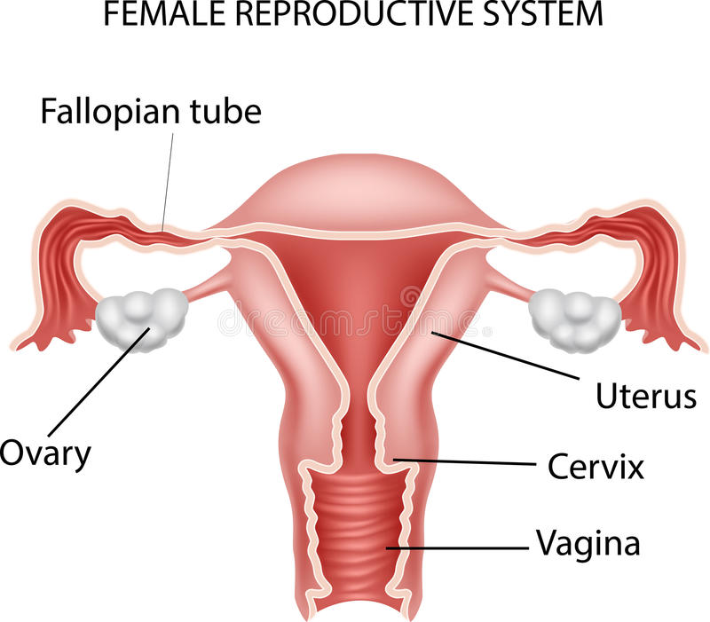
The Uterine tube, also known as the fallopian tube, are J shaped tubes in the female's reproductive system. The function is to assist in the transfer and transport of the ovum from the ovary, to the uterus every month. During sperm and fertilization, the fallopian tube moves the egg to the uterus for implantation. "Male sperm cells to the egg, provide a suitable environment for fertilization and transport the eggs from the ovary, where it is produced, to the central channel of the uterus" (Encyclopedia Britannica, 2019)
(Anon, n.d)
The uterus is where an unborn baby (fetus) is developed and grows inside the uterus, it is also known as the womb. The uterus vagina and cervix all link together.
Ovaries are small oval shaped glands that are placed on either side of the uterus. Ovaries produce and release eggs (oocytes) in the reproductive system at the mid-point of a female's menstrual cycle. The ovaries also produce the female hormones – estrogen and progesterone. "The ovaries release an egg at the midpoint of each menstrual cycle. Usually, only a single oocyte from one ovary is released during each cycle, with each ovary taking an alternate turn in releasing an egg" (Society for Endocrinology, 2018)
The cervix is the lower, narrow end of the uterus that forms a canal between the vagina and uterus. The role of the cervix is that the sperm can travel through to fertilize eggs and when a woman's body is not carrying a baby, the cervix keeps unhealthy things out of your body . When pregnant the cervix helps the baby be in place until fully developed. "The cervix acts as the door to the uterus which sperm can travel through to fertilize eggs" (INTEGRIS,n.d)
Vagina is the muscular canal that extends from the outside of the vulva to the neck of the uterus – called the cervix. The vagina is also the pathway from which the menstrual blood leaves the body during periods. The vagina has several roles within the reproductive system, roles like:
Sexual intercourse – receiving the penis and ejaculate – assisting it to its transport to the uterus
Childbirth – the vagina expands to provide a channel for delivery of a child from the uterus
Menstruation – serves a canal for menstrual blood and tissue to leave the body.

Slide 4
POLYCYSTIC OVARY SYNDROME – PCOS + RECOMMENDATIONS
This is a condition that occurs in the ovaries. The ovaries make an abnormal number of androgens, male hormones – which are usually present in woman in small amounts. Meaning, women with this diagnosis produce a higher than the normal number of male hormones. This condition brings along side effects that affect the woman's body in many ways. PCOS causes an in balance in the female system – causes them to have irregular periods, skip menstrual periods and causing difficulties to become pregnant. Women who are obese are more likely to get diagnosed with PCOS and women become a higher risk of getting diagnosed with diabetes and heart disease. There is currently no cure for this condition and does not go away even after menopause women often continue to have high levels of androgens. However, if this condition is left untreated it can create severe health risks for the individual in the future – health issues like acne scars can happen or heart disease. As there is no exact cure for this condition it is believed that by taking medication it can control and calm down the symptoms and reduce any health risks that can occur in the future.
These are the following symptoms:
Infertility
Acne, oily skin
Excess hair growth on face, stomach, chest, toes and thumbs
Baldness
Patches of dark brown and black skin.
Recommendations:
To avoid further health risks, it is believed to maintain a healthy lifestyle and a balanced diet is important as it will help reduce any further complications. By eating low fat, high carbohydrates can increase insulin levels – it is advised to limit carbohydrates. Maintain a healthy diet and eat foods with high fiber and natural. " Two of the primary ways diet affects PCOS are weight management and insulin production however, insulin plays a significant role in PCOS so managing insulin levels with a PCOS diet is one of the best steps to manage the condition" (www.medicalnewstoday.com,2020)

Slide 5
REFERENCES
Anon, (n.d.). Available at: https://www.dreamstime.com/illustration/reproductive-system.html.
Clarke, B.L. and Khosla, S. (2010). Female reproductive system and bone. Archives of Biochemistry and Biophysics, [online] 503(1), pp.118–128. Available at: https://www.ncbi.nlm.nih.gov/pmc/articles/PMC2942975/
Encyclopaedia Britannica (2019). fallopian tube | Anatomy & Function. In: Encyclopædia Britannica. [online] Available at: https://www.britannica.com/science/fallopian-tube.
INTEGRIS (n.d.). Everything You Need to Know About Your Cervix. [online] integrisok.com. Available at: https://integrisok.com/resources/on-your-health/2019/may/everything-you-need-to-know-about-your-cervix#:~:text=The%20cervix%20acts%20as%20the.
Jacobson, J. (2019). Uterus: MedlinePlus Medical Encyclopedia Image. [online] Medlineplus.gov. Available at: https://medlineplus.gov/ency/imagepages/19263.htm
National Institute on Aging. (n.d.). What Is Menopause? [online] Available at: https://www.nia.nih.gov/health/what-menopause#:~:text=Menopause%20is%20a%20point%20in.\
Society for Endocrinology (2018). Ovaries | You and Your Hormones from the Society for Endocrinology. [online] Yourhormones.info. Available at: https://www.yourhormones.info/glands/ovaries/.
www.medicalnewstoday.com. (2020). PCOS diet: Foods to eat and avoid. [online] Available at: https://www.medicalnewstoday.com/articles/323002#foods-to-eat.

