Slide 1

Module Code: LCMB7023
Lecturer: Gladius Kulothungan
Assessment: Presentation
Master of Business Administration
Name | ID
Md Kausar Hosen | 2406152
Presentation Date: 09/12/25

Slide 2
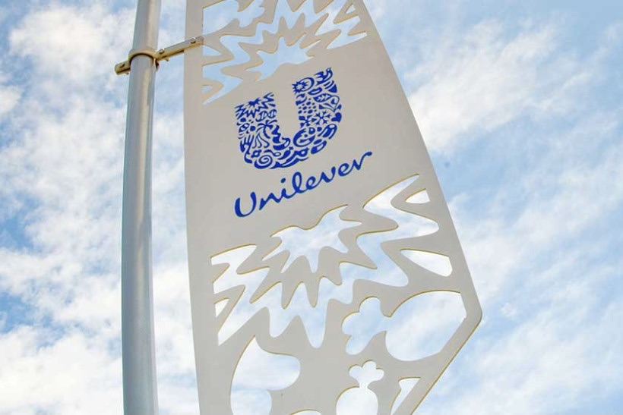
Table Of Contents
Introduction
Company Overview
Current HR Policies and Practices
Role of Line Managers in HR Implementation
Strategic Alignment of HR Practices with Unilever’s Goals
Key HR Challenges Faced by Unilever
Recommendations
Conclusion

Slide 3
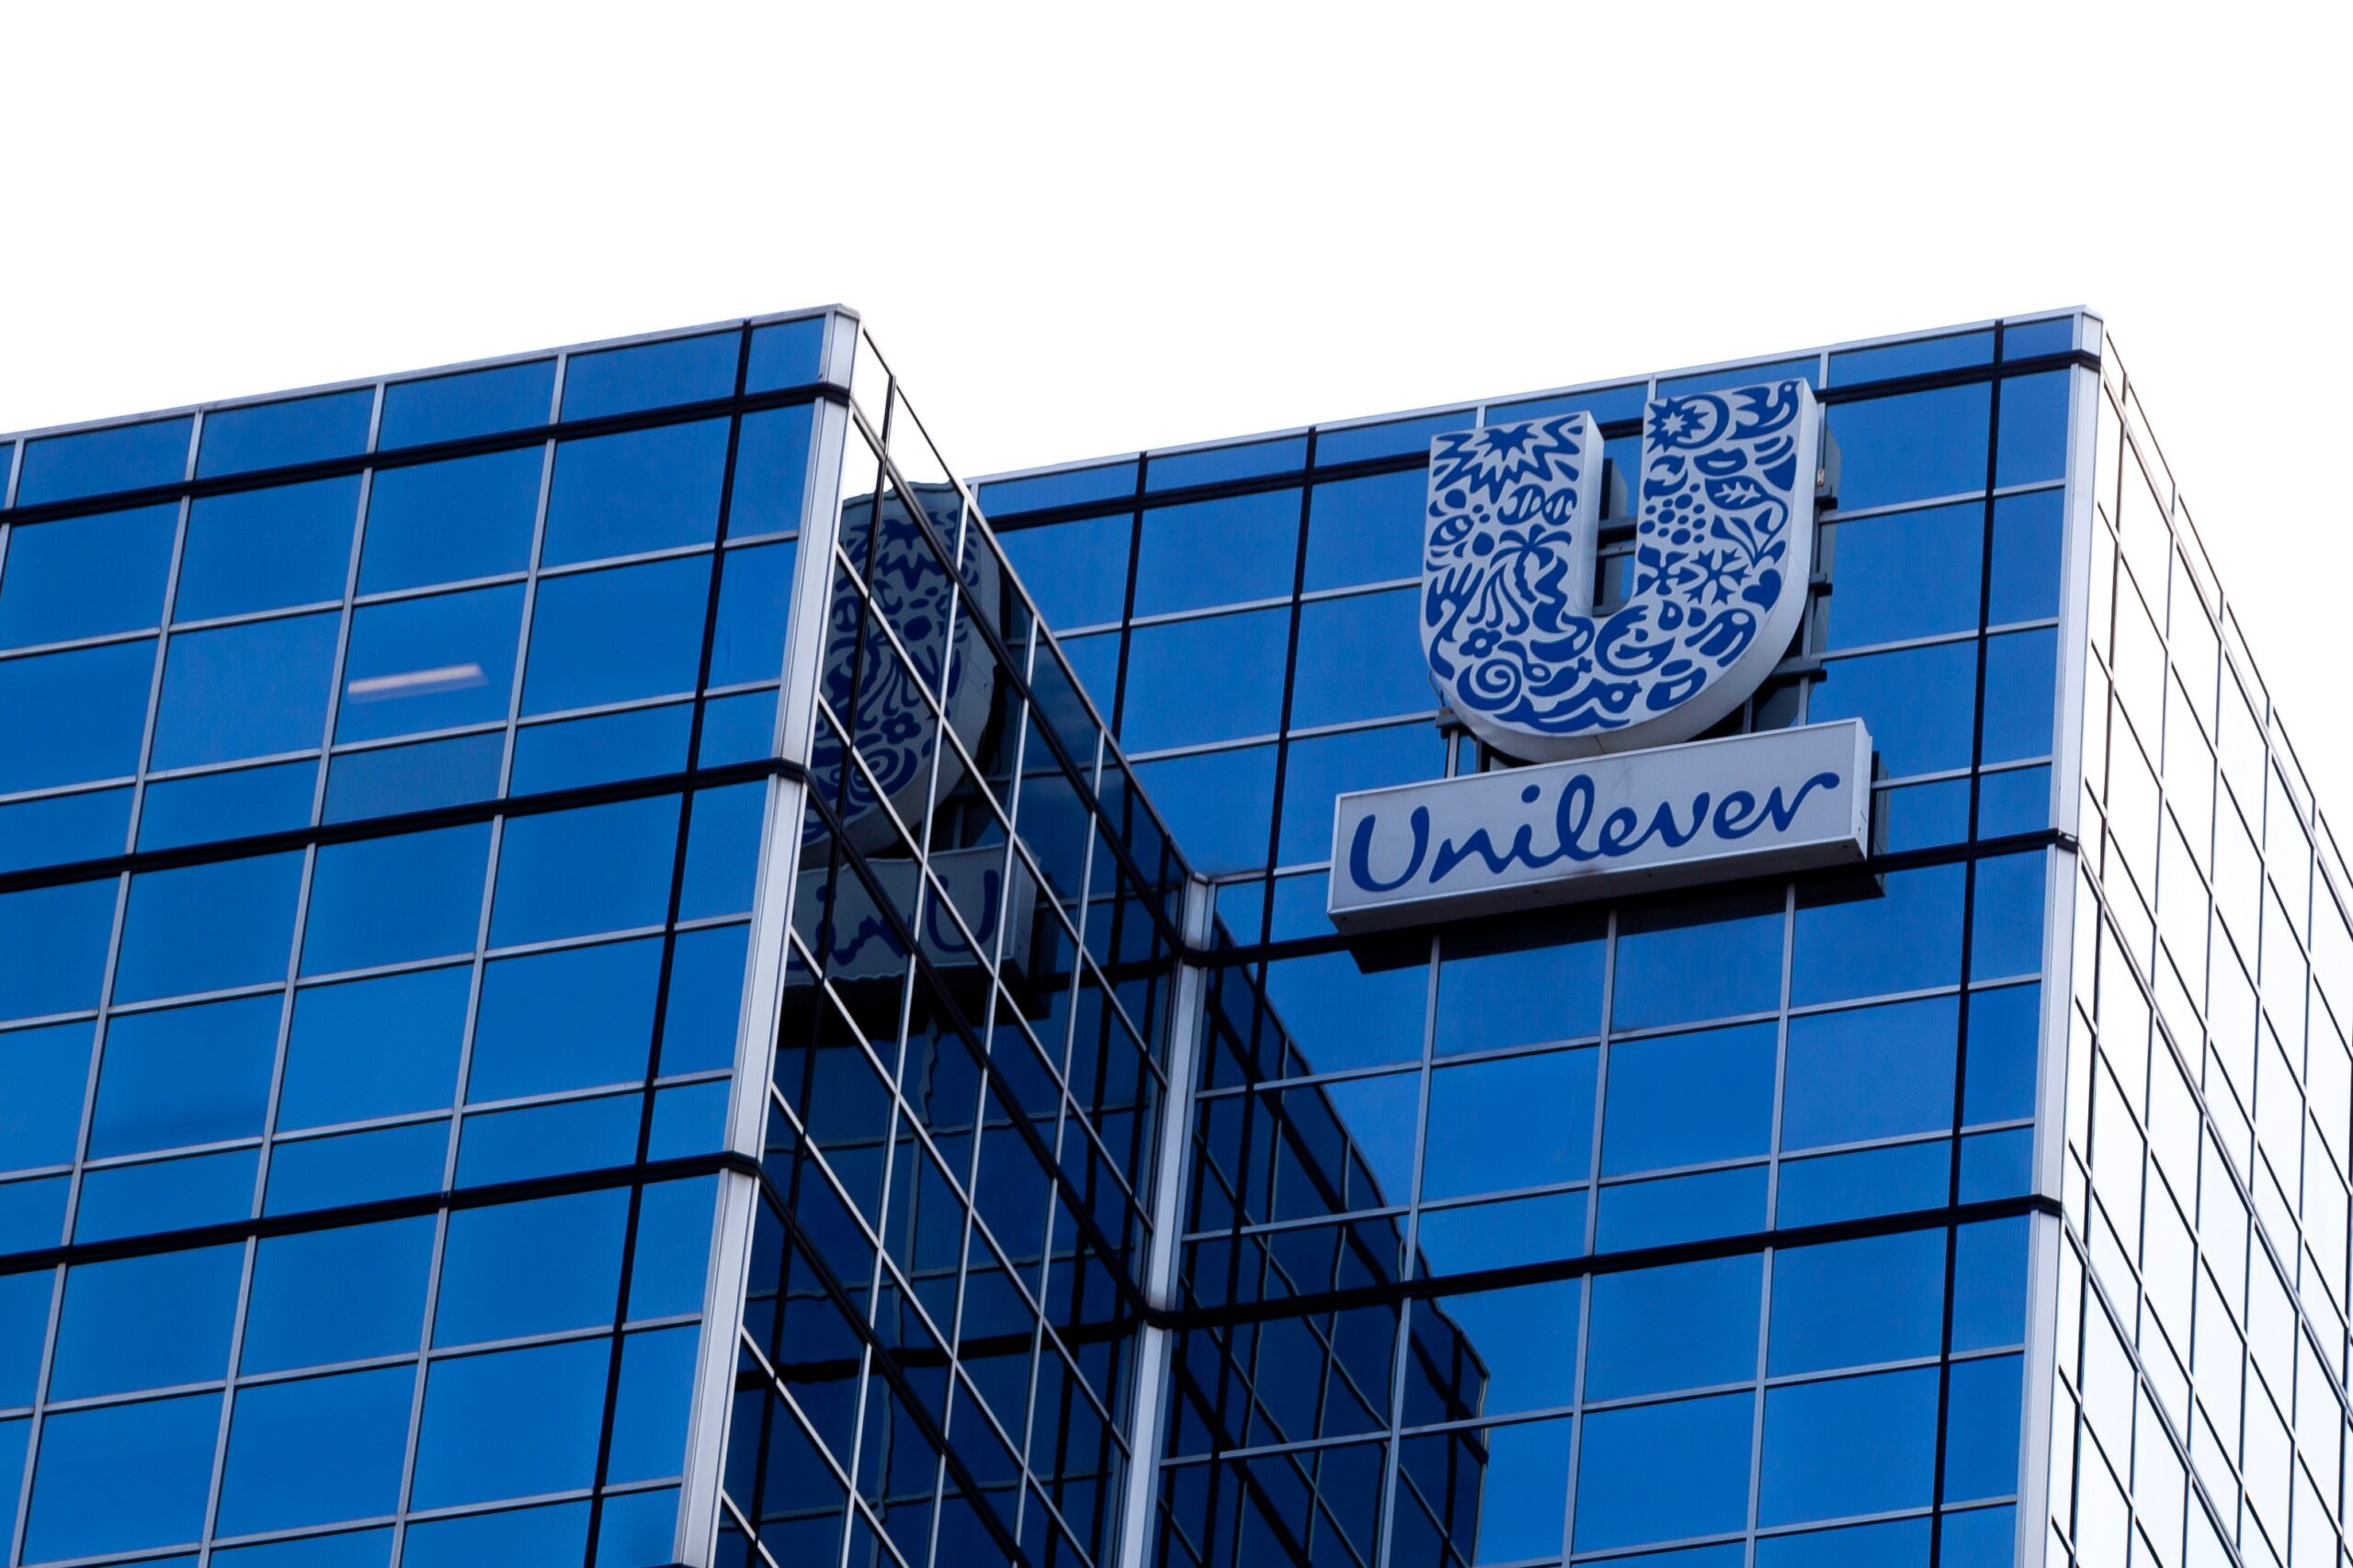
Introduction
Human capital management plays a crucial role in supporting organisational success, especially within large global companies such as Unilever. Operating in over 190 countries with a diverse workforce, Unilever faces increasing challenges related to global operations, talent development, performance management, and diversity and inclusion. This report provides a critical analysis of Unilever’s current HR policies and practices, the role of line managers in implementing them, and how these practices align with the company’s strategic goals. It also identifies key HR challenges and offers practical recommendations to strengthen Unilever’s human capital strategy and overall organisational performance.

Slide 4
Company Overview
Unilever is a global consumer goods company operating in more than 190 countries with a workforce of over 127,000 employees. Known for brands like Dove, Knorr, and Sunsilk, the company focuses on delivering sustainable, innovative products across home care, personal care, and food categories. Guided by its “Unilever Compass” strategy, the organisation prioritises responsible growth, diversity, inclusion, and employee wellbeing. Its large international presence and diverse workforce require strong human resource management to support its global operations and long-term business goals.

Slide 5
Current HR Policies and Practices at Unilever
Training & Development: Offers the Unilever Learning Hub, leadership programmes, and continuous skill development.
Performance Management: Uses a combined system of annual reviews and regular feedback conversations.
Diversity, Equity & Inclusion (DEI): Implements global DEI targets, inclusive recruitment, and employee resource groups.
Global Mobility: Provides international assignments and talent rotation to build global leadership capability.
HR Technology: Uses HR analytics and digital HR platforms to support data-driven decision-making.

Slide 6
Performance Oversight: Conduct performance reviews and provide continuous feedback to employees.
Training Support: Identify skill gaps and encourage employees to participate in development programmes.
DEI Implementation: Promote inclusive practices, reduce bias, and support diversity goals within teams.
Employee Wellbeing: Monitor workload, support work–life balance, and address employee concerns.
Communication: Act as a bridge between HR and employees, ensuring policies are understood and applied.
Team Development: Coach, mentor, and guide employees to improve performance and career growth.
Role of Line Managers in HR Implementation

Slide 7
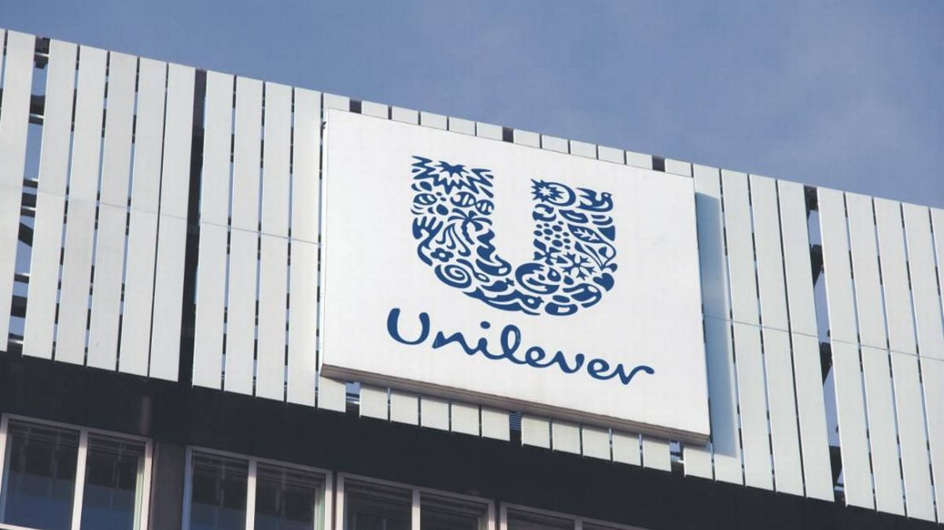
Strategic Alignment of HR Practices with Unilever’s Goals
Sustainable Growth: HR supports Unilever’s “Compass” strategy by building a skilled workforce that drives innovation and responsible business practices.
Leadership Development: Training and mobility programmes create future leaders aligned with long-term strategic needs.
Diversity & Inclusion: DEI initiatives support Unilever’s aim to represent its diverse global consumer base and strengthen decision-making.
Global Competitiveness: Performance management and talent development improve productivity across all markets.
Future-Fit Workforce: Digital HR tools and continuous learning prepare employees for technological and market changes.

Slide 8
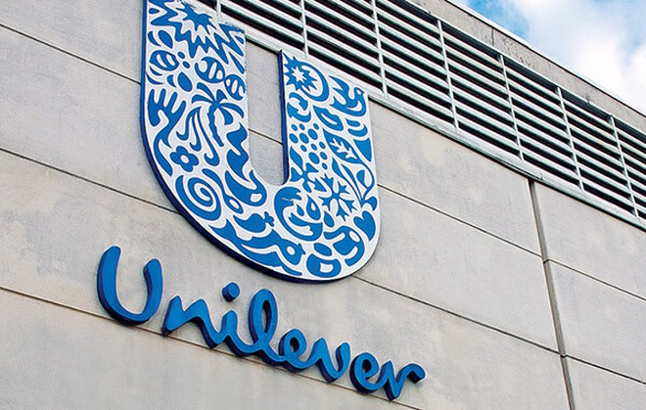

Key HR Challenges Faced by Unilever
Global Mobility Complexities: High costs, cultural adjustment issues, and compliance barriers in international assignments.
Skills Gaps: Need for stronger digital, leadership, and future-ready skills across global teams.
Performance Management Issues: Risk of bias, inconsistent evaluations, and challenges assessing hybrid/remote work.
DEI Implementation Gaps: Difficulty ensuring consistent DEI practices across different regions and cultures.
Employee Wellbeing: Rising stress, workload pressures, and retention challenges in competitive markets.

Slide 9

Recommendations
Improve Global Mobility Support: Provide cultural training, clearer repatriation plans, and better compliance tracking using mobility analytics.
Strengthen Training & Development: Expand digital learning, introduce competency-based programmes, and measure training effectiveness.
Enhance Performance Management: Increase regular check-ins, use objective metrics, and train managers to reduce bias in evaluations.
Advance DEI Initiatives: Set DEI KPIs for managers, expand inclusive leadership training, and use anonymised recruitment practices.
Promote Employee Wellbeing: Introduce workload monitoring tools, expand mental health resources, and promote flexible work options.

Slide 10
Conclusion
Unilever has strong HR practices that support its global operations, but it still faces challenges related to skills development, international mobility, performance management, and DEI consistency. Line managers play a key role in applying these policies and supporting employees. By improving training, strengthening performance systems, enhancing DEI efforts, and promoting employee wellbeing, Unilever can build a more effective and future-ready workforce. These actions will help the company remain competitive and aligned with its long-term strategic goals.

Slide 11
Reference
Forbes (2024). Unilever. [online] Forbes. Available at: https://www.forbes.com/companies/unilever/ [Accessed 2 Dec. 2025].
Kissinger, D. (2023). Unilever’s SWOT Analysis & Recommendations. [online] Panmore Institute. Available at: https://panmore.com/unilever-swot-analysis-recommendations[Accessed 2 Dec. 2025].
Unilever (2024). Unilever in the UK. [online] Unilever. Available at: https://www.unilever.co.uk/unilever-in-the-uk/[Accessed 4 Dec. 2025].
Unilever (2025a). Home. [online] Unilever UK & Ireland. Available at: https://www.unilever.co.uk/[Accessed 5 Dec. 2025].
Unilever (2025b). Our Company. [online] Unilever. Available at: https://www.unilever.co.uk/our-company/[Accessed 7 Dec. 2025].
Unilever (2025c). Unilever at a Glance. [online] Unilever. Available at: https://www.unilever.com/our-company/at-a-glance/[Accessed 7 Dec. 2025].
Unilever (2024). Annual Report and Accounts 2024. [online] Unilever. Available at: https://www.unilever.com/investors/annual-report-and-accounts/[Accessed 6 Dec. 2025].
Unilever PLC (2025a). COP30: Unilever calls for governments to unlock sustainable business growth. [online] Unilever. Available at: https://www.unileverusa.com/news/2025/cop30-unilever-calls-for-governments-to-unlock-sustainable-business-growth/[Accessed 7 Dec. 2025].
Unilever PLC (2025b). How AI is transforming Unilever’s Personal Care business. [online] Unilever. Available at: https://www.unileverusa.com/news/2025/how-ai-is-transforming-unilevers-personal-care-business/ [Accessed 7 Dec. 2025].
Unilever PLC (2025c). How Unilever’s marketing is connecting social to sales at speed. [online] Unilever. Available at: https://www.unileverusa.com/news/2025/how-unilevers-marketing-is-connecting-social-to-sales-at-speed/ [Accessed 8 Dec. 2025].

Slide 12
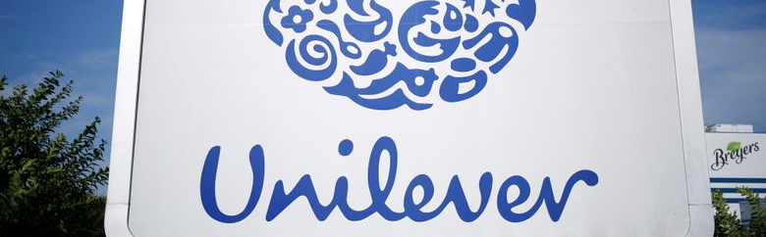
Thank you

