Slide 1

GreenGlow Energy
Corneliu Ciobanu

Slide 2


Introduction
Business Concept: GreenGlow Energy is committed to offering inexpensive solar and wind energy solutions for home and commercial clients.
01
Core Mission: To reduce carbon emissions through accessible renewable energy while maintaining great economic viability.
02
Market Opportunities: Rising global interest in sustainability, combined with supportive government regulations, creates a favorable atmosphere for clean energy adoption.
03

Slide 3

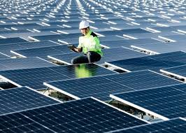

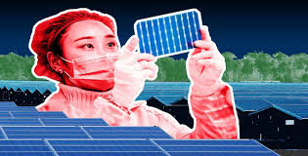
Key Features of the Sustainable Enterprise
Innovative Technology: Uses high-efficiency solar panels, wind turbines, and battery storage.
Holistic sustainability/: Focusses on the environmental, social, and economic pillars to ensure long-term viability.
Community Engagement: Provides educational activities and training to promote widespread renewable adoption.
Resilient Business Model: Multiple revenue sources (installations, maintenance contracts, partnerships) to reduce risk.

Slide 4
Competitive Advantages and Justification
Government Incentives: Leverages tax credits and subsidies, reducing costs for clients
Strong Branding and Partnerships: Collaborations with real estate developers and local organizations to reach broader markets
Scalability: Structured for expansion across regions, enabling economies of scale and lower installation costs
High Demand: Growing consumer preference for clean energy solutions ensures a stable and expanding customer base

Slide 5
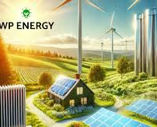
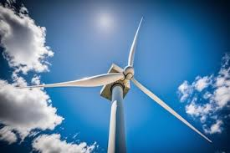
Why This Enterprise Will Succeed
Strategic Positioning: In line with global trends favouring renewable energy usage.
Financial Stability: A combination of private investment, socially responsible finance, and government grants.
Adaptability: Ability to diversify offerings (e.g., small-scale hydropower) and respond to legislative or market changes
Social Impact: Strengthens reputation and stakeholder support by increasing local capacity, educating communities, and providing demonstrable environmental benefits.

Slide 6



THANK YOU

Slide 7
References
Armstrong, C. M., Niinimäki, K., Kujala, S., Karell, E., & Lang, C. (2014). Sustainable product-service systems for clothing: exploring consumer perceptions of consumption alternatives in Finland. Journal of Cleaner Production, 97, 30–39.
Franceschelli, M. V., Santoro, G., & Candelo, E. (2018). Business model innovation for sustainability: a food start-up case study. British Food Journal, 120(10), 2483–2494. https://doi.org/10.1108/BFJ-01-2018-0049
https://www.british-business-bank.co.uk/business-guidance/guidance-articles/sustainability/green-energy
https://www.yuenergy.co.uk/understanding-renewable-energy/
https://www.sseenergysolutions.co.uk/news-and-insights/why-your-small-business-should-choose-renewable
https://groundworksbs.org.uk/renewable-energy-5-benefits/
https://www.solarpowereurope.org/insights/outlooks/eu-market-outlook-for-solar-power-2023-2027/detail
https://www.mckinsey.com/~/media/mckinsey/business%20functions/mckinsey%20digital/our%20insights/the%20top%20trends%20in%20tech%202022/mckinsey-tech-trends-outlook-2022-full-report.pdf
https://www.irena.org/-/media/Files/IRENA/Agency/Publication/2019/Nov/IRENA_Future_of_Solar_PV_2019.pdf

