Slide 1

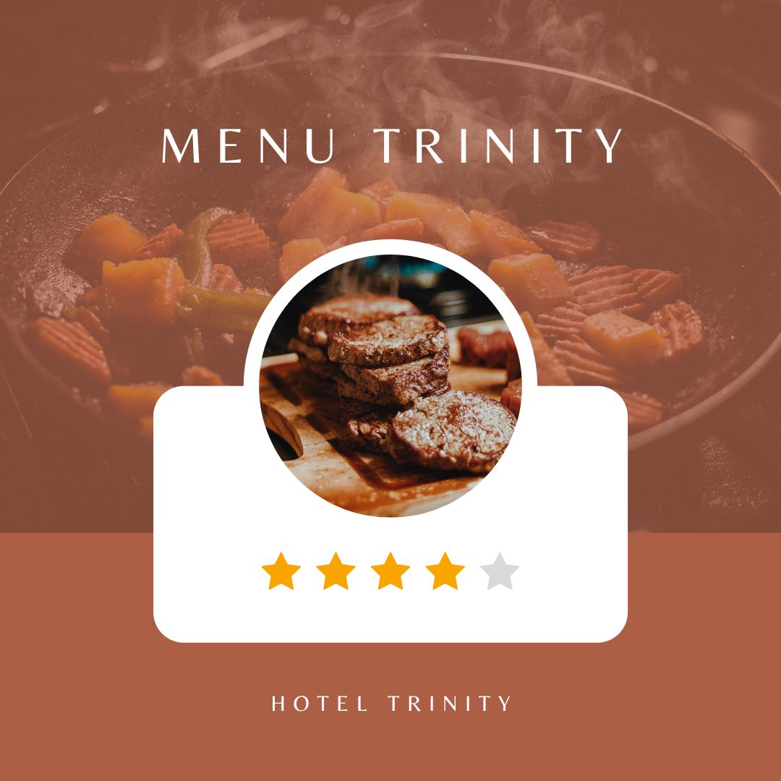
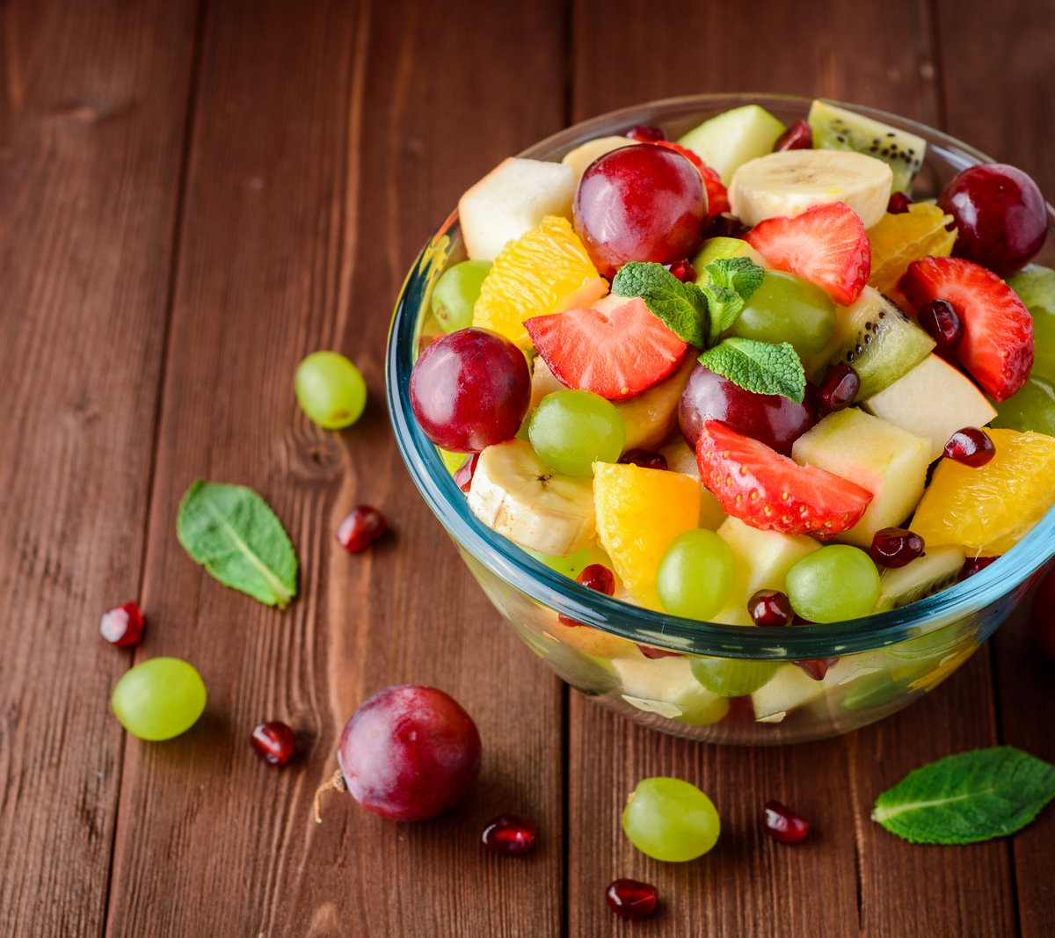
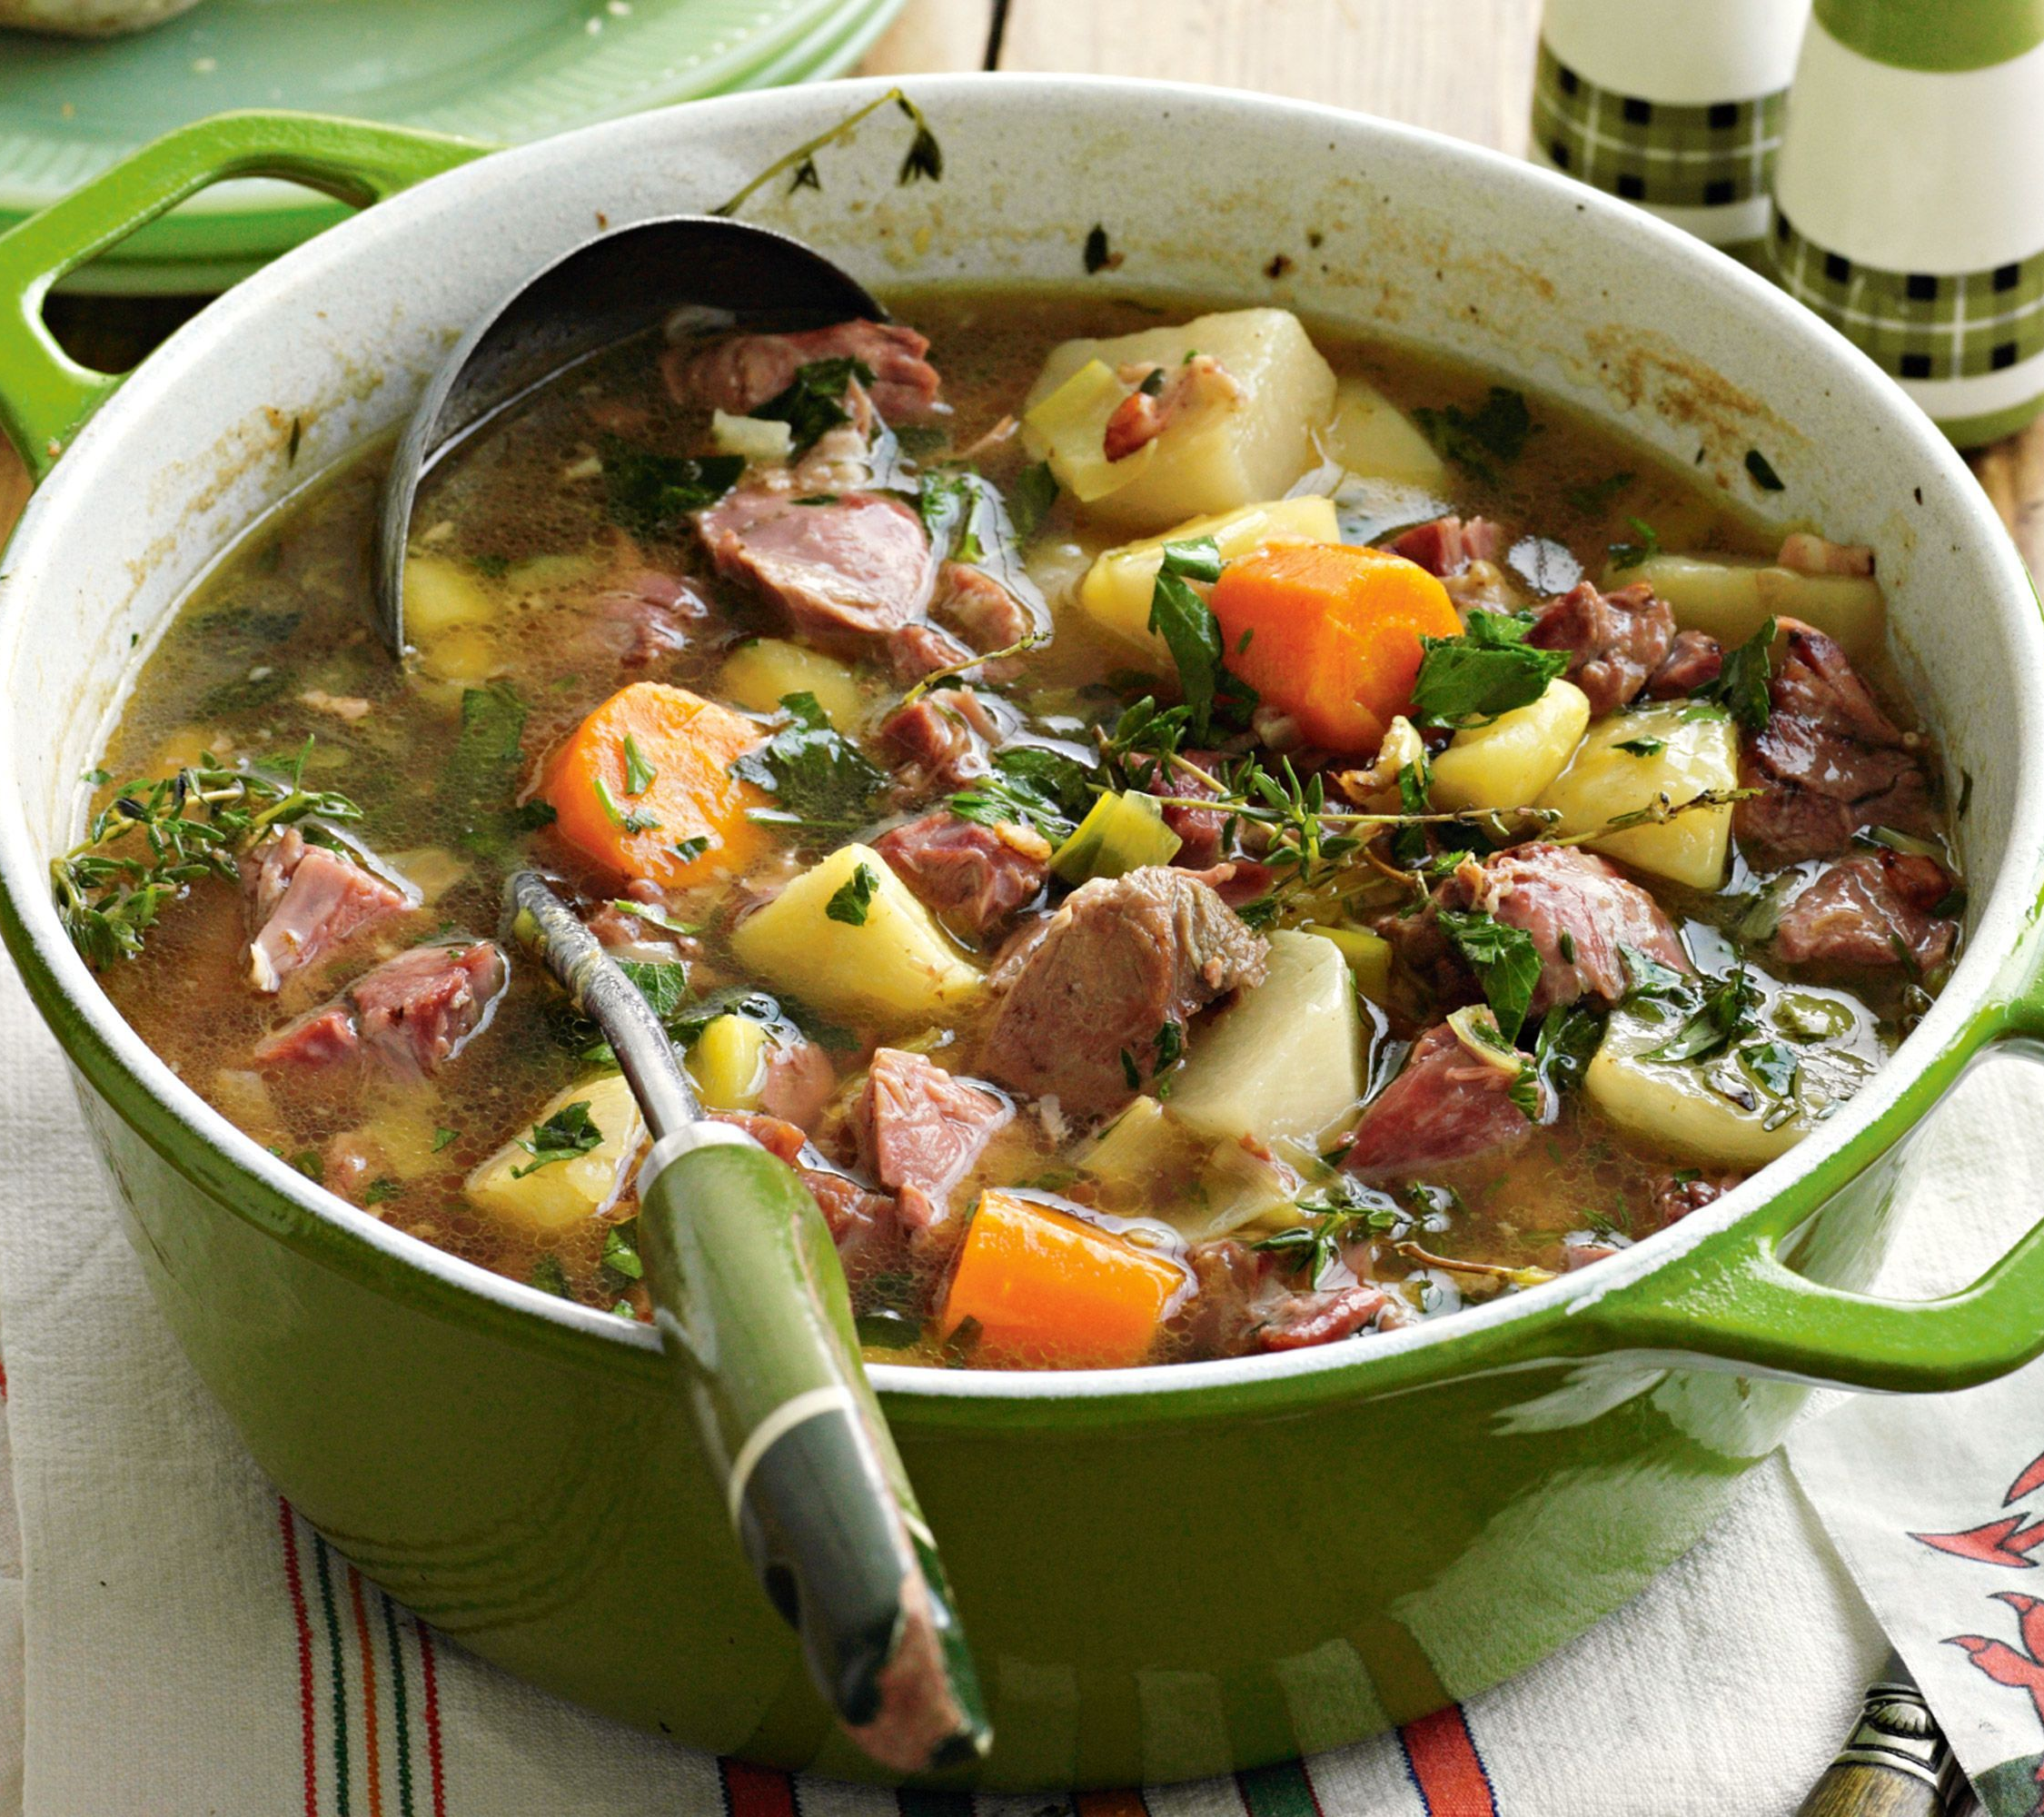
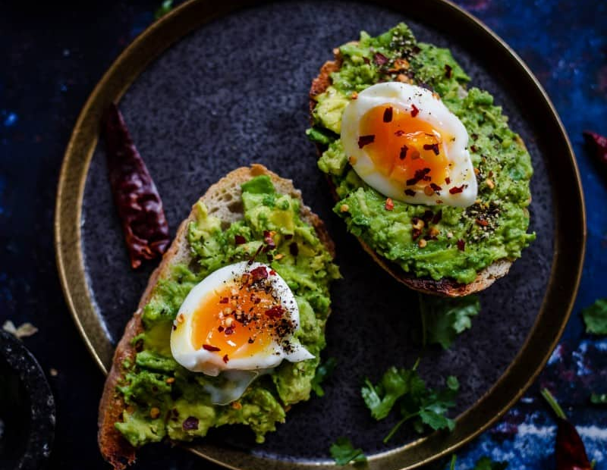
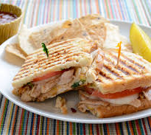
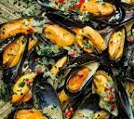
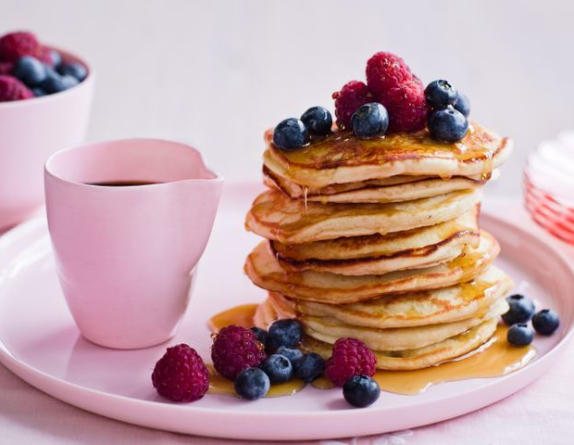
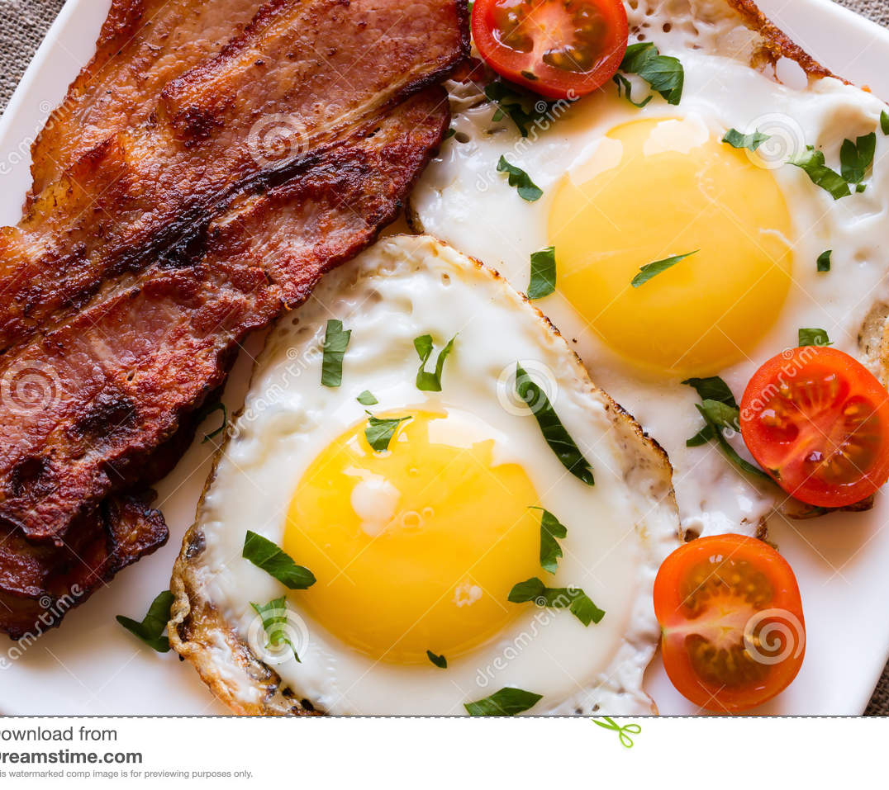
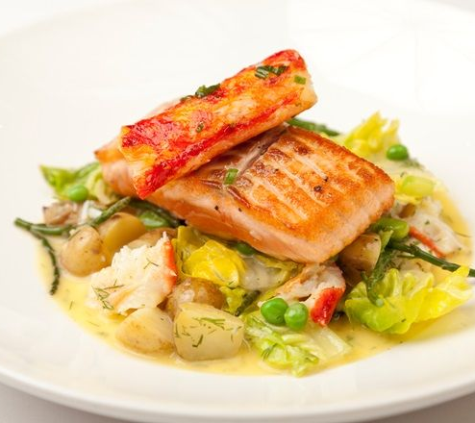
Student Number: 2120533
MENU TRINITY HOTELS
ALA-CARTE
BREAKFAST
FRESH FRUIT BOWL $20
Welsh Lamb Soup (Cawl) $57
Fresh fruits of varieties finely chopped to give a kickstart to your morning.
SINGLE SERVING OF LAMB SOUP WITH VEGETABLES
AVOCADO and egg toast $25
Toast topped with mashed avocado and soft boiled eggs with a pinch or salt and pepper on it.
CHICKEN SANDWICH $30
Conwy Mussels $120
Rotisserie chicken on a ciabatta roll, topped with classic fixings
Pan-fry the muscles with garlic, shallows, white wine, parsley, and double creampaired with rice wine and pinot grigio.
egg free pancakes $48
Egg free pancakes with berries.
BACON AND EGG $20
Sewin & samphire $86
Half fried eggs with fried bacon and tomatoes topped with pepper and salt.
Combination of sea trout and European plant to give the best flavors of the sea food [aired with merlot wine and red wine.
ORDER TIMINGS : 12:00 PM – 22:00 PM

Slide 2

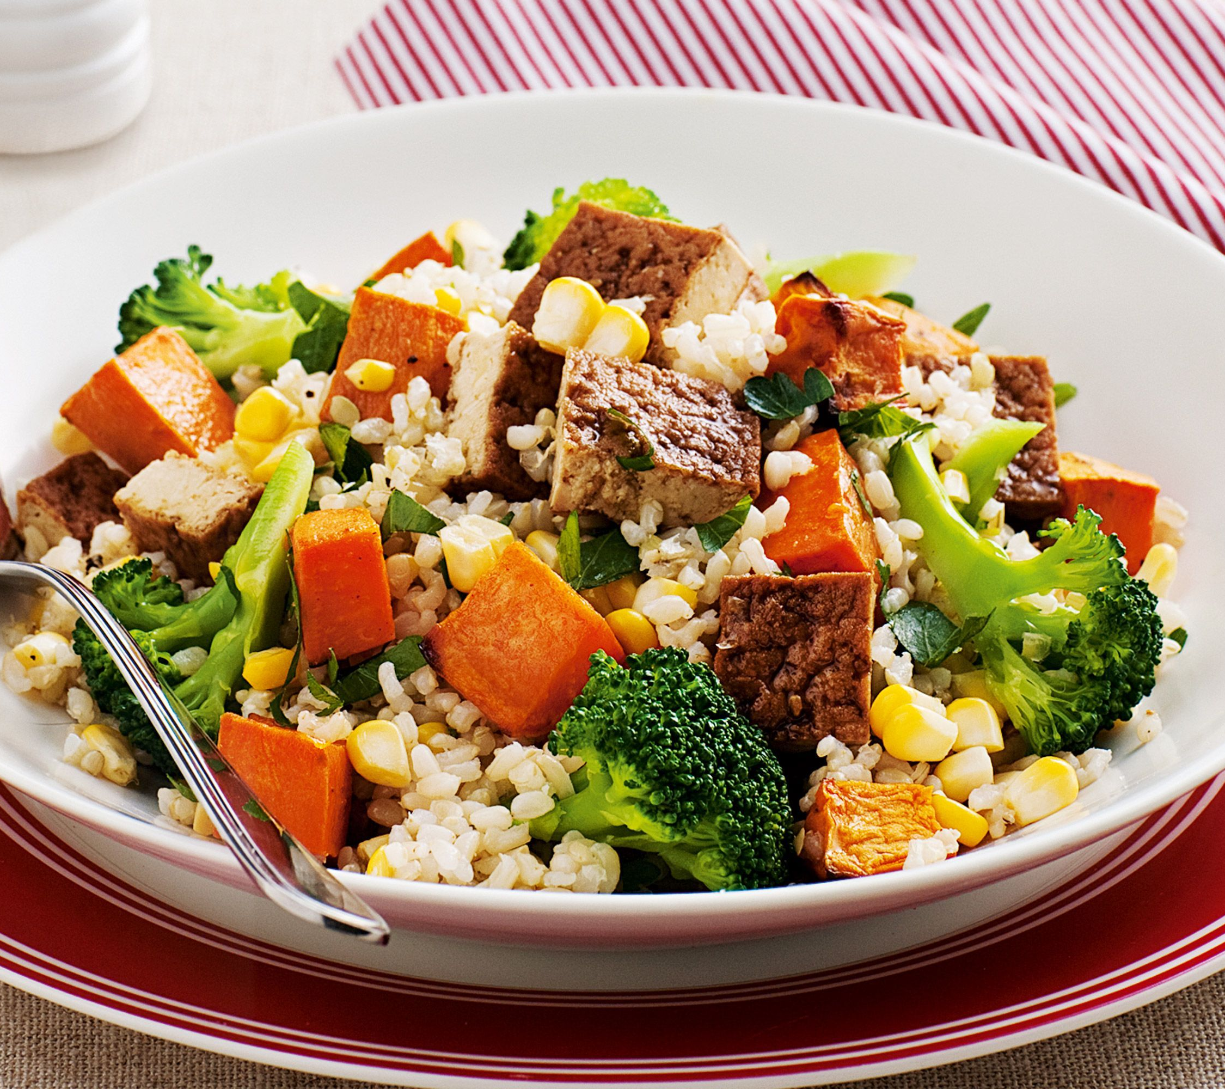
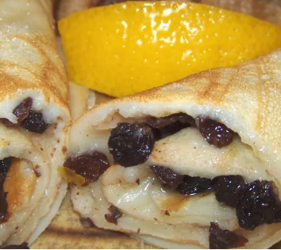

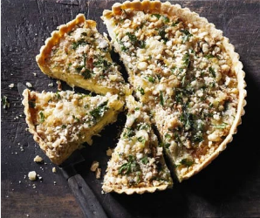
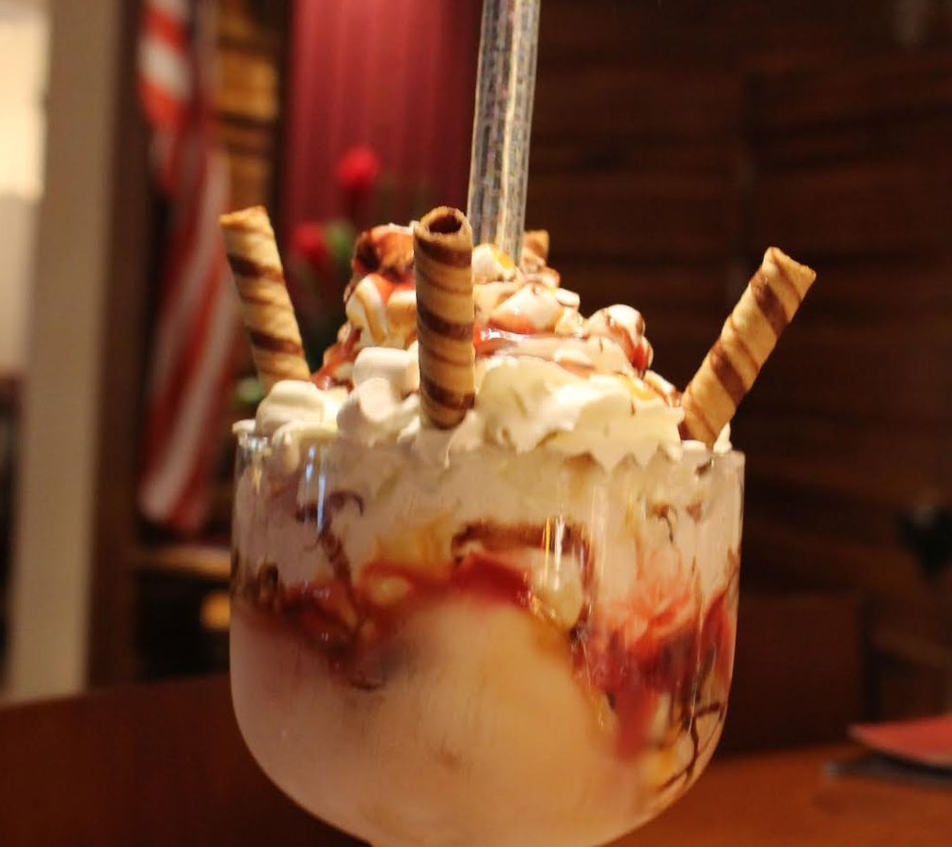
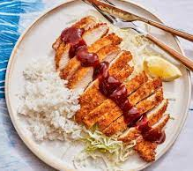

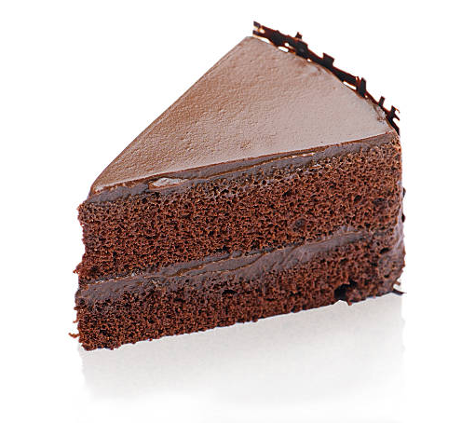
BEVERAGES
DESERT
RED WINE $70
TOFU and brown rice salad $40
Single serving of red wine to give a punch to your evening
WELSH CREPES $14
Allergens: Recipe may contain sesame and soybean.
A mixture of eggs, flour sugar and lemon zest with blueberries.
LEEKS $90
ICECREAM SUNDAE $20
Bread tossed with meaty vegetables and subtle sweetness.
Americano $15
Ice cram sundae with toppings
A perfect start for a day.
CHICKEN katsu $60
CHOCOLATE FUDGE CAKE - one slice $10
The panko-coated fried cutlets are typically accompanied by finely sliced cabbage and tangy, sweet and salty katsu sauce
Fresh orange juice $15
Chocolate fudge cake topped with dark chocolate with or without eggs both available
Fresh juice of tropical fruit to add on to your experience by the sea.
Call : 02 9999 99990- 10, OR www.trinityhotels.com.pk

Slide 3
References
Alexeev, A., n.d. Fried eggs fried bacon and cherry tomatoes sprinkled with parsley. [Online].
Anon., 2022. Welsh Food – 18 Best Traditional Dishes as Recommended by a Local. [Online].
Anon., n.d. STRONG ROOTS. [Online]
Available at: https://www.strongroots.com/recipes/broccoli-purple-carrot-bites-cabbage-noodle-bowls/
FERRANTE, M., n.d. RECIPE COURTESY OF MAYA FERRANTE FOR FOOD NETWORK KITCHEN. [Online]
Available at: https://www.foodnetwork.com/recipes/food-network-kitchen/chicken-katsu-9840942
Hobbs, S., n.d. Egg-free pancake. [Online]
Available at: https://www.taste.com.au/recipes/egg-free-pancakes/d33e1979-3374-4dc8-a09f-8a7e406e86c7
Michela Chiappa,BARILLA, 2022. Simple pasta recipe perfect for summer events. [Online].
Philpott, S., 2016. 26 gorgeous veggie and vegan brunches in Cardiff. [Online]
Available at: https://www.walesonline.co.uk/whats-on/food-drink-news/26-gorgeous-veggie-vegan-brunches-11392885
Ross, C., 2021. Top 10 foods to try in Wales. [Online]
Available at: https://www.bbcgoodfood.com/howto/guide/top-10-foods-try-wales
(Ross, 2021),(Anon., n.d.), (Michela Chiappa,BARILLA, 2022)(Anon., 2022), (FERRANTE, n.d.), (Hobbs, n.d.),(Philpott, 2016), (Alexeev, n.d.)

