Slide 1
Biblical and post-Holocaust theodicy
HPRS6036
Amy Seale
1700646

Slide 2
Contents
Introduction
The Book of Job
Theologians and their approaches to Job
Outline of my final chapter
Evaluation/ Concluding points
Questions regarding my research
Potential issues or problems with my research topic
Bibliography

Slide 3
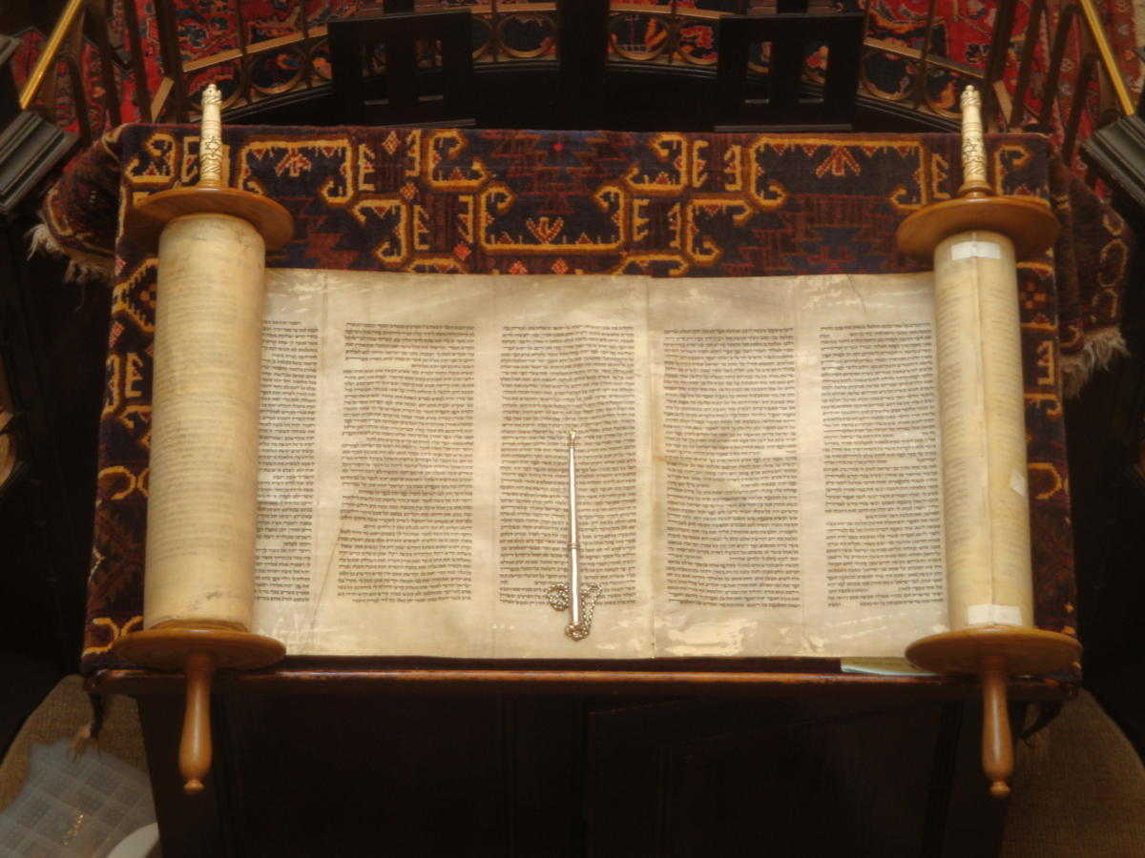
Chapter 1- Introduction
What is the purpose of this research topic?
Biblical narratives
Original source- the Bible
Key points I will be discussing and why they are relevant:
The Book of Job
Relation to the works of Holocaust Theologians
Impact this has had on theology
Fig 1

Slide 4
Chapter 2- Book of Job
Introduction to the Book of Job
Job was the ideal person that Satan wanted God to test for his faith- he was highly religious (Job 1:13, Job 2:13)
“That same day, R.Joshua b.Hyrcanus expounded: Job served the Holy One, blessed is he, only from love, as it is written though he slay me yet will I wait for him.” (Nashim, Sotah 4.5)
Quotes linked with Job and what has been said about the Book of Job
“…blameless and upright, one who feared God and turned away from evil.” (Job 1:1)
“… it’s basis is a fiction, conceived for the purpose of explaining the different opinions which people hold on Divine.” (Maimonides, Part 3 22:1)
Notes:
The book of Job is a book within the Hebrew Bible that comes under the Ketuvim works within Judaism.

Slide 5
Chapter 2- (continued)
3 key themes within the text:
-Suffering- “the problem of scripture is not why suffering exists, but why it afflicts some people and not others,… Why do the wicked prosper, while those who try to keep faith with God suffer?” 1
-God- His response to Job (Job 38-39) “If humans cannot comprehend God’s creation, that is, why should they imagine that they can understand the precise mechanisms of God’s justice?” 2
-Relatability with certain characters-
“In ancient Israel it was indisputable that God is almighty, that he is perfectly just and that no human is pure in his sight. These three assumptions were also fundamental to the theology of Job and his friends.” 3
Importance of this text in relation to modern holocaust theologians
1 John Bowker, “Problems Of Suffering In Religions Of The World” (Cambridge: Cambridge University Press, 1970).p.9.
2 David Charles Kraemer, Responses To Suffering In Classical Rabbinic Literature (New York: Oxford University Press, 1995).p.32.
3 Unknown author, "Book Of Job - Read, Study Bible Verses Online", Bible Study Tools, 2002 https://www.biblestudytools.com/job/ [Accessed 10 March 2020].

Slide 6
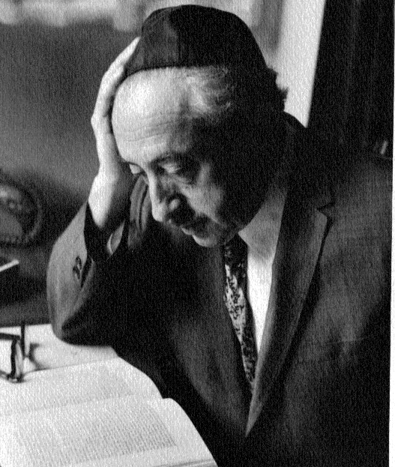
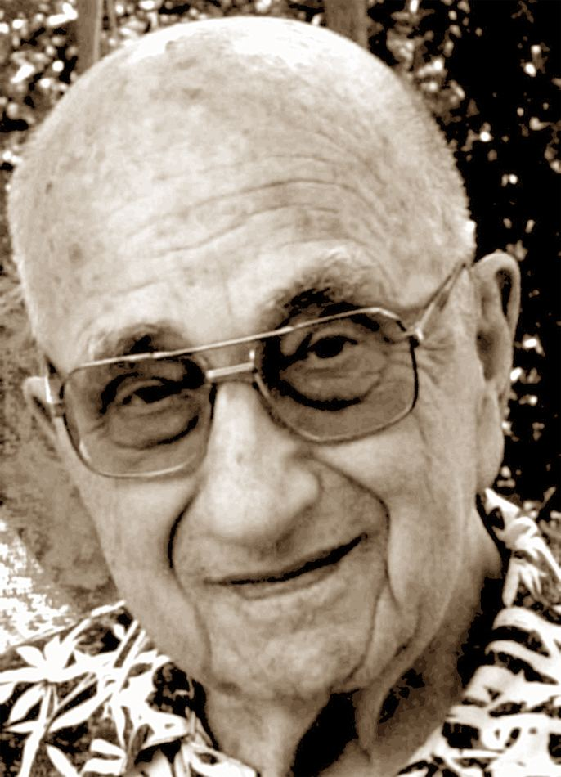
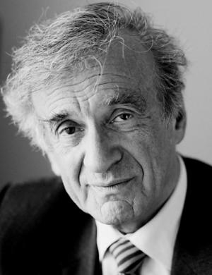
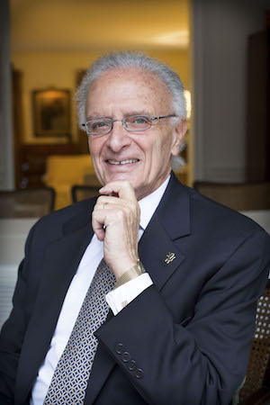
Chapter 3- Theologians approach to post-Holocaust dialogues
Fig 2
Fig 3
Fig 4
Fig 5
Eliezer Berkovits
1908-1992
Emil Fackenheim
1916-2003
Elie Wiesel
1928-2016
David R Blumenthal
1938-Present
Notes:
Why did I choose these 4 theologians? I chose these four theologians in particular due to their works on Holocaust Theology- with Berkovits being one of the earliest theologians to express his views on God and faith after the Holocaust, where he tries to explore how God had to remain ‘hidden’ otherwise God too would have endured suffering in this way. This is followed then by Fackenheim, who published his works around 10 years later, with an appealing factor towards his theology of the 614th Commandment.
Wiesel wrote of his experiences in the concentration camps in his book ‘night’ which was published shortly after Fackenheim’s work. His personal encounters of evil and suffering is the main reason behind his theology of protest- with a transition from being a Jewish scholar, to the loss of faith after witnessing evil, to a protest of questioning God for answers. Blumenthal takes another approach to protest where he encourages others to question God- in a way of why could a loving God allow such suffering on his Chosen People? He also acknowledges that God is partly responsible for the Holocaust- where he sees that it is human actions on others that have caused this suffering, with God remaining silent also is where Blumenthal takes his theology further.
Each theologian has a different approach to post-Holocaust discussions on God and suffering. However, I have noted on some similarities where these Theologians can be linked together, with Berkovits and Fackenheim exploring the ways to remain faithful, especially after the Holocaust, and Wiesel and Blumenthal taking another approach through protest with God for answers.

Slide 7
Chapter 3- Theologians approach to Job
“Fackenheim dares to make a religious affirmation of what drives others to atheism or silence. Like Job, he gives expression to a profound faith.” 2
“because of his faith, Job cannot accept a defense of God that implies an insult to the dignity of the God whom he believes” 1
An important question to
ask is as follows:
‘Is there a link with these
Theologians and Job?’
Links to Job
“[religious believers] piously claim ignorance of God’s ways, and change the subject. The Theology of Job’s comforters, not the theology of Job.” 4
“[Wiesel] has a perennial quarrel with God. Wiesel has been described as the Job of the twentieth century…” 3
1 Eliezer Berkovits, ‘Faith After The Holocaust’ (New York: Ktav Publishing House, Inc., 1973).p.p.68-69.
2 Steven T Katz, ‘Post-Holocaust Dialogues: Critical Studies In Modern Jewish Thought’ (New York: New York University Press, 1985).p.154.
3 Jakob Jocz, Dan Cohn-Sherbok, ‘Holocaust Theology’ (Exeter: University of Exeter Press, 2002).p.62.
4 Dan Cohn-Sherbok, ‘God and the Holocaust’ (Leominster: Gracewing Fowler Wright Books, 1996).p.241.
Notes:
Explore similarities and links that each theologian has through their experiences and within their works.
Jacob Jocz, another theologian, highlights this aspect about Wiesel due to his ‘theology of protest’ with God after his experiences within concentration camps. Wiesel also in his play ‘The Trial of God’ highlights himself as the character of Job within the play, where God is on trial for allowing suffering. Although this protest seeks for answers by Wiesel, he also gains his faith after the holocaust through this questioning.
Blumenthal takes a drastic response to Job, where he highlights this notion of Job’s comfortors as a way of looking for better things to come as what happened with Job. However, Blumenthal notes that this is not the case, with Job being the ‘ideal sufferer’ who receieves reward, unlike the millions of men, women and children who lost innocent lives which will not be rewarded.
Berkovits highlights this aspect which shows how even as he describes his faith in a similar way to Job, that due to his faith he like Job cannot insult the God in which he believes.
It is highlighted clearly in this description by Steven T Katz where Fackenheim argues on this idea of remaining with faith, like Job did. With this, it further shows also this strong affirmation of faith to God not only from Fackenheim but also what can be seen through Job.
Wiesel

Slide 8
Chapter 4- Comparison of different theological approaches
My final chapter will include a comparison and contrast of such ideas and approaches to these discussions on post-Holocaust dialogues.
“Job’s appeal to post-Holocaust Jewish thinkers seems obvious enough: Job is the biblical archetype of unwarranted, senseless suffering.” 5
“The shoah challenges all who accept the concept of a loving, providential God- and those who do not.” 6
“For Fackenheim, the state of Israel is living testimony to God’s continued presence in history.” 7
Why are these debates necessary for modern discussions?
5 Dan Matthewson, "Between Testimony And Interpretation: The Book Of Job In Post-Holocaust Jewish Theological Reflection", Studies In The Literary Imagination, 41.2 (2008).p.17.
6 Elizabeth Pinder-Ashden, "How Jewish Thinkers Come To Terms With The Holocaust And Why It Matters For This Generation: A Selected Survey And Commen", EJT, 20.2 (2011).p.132.
7 Steven T Katz, Post-Holocaust Dialogues: Critical Studies In Modern Jewish Thought (New York: New York University Press, 1985).p.155.

Slide 9
Chapter 5- Evaluation/ Conclusion
Evidence and research gathered:
Looking at Job as an ancient text and applying it to the theories of Holocaust Theologians
Is there an overarching element that determines the need to have these discussions today?
These works have impacted Jewish religious thought largely after the Holocaust.
Why are these Theologians still having a massive impact on post-Holocaust Jewish thought today?

Slide 10

Questions regarding my research
Fig 6
What is interesting to me about this research?
Has it impacted on religious thought?
Attitudes towards religious/ minority groups within society
A major aspect of Jewish history which must not be repeated or forgotten

Slide 11
Problems/ issues with my research
Job:
Time of writing- “There is no question that the book was already written by the second century BCE, since an Aramaic translation of the Book of Job was discovered among the Dead Sea Scrolls.” 8
Use of the text- Used by the four theologians I have discussed previously for emphasis on this relation between humanity and God.
Problems when compared with those who suffered during the Holocaust- millions lost their lives and families destroyed, how does this compare to Job- who kept his life?
Theologians:
Publications of theological debates and discussions- as early as 1970’s
Personal experiences affect opinions- with this, it affects both faith and religion where there is either this route of finding the loving God once more or disregarding the idea of a loving God ever existed after the Holocaust.
8 Elon Gildad, "Who Really Wrote The Book Of Job?", Haaretz.Com https://www.haaretz.com/jewish/MAGAZINE-who-really-wrote-the-book-of-job-1.5434183 [Accessed 11 March 2020].

Slide 12
Bibliography
Berkovits, Eliezer, ‘Faith After The Holocaust’ (New York: Ktav Publishing House, Inc., 1973)
Cohn-Sherbok, Dan, Jacob Jocz, ‘Holocaust Theology: A Reader’ (Exeter: University of Exeter Press, 2002)
Cohn-Sherbok, Dan, ‘God And The Holocaust’ (Leominster: Gracewing Fowler Wright Books, 1996)
Gildad, Elon, ‘Who Really Wrote The Book Of Job?’, Haaretz.Com https://www.haaretz.com/jewish/MAGAZINE-who-really-wrote-the-book-of-job-1.5434183 [Accessed 11 March 2020]
John Bowker, ‘Problems Of Suffering In Religions Of The World’ (Cambridge: Cambridge University Press, 1970)
Katz, Steven T, ‘Post-Holocaust Dialogues: Critical Studies In Modern Jewish Thought’ (New York: New York University Press, 1985)
Kraemer, David Charles, ‘Responses To Suffering In Classical Rabbinic Literature’ (New York: Oxford University Press, 1995)
Matthewson, Dan, ‘Between Testimony And Interpretation: The Book Of Job In Post-Holocaust Jewish Theological Reflection’, Studies In The Literary Imagination, 41 (2008)
Pinder-Ashden, Elizabeth, ‘How Jewish Thinkers Come To Terms With The Holocaust And Why It Matters For This Generation: A Selected Survey And Commen’, EJT, 20 (2011)
Unknown Author, ‘Book Of Job - Read, Study Bible Verses Online’, Bible Study Tools, 2002 https://www.biblestudytools.com/job/ [Accessed 10 March 2020]

Slide 13
Images Bibliography
Fig 1: Lev, Tsafi, Torah Scroll, 2013 https://www.myjewishlearning.com/rabbis-without-borders/is-torah-just-for-jews/ [Accessed 11 March 2020]
Fig 2: Wikipedia, Eliezer Berkovits, 2020 https://en.wikipedia.org/wiki/Eliezer_Berkovits [Accessed 11 March 2020]
Fig 3: Joshi, Tripti, Emil Fackenheim, 2018 https://alchetron.com/Emil-Fackenheim [Accessed 11 March 2020]
Fig 4: Hirt-Manheimer, Aron, Elie Wiesel https://reformjudaism.org/jewish-life/arts-culture/literature/god-indifference-and-hope-conversation-elie-wiesel [Accessed 11 March 2020]
Fig 5: Borden, Anne, David R Blumenthal, 2020 http://davidblumenthal.org/ [Accessed 11 March 2020]
Fig 6: Sawyer, Katie, Question, 2012 https://www.eventbrite.com/blog/ds00-show-relevant-custom-questions-with-conditional-logic/ [Accessed 11 March 2020]

Slide 14
Thank you for listening
Any questions?

