Slide 1

MODULE: EFFECTIVE TEAMWORKING & COMMUNICATION
LCLM4003
BREAKING COMMUNICATION BARRIERS
GROUP MEMEBERS: MOHAMEDRAZA MOHAMED 2520393
RUT-CARMEN MARCU 2520928
MARINELA ANA MATEI 2523890
BETTY ANITA OWUSU 2521404

Slide 2

OVERVIEW
THE 5 BARRIERS:
ENVIROMENTAL NOISE
LANGUAGE/COMMUNICATION
GENERATIONAL/AGE
EMOTIONAL
CULTURAL
RECOMMENDATIONS
CONCLUSION
REFERENCES
COMPANY BACKGROUND & PROBLEM STATEMENT

Slide 3
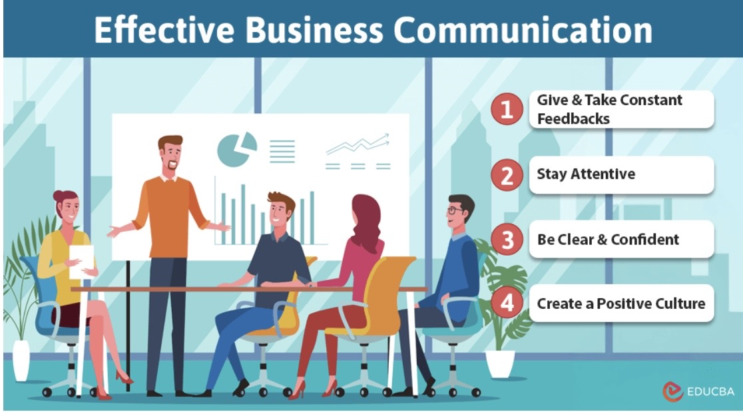
WHAT IS BUSINESS COMMUNICATION?
"An area of the organisational management that pertains to the sharing of information, internally and externally to achieve company objectives". (Nishant Baxi 2023)
Internal Communication is within the company and flows downwards, upwards or horizontally
External communication is with the outside Stakeholders.

Slide 4

COMPANY BACKGROUND
FLIGHT FOODS LTD
The Problem: Losing market share due to airline complaints about:​​
.Under-cooked food​​
. Poor packaging​​
. Meat found in vegetarian meals.
Industry: Ready meals manufacturing for airlines.​
Size: Medium Enterprise​
Workforce: 40 employees, aged 16-60 from 5 distinct cultural groups.​​
​
Key Issue: Communication breakdowns between management and the multicultural workforce are compromising food hygiene and quality standards.

Slide 5

Environmental Noise
"Noise in communication theory is defined as any unwanted interference that disrupts the clarity or fidelity of a message moving between a sender and a receiver" (Climb,2025)
LOUD MACHINERY AND CONSTANT NOISE MAKES IT DIFFICULT FOR MESSAGES TO BE HEARD AND UNDERSTOOD.
LOUD MACHINERY AND CONSTST BACKGROUND NOISE MAKE IT DIFFICULT FOR MESSAGES TO BE HEARD AND UNDERSTOOD

Slide 6
SHANNON & WEAVER MODEL( 1949)
INFORMATION SOURCE (GARY)
TRANSMITTE (ENCODE MESSAGE WEAR YOUR HAIR NETS, CHECK THE TEMPERATURE)
CHANNEL
RECIEVERS
NOISY MACHINES (CLANKING AND BANGING

Slide 7

SUGGESTIONS
USE VISUAL COMMUNICATION
DESIGNATED QUIET ZONES
INVEST IN NOISE REDUCTION EQUIPMENTS
USE WRITTEN OR VISUAL BACKUP

Slide 8


Language/Communication
Berlo’s SMCR model: This stands for Gary’s instructions (Berlo,1960) :​
This explains that successful communication is when the sender and receiver have the same communication skills, language and understanding.
In this case, Gary speaks English, but his employees don’t; this means that the message is misunderstood.
MESSAGE
SOURCE
Gary Communicates
Keep hairnets on at all times.
Wash hands regularly.
Do not chat while operating machinery.
Keep fresh meat chilled.
Follow food hygiene and safety procedures.
Gary communicates through:
Spoken instructions.
Body language/ pointing.
Posters and warning signs.
Visual communication.
Factory Employees
40 workers aged 16-60.
Five different cultural backgrounds.
Many have limited English.
No formal food hygiene training before starting.
CHANNEL
RECEIVER
Gary-Floor Manager
Qualified in Food Hygiene and Safety.
Gives food hygiene instructions.
Speaks mainly English.
Uses demonstrations and signs.

Slide 9
Suggestions​
Improve communication with multilingual materials
Provide interpreters
Give simple English training
Use pictures and symbols
• Implement regular feedback sessions to assess understanding
• Create bilingual signage and written materials in key areas.

Slide 10

Age Communication barrier
The theory:
Schramm’s Model of communication: people understand messages differently because of their different experiences (Schramm,1954) .
SENDER
Gary (Floor Manager)
Encodes the message.
Gives food hygiene instructions.
MESSAGE
Wear hairnets
Wash hands
Do not chat when using machines.
Keep meat chilled.
Follow food hygiene rules.
RECEIVER
Employees (Aged 16-60 years)
Older workers.
Understand instructions
Younger workers misunderstand or ignore instructions.
EFFECT
Instructions not followed.
Food hygiene errors.
Customer complaints.
Loss of business.
.
DIFFERENT AGES AND GENERATIONS HAVE DIFFERENT WORK STYLES, EXPECTATIONS AND PREFERNCES FOR COMMUNICATION

Slide 11
Suggestions for age barrier
Give
Give extra support to younger staff
Pair
Pair experienced staff with new employees
Use
Use practical demonstrations
Offer
Offer mentorship programs for professional development
Conduct
Conduct regular training workshops to enhance skills
Encourage
Encourage team-building activities to foster collaboration

Slide 12

Emotional Communication Barrier
EMOTIONAL BARRIER
Gary's frustration and stress create an emotional barrier that affects communication. In the Shannon and Weaver Model, these emotions act as psychological noise, interfering with the message being received correctly. Gary calls the workplace a "madhouse" and shouts "Idiots!" after finding unsafe food handling, which may make employees feel intimidated or defensive. As a result, workers are less likely to understand, trust, or follow his food safety instructions effectively. According to the Shannon and Weaver Model (1949), communication involves a sender, message, channel, noise, receiver, and feedback.
SENDER Gary ( Floor Manager) Wants to communicate food hygiene and safety instructions .
CHANNEL Verbal instructions and signs in the factory.
MESSAGE Instructions about food hygiene e.g. " wash your hands regularly".
NOISE ( Emotional) Frustration ,Anger ,Stress & Impatience These emotions distort the message and reduce clarity
RECIVER (Factory Employees) From different background cultural groups and age groups.
EFFECT Message may be misunderstood, ignored or avoided, Poor hygiene practice continues.
Feedback - Limited or negative feedback employees may avoid Gary so he doesn’t know if the message is understood

Slide 13
Suggestions for Emotional Barriers
How Gary Could Overcome the Emotional Barrier
Remain calm and professional when communicating instructions.
Use positive reinforcement rather than criticism to encourage correct behavior.
Address mistakes privately instead of shouting in front of other employees.
Schedule regular training sessions when staff are not under pressure, reducing stress for both Gary and employees.
Encourage two-way communication by asking employees to repeat or demonstrate instructions to confirm understanding.

Slide 14

Cultural Standards and Practises
CULTURE IS THE WAY A GROUP OF PEOPLE LIVE (WILLIAMS 1958).
BERLO;S SMCR: THE CULURE AND SOSCIAL SYSTERM ELEMENTS OF BOTH SOURCE AND RECEIVER ARE MIS ALIGNED
DIFFERENT CULTURAL BACKGROUNDS ,VALUES AND PRACTISES AFFECT UNDERSTANDING OF RULES AND BEHAVIOUR AND WORKPLACE NORMS
5 DISTINCTIVE CULTURAL PRACTISES AND VALUES
SOURCE:GARY
MESSAGE: WASH HANDS ETC
CHANNEL:FACE TO FACE

Slide 15
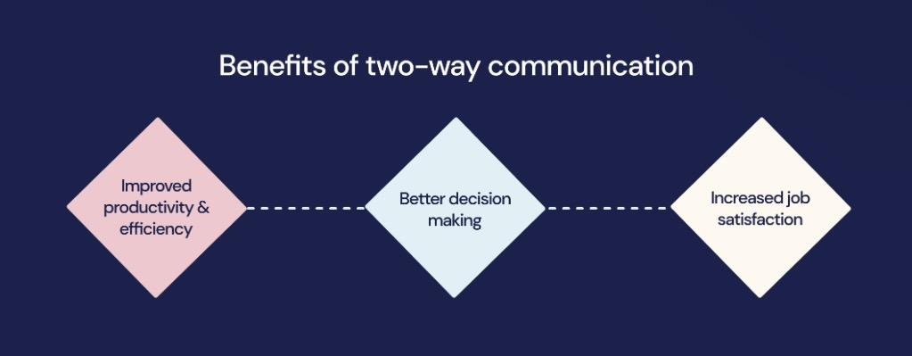
SUGGESTIONS
CROSS- CULTURAL TRAINING. (Husain et al 2025)
ADAPT ENCODING METHODS
(CULTURAL EMPATHY, ACTIVE LISTENING)
CULTURAL LIASONS TO FACILITATE TWO-WAY FEEDBACK LOOPS

Slide 16

RECOMENDATIONS
IMMEDIATE ACTIONS: Formal pre -employment hygiene training (FSA 2021) Multilingual visual aids Demonstration based training Feedback mechanisms
MEDIUM ACTIONS: Gary needs support Cultural awareness workshops (Acquah 2026) Regular staff meetings Emotional intelligence development
LONG TERM ACTIONS: Equipment modernisation Diverse recruitment at management level Continuous improvement culture

Slide 17
CONCLUSION
EEEE
EHHHGG
Effective communication is essential for marketing, food safety, quality and customer satisfaction.
By understanding the barriers and applying the right strategies flight foods limited can build a stronger team, improve operations and win back the trust of their airline partners.
G

Slide 18
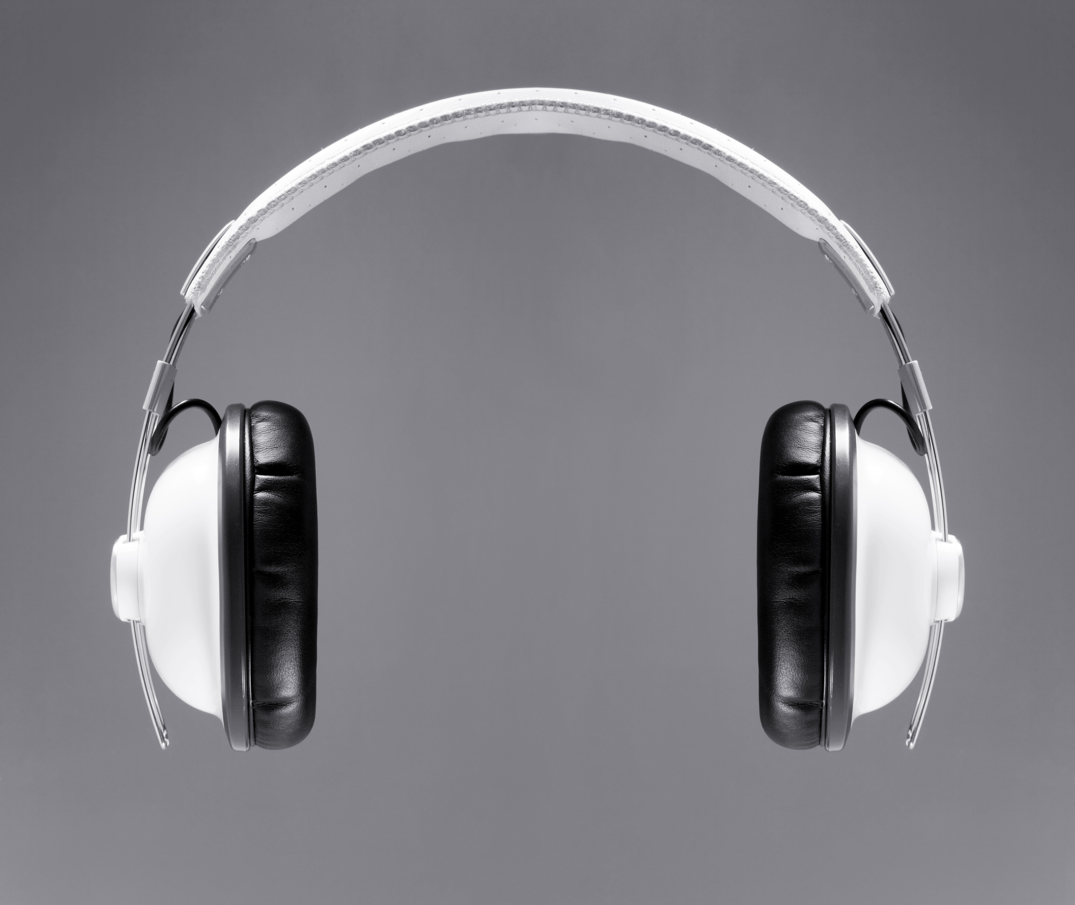
THANK YOU FOR LISTERNING ANY QUESTIONS?

Slide 19
REFERENCE LISTS
Acquah,V(2026).When workplace culture collides: A case for cultural intelligence. Available at: https://culturalq.com/blog/when-work-place-cultures-collide-a-case-for-cultural-intelligence/.( Accessed 30th June 2026).
Berlo, D.K. (1960) The Process of Communication: An Introduction to Theory and Practice. New York: Holt, Rinehart and Winston.
Climb (2025) What is noise in communication:4 types and solutions. Available at:What Is Noise in Communication? 4 Types and Solutions - CLIMB, (Accessed 30th June 2026).
Food Standard Agency (2021). Food Allergy and Intolerance Training. Available at:Home | FSA Food Allergy Training. (Accessed 1st July 2026).
Goleman, D. (1995). Emotional intelligence: Why it can matter more than IQ. Bantam Books.
Husain, k, Shehzard, I.S & Kayode,B.K (2005) Bridging Culture: Analysing the role of communication:Strategies in Enchansing Cross-Cutural Interactions. Available at:Bridging Culture: Analysing the role of communication strategies in enhancing cross-cultural interactions | Environment-Behaviour Proceedings Journal. (Accessed 2nd July 2026)

Slide 20
References List
Schramm,V (1954). The process and effects of mass communication. University of illnois Press.
Shannon,C & Weaver W (1949). The mathematical Theory of communication. University of illnois Press.
Williams, R (1958). Culture and Society. Chatto & Windus

