Slide 1
Programme: BA Business Management
Module: Managing People
Gita Mollova 2009477

Slide 2

HR is……!
Training Seminar
Team building
People management
Consultant
Evaluation
Recruitment

Slide 3
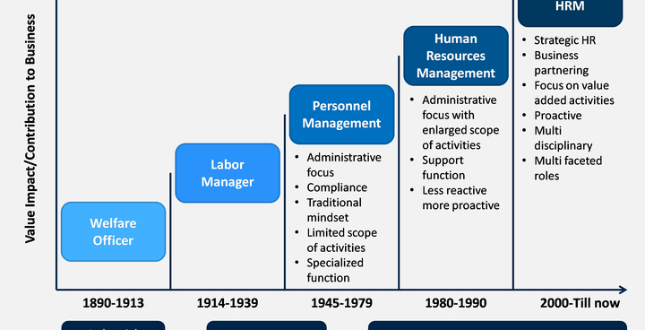

Slide 4

HRM skills
Curiosity
Courage to challenge
Collaborative
Role model
Skilled influencer
Driven to deliver
Personally credible
Courage to challenge

Slide 5
Operational purpose of human resources
Procure | Develop | Compensate | Integrate | Maintain
Job analysis Recruitment Selection Placement Onboarding Transfer Promotion | Performance Appraisal Training Career planning Development Transition planning | Evaluation Wages & Salary Bonus & incentives Payroll | Labor Relation Motivation Grievance Discipline | Health & Safety Risk Management Social security Welfare Record Keeping

Slide 6
Operational purpose of human resources
Giving equal chance for everyone.
Recruiting and hiring the best individual for the position
Paying equal price for equal work.
Providing accurate and timely information
Knowing and appreciating on time
Keeping the peace in the workplace
Making a decision based on the outcome.

Slide 7

CIPD
WHO is ….?
The Welfare Workers' Association was founded in 1913. (WWA).
Providing assistance to individuals and organisations.
Since July 1, 2000, it has been known as the Chartered Institute of Personnel and Development (CIPD).

Slide 8

Continue……
CIPD today
There are almost 160,000 members.
The business associate promoting improved work and workplace conditions
Provide an insightful perspective on the quickly changing world of work.

Slide 9
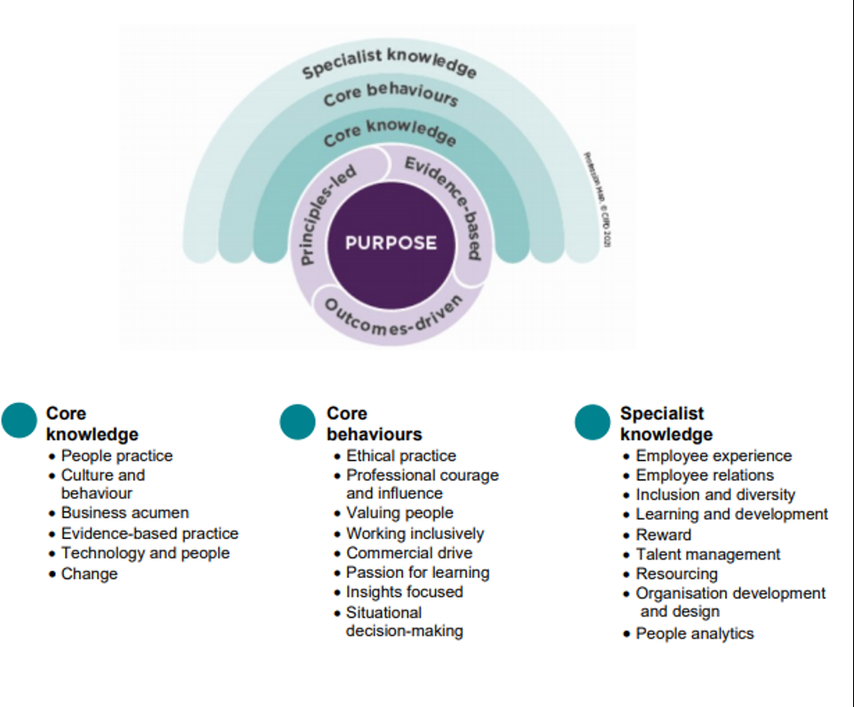
CIPD Professional map

Slide 10

Employee Employer Relationship
Tipes of relationship
Benefits

Slide 11

Taylor’s Scientific Theory
science not rule of thumb.
Cooperation not individualism.
Development of each and every individual to his/her greatest efficiency and prosperity.
Harmony not discord

Slide 12

THANK YOU

