Slide 1

Jade Caroline Dore
Student ID: 2112020
Programme: BA Leadership and Management Skills for the Workplace
Module: Developing Innovation and Creativity for Business Advantage
Module Code: BMSW6102
Lecturer: Dr Oluwaseun Adegbite
Task 2 Presentation

Slide 2


Blockbuster was an entertainment rental service.
Provided a service to rent movies/games for a fraction of the price of buying them.
They had a large collection of inventory and were conveniently placed on most high streets.
1985 - 2013
(Anantharam, 2020; Girotra and Netessine, 2014; Heritage, 2023)

Slide 3

Organisation Chose and Why?
It was a well-established organisation for decades on the UK high streets.
Prime example of how organisation’s can fail by not using innovation to their advantage.
Blockbuster Logo (Anantharam, 2020)

Slide 4
Blockbuster’s Main Causes of Innovational Failure
Failure to keep up with emerging trends
Failure to see a competitor /threat
Failure to act in time
Blockbuster’s demise
(Davis and Higgins, 2013; Freeman, 2012; Randall, 2010)

Slide 5

External Research Used and Which Was Most Useful?
Case Studies based on Blockbuster
Academic sources related to business innovation mainly Google Scholar
Online credible sources

Slide 6
Finding information on Blockbuster’s services
High word count
Reading a lot of research to then find no relevance
Challenges
Time management

Slide 7

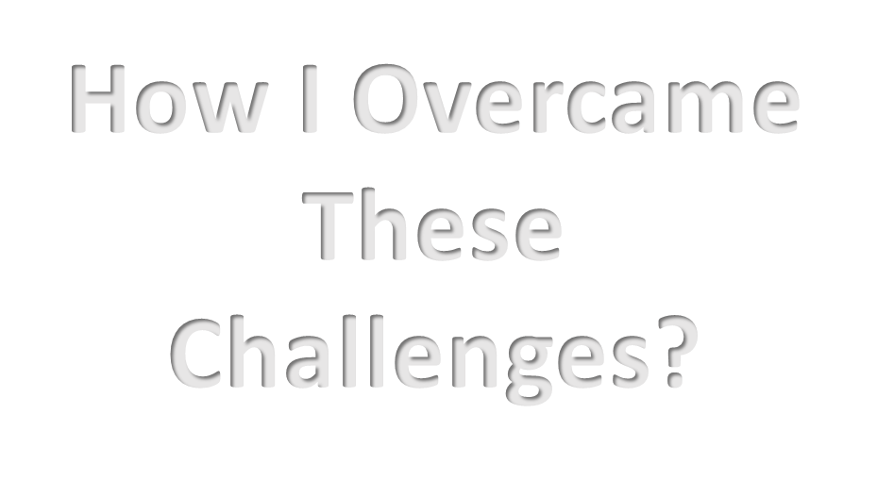

Slide 8

Choose a different organisation that has failed much recently.
What Would I Do Differently?

Slide 9
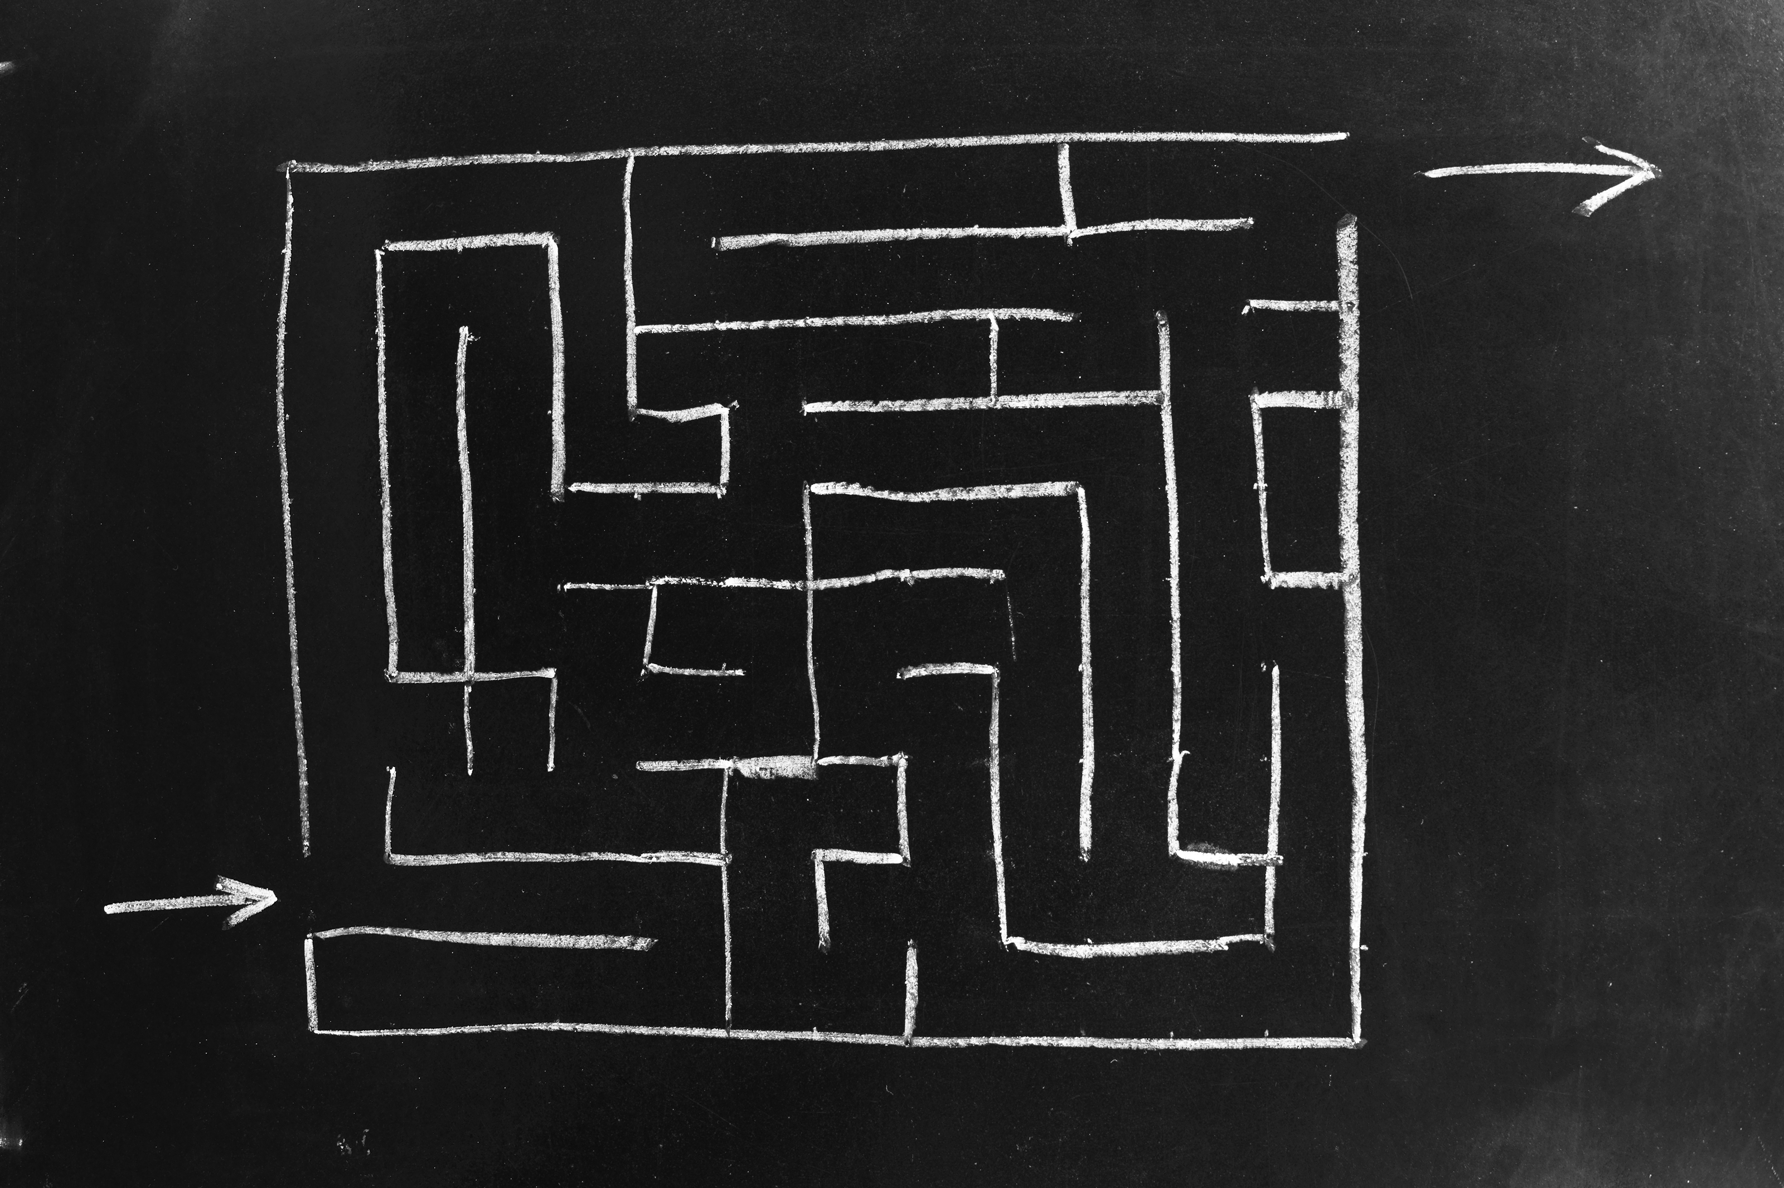
Concepts and Theories Explored That Aided My Assignment

Slide 10
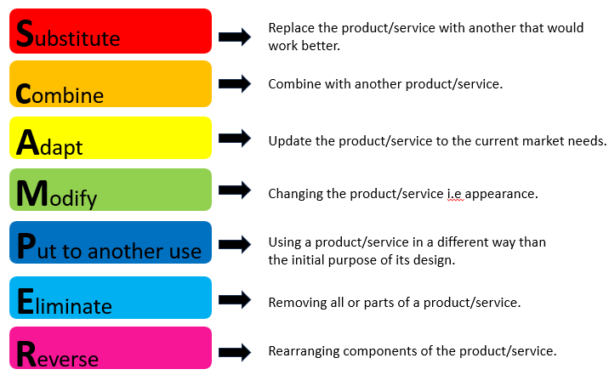
SCAMPER model explained (Dore,2023)

Slide 11

SCAMPER MODEL
Benefits of using SCAMPER
SCAMPER is a creative thinking tool.
Is used in the early strategic/research and development stages.
Aids to finding different ways of viewing an idea to find the most efficient.
(Abdi, et al., 2011; Serrat, 2017)

Slide 12
Excessive financial strain
Lack of incentive to innovate
Lack of time (Took too long)
Barriers
Explained
Information was found to back up points from various sources online and case studies researched.
(Davis and Higgins, 2013; Freeman, 2012; Randall, 2010)

Slide 13

Schumpeterian Innovation ‘Creative Destruction’
‘’destroying the old one, incessantly creating a new one.“
(BBC, 2021; Schumpeter, 1942)
Notes:
13

Slide 14
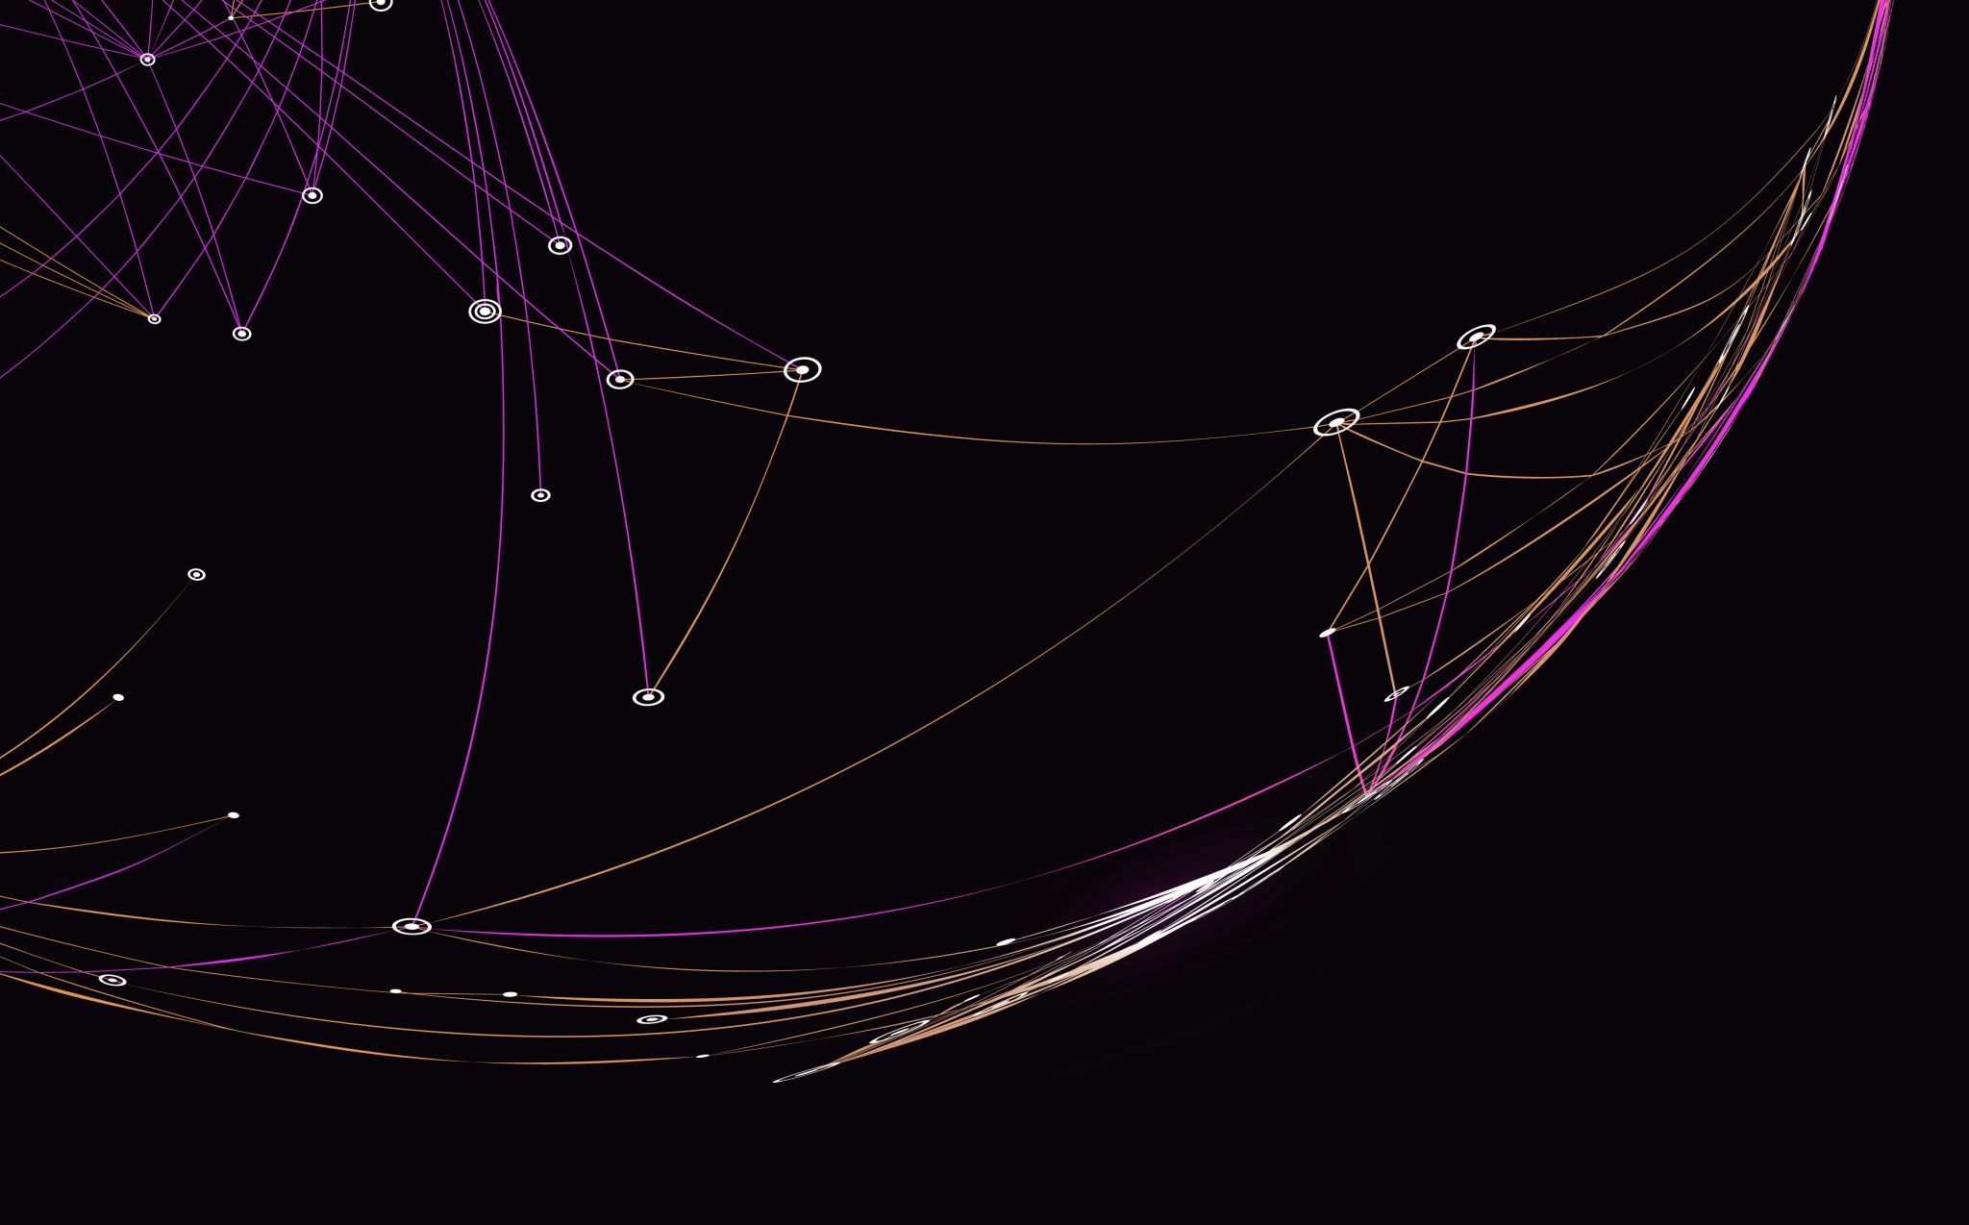
My Understanding of Innovation

Slide 15
Innovation Explained
Innovation is a change or an improvement that disrupts the usual way of doing things.
Adapting and improving the business model.
For innovational ideas to be successful it has to create a need in the market or be of value to consumers.
To keep being successful in an adaptive and competitive market, innovation is required.
(Arora and Singer, 2006; Rogers and Rogers, 1998; Schumpeter, 1942)

Slide 16

Knowledge Taken From Assignment
Innovation requires financial investment.
Organisations need to act in a timely manner.
Innovation is always a risk but organisations must take the risk to keep moving forward competitively.
Technology has rapidly progressed innovation in organisations.
(Rudlin, 2022; Schumpeter, 1942).

Slide 17


Slide 18
Referencing List
Abdi, N., Zarei, B., Vaisy, J. and Parvin, B. (2011) Innovation models and business process redesign. International Business and Management, 3(2), pp.147-152.
Anantharam, R. (2020) Navigating the Choppy Seas of Digital Transformation. [online] Available at: https://www.redapt.com/blog/navigating-the-choppy-seas-of-digital-transformation [Accessed 02 November 2023].
Arora, R. and Singer, J. (2006) Customer satisfaction and value as drivers of business success for fine dining restaurants. Services Marketing Quarterly, 28(1), pp.89-102.
BBC, (2021) Netflix considers crackdown on password sharing. BBC News. [online] 12 Mar. Available at: https://www.bbc.co.uk/news/technology-56368698. [Accessed 02 November 2023].
Davis, T. and Higgins, J. (2013) A blockbuster failure: how an outdated business model destroyed a giant.
Freeman, D., (2012) Web 2.0 and the death of the blockbuster economy. Misunderstanding the internet, 1, pp.69-94.
Randall, R.,(2010) No business is exempt from potential disruption of new strategy. Central Penn Business Journal.
Rudlin, D. (2022) The existential crisis of traditional shopping streets: the SUN model and place attraction paradigm. Journal of Urban Design, 27(1), pp.63-65.
Schumpeter, J.A. (1942) Socialism, capitalism, and democracy. Harper and Brothers.
‌Serrat, O.( 2017) The SCAMPER technique. Knowledge solutions: tools, methods, and approaches to drive organizational performance, pp.311-314.
‌

