Slide 1



Engineering / Technical
Drawing
A Guide to the Production & Interpretation of Drawings to BS8888
Lecture 5
Limit Tolerancing and Fit Classifications
Richard J Morgan

Slide 2
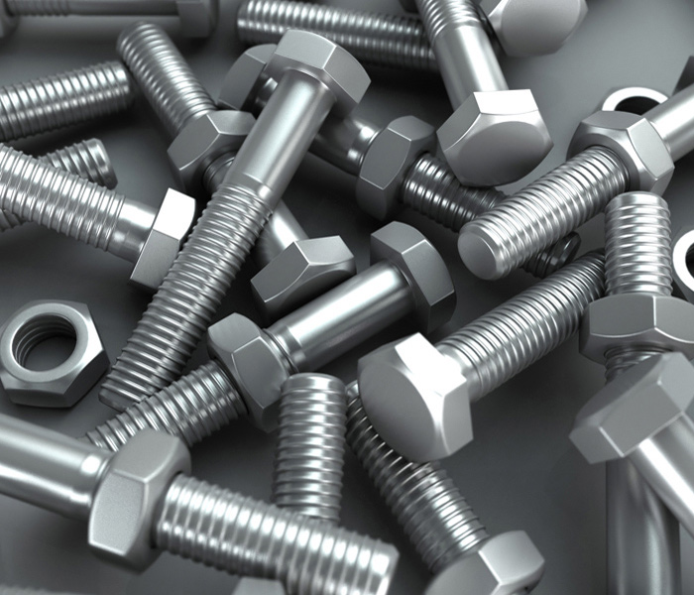
Origins of Standardisation
Mating components e.g.
  Nuts & Bolts
  Shafts & Bushes
  Gears
  until mid 19th century had to
  be made in matching pairs (non interchangeable)
This lack of standardisation was wasteful & time-consuming
Maintenance of machinery was difficult (replacement parts were not available)
In mid 19th century Sir Joseph Whitworth pioneered a screw thread system which has developed into the high level of standardisation that exists in industry today

Slide 3
Standardisation
Interchangeability
Standard component
Standard specification
Dimensional control
BSI and ISO aim to co-ordinate the efforts of produces and users in the improvement, standardisation and simplification of engineering/industrial components and materials
  By simplifying production and distribution
  By eliminating the waste of time and materials involved in the production of unnecessary varieties of patterns & sizes of articles for the same purpose
  By setting standards of quality
  By setting standards of dimension (size)
  By setting standards of performance and service life
  By promoting the general adoption of BS’s &/or IS’s

Slide 4
Standardisation
Standardisation may be summarised as follows:
Use of standardised components
Lower unit costs
Interchangeability
Improved quality

Slide 5
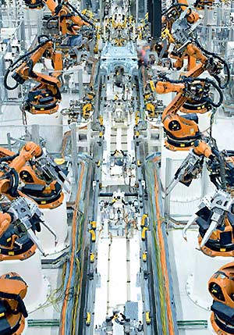
Standardisation
Lower Unit Costs
  are achieved when components are produced in large batch sizes or by continuous flow production techniques using semi or fully automated processes
  Not only are the direct labour costs
  reduced but together with overhead
  costs, they are spread over a large
  number of components. This reduces
  the cost per unit component
  Large batch & continuous production
  permits the bulk purchasing of materials,
  which further reduces costs
  By keeping the range of sizes of components to the minimum necessary to satisfy the needs of industry, storage and distribution costs are also kept to a minimum

Slide 6
Standardisation
Improved Quality
  Is achieved by the use of standard
  specifications which prescribe
  minimum standards of:
  Material quality
  Dimensional accuracy
  Performance
  Reliability
  Safety
The accumulative effects of
standardisation and
interchangeability within the
engineering industry has been
summarised on the chart
Low production costs
+
Low material costs
+
Low storage and distribution costs
+
Specified minimum quality
+
Interchangeability
=
Low cost components of
guaranteed quality and
availability
=
Improved manufacturing efficiency

Slide 7
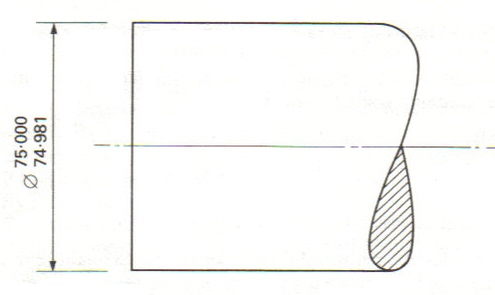
Toleranced Dimensions
The diagram shows a shaft that has been dimensioned so that is its diameter lies between 75.000mm & 74.981mm
The designer has decided, in his/her wisdom, that any shaft lying between these sizes will function satisfactorily in the application for which it is intended
The dimensions given are called limits of size
The algebraic difference between the limits is called the tolerance
75.000 – 74.981 = 0.019 = tolerance

Slide 8
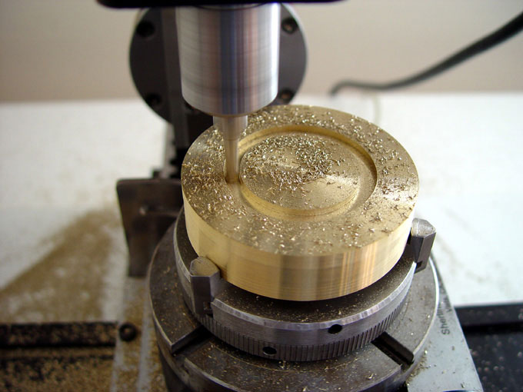
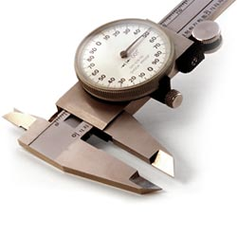
Why Provide Toleranced Dimensions?
It is not possible to manufacture any workpiece to an exact size
If it were, hypothetically, possible to do so, there is no means of measuring such a workpiece exactly
To achieve interchangeability through standardisation, two things are required:
a) a standard specification
b) dimensional control

Slide 9
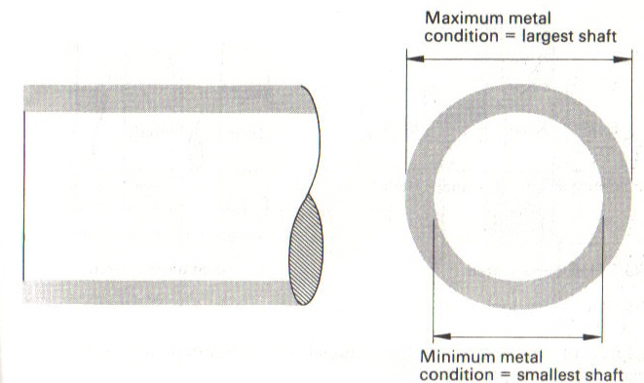
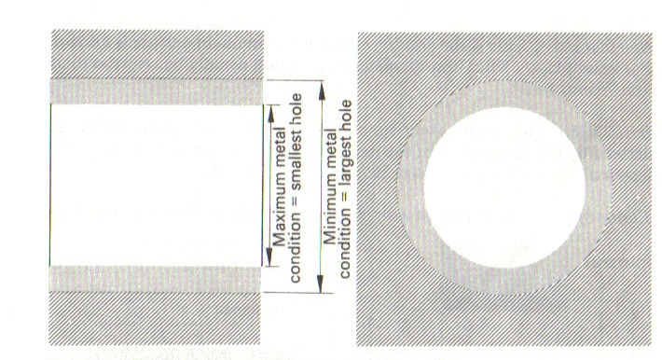
Maximum & Minimum Metal Condition
The terms maximum metal condition & minimum metal condition are often met in connection with limit systems and the gauging of workpieces
Metal Conditions (Shaft)
Metal Conditions (Hole)

Slide 10
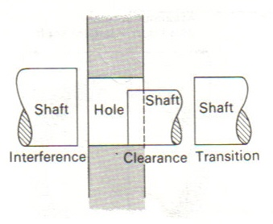
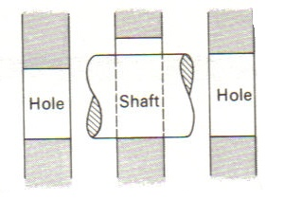
Hole & Shaft Basis Systems
To obtain a given class of fit between two mating components, such as a shaft and bearing, the fit may be obtained in two ways
1) By having a constant size hole in the bearing and changing the shaft to suit. This is called a hole basis system
2) By having a constant size of shaft and changing the hole size to suit. This is called a shaft basis system
The hole basis system is more easily employed since it is easier to maintain a standard hole size (reamers & drills)
The Hole Basis System
The Shaft Basis System

Slide 11
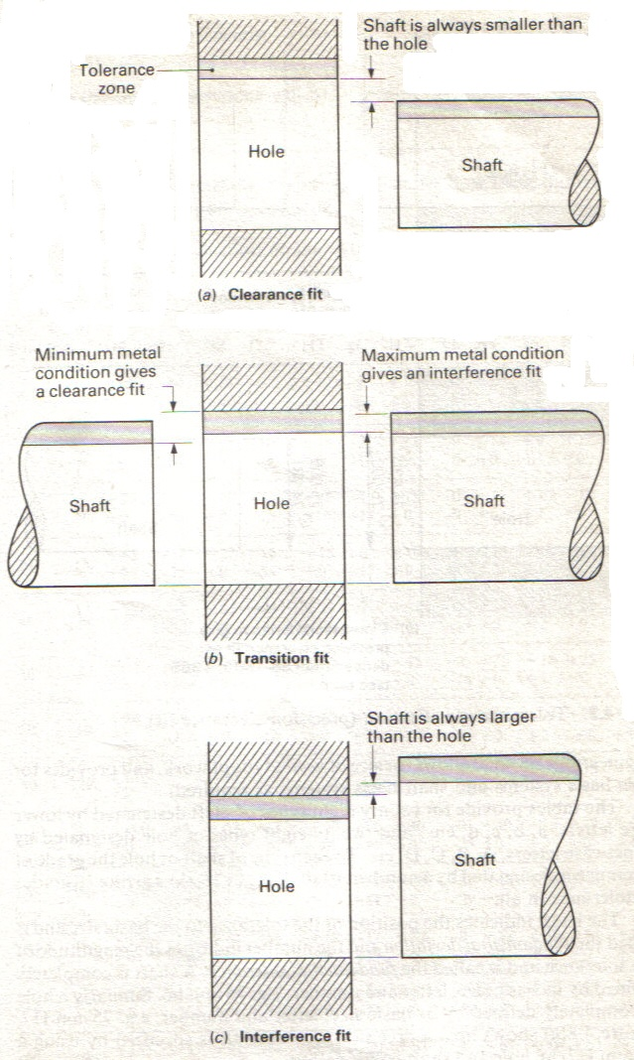
Classifications of Fit
Clearance Fit
  The shaft is always smaller than the
  hole it is mating
  with, even under maximum metal
  conditions
Interference Fit
  The shaft is always larger than the
  hole it is mating with
  even under minimum metal
  conditions
Transition Fit
  Shafts and holes within the limits
  specified will give a
  range of fits from clearance under
  minimum metal
  conditions to interference under
  maximum metal
  conditions

Slide 12
Limit and Fits Definitions
Nominal size
  This is the size by which the component feature is known. E.g. a 75.015mm hole would usually be referred to as ‘the 75mm hole”
Basic size
  This is the exact functional size from which the limits are derived by the application of the necessary tolerances and clearance. The nominal size and the basic size are frequently the same
Limits of size
  The limits of a dimension are the maximum and minimum sizes by which it is permissible to manufacture a given workpiece if it is to function correctly
Tolerance
  This is the algebraic difference between the upper and lower limits of size. Its magnitude and disposition is determined by the functional needs of the component and the economics of production
Minimum clearance
  This used to be known as allowance and is the arithmetical difference between the maximum metal condition for a shaft and the maximum metal condition for the hole i.e. the largest shaft and the smallest hole giving the tightest fit that will function correctly

Slide 13
Limit and Fit Definitions cont…
Actual size
  The measured size correct to 20°c
  Unilateral tolerances are those where the tolerance zones lie to one side only of the basic size
  Bilateral tolerances are those where the tolerance zones cross the basic size
Clearance fit
  This occurs when the shaft is smaller than the hole no matter what combination of shaft and hole is selected
Transition fit
  Transition fit occurs when:
    The largest shaft and the smallest hole gives an interference fit
    The smallest shaft and the largest hole gives a clearance fit
Interference fit
  This occurs when the shaft is larger than the hole even when the largest shaft and the smallest hole is selected or the smallest shaft and the largest hole

Slide 14
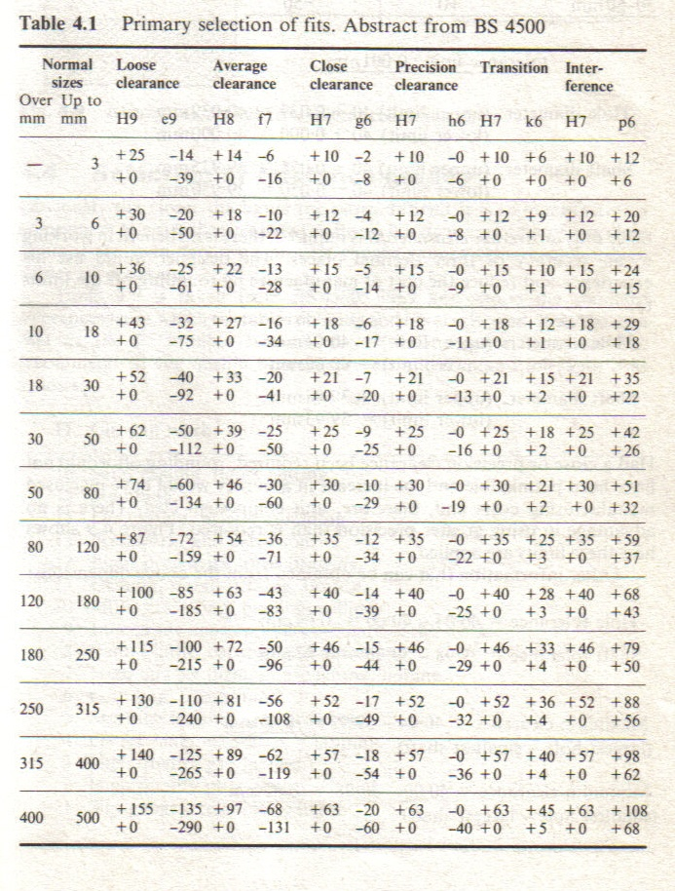
Primary Selection of Fits (Abstract from BS 4500)
Type of fit
required
Types of
shaft (lower
case)
Hole size
(nominal)
Types of
hole (upper
case)

Slide 15
Limits & Fits Example 1
To derive the dimensions for a hole and shaft of nominal diameter 40mm so that an average clearance fit is obtained
Since the nominal size of the shaft/hole is 40mm, the 30 -50mm band is selected from the limits and fits table
The following conditions then apply:
Nominal size | H8 | f7
30-50mm | +39 +0 | -25 -50
Tolerance unit 0.001mm

Slide 16
Limits & Fits Example 1 cont…
Hole diameter: (upper limit) 40 + 0.039 = 40.039mm
(lower limit) 40 + 0.000 = 40.000mm
Shaft diameter: (upper limit) 40 – 0.025 = 39.975mm
(lower limit 40 – 0.050 = 39.950mm
Since only an average clearance fit is required, there is no benefit to working to an accuracy of three decimal places. The engineer would use his/her experience and reduce cost of manufacture by rounding off the limits to:
Hole diameter: (upper limit) = 40.04mm
(lower limit) = 40.00mm
Shaft diameter: (upper limit) = 39.98mm
(lower limit) = 39.95mm
(Had a close or precision clearance been required, rounding off would not have been permissible)

Slide 17
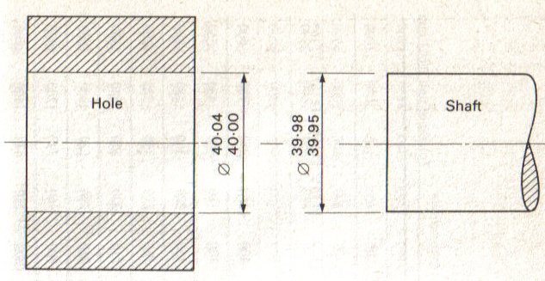
Limits & Fits Example 1 cont…
Other information which can be obtained from the dimensions:
Hole tolerance = 40.04 – 40.00 = 0.04mm
Shaft tolerance = 39.98 – 39.95 = 0.03mm
Maximum
Clearance = 40.04 – 39.95 = 0.09mm
(largest hole) (smallest shaft)
Minimum
Clearance = 40.00 – 39.98 = 0.02mm
(smallest (largest
hole) shaft)

Slide 18
Limits & Fits
Limits & Fits tables provide:
  28 types of hole designated by upper case letters A,B,C,D etc.
  28 types of shaft designated by lower case letters a,b,c,d etc.
To each type of shaft or hole, the grade of tolerance is designated by a number, 01,0,1,2,…16, thus giving 18 grades of tolerance in total.

Slide 19
Limits & Fits
75mm H7/h6
Feature
Dimension
Letter
Number
Basic size of
Feature
Position of tolerance with
respect to the basic size
Magnitude of tolerance
Fundamental deviation
Fundamental tolerance

Slide 20
Selection of Tolerance Grades
The closer the limits, the more difficult it is to manufacture a component to a size which lies between them
Ensure that the manufacturing process selected is capable of the required level of precision

