Slide 1
Isolation in elderly care
Rhiannon Fenwick

Slide 2


(The good care group, 2017)
(Johns Hopkins medicine, N.D.)
Notes:
This presentation is going to explain using a social theory the impact that isolation has on elderly people who are living in a caring environment for example a residential home.
Loneliness effects people at all ages, however one million people aged 65 or over have reported that they always or often feel lonely, this is within the UK.

Slide 3
Loneliness vs isolation
Loneliness is a feeling, an individual can feel alone when surrounded by many people.
Isolation is when an individual is alone physically.
(Age UK, N.D.)
Notes:
The words loneliness and isolation are usually used together, however they are not the same thing. Age UK defined loneliness as a feeling, an individual can feel alone when surrounded by many people. They define isolation as when an individual is alone physically.

Slide 4
Isolation and social isolation
Isolation – is subjective, it is a negative feeling when an individual believes there is a lack of connection.
Social isolation – is objective, it is defined by the amount of social relationships and contacts a person has.
(Age UK, 2015)
Notes:
Age UK, give two different definitions for the meaning of isolation and social isolation.
Isolation –age UK say that this is a subjective feeling, it is a negative feeling when an individual believes there is a lack of connection.
They say that social isolation – is objective, it is defined by the amount of social relationships and contacts a person has.

Slide 5
Social theory of isolation
‘Social isolation is a deprivation of social connectedness.’
(Zavaleta et al, 2014, pp.5)
Notes:
Zavaleta et al, 2014, says that ‘Social isolation is a deprivation of social connectedness.’ So individuals such as the elderly would be isolated due to a lack of social connections. The level of isolation that a person is in depends on the quality and the amount of connections they have socially, for example the amount of interactions they have and how often they have them for. Some people who are alone might feel lonely and this could then lead to isolation, however some people may feel lonely while others are around them.

Slide 6
Connections
Individual
Group
Community
Larger social environment
(Zavaleta et al, 2014, pp.7)
Notes:
Zavaleta et al, 2014 says that there are four types of connections a person can make:
Individual connections: which would be connections with a partner, family co-worker or a friend. For an individual living in a care home, this would be friends or family visiting them or taking them out for the day or a certain activity.
Group connections: this would be a small cohesive community such as going to church, or to any clubs with people who have similar interests.
Community connections: This is similar to groups however perhaps on a larger scale, so for example a village or a small community that is based in a large setting.
Larger social environment connections: this would be being a part of institutions or a society.

Slide 7
Zavaleta et al (2014)
Social cohesion
(Chan, J. and Chan, E. 2006)
Social exclusion
(NHS, 2010)
Social capital
Notes:
Within Zaveleta’s theory, there are three different concepts. These are social cohesion, social exclusion and social capital.
Social cohesion has been defined by Joseph Chan and Elaine Chan (2006) as ‘a state of affairs concerning both the vertical and horizontal interactions amongst members of society as
characterized by a set of attitudes and norms that include trust, a sense of belonging and the willingness to participate and help, as well as their behavioural manifestations.’ meaning it is society living in a close community, everyone feels as though they belong and can trust one another.
Social exclusion has been defined by the national health service in 2010 as ‘A term used to describe a situation in which a person (or a group of people), resident in a society is excluded from the key activities of the society, and is prevented from participation by factors beyond his or her control’ This would be an individual or group not being a part of a cohesive community,
And social capital…..

Slide 8
Social capital
Social capital is how important social connections are with family, groups and the community.
It says the theorists use the term ‘social capital’ to address how important social connectivity when referring to a persons ability to gain power or resources.
(Zavaleta et al, 2014, pp. 11)
Notes:
Zavaleta et al, 2014 defines social capital as how important social connections are within family, groups and the community for example social groups for individuals who have the same interests, such as going to church. It says the theorists use the term ‘social capital’ to address how important social connectivity when referring to a persons ability to gain power or resources.

Slide 9
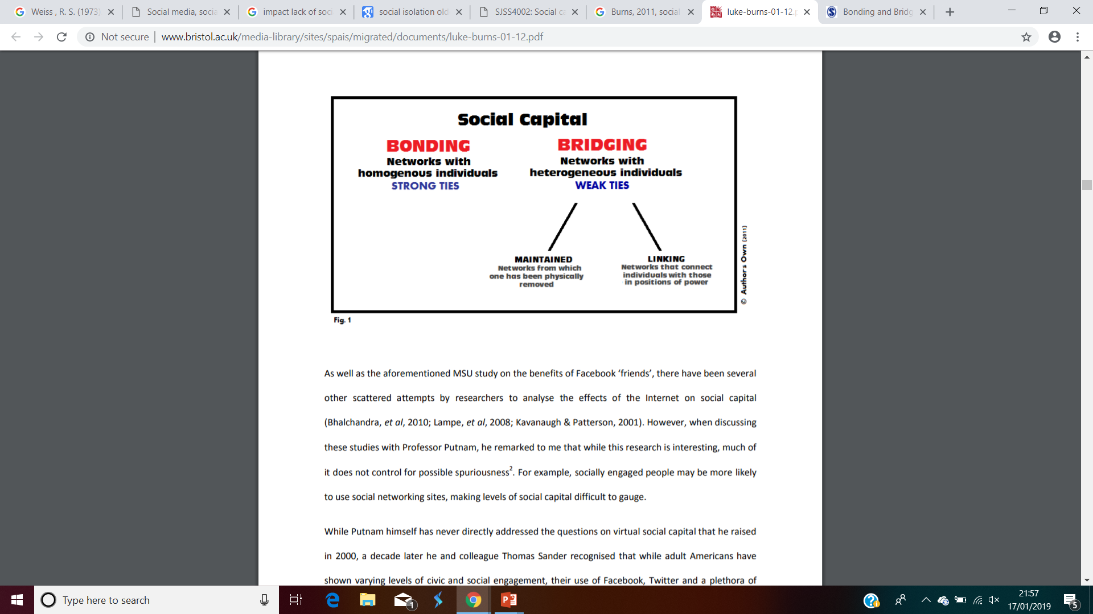
Bonding, bridging and linkages
(OECD,N.D.)
‘childhood and old age, bonding social capital is more important to health and, as people seek employment, bridging social capital is more important’.
(Rosalyn Harper, 2002, pp.3)
(Luke Burns, 2011, pp.11)
Notes:
Within social capital there is bonding, bridging and linking. Bonding is when there are strong links that are down to a mutual connection, for example family and friends, going out with family and friends or going to church or other activities that require a mutual connection. Bonding could be seen as the most important for the elderly generation. On page three of The measurement of Social Capital in the United Kingdom by Rosalyn Harper 2002, it states ‘childhood and old age, bonding social capital is more important to health and, as people seek employment, bridging social capital is more important’.
Bridging are thinks that occur with a distance, such as distant friends and colleagues. And linkages are the links in which people have in order to move up or down their social ladder.

Slide 10
Impacts our physical health
Our social health has a big impact on our physical health. Social interactions are as important as physical exercise.
(A Hand to Hold, 2017)
Notes:
An organisation whose aim is to provide professional home care for the elderly called A hand to hold said in 2017 that an individuals social health has a big impact on their physical health and the social interactions that people have are as important as physical exercise. It says that people who loose their social connections are at a higher risk of developing depression.
For some individuals there are barriers that prevent them from being as social as others such as a lack of transport, disability, lack of connections, ill health and some individuals don’t like change as it makes them feel insecure and vulnerable.

Slide 11
Older people living in care homes
‘Severe loneliness is experienced by an estimated 22-44% of care residents.’
(Watmough and Begault, 2015-2016)
‘A shocking 60 percent of people in care homes get no visitors.’
(Bettal Consultancy, 2017)
Notes:
Ellie Watmough and Marine Begault undertook a project on the action of loneliness in care homes in tower hamlets in 2015 to 2016. it says that elderly people who have moved into a care home have most likely lost a significant person in their life, their home or their independence. They then become isolated when moving into a home that focuses on their physical health, forcing them to become dependent on people which then deteriorates both their physical and mental health. It says that ‘Severe loneliness is experienced by an estimated 22-44% of care residents’.
Bettal Consultancy in 2017 said that ‘A shocking 60 percent of people in care homes get no visitors.’ this is a very high percentage, within the piece of writing it says that Louise Goulden says that care home residents are just like anyone else stating “They were in their local community, they were working, they were raising families, and now because they’ve reached a certain physical or mental state they’re shut off in this kind of secretive world.”

Slide 12
Age UK
‘The effect of loneliness and isolation can be as harmful to health as smoking 15 cigarettes a day, and is more damaging than obesity.’
(Age UK, 2015)
‘1.7% or 200,000 older people 65+ have not had a conversation with friends or family for a month’
(Age UK, N.D.)
Notes:
Age UK in 2015 says that ‘The effect of loneliness and isolation can be as harmful to health as smoking 15 cigarettes a day, and is more damaging than obesity.’. Age UK also says that 1.7% which is equivalent to 200,000 older people over the age of 65 have not had a conversation with a friend or a family member for a month.

Slide 13
Older people living in care homes
‘Socially isolated people can quickly become withdrawn’
(QCS, 2017)
‘Individuals can suffer from increased blood pressure, a weakened immune system, and are at higher risk of heart attacks, strokes, and the onset of disability.’
(Prestige nursing and care. 2014)
Notes:
QCS released an article in 2017 that says that people assume that people live in care homes have company constantly, however having people around constantly does not mean that a person cant feel lonely or isolated.
Social isolation can have an impact on an individuals physical health as well as their mental health. Prestige nursing and care in 2014 said that ‘Individuals can suffer from increased blood pressure, a weakened immune system, and are at higher risk of heart attacks, strokes, and the onset of disability.’
In conclusion the impact that isolation has on elderly individuals who are living in a care environment such as a residential home is huge. Looking at Zavaleta et al’s theory in 2014 it has a effect on their bonding connections as it effects the accessibility to communicate with others outside of the care setting due to transport or illness, making them reliant on friends and family to have the time and resources leaving an individual dependent on others which can effect their well-being due to lack of independence. Isolation cause physical health as well as mental health and can contribute to the deterioration of an individuals capabilities. ‘The effect of loneliness and isolation can be as harmful to health as smoking 15 cigarettes a day, and is more damaging than obesity.’ Age UK 2015. Thank you

Slide 14
References
A Hand to Hold, (2017) The Importance of Social Connections for the Elderly. Available at: https://www.ahandtohold.com/blog/importance-social-connections-elderly (Accessed: January 15th 2019).
Age UK, (2015) Promising approaches, to reducing loneliness and isolation in later life. Available at: https://www.campaigntoendloneliness.org/wp-content/uploads/Promising-approaches-to-reducing-loneliness-and-isolation-in-later-life.pdf (Accessed: January 16th 2019)
Age UK, (N.D.) Parliamentary briefing. Available at: https://www.ageuk.org.uk/globalassets/age-uk/documents/reports-and-publications/reports-and-briefings/health-wellbeing/jo_cox_loneliness_booklet.pdf (Accessed: January 16th 2019)
Chan, J.T.H. & Chan, E.,( 2006), ‘Reconsidering social cohesion: Developing a definition and analytic framework for empirical research’, Social Indicators Research 75, 273–302. Available at: http://dx.doi.org/10.1007/s11205-005-2118-1 (Accessed: January 17th 2019)
Johns Hopkins medicine, (N.D.) Depression: What You Need to Know as You Age. Available at: https://www.hopkinsmedicine.org/health/healthy_aging/diseases_and_conditions/depression-what-you-need-to-know-as-you-age (Accessed: January 17th 2019)
NHSWales, (2010) Health and Social Exclusion Available at: http://www.wales.nhs.uk/sitesplus/888/page/44499 (Accessed: January 17th 2019).

Slide 15
References
OECD,(N.D.) What is social capital? Available at: https://www.oecd.org/insights/37966934.pdf (Accessed: January 17th 2019)
Prestige nursing and care. (2014) Lonely Britain? Social isolation reaches crisis point. Available at: https://www.prestige-nursing.co.uk/companionship/lonely-britain-social-isolation-reaches-crisis-point/ (Accessed: January 17th 2019)
Quality compliance systems, (2017) The impact of social isolation and loneliness on older people. Available at: https://www.qcs.co.uk/impact-social-isolation-loneliness-older-people/ (Accessed: January 17th 2019)
Rosalyn Harper (2002) pp.3. The measurement of Social Capital in the United Kingdom. Available at: http://www.oecd.org/unitedkingdom/2382339.pdf (Accessed: January 17th 2019)
The good care group, (2017) Living alone may increase risks for older people Available at: https://www.thegoodcaregroup.com/news/living-alone-may-increase-risks-older-people/ (Accessed: January 17th 2019)
Watmough, E. and Begault, M. , (2015-2016) Action on loneliness in care homes. Available at: https://www.towerhamlets.gov.uk/Documents/Public-Health/Magic_Me_Action_On_Loneliness_in_Care_Homes_Public_Report.docx.pdf (Accessed: January 16th 2019)
Zavaleta ,D. Samuel, K. and Mills, C (2014) Social Isolation: A conceptual and Measurement Proposal. OPHI working paper No.67. Oxford Poverty & Human Development Initiative (OPHI). Oxford. University of Oxford.

