Slide 1


The Role of Influencers in Modern Marketing
Influencers significantly influence consumer awareness and purchasing behavior in online markets (Rachmad, 2024).
The utility of the influencer is contingent on how well the influencer is congruent with the product and target audience. Congruence builds trust and engagement (Belanche et al., 2021).
Trust is an underlying component of influencer success; consumers are more likely to respond positively when influencers appear genuine and trustworthy (Kim & Kim, 2021).
AI-driven tools are also being employed to choose influencers, as well as predict campaign outcome and constitute greater precision in influencer marketing plans (Sands et al., 2022).

Slide 2
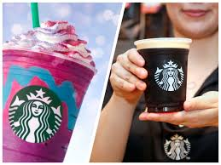
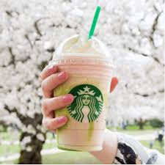
Real-World Example: Starbucks & Micro-Influencers
Starbucks frequently works together with micro-influencers on platforms such as Instagram and TikTok to convey messages related to new drinks, seasonal subjects, and aspects of brand purpose.
Micro-influencers typically focus their content on lifestyle topics rather than direct advertising, and therefore, sponsored posts tend to be organic and relatable for followers.
This approach is consistent with research and theorising from Belanche et al. (2021), who found that influencer-brand congruence is paramount for creating persuasiveness.
Starbucks is also leveraging personalised content and user-generated content, as Kim and Kim (2021) found support for the idea that authenticity translates into trust with consumers.
In using smaller influencers instead of celebrities, Starbucks is developing a more approachable relationship and creating consistent engagement within the community.

Slide 3

Conclusion
The example illustrates the effectiveness of influencer marketing when influencers fit the brand's style, message, and audience (Belanche et al., 2021).
Trust is a necessary component; influencers must seem authentic and sincere for successful campaigns (Kim & Kim, 2021).
Influencer marketing is moving in new directions as AI tools are assisting brands in finding suitable influencers and evaluating the effectiveness of campaigns (Sands et al., 2022).
Overall, influencers continue to play an important role in present-day marketing practices and transforming the connection from brands to consumers in a digital space (Rachmad, 2024).

Slide 4
Reference
Belanche, D., Casalo, L.V., Flavián, M. and Ibanez-Sanchez, S. (2021). Understanding influencer marketing. The role of congruence between influencers, products and consumers. Journal of Business Research, 132, pp. 186–195.
Kim, D.Y. and Kim, H.Y. (2021). Trust me, trust me not. A nuanced view of influencer marketing on social media. Journal of Business Research, 134, pp. 223–232.
Rachmad, Y.E. (2024). The Role of Influencers in Modern Marketing Campaigns. Yoesoep Edhie Rachmad Publication.
Sands, S., Campbell, C.L., Plangger, K. and Ferraro, C. (2022). Unreal influence. Leveraging AI in influencer marketing. European Journal of Marketing, 56(6), pp. 1721–1747.
https://www.socialwick.com/the-role-of-influencers-in-modern-marketing
https://stackinfluence.com/how-influencers-have-changed-marketing/

