Slide 1
Introduction to Data Visualization
Prepared by: Serif Salem

Slide 2
Introduction

Slide 3
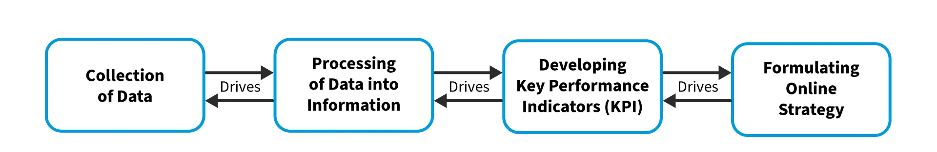
What is Information Science?
Information Science is the study of how information is collected, organised, and used to make better decisions.
It combines technology, data, and human interaction to help us find, share, and understand information.

Slide 4
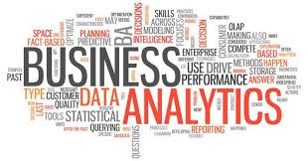
What is Business Analytics (BA)
Business Analytics is …..
  The systematic exploration and analysis of an organisation’s data
  Using analytical methods (data mining, predictive modelling, and machine learning)
  To generate actionable insights
  To improve strategic data-driven decision-making (performance, optimise processes, and anticipate future trends)

Slide 5
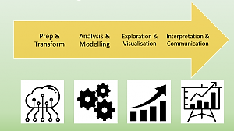
The Main Steps of the BA Process
Data preparation and transformation
  Get the data ready by cleaning and organising it to make sure it’s accurate and usable.
Data analysis and modelling
  Apply statistical and machine learning techniques to find patterns and make predictions.
Data exploration and visualization
  Use charts and graphs to quickly understand data trends and relationships.
Data interpretation and communication
  Turn findings into clear insights and communicate them to help decision-makers take action.

Slide 6
Types of BA
Type of Business Analytics | Purpose | Function | Examples
Descriptive Analytics | Understand what happened | Summarises historical data to identify patterns | Sales reports, customer segmentation, KPI dashboards
Diagnostic Analytics | Understand why it happened | Analyzes data to find causes and relationships | Root cause analysis, correlation analysis, anomaly detection
Predictive Analytics | Forecast future outcomes | Uses models to predict future events | Demand forecasting, customer churn prediction, risk assessment
Prescriptive Analytics | Recommend optimal actions | Provides actionable advice using optimisation | Inventory optimisation, pricing strategies, resource scheduling

Slide 7

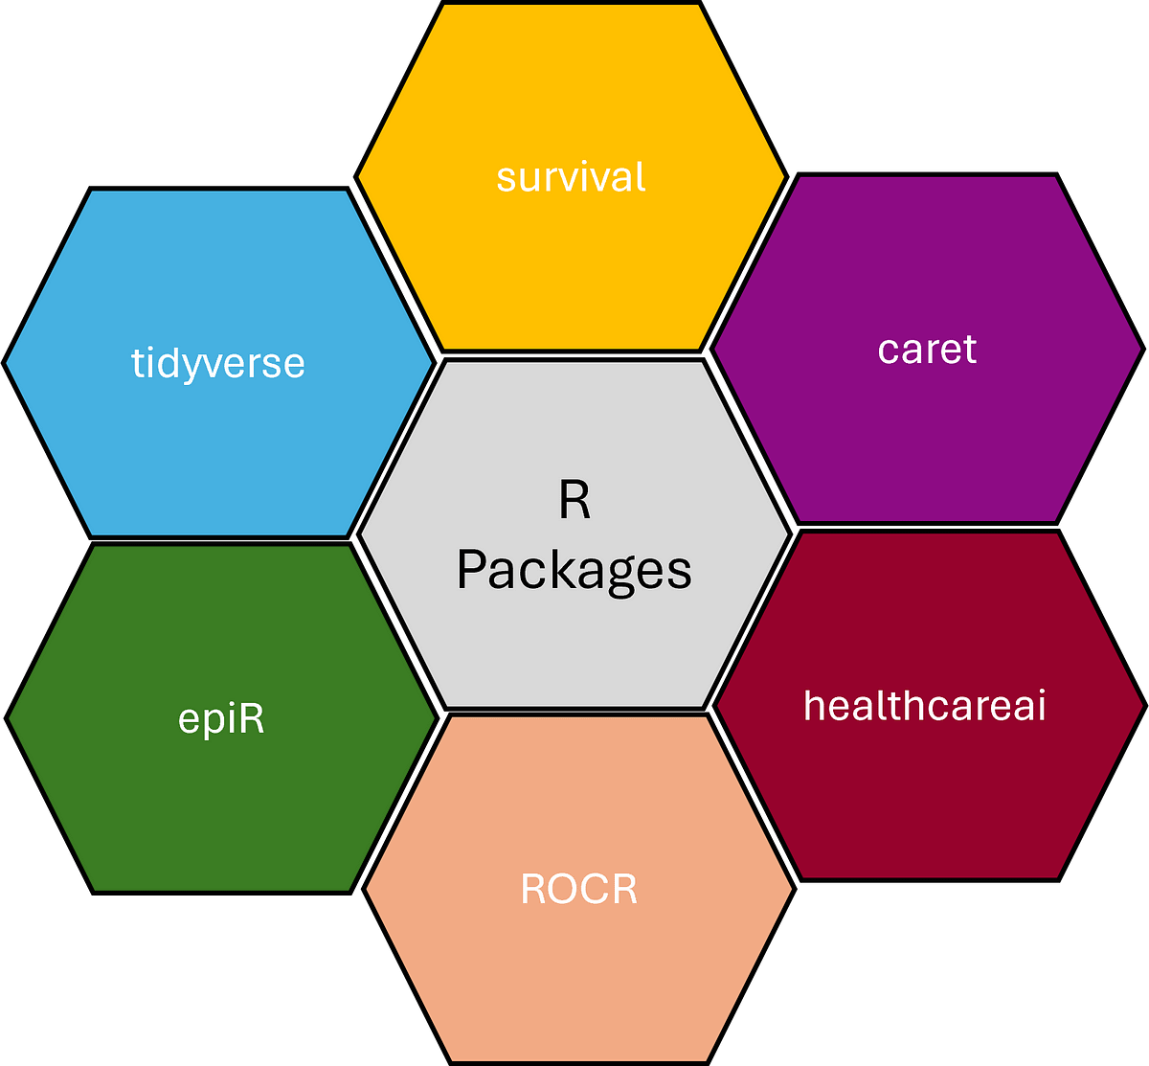



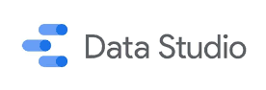




Business Analytics Tools

Slide 8
Data Visualization

Slide 9
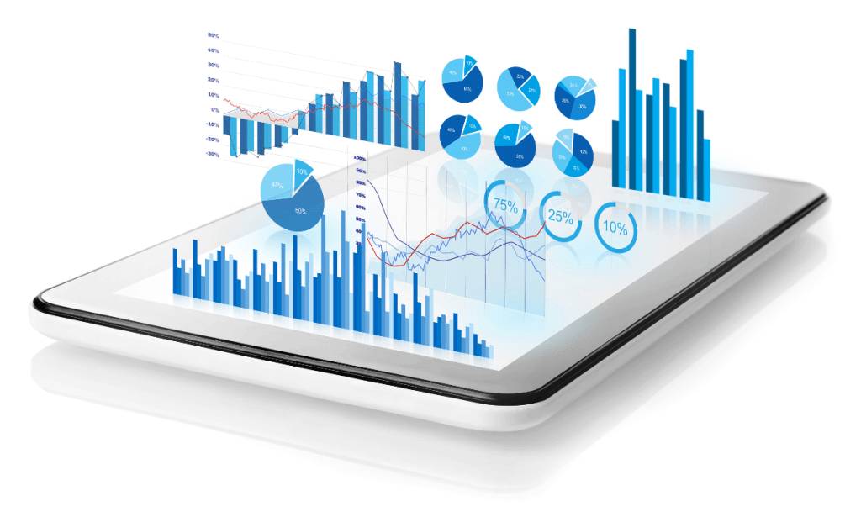
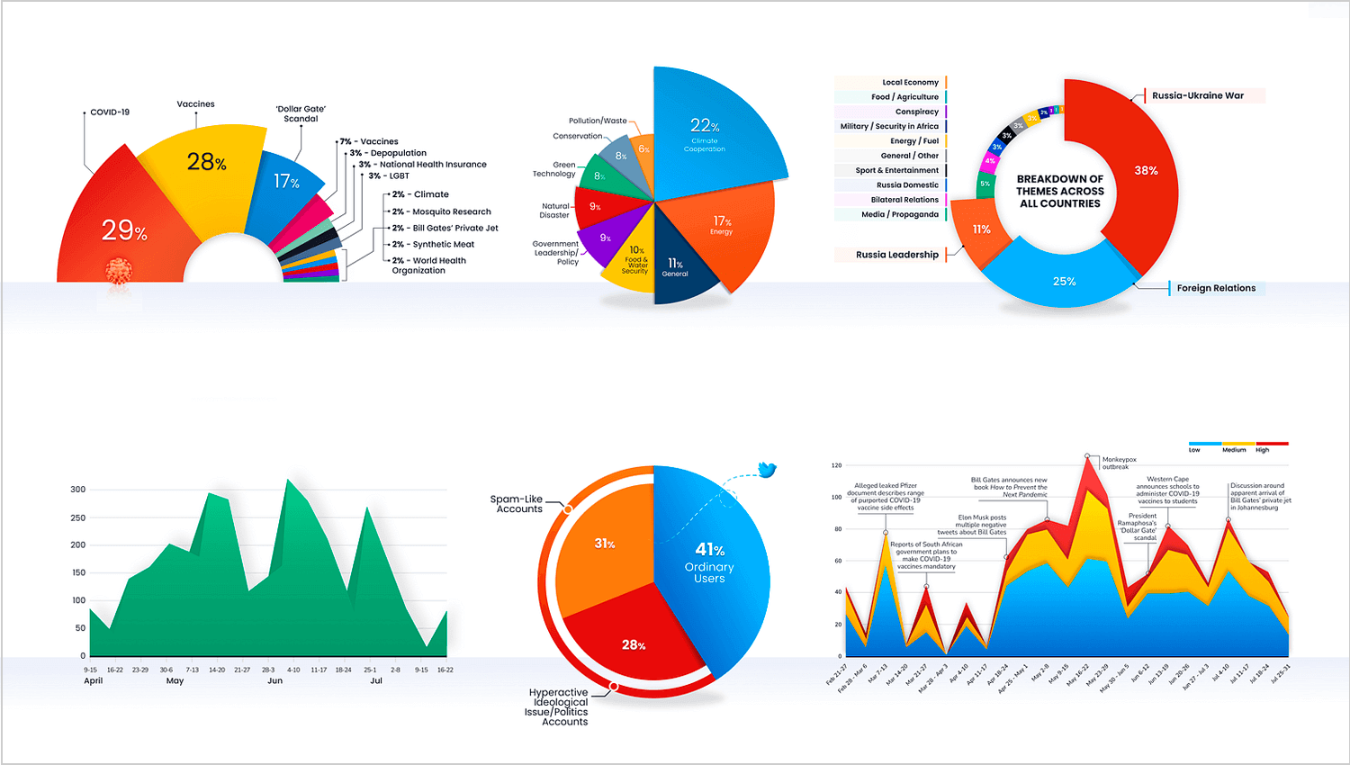
Defining Data Visualization
Transforming raw data into visual formats.
Helps to identify trends, patterns, and outliers.
Simplifies complex datasets for easier communication.

Slide 10
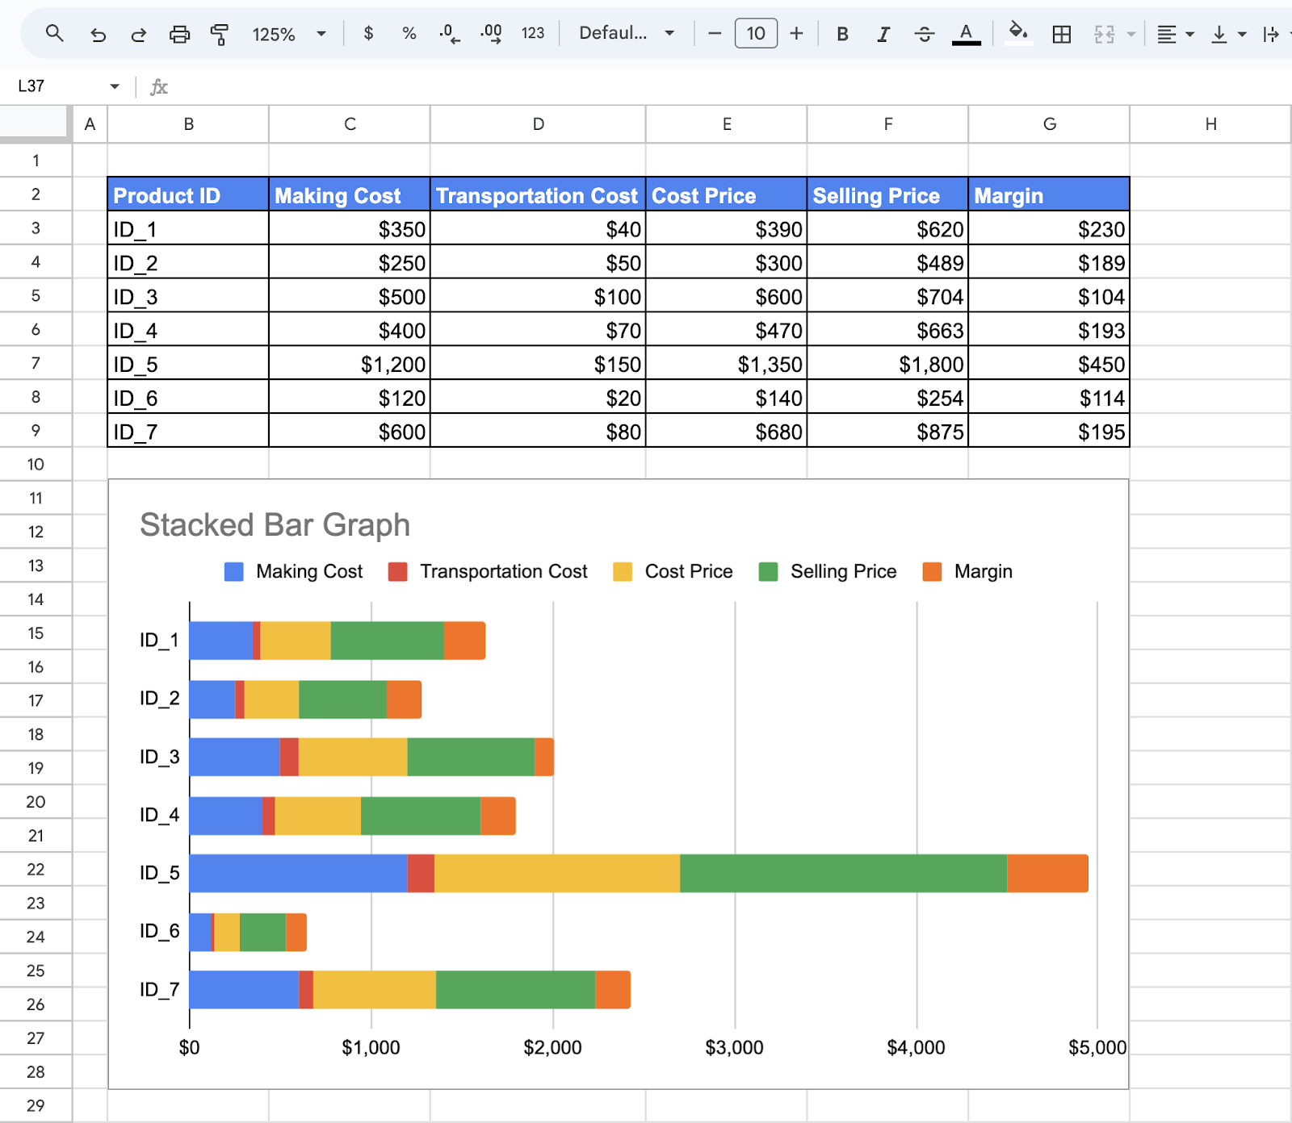
The Importance of Data Visualization
Enhances decision-making with clear insights.
Communicates findings effectively to diverse audiences.
Saves time in data analysis and interpretation.

Slide 11
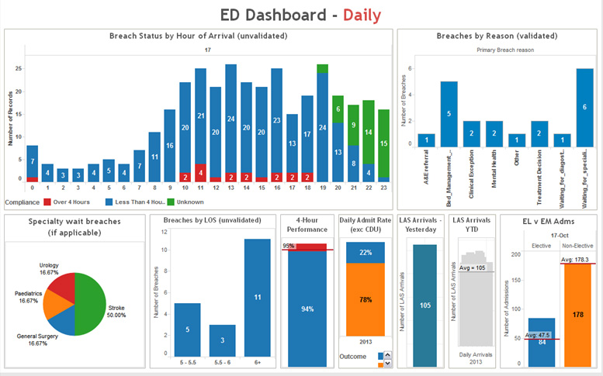
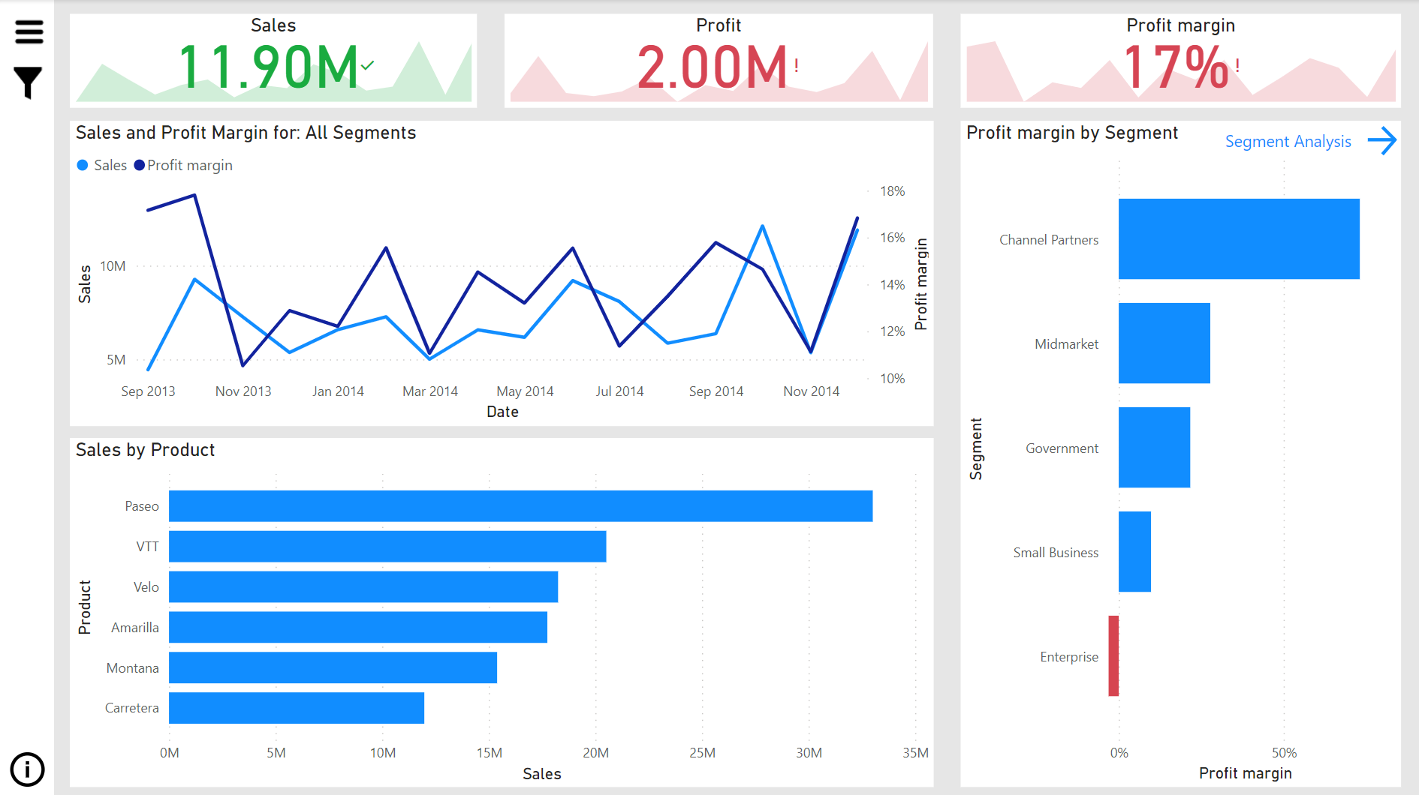
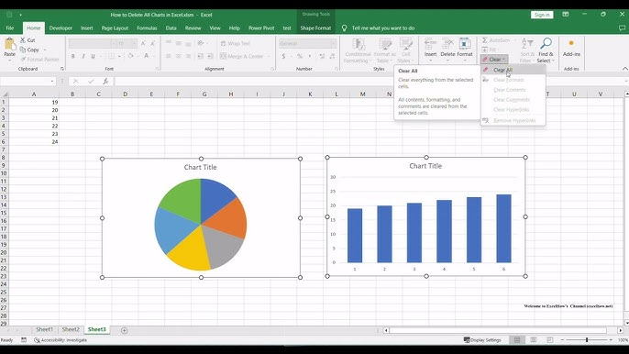
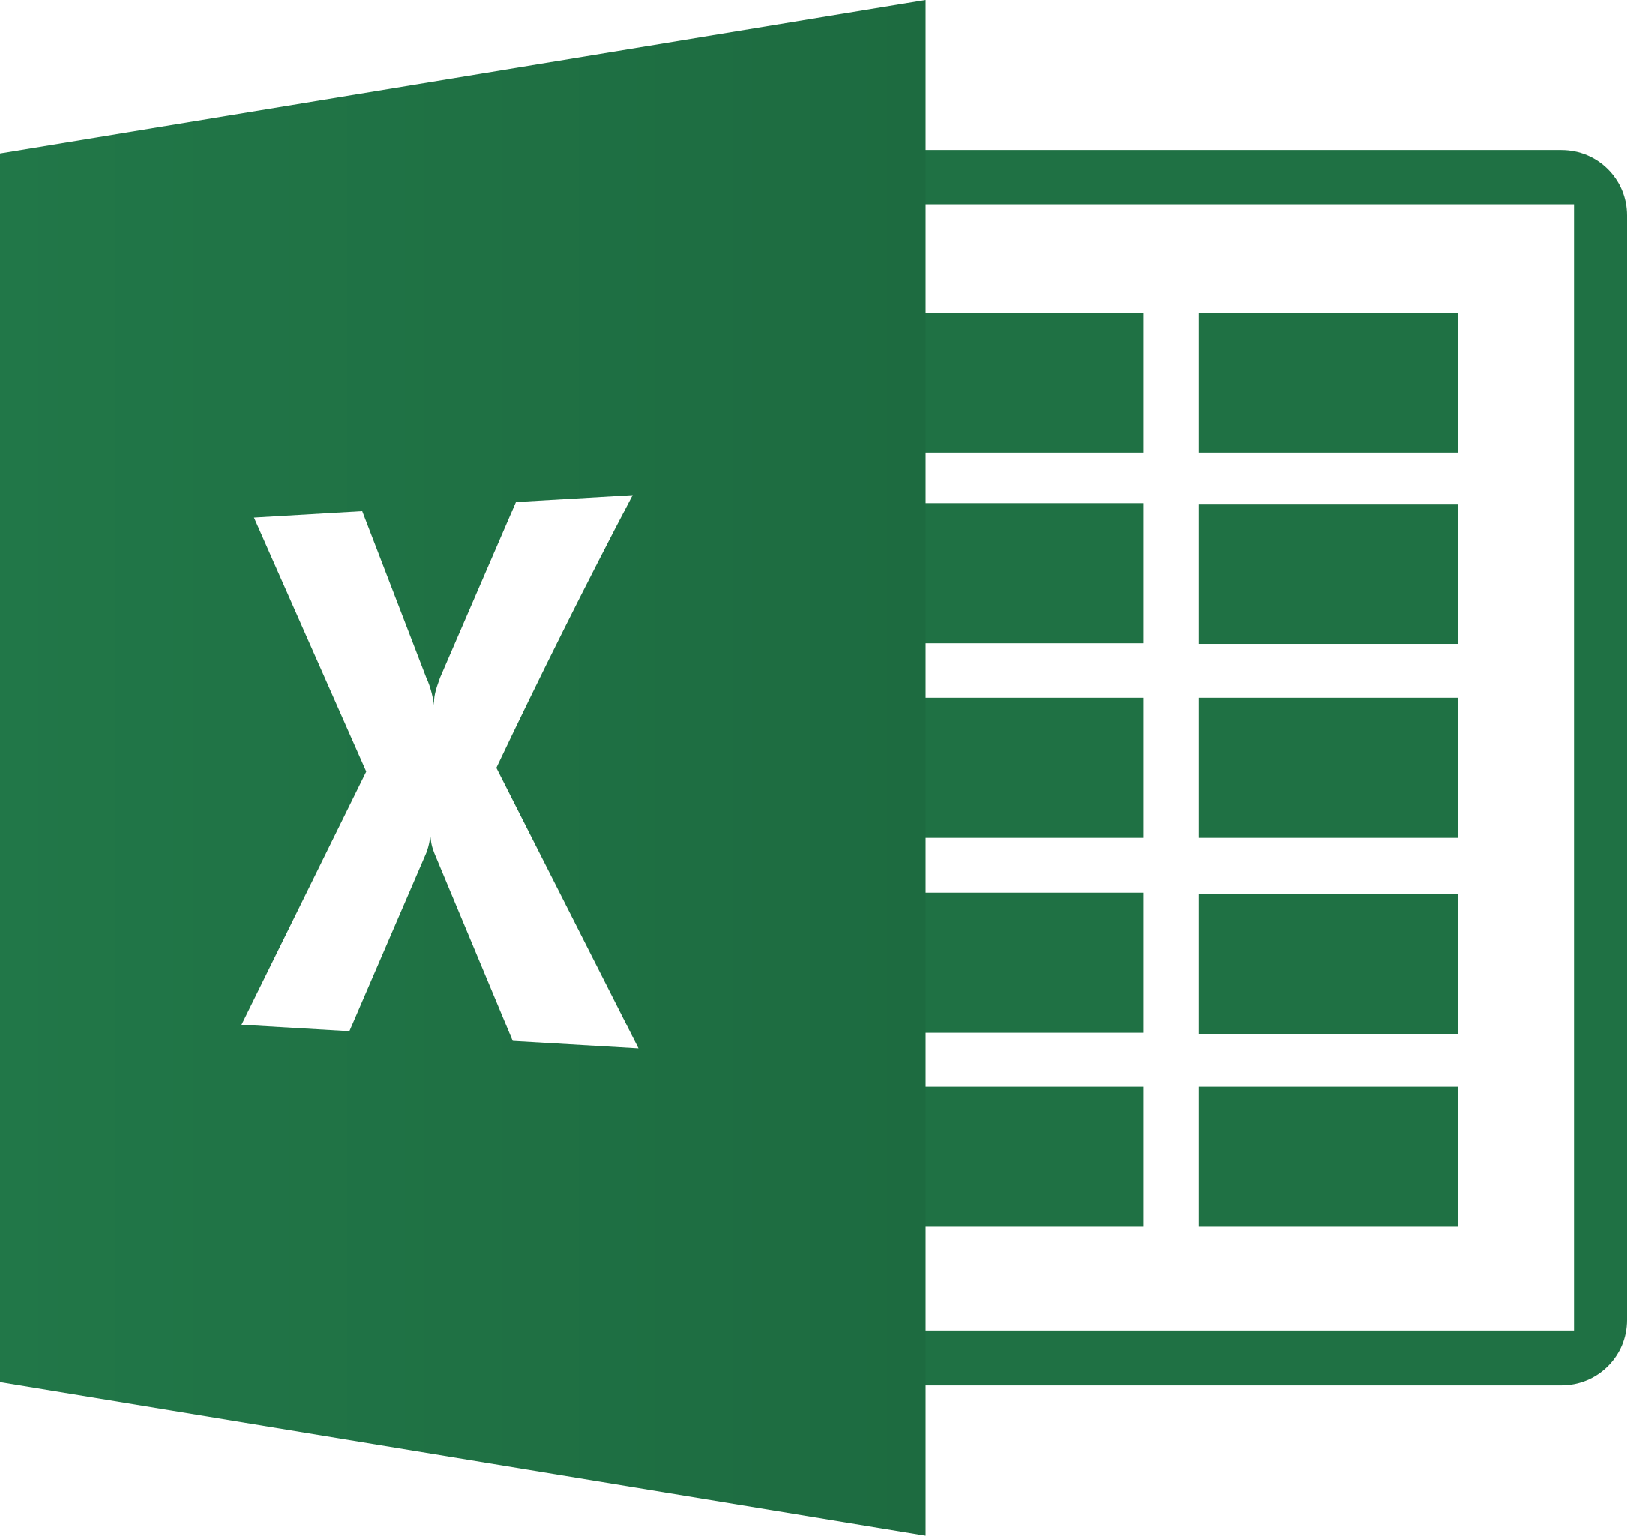
Popular Tools for Data Visualization
Tableau: Interactive dashboards and ease of use.
Power BI: Seamless integration with Microsoft tools.
Excel: Familiar and widely available for basic charts.

Slide 12
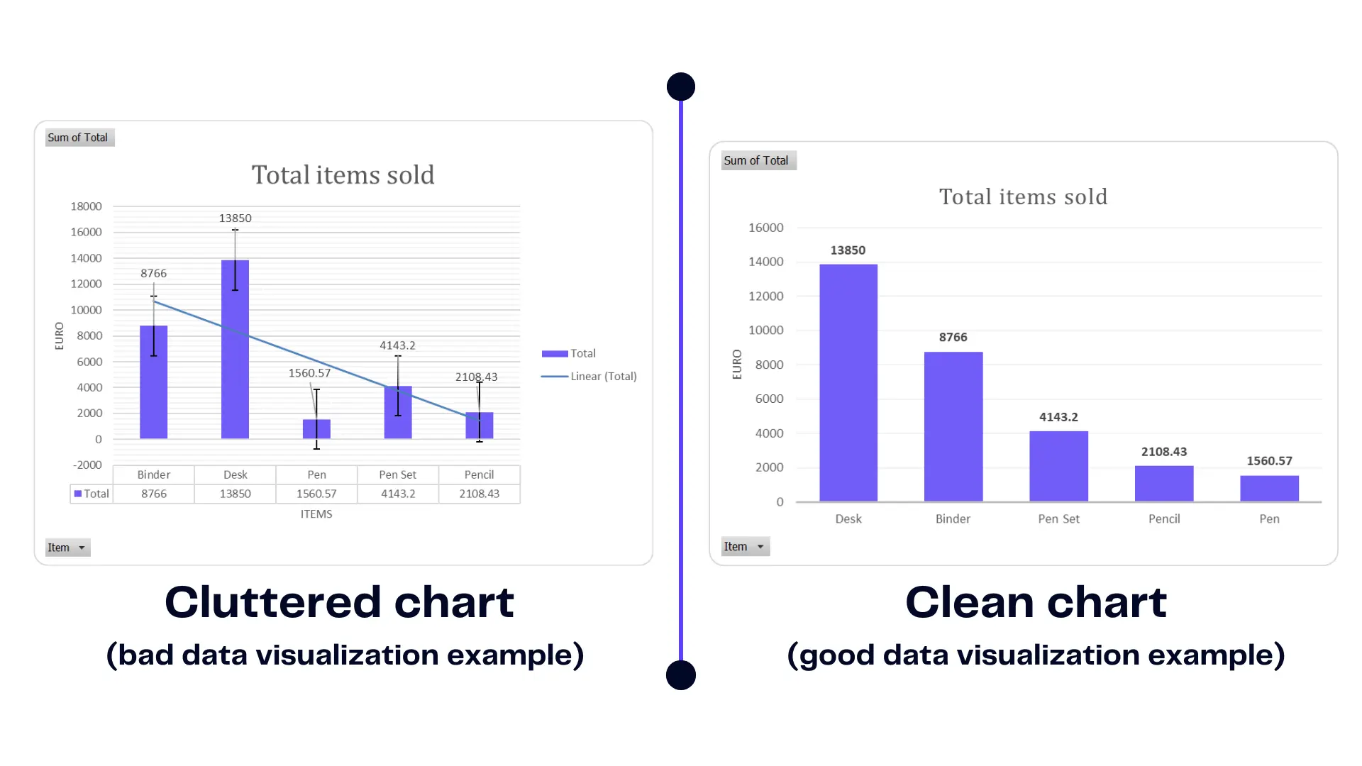
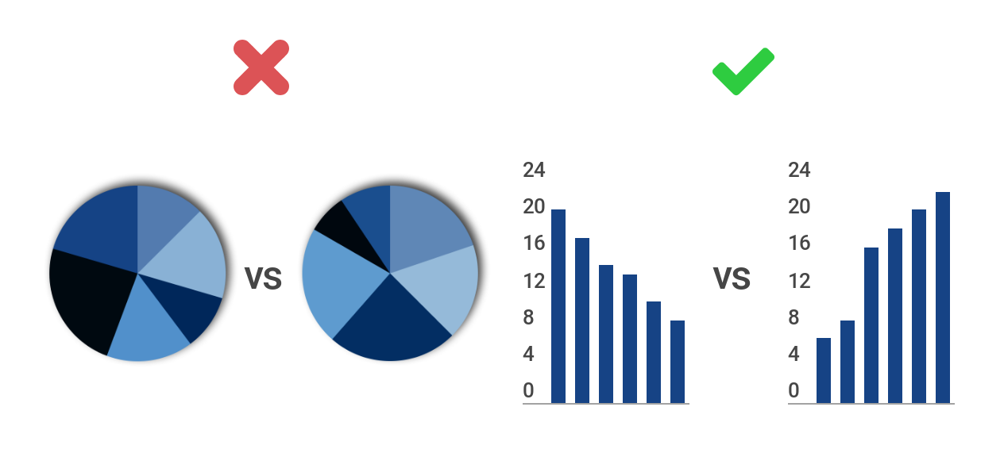
Best Practices for Impactful Visuals
Keep visuals simple and focused.
Use appropriate chart types for the data.
Maintain consistency in colour and design.
Avoid clutter and unnecessary elements.
Annotate key insights.

Slide 13
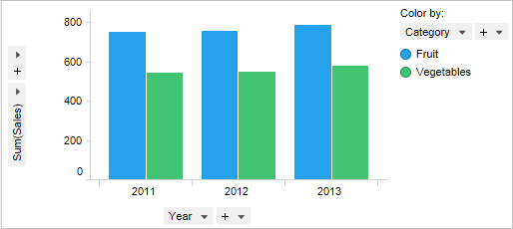
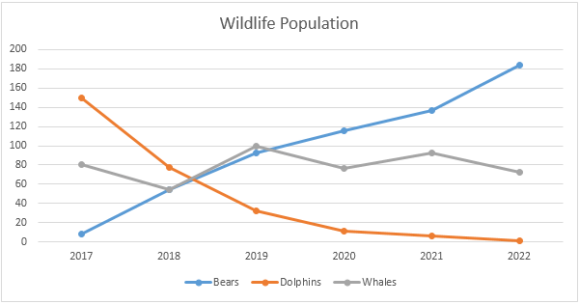
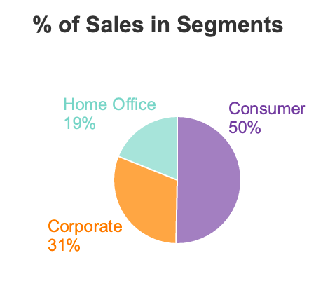
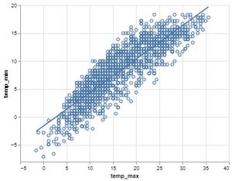
Basic Visualisation Types
Bar Charts: Compare quantities across categories.
Line Charts: Show trends over time.
Pie Charts: Represent proportions and percentages.
Scatter Plots: Highlight relationships between variables.

Slide 14
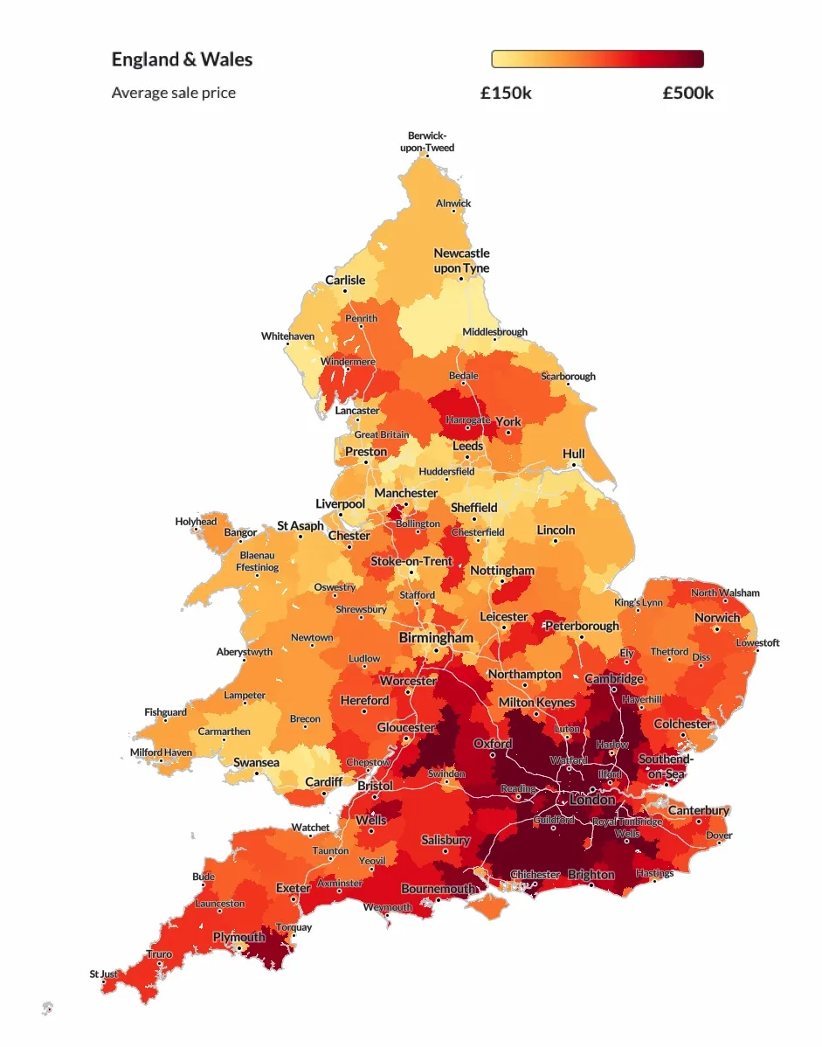
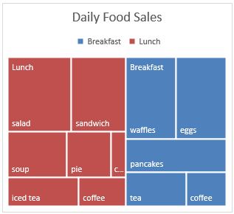
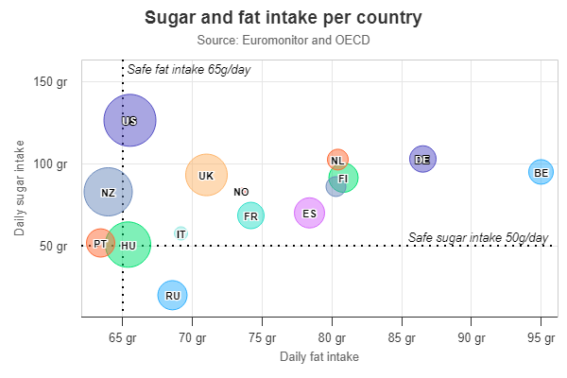
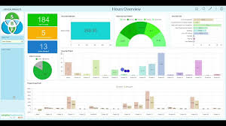
Advanced Visualisation Types
Heat Maps: Represent data intensity using colours.
Treemaps: Display hierarchical data.
Bubble Charts: Add a third dimension (size) to scatter plots.
Dashboards: Combine multiple visualisations for holistic insights.

Slide 15
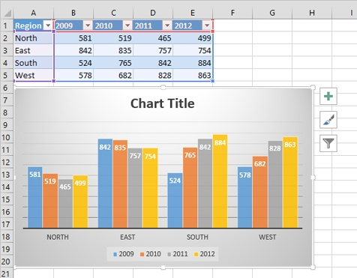
Example: Visualizing Sales Data
Raw data: Yearly sales across regions.
Visualization: regional trends in a bar chart.
Insights: Highlight regions with the highest/lowest sales.

Slide 16
Data Visualization Categories
Basic Charts & Graphs (Exploratory Visuals)
Distribution Visuals
Relationship & Correlation Visuals
Hierarchical & Composition Visuals
Time-Series Visuals
Geospatial & Mapping Visuals

Slide 17
1. Basic Charts & Graphs (Exploratory Visuals)
These are fundamental visualizations used for summarizing and exploring data.
Bar Chart – Compare categorical data.
Column Chart – Vertical bars to compare different categories.
Line Chart – Show trends over time.
Pie Chart – Represent proportions in a whole.
Scatter Plot – Show relationships between two variables.
📌 Use Case: Exploratory data analysis, business reports, performance comparison.

Slide 18
2. Distribution Visuals
Used to show the spread and distribution of data points.
Histogram – Show frequency distribution of continuous data.
Box Plot (Box-and-Whisker Plot) – Display median, quartiles, and outliers.
Density Plot – Estimate the probability distribution of a dataset.
📌 Use Case: Analyzing patterns, detecting outliers, understanding data variation.

Slide 19
3. Relationship & Correlation Visuals
Used to understand relationships between multiple variables.
Scatter Plot – Show correlation between two variables.
Bubble Chart – Like a scatter plot but includes a third variable through bubble size.
Heatmap – Visualize matrix data (e.g., correlations, website clicks, risk levels).
Pair Plot – Display multiple scatter plots between different variables.
📌 Use Case: Finding correlations, regression analysis, financial market analysis.

Slide 20
4. Hierarchical & Composition Visuals
Used to show parts of a whole or hierarchical relationships.
Pie Chart & Donut Chart – Show proportions.
Tree Map – Show nested categories in a hierarchical structure.
Sunburst Chart – Visualize hierarchical data in a radial format.
Stacked Bar/Area Chart – Show cumulative totals with breakdowns.
📌 Use Case: Market share analysis, budget breakdown, financial reporting.

Slide 21
5. Time-Series Visuals
Used to track changes over time.
Line Chart – Display trends over time.
Area Chart – Show volume of change over time.
Candlestick Chart – Commonly used in stock market analysis.
📌 Use Case: Sales trends, website traffic, financial trends.

Slide 22
6. Geospatial & Mapping Visuals
Used for location-based data.
Choropleth Map – Color-coded maps to represent values across regions.
Scatter/Point Map – Plot individual data points on a map.
Heatmap (Geospatial) – Show intensity of data in specific locations.
Flow Map – Visualize movement (e.g., migration, supply chains).
📌 Use Case: Sales distribution, demographics, logistics & supply chain.

