Slide 1
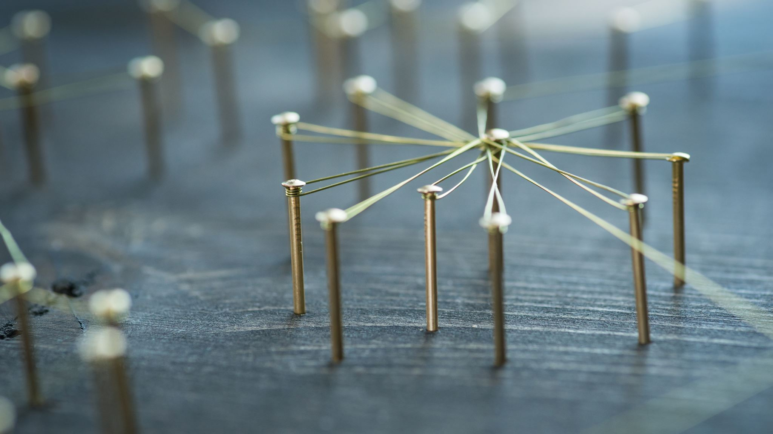
The Marketing mix

Slide 2
The Marketing Mix
Originated in the 1960’s, Neil Borden (1964) identified twelve controllable marketing elements that if properly managed would create a profitable business operation. Jeremy McCarthy (1964), then reduced this theory to four key areas:
Price
Product
Promotion
Place
Marketers and academics quickly embraced this new paradigm

Slide 3

The development of the Marketing mix, mirrored the things we have already covered in this module, eg:
More consumer based marketing
Addition of services to marketable items
A more comprehensive package, driven again by consumers the creation of add on services.

Slide 4
Activity
In groups, discuss the 4 p’s, consider what it does and does not cover. What is it particularly good at? What are the limitations of it?

Slide 5
The Marketing Mix 4 Ps:
Product - The Product should fit the task consumers want it for, it should work and it should be what the consumers are expecting to get.
Place – The product should be available from where your target consumer finds it easiest to shop. This may be High Street, Mail Order or the more current option via e-commerce or an online shop.
Price – The Product should always be seen as representing good value for money. This does not necessarily mean it should be the cheapest available; one of the main tenets of the marketing concept is that customers are usually happy to pay a little more for something that works really well for them.
Promotion – Advertising, PR, Sales Promotion, Personal Selling and, in more recent times, Social Media are all key communication tools for an organisation. These tools should be used to put across the organisation’s message to the correct audiences in the manner they would most like to hear, whether it be informative or appealing to their emotions.

Slide 6

Activity
Considering all the things we have learnt already in this module about Social Marketing, apply the 4 p’s to the Social Marketing context. What will it look like?

Slide 7
Social Marketing 4 P’s
Product
Think about tangible object or service you can provide to support or facilitate behaviour change?
Can you offer a new product/service or adapt one that already exists? Product examples include in-home blood pressure monitoring kits, improved HIV tests, journals to plan and track food intake.

Slide 8
Price
Consider interventions that would decrease the costs to the individual of taking the desired action (not only the monetary cost, but emotional, psychological and time costs). List out the “price” or barriers for your audience segment to carry out the desired behaviour, then brainstorm interventions to diminish those barriers.
Eg: Introducing a walking club program at the workplace for those who cite lack of support and lack of time as barriers to regular exercise.

Slide 9
Place
Think about where the audience will perform the behaviour or access the new or adopted product/service. How can you make it convenient and pleasant (even more so than the competing behaviour)?
Examples include: placing condom machines in pub toilets, offering helplines that are available 24 hours a day, having breast feeding consultants check on new mothers after they leave hospital.
Consider – the people that will take your program to the audience, the need for peer educators, counselors or others who can make your program or its activities more accessible.

Slide 10
Promotion
Use your market research to determine the communication channels and activities that will best reach your audience to promote the benefits of the desired behaviour. What advertising or public relations media do they pay attention to (eg. Newspaper, radio, postcards, billboards, social media)? What special promotional items would you like (Water bottles, magnets, pencils)? What special events do they attend? (Concerts, sports event, conferences)? How can you include influencing audiences?

Slide 11
Activity
Watch the following Social Marketing videos and make notes on the 4’s of each video. We shall discuss after.
https://www.youtube.com/watch?v=jGY-T4W-BOc
https://www.youtube.com/watch?v=K9vFWA1rnWc
https://www.youtube.com/watch?v=0c7EPn-N-Ro

Slide 12
In the late 1970’s it was acknowledged that marketing had changed, Booms and Bitner (1981) added the additional P’s:
People – All companies are reliant on the people who run them from front line Sales staff to the Managing Director. Having the right people is essential because they are as much a part of your business offering as the products/services you are offering.
Processes –The delivery of your service is usually done with the customer present so how the service is delivered is once again part of what the consumer is paying for.
Physical Evidence – Almost all services include some physical elements even if the bulk of what the consumer is paying for is intangible. For example a hair salon would provide their client with a completed hairdo and an insurance company would give their customers some form of printed material. Even if the material is not physically printed (in the case of PDFs) they are still receiving a “physical product” by this definition.

Slide 13
8th P?
The 8th P of the Marketing Mix:
Productivity & Quality - This P asks “is what you’re offering your customer a good deal?” This is less about you as a business improving your own productivity for cost management, and more about how your company passes this onto its customers.

Slide 14
“Even after 31 years (or 54 in the case of the original P’s) the Marketing Mix is still very much applicable to a marketer’s day to day work. A good marketer will learn to adapt the theory to fit with not only modern times but their individual business model”.
DISCUSSION – What do you think of this quotation?

Slide 15
Alternative opinion
Some theorists believe that the traditional 4 or 7 P’s approach is out of date, there are many reasons for this including:
Lack of experiential consideration
Focused on short term, sales and transactions.
To simplistic to be added to the complex world of contemporary marketing
Internal orientation – Looking at the seller rather than the buyer

Slide 16
The need for a new model?
Which could include:
Stakeholder and Community engagement
Relational thinking
Co-creation
Advocacy
Lobbying
Public and media relations
Strategic and Holistic approach to behaviour change

Slide 17
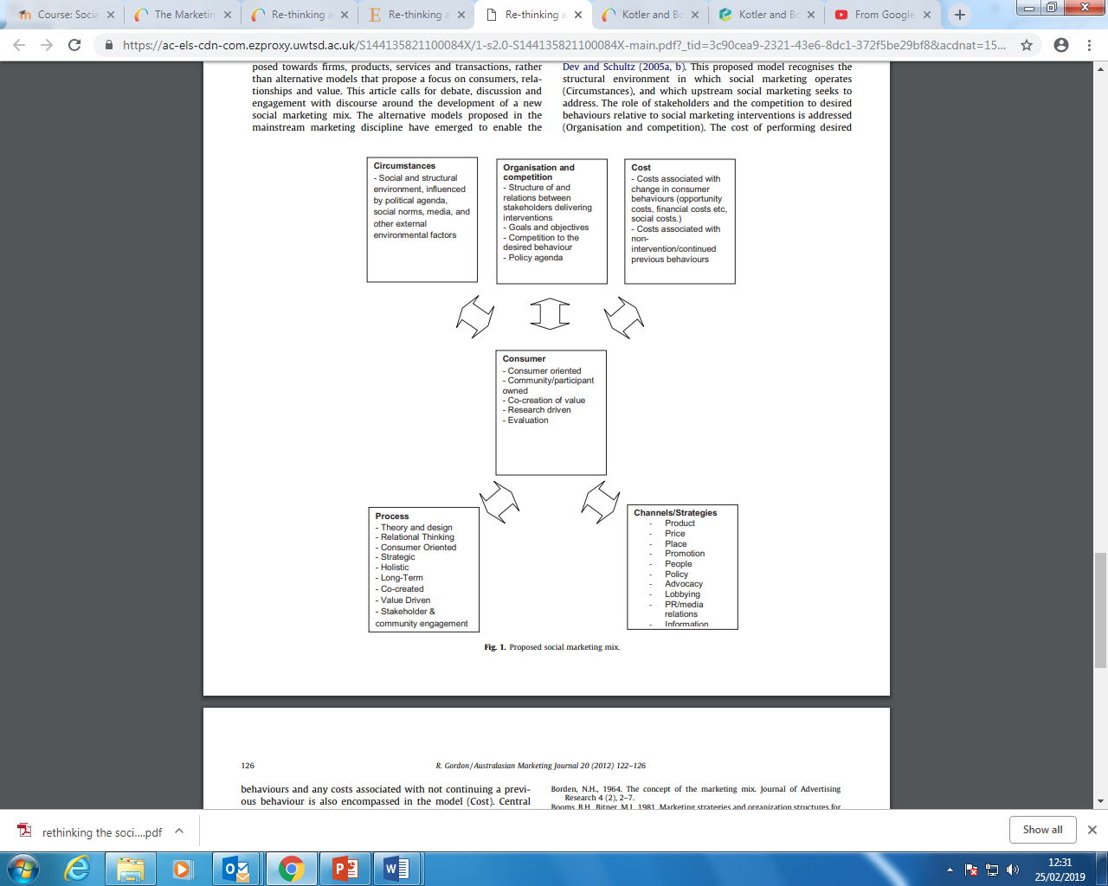

Slide 18
Here is another suggestion…
https://www.youtube.com/watch?v=ohTg-SIfgkk

Slide 19
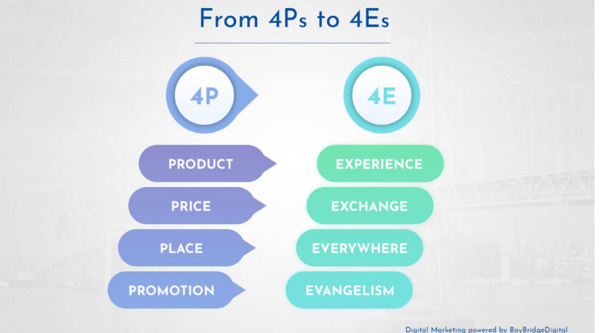
4 E’s

Slide 20
From Product to Experience
Today’s consumers don’t expect just to be sold a product or a service. Luxury retail and aircraft carriers have understood that time ago. This is now expanding to more mainstream areas and has become primary in services. Think of how some car manufacturers welcome customers buying a used car with a VIP pack…
That experience helps them relate to the brand and feel emotional about company or product. An event that offers an exciting or immersive experience with the brand is the perfect opportunity to gain a loyal customer, and a great deal of brand exposure. Even FMCG are driven to that era. Red Bull is famous for doing this well with extreme sports and other events geared around the theme of “Red Bull Gives You Wings.”

Slide 21
From Price to Exchange
Until recently, the price was driven by the production cost of a product or service, by its scarcity, or a prevision on how these two elements could evolve in the future.
Today, boundaries get blurrier every day between the actual cost of a good, the cost of ownership of the same good. Do you see the price of a car advertised anymore?
Yield management has come to an extreme point where users can get services for almost nothing. Free, Freemium, business models based on selling data or ad space.
At the same time, physical products can almost always be found for astronomically low prices, although the quality may be quite questionable.
As customers struggle more and more in this complexity, educating accompanying them becomes critical in the process of driving their purchase decision and show them what they will gain. At the same time, experience and emotional connection are already a critical element of the price shaping.

Slide 22
From Place to Everywhere
As we are entering the era of immediateness, brands need to be able to capture, anticipate and drive customers mood, or will to consume, anywhere at any time. And be able to respond to it on the spot.
Having a physical storefront is no longer enough to be successful. Modern marketing mandates an omnichannel strategy that lets consumers conveniently reach you where they’re at, whether that’s a physical location or online through social media, your website, or other channels.
Besides, brands need to propose a seamless experience to anchor their image and promise into customers mind avoiding dissonance. In particular, customer support and sales are decisive for the delivery of the experience, whatever the channel.
Disney is a reference in that area, with a mobile-responsive website that works hand-in-hand with their mobile app and the park’s Magic Band.

Slide 23
From Promotion to Evangelism
Abundant literature describes the recent changes in customer behavior and how they meet brands. To cut the story short, brands are not the only source of information anymore. Customer networks provide information from multiple sources ranging from blogs, forums, and social networks. The role of promotion is not only to inform and seduce anymore but provide consistent and positive message aligned with brand value and experience.
While traditional advertising still has its place, the way to reach customer has been totally transformed. Brand advocacy and customer evangelists have crucial to provide customers the needed trust and value to engage with the brand. Content marketing has become a must to proactively engage customers to get in contact with brands.
Influence marketing, encouraging happy customers to spread the word about what brands offer, is one of the tools that can help implement this approach. User-generated content (such as the incredible number of GoPro videos recorded, uploaded, and distributed online by GoPro customers) is essentially free advertising, supported by social proof that what the brand offers is worth buying.

Slide 24
Summary
We have looked at the traditional marketing mix, how and when it was expanded, how more recently it was applied to the Social marketing context and lastly, possible replacements.
Four our last activity today, in groups discuss which model you prefer and why? If you aren’t comfortable with any of the examples, create you own?

