Slide 1
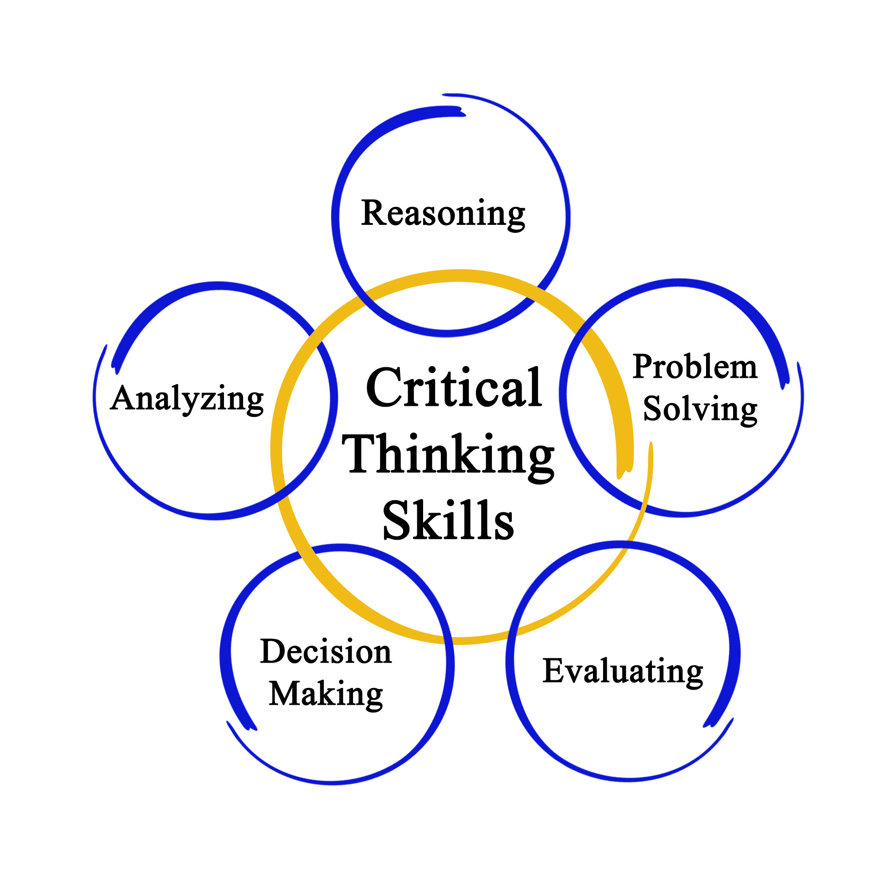

Critical Thinking Skills
What is Critical Thinking?
Critical thinking is the ability to absorb and analyse information whilst researching evidence to support the information to reach a summative or logical conclusion.
According to Judge, Jones and McCreery (2011) a critical thinker will question and challenge their knowledge and perceived wisdom. Supporting this belief Cottrell (2005) suggests a critical thinker requires the ability to critically evaluate their own actions and beliefs and to understand other people’s reasoning to conclude an argument.
Cottrell (2005), also describes critical thinking as a process that requires the ability to identify other people’s positions, thus questioning the authors point of view to reveal any possibilities of bias and recognising techniques used by authors to persuade the audience to agree to their argument, evaluating opposing views and theories to draw conclusions based on a range of evidence from reliable sources.
According to both Cottrell (2005), and Judge, Jones and McCreery (2011), one of the most important skills an academic can have been the ability to think critically, without this ability the student would find it difficult to present a well-constructed argument. Critical thinking is encouraged in students from early education where the Department for Education mentions that children should be encouraged to develop and make links between ideas and explore strategies for completing things. DFE (2012). Critical thinking is a life skill, it is not about mistrusting everything that is heard but about using curiosity to explore alternative ideas and concepts and seek the most probably explanation or conclusion, as Moore et al (2011) states that in education and life a great habit to adopt is not to take anything at face value.
A variety of personal skills are required to be a competent critical thinker, these skills include but are not limited to reflection, research, notetaking, and collaboration.
Research
A part of the critical thinking processes an element of research is required. Research is key to fulfil the learner’s curiosity on the subject that they are studying. Moore et al (2011) asserts that research is an investigative process that helps to increase knowledge and solve practical problems and that it gives an opportunity to discover new aspects and perspectives. Research can come from a variety of sources, such as books, eBooks, websites, journals, questionnaires, and official documents. As Bates (2019) explores when discussing Blooms taxonomy that learning begins with knowledge, with the learner recalling and recognising the information. Then with comprehension, understanding the meaning of the information leading onto application, using the information learnt before they can analyse and interpret the information. This is where the research and reading are relevant to the ability to critically think. As Blooms taxonomy argues that the understanding and application of knowledge is essential before the learner would have the intellectual development to analyse, synthesize and evaluate the information.
The information that is being researched should be reliable, credible and from trusted sources. Godfrey (2009) states that sources should be from reputable and authoritative sources. Secondly Moore et al (2011) suggests that researchers should question the author looking at bias, the authors qualifications, experience, and previous publications. The reader needs to explore supporting and conflicting information and look for evidence to support the authors statements. Cottrell (2005) supports this view but also expands the theory by suggesting that the learner needs to be aware of persuasive language from the author persuading the reader to accept their views and beliefs, to analyse information from studies to ensure that the information collected was realistic and collated. The information and evidence researched needs to have a positive correlation or causal link to ensure that the information can be successfully compared. It should be questioned if trends in the information as coincidental or from cause and effect. Cottrell (2005) also suggests that the evidence to support the information needs to be authentic and valid so proven to be what it states. The source should also be current so that the information contained in the source is correct at the time of research.
To start research, the information must be relevant to the topic, the learner should question the material they have read to enable them to analyse and evaluate the information. Burns and Sinfeild (2004) mention that academic reading should consist of careful selection of reading material that is read in an interrogatory manner. Cottrell (2008) somewhat agrees with this an suggests that to develop critical thinking students require a detective-like mind.
During university studies learners will be allocated a reading list. It may not be practical or required for the student to read every page of every book. Cottrell (2008) it helps to become a smart reader reading interactively, questioning reading, and looking for answers by using the index to find information quickly. Moore et al (2011) suggests deciding what you want to read and making notes to summarise what you read in your own words
Note making.
Notetaking should allow the student to review, compare the key information researched to allow critical thinking to make a judgement or reach a conclusion.
There appears to be no best method to successful note making and it does not involve writing down everything you read or hear. Cottrell (2009) lists considerations when making notes, one should consider if the information is needed, how will the information be used and what questions will be answered from the information noted.
There are different methods of note taking. Note making can be linear where information is taken down line by line or as pattern notes such as a mind map or brainstorm. There are benefits and disadvantages to both.
As Learning Strategies Center Cornell (2020) discusses the Cornell note taking method is a popular notetaking method designed by Paulk in 1962. Cornell notetaking is a linear method of notetaking that includes dividing a page into three columns with a question column, note column and summary. The question column is beneficial in critical thinking as it allows students to consider what they wish to gain from the research method prior to the research being undertaken. According to Burns and Sinfeild (2004) linear note making is a passive form of note taking and as the information all looks the same it may be difficult to focus on specific points, it also allows information to be missed or excluded if the learner cannot write at an appropriate pace. They can useful and include a high volume of information if the student is able to write quickly.
Pattern notes could include a key word system, mind mapping, pictures, colours, anything that could be used as memory triggers. Advantages of pattern notes are that learners do not have to write as quickly, less likely to miss out key information and are able to find information and categorise them easily, thus being able to use them to compare to other information research and critique the information found.
Burns and Sinfield (2004) discuss Buzan’s argument regarding mind mapping where Buzan argues that for active learning to take place learners need to engage both the creative right side of the brain and the logical left-handed side. Buzan argues that traditional linear note making only utilises the logical left side of the brain whilst a mind mapping approach where notes are mapped out non-hierarchically in a pattern would engage the student in more active learning resulting in the student retaining more information. Bates (2019) discussing Roger’s theory where the teacher is the facilitator where they provide resources for learners arrive at their own solutions rather than providing direct answers to problems, Buzan’s arguments relates to this theory as linear note taking would consist of the student directly noting the teachers’ ideas and words where pattern or mind mapping techniques allow the student to use their own interpretation ideas and thoughts to come to their own conclusions.
Reflection
Reflection is a key skill that contributes to critical thinking. Cottrell (2008) suggests that if a student uses a self-evaluating, active reflective approach to learning, where they reflect upon points raised in their reading and their own way of approaching these points then they will develop a deeper long-term understanding of the topics and will improve as a learner and a practitioner.
Godfrey (2009) explains that a to aid critical thinking it is helpful to write a short reflection using the notes that have been produced from research. To maximise the effectiveness of the reflection, the reflection should include the students’ own thoughts from the questioning, an evaluation, and the location of the text. This should enable the learner to conclude. Judge, Jones and McCreery (2011) explains critical reflection implies a change of perspective, it encourages a student to critically review their own thoughts and assumptions. This ensures students disregard any previous bias and ensure their conclusion is extracted from evidence and fact rather than opinion again supporting the student in their critical thinking to draw a conclusion.
Reflection not only is a key skill for students but according to Paige-Smith and Craft reflective practise is a key expectation of early years practitioners. It is imperative that activities, observations, and care are reflected upon continuously to ensure that the environment is challenging, engaging, supportive and meets the needs of the curriculum. Welsh Government (2020) mentions when discussing the New Curriculum for Wales that schools will be required to develop their own curriculum, reflective practise will be significant as settings reflect on learning plans to explore if lessons have been successful in meeting the four core purposes. Whilst Aubrey and Riley (2016) firstly state when discussing the theorist Dewey that a flexible integrated curriculum that meets the needs of an individual child should be at the heart of active experience for learning, which is broadly what will happen within the New Curriculum for Wales secondly, they suggest Dewey believed that active experience is nurtured by free inquiry and criticism and should be seen by the learner as a process of personal experience and development. Again, showing that reflection for practitioners and students is required for critical thinking.
Source, Literacy Pathway (2020)
Conclusion
For successful critical thinking students and practitioners require a range of skills. Each skills complements the next. Researching the information, providing the information comes from a reliable source provides the literature that is required for study. Note taking extracts the information of most importance and enables the learner to present the key points in a suitable format to meet their requirements for learner. As suggested by Bates (2019) when explaining Flemings VARK model of different learning styles, students do no all learn in the same way. Students may find either Visual, Auditory, Reading, or Kinaesthetic (learning from activity) beneficial to their studies. The various methods of Note taking, and reflection allow the student to analyse their research using the method that is most beneficial to the individual. Using a combination of approaches ensures the student can make a well-constructed argument and reach a non-bias conclusion based on the evidence discovered.
Source, Talentlens (N.D)

Slide 2
Reference List
Aubrey, K and Riley, A. (2016) Understanding and Using Educational Theories. London: Sage Publications
Ayoa (2015) How to Mind Map with Tony Buzan. Available at: Tony Buzan Mind Mapping Tutorial - Bing video (Accessed on 18/09/2021)
Bates, B. (2019) Learning Theories Simplified. London: Sage Publishing
Burns, T and Sinfield, S. (2004) Teaching Learning and Study Skills: A Guide for Tutors. London: Sage Publications
Cottrell, S. (2005) Critical Thinking Skills: Developing Effective Analysis and Argument. Hampshire: Palgrave Macmillan
Cottrell, S. (2009) The Study Skills Handbook. Hampshire: Palgrave Macmillan
Department for Education (2021) Statutory Framework for the Early Year Foundation Stage; Setting the standards from birth to five. Available at: Statutory framework for the early years foundation stage (publishing.service.gov.uk) ( Accessed: 15 September 2021)
Godfrey, J. (2009) How to use reading in your essays. Hampshire: Palgrave Macmillan
Judge, B, Jones, P and McCreery, E. (2011) Critical Thinking for Education Students. Exeter: Learning Matters Limited.
Learning Strategies Center Cornell (2020) How to use Cornell Notes. Available at: The Cornell Note Taking System – Learning Strategies Centre (Accessed 18/09/2021)
Literacy Pathway (2021) Critical Thinking Skills. Available at: Critical Thinking Skills | Literacy Pathway (Accessed 24/09/2021)
Moore, S. et al. (2011) The Ultimate Study Skills Handbook. Berkshire: Open University Press
Paige-Smith, A and Craft, A. (2009) Developing Reflective Practise in the Early Years. Berkshire: Open University Press
Pearson Talentlens (N.D) Leader in Candidate Selection Tests. Available at: Pearson Talentlens | Leader in Candidate Selection Tests (Accessed 24/09/2021)
Welsh Government (2021) A New Curriculum in Wales Changing the way children and young people learn in school. Available at: Caerphilly well-bein plan 2018-2023 (gov. wales) (Accessed: 20 September 2021)

