Slide 1


The Behaviourist Appraoch
By Kayleigh Francis

Slide 2

What is the behavourist approach?
The behaviourist Aproach is learning and studying the changes in behvaiour. This can be caused by the environment (nurture) the person is in, or just the person individually (nature).
Many theorists believe that by using the principals of classical and operant conditioning can explain the person behaviour.

Slide 3
What is classical conditioning ?
Classical conditioning is learning a process that occurs when two stimuli are paired together repeatidely. The first stimulus evokes a natural response by the subject whilst the second one is learned. But after enough pairing together the second becomes conditioned and causes the response to happen as it would the first stimuli.

Slide 4
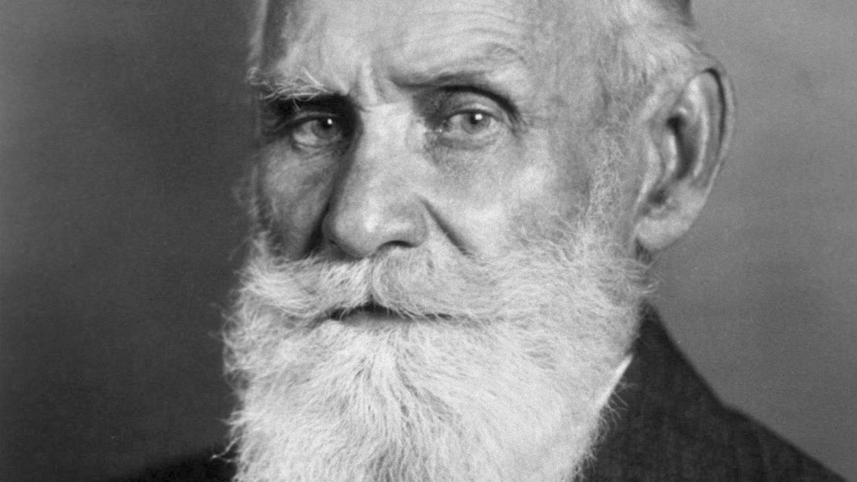
Ivan Pavlov (1977)
Ivan Pavlov was a russian phychologist in the 1890s. He discovered Classical conditioning by accident,
Ivan Pavlov was doing research on digestive system in dogs that he kept in his lab.
Dogs naturually salivaite when presented with food. So Ivan Pavlov surgically implanted tubes into the dog's mouth to measure how much the dog would salivate when presented with food.
Ivan Pavlov discovered that the dogs were associating footsteps and their bowl with food so the dogs would naturally salivate . So the dogs were classically conditioned to evoke drooling when they heard footsteps or see their bowl.
So Ivan Pavlov expermineted with a bell and preseneting the dog with food after enough times Pavlov would only have to ring the bell and the dog would drool as a response, classically condioning the dog.
https://www.google.com/url?sa=i&url=https%3A%2F%2Fen.wikipedia.org%2Fwiki%2FIvan_Pavlov&psig=AOvVaw2Z_YMBboV9xlXji6B6Ia90&ust=1605701807508000&source=images&cd=vfe&ved=0CAIQjRxqFwoTCPiersDHie0CFQAAAAAdAAAAABAD

Slide 5
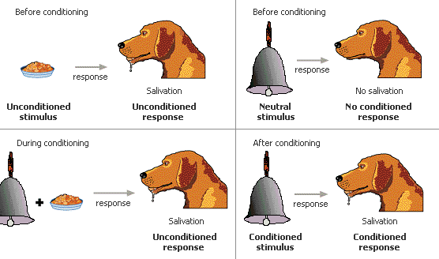
https://www.google.com/url?sa=i&url=https%3A%2F%2Fmedium.com%2Fhistory-of-education-timeline%2Fpavlovs-dogs-and-the-importance-of-environment-in-learning-b1cefd40d527&psig=AOvVaw0qX0X4yKMApuyptcMmKdPd&ust=1605702289742000&source=images&cd=vfe&ved=0CAIQjRxqFwoTCKCiqqfJie0CFQAAAAAdAAAAABAD

Slide 6
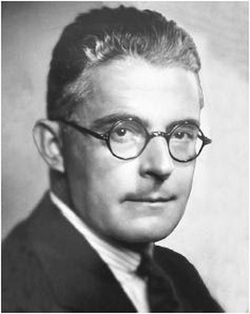
John B Watson (1920)
John B wastson was another physgologist who did a famous expertment with a baby called little Albert.
During the experiment little Albert was sat down whilst John B Watson realised the white rat would run around little baby Albert and baby albert was not bothered by the white rat.
John then experimented by having the white rat run around albert and whilst john and some other reasherches made loud noise which caused little Albert to cry and be scared.
The next experment was to put baby Albert and the rat together again without the loud noises and banging.
Sure enough baby Albert was very scared of the rat and strated to cry.
Therefore John B Watson used classical conditoning with little albert, causing him to be scared of the white rat.
https://www.google.com/url?sa=i&url=https%3A%2F%2Fhberglund210.weebly.com%2Fjohn-b-watson.html&psig=AOvVaw1Ru21CAKenRS_uYa-8RKhy&ust=1605703474006000&source=images&cd=vfe&ved=0CAIQjRxqFwoTCKD3mN3Nie0CFQAAAAAdAAAAABAD

Slide 7
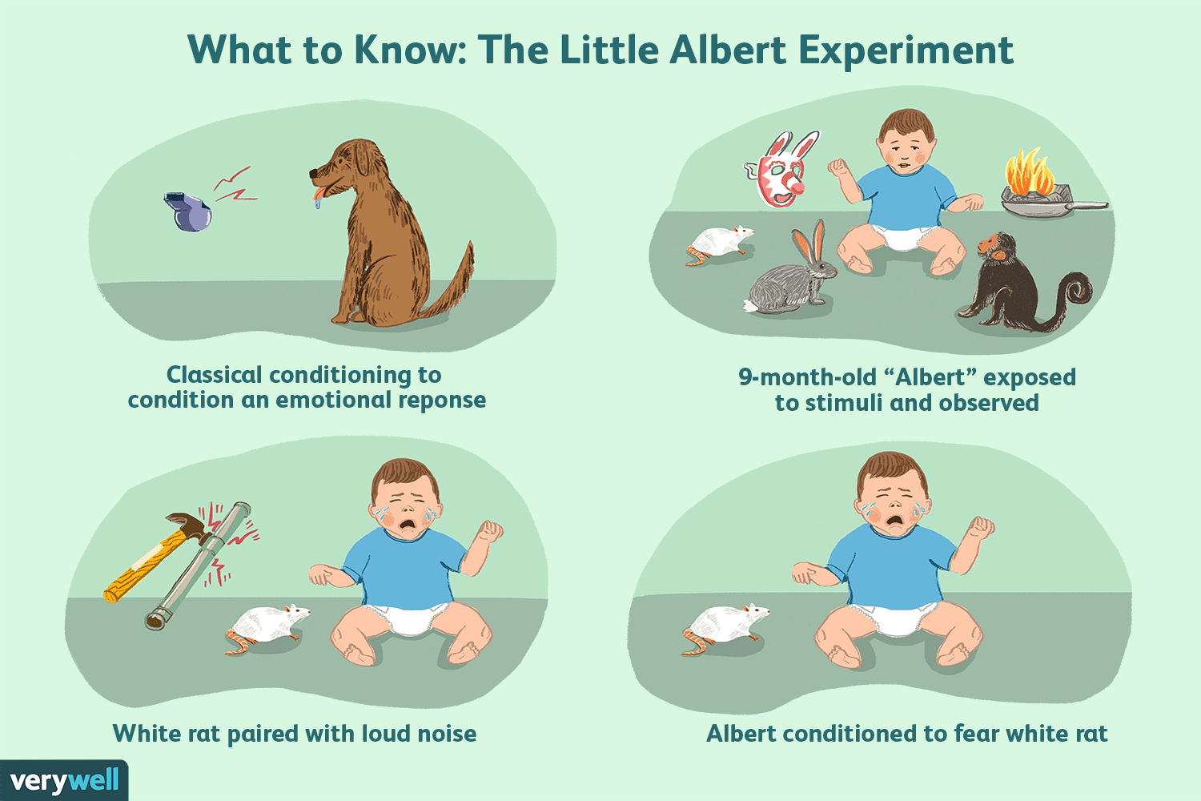
https://www.google.com/url?sa=i&url=https%3A%2F%2Fwww.verywellmind.com%2Fthe-little-albert-experiment-2794994&psig=AOvVaw18AcEwgZ8GhuxJ_3CThI0E&ust=1605703532763000&source=images&cd=vfe&ved=0CAIQjRxqFwoTCOCYqPfNie0CFQAAAAAdAAAAABAD

Slide 8
What is operant condtioning ?
Opreant conditiong is all depending on a person's behaviour by using posstive and negative reinforcment ( action and counqeince ).
For example if a child cleans his toys away after playing the child gets a biscuit or sweet but if the child is naughty and doesn’t want to clean his toys up after playing, he want got the busicuit or sweet.
The child is most likely to clean is toys away knowing theres a reward at the end of it.

Slide 9
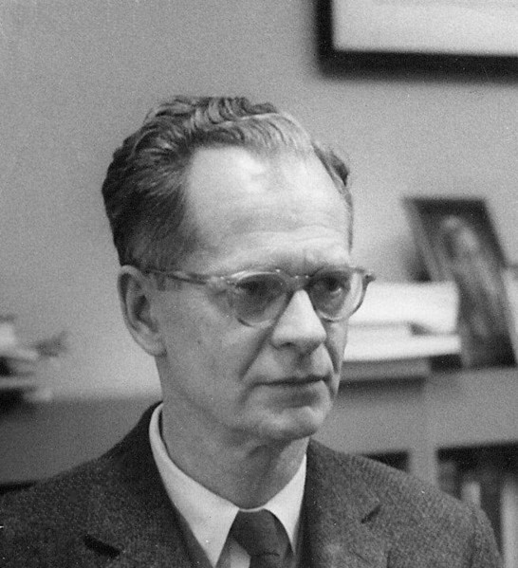
Burrhus frederic skinner B.F Skinner (1969)
B.F Skinner was a physcholgoist and scientist who did a famous expermient called the "Skinner Box".
B.F Skinnner would put a rat in a box with a light in and a lever that would despense food the bottom of the box had an electric grid. If that rat pushed the lever B.F Skinner would reward the rat with a treat. At first the rat almost never presses the lever.
But then when he realised the lever give him treats, he used the lever all the time, therefore conditoning the rat using positive reinforcement .
B.F Skinner would also turn on the electric grid in the box which would cause pain to the rat. The rat would run around panicked and eventually realised by pushing the lever the elecric shock would stop, therefore using negative reinforcement to condition the rat.
https://www.google.com/url?sa=i&url=https%3A%2F%2Fen.wikipedia.org%2Fwiki%2FB._F._Skinner&psig=AOvVaw0fJ5Zn5M13Q2UDgr9nvYFp&ust=1605703409883000&source=images&cd=vfe&ved=0CAIQjRxqFwoTCIibybzNie0CFQAAAAAdAAAAABAD

Slide 10
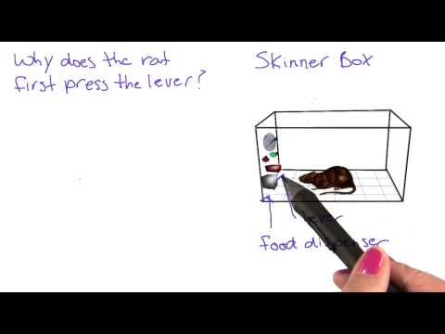
https://www.youtube.com/watch?v=bDWwXdYWqGk

Slide 11


Positive and negative reinforcement
Positive reinforcement
Negative reinforcement
Positive reinforcement is encouraging or establishing a pattern of behaviour by giving a reward or praise when the person or animal does something that aligns with the researchers plans.
Negative reinforcement is removing or avoiding a negative outcome by using a negative stimuli to discourage behaviour.

Slide 12

Nature or Nurture/ Conclusion
The behaviourist appraoch is more on the side of nurture. The theorists spoken about in these slides all did different experiments with animals and children, which the child or animal has learned different behaviours through classical and operant conditioning and through positive and negative reinforcement.
https://www.google.com/url?sa=i&url=https%3A%2F%2Fwww.instituteofcaninebiology.org%2Fblog%2Fis-it-nuture-or-nature&psig=AOvVaw2NVIlrKNca1cGXcsxci021&ust=1605704153325000&source=images&cd=vfe&ved=0CAIQjRxqFwoTCPjB26DQie0CFQAAAAAdAAAAABAD

Slide 13
Reference list
Pavlov, I., 1977. Classical conditioning. Learning and Instruction, 4
Skinner, B., Fredric. 1969.”. Contingencies of reinforcement: a theoretical analysis”. New York, Appleton-Century-Crofts.
Watson, J.B. and Rayner, R., 1920. Conditioned emotional reactions. Journal of experimental psychology, 3(1), p.1.

