Slide 1
Policing Terrorism
Support Session 15/11/21
Aim of session:
-Welcome back!
-Introduce Assessment 2 in more detail
-Go over key terminology for the next few weeks
-Discuss Reading Week Task

Slide 2

Assessment 2
Submission date: 07/01/22 (Before 23:59hrs)
‘Students will produce a 2500 word report designed to evaluate the effectiveness of the response of the emergency services and partner agencies to a selected terrorist attack within the United Kingdom’.
Your title should be :
“The…….. (name of selected attack)………terrorist attack - an evaluation of the effectiveness of emergency services and partner agencies response”

Slide 3
Key Definitions
Emergency
Major Incident
Critical Incident

Slide 4
”Emergency”
An event or situation which threatens serious damage to human welfare in a place in the UK, the environment of a place in the UK, or the security of the UK or of a place in the UK.
(College of Policing, 2021)

Slide 5
“Major Incident”
An event or situation, with a range of serious consequences, which requires special arrangements to be implemented by one or more emergency responder agencies
Major incident can take many different forms:
natural disasters
transport incidents
industrial incidents
and terrorism
(College of Policing, 2021)

Slide 6
”Critical incident”
Any incident where the effectiveness of the police response is likely to have a significant impact on the confidence of the victim, their family and/or the community
Ambulance and fire services do not yet have the same critical incident methodology as the police service.
Examples:
Homicides
serious sexual offences
firearms incidents
hate crimes
police pursuits
(College of Policing, 2021)

Slide 7

The Civil Contingencies Act 2004

Slide 8
Reading Week Task:
What is the Civil Contingencies Act 2004?
-establishes a new legislative framework for civil protection in the UK
-a clear set of roles and responsibilities on those organisations with a role to play in preparing for and responding to emergencies.

Slide 9
The Civil Contingencies Act 2004
Two Parts:
Part 1 - Local arrangements for civil protection
Part 2 – Emergency Powers

Slide 10


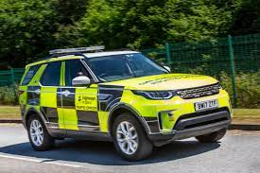
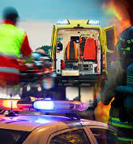


Part 1 - Responders
Category 1 Responders
- Organisations at the core of the response to most emergencies (the emergency services, local authorities, NHS bodies). These have the many duties/responsibilities – discuss?
Category 2 Responders
- Organisations (the Health and Safety Executive, transport and utility companies) are ‘co-operating bodies’. These have less duties/responsibilities – discuss?
(College of Policing, 2021)

Slide 11
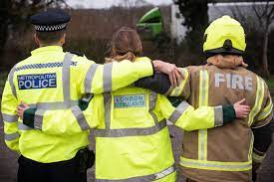

Part 2
- The Use of Emergency Powers
Task: What does this part of the Act include?

Slide 12

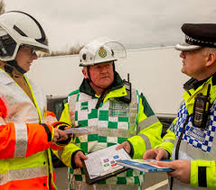
Joint Emergency Service Interoperability Programme
-provides agreed joint working practices to improve the way the police, fire and ambulance services work together when responding to incidents.
-delivers a number of products to help promote and embed interoperability across the emergency services.
Task: Why is JESIP important?
(College of Policing, 2021)

Slide 13
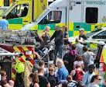

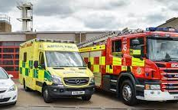
JESIP
– 5 Principles
Five principles of interoperability:
  -co-location
  -communication
  -coordination
  -joint understanding of risk
  -shared situational awareness
(College of Policing, 2021)

Slide 14
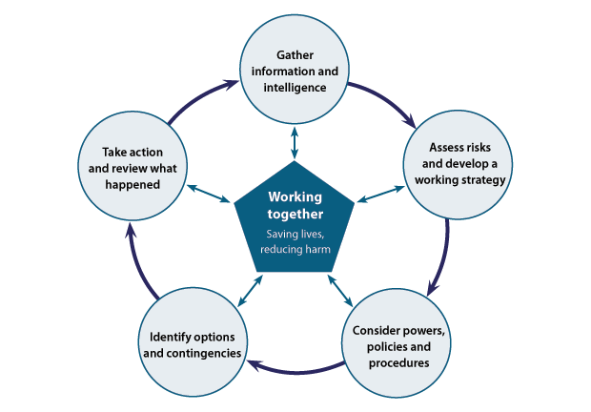
Joint Decision Model
Does this look familiar?
2. What’s the difference between the NDM & JDN?
3. When is the JDM used? When is the NDM used?
Taken from: https://www.app.college.police.uk/app-content/civil-emergencies/civil-contingencies/command-control-and-coordination/#joint-decision-model-jdm

Slide 15
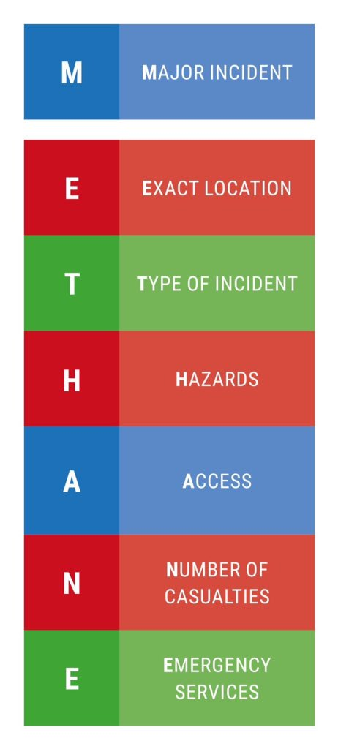
METHANE
-mnemonic used when passing information between emergency responders and control rooms to enable the establishment of shared situational awareness.
1. Why is this important?
(JESIP, 2021)

