Slide 1
Addressing Employee Retention, Succession Planning, and Fleet Decarbonisation in Logistics Operations.
Adrian Cartlidge - 2415605
Engineering Management Leadership
20/05/2025
Over the past five years, the company has faced numerous challenges while trying to improve the bottom line. From workforce shortages and skill gaps to increasing environmental pressures, they’ve encountered unprecedented disruption in our logistics operations.
This presentation outlines our strategic response to two critical challenge areas:
  1. Enhancing employee retention & addressing succession planning.
  2. Implementing measures for decarbonising our aging MAN truck fleet.
These objectives are essential not only for improving internal operations but also for maintaining competitiveness and delivering consistent, high-quality service in a rapidly evolving market landscape.

Slide 2





Presentation Objectives
Address Succession Planning
Develop a structured framework for identifying and nurturing future leaders within the organisation, creating clear career pathways that enhance employee retention and organisational stability.
Improve Employee Retention
Implement strategic initiatives focusing on competitive salaries, training opportunities, and positive work environments to reduce turnover and improve employee loyalty.
Decarbonise MAN Truck Fleet
Execute short, medium, and long-term measures to reduce emissions from their aging fleet, aligning with environmental regulations while maintaining operational efficiency.
Enhance Market Competitiveness
Align all initiatives with market standards to maintain our competitive edge and continue delivering high-quality service to our customers.

Slide 3
Succession Planning – Why It Matters
Succession planning is a vital strategic approach that significantly influences employee retention and organisational stability.
It serves as a mechanism that ensures continuity in leadership and critical roles while simultaneously adopting a culture of development and loyalty among employees (Tetteh & Asumeng, 2022) (Hassan & Siddiqui, 2020).
Integrating succession planning with other strategic initiatives, such as employee engagement and organisational culture, further reinforces its effectiveness.
Companies that actively communicate their succession plans and recognise employee contributions create an environment of satisfaction and loyalty (Arubayi, 2022).
Effective succession planning creates a structured framework for career development within the organisation.
Employees who perceive potential for progression are more likely to remain committed to their employer.
This is particularly true in industries where the cost of turnover is high; recruitment and training for new hires can be significantly more expensive than investing in the development of existing employees (Ghosh et al., 2019).
Another crucial aspect is the mentoring and coaching associated with succession planning efforts.
By implementing formal mentoring programs, organisations can ensure that knowledge transfer occurs effectively, preparing employees for future roles and responsibilities (Amahwa & Egessa, 2021).
Notes:
1. Succession planning is a vital strategic approach that significantly influences employee retention and organisational stability.
2. Integrating succession planning with other strategic initiatives, such as employee engagement and organisational culture, further reinforces its effectivvness
3.Effective succession planning creates a structured framework for career development within the organisation
4. Another crucial aspect is the mentoring and coaching associated with succession planning efforts

Slide 4





Operational Improvements for Retention
Competitive Salaries
Attractive salaries and comprehensive benefits, lead to higher satisfaction (Darmayanti et al., 2024)(Hanai & Pallangyo, 2020).
It motivate employees to remain within the company while enhancing their productivity and commitment (Zainal et al., 2022).
Salaries should be regular assessed to ensure they meet or exceed industry standards.
Training & Development
Continuous professional growth opportunities such as skills training and leadership development (Hanai & Pallangyo, 2020)
Demonstrates that the employer is invested in their personal and professional growth (Mehreen & Ali, 2022).
These opportunities contribute to their job satisfaction and performance (Setia et al., 2022) (Arubayi, 2022) .
Positive Work Environment
Open communication and employee engagement (Arubayi, 2022) (Zainal et al., 2022)
Focus on building a culture of trust and collaboration, where employees feel valued and heard.
Engaged employees tend to have a stronger emotional connection to their workplace (Ojo & Alli, 2024).
Clear Career Pathways (Succession Planning)
Structured progression opportunities, employees are more likely to feel secure in their jobs (Amahwa & Egessa, 2021)
Effective succession planning helps in identifying and nurturing talent, preparing for future leadership needs (Bano et al., 2024)
Technological Support
Tools for tracking engagement and satisfaction (Garg et al., 2021).
These insights enable data-driven decisions to be made to enhance retention strategies effectively.
Operational improvements aimed at enhancing employee retention are essential for organisations, particularly in the competitive landscape of logistics. Research shows that retention of skilled employees not only mitigates costs associated with high turnover rates but also ensures continuity of service quality (Darmayanti et al. 2024) (Bano et al. 2024).
Strategic initiatives focusing on various dimensions, including salary, training, and workplace environment, are effective in reducing turnover and improving employee loyalty.

Slide 5
Recruitment and Training Opportunities
Recruitment and training opportunities, including apprenticeships and internal initiatives, are integral components of effective employee retention strategies. Companies that prioritise these aspects attract top talent and enhance the skill of their workforce, leading to improved performance and employee satisfaction.
Apprenticeship Programs
Internal Training Initiatives
Develop structured apprenticeships that blend practical experience with academic learning.
Apprenticeships allow companies to tailor training to operational needs, creating a pipeline of well-equipped employees familiar with company culture & processes (Wolnowska et al. 2018) (Ren, 2019).
Investing in continuous training through workshops, mentorship opportunities, and leadership development helping employees develop new skills (Yew et al. 2024) (Malhotra (2018)
Employees who feel supported in their career development are less likely to leave viewing their employer as committed to their success (Yew et al., 2024) (Srimulyani & Hermanto, 2022).
Employee Participation Models
Employer Branding
Implement comprehensive participation models within training processes to better align the development initiatives with individual objectives.
Involving employees in decision-making about their training pathways enhances engagement and commitment to the organisation (Khalid & Nawab, 2018)
Effective employer branding emphasising the value placed on training and development. attracts candidates seeking growth alongside competitive salaries (Arasanmi & Krishna, 2019) (Ramachandaran, 2023)
Potential employees understand that a company that prioritises training and career development they remain long-term once hired.

Slide 6




Addressing Resistance To Change
Effective management of resistance to change involves encouraging employee engagement, clear communication, and empowerment, as these factors significantly influence how employees perceive and react to change.
Increase Employee Engagement
Encourage change engagement by encouraging employees to see themselves as active participants rather than passive subjects (Albrecht et al., 2020).
Engaged employees exhibit more positive attitudes towards change initiatives, reducing resistance.
Employees who feel involved are more likely to contribute positively to change, enhancing overall flexibility (Komariyah & Ismawanti, 2024).
Leverage Resistance as Feedback
Recognise that resistance often originates from valid concerns about potential impacts on roles and workloads.
Resistance may provide constructive feedback for improving change management processes (Furxhi, 2021)
Understanding the root causes of resistance can also provide valuable insights and strengthen the relationship between management and employees.
Enhance Communication
Provide clear and consistent communication regarding reasons for change and anticipated benefits can significantly mitigate resistance (Heuvel et al., 2013)
When employees understand both the rationale for change and how it aligns with their goals, their willingness to accept change increases.
Regular updates and transparency throughout the change process can alleviate uncertainties that often fuel resistance.
Empower Employees
Involve employees in the change process to enhance their readiness to embrace rather than resist it.
Employees feel valued and respected during decision making, they're more likely to support change initiatives (Zulkarnain et al., 2024)
This empowerment cultivates a sense of ownership and responsibility, encouraging support for change rather than opposition.

Slide 7
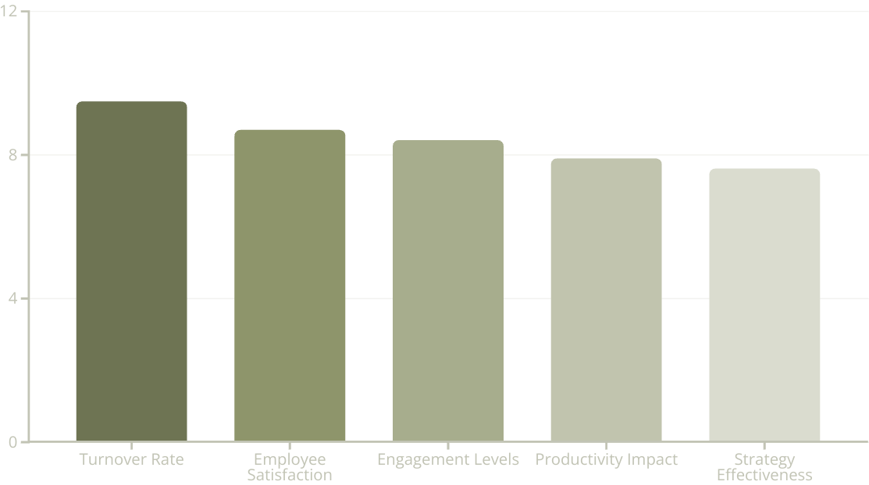
Measuring Success in Employee Retention
Measuring the success of employee retention strategies is essential for companies seeking to enhance workforce stability. It involves tracking turnover rates, assessing employee satisfaction and engagement, evaluating productivity impacts, and analysing the effectiveness of specific strategies tailored to workforce needs.
Analysing changes in turnover rates before and after implementing retention strategies provides critical insights into their effectiveness (Thakur, 2025)
Regular review of employee satisfaction and engagement offers valuable assessments of retention strategy impact. Effective retention strategies not only reduce turnover but can also enhance overall organisational performance through improved employee engagement and morale. (Lewis & Sequeira, 2016)
By analysing productivity metrics, organisations can determine whether investments in retention are yielding greater output, consequently justifying their resource allocation.
Continuous review and refinement of retention strategies based on established metrics are crucial. Companies must recognise that what works today may not be effective tomorrow; hence, ongoing evaluation and adaptation are critical for sustained success in employee retention (Lewis & Sequeira, 2016).

Slide 8
Recommendations & Next Steps for Employee Retention
RECOMMENDATIONS
Implement Comprehensive Onboarding Develop a structured onboarding process that effectively integrates new hires into the organisation.
Cultivate a Culture Continuous Learning Facilitate lifelong learning and professional development through regular training programs and upskilling initiatives,
Establish Transparent Communication Facilitate open lines of communication between management and employees.
Develop Mentoring Programs Create formal programs that pair experienced employees with newer staff members.
Conduct Regular Employee Engagement Surveys Implement ongoing engagement surveys to gather feedback about employee satisfaction, workplace culture, and perceptions of management.
Enhance Employer Branding Create a strong employer brand that reflects the companies' values, culture, and commitment to employee development
Design Succession Planning Strategies Identify key roles within the organisation and prepare employees for progression
Monitor and Evaluate Retention Strategies Establish key performance indicators (KPIs) to assess the effectiveness of implemented strategies
NEXT STEPS
Develop an Action Plan: Formulate a strategic action plan detailing specific initiatives, responsible stakeholders, timelines, and alignment with overall companies' goals.
Engage Key Stakeholders: Organise a series of workshops or meetings with leaders across various departments to discuss proposed strategies, gather input, and encourage ownership of initiatives.
Pilot New Initiatives: Implement a pilot program for select strategies (e.g., mentorship, training programs) to evaluate their effectiveness in a controlled environment before broader rollout.
Continuous Feedback and Improvement: Create a feedback loop wherein employees can provide thoughts on new initiatives and suggest improvements, ensuring that the organisation remains responsive to their needs.
Regularly Review Progress Schedule quarterly reviews to evaluate the impact of retention strategies—adjusting the approach based on measurable outcomes, employee feedback, and overall satisfaction levels

Slide 9








Fleet Decarbonisation – Current Status
Fleet Composition
Fuel Type & Emissions
MAN Trucks aged 3-5 years
Primarily diesel-powered fleet
Relatively modern but primarily diesel-powered
Emissions performance not fully aligned with sustainability goals
Sustainability Initiatives
Operational Efficiency
Planning software implemented but faced resistance.
Initial measures implemented
Employee acceptance remains a challenge
Speed limited to 56 mph for fuel efficiency
To effectively decarbonise operations, the company must implement a strategy focusing on green logistics practices and technological innovations while addressing the underlying challenges that led to resistance against previous measures (Liu et al., 2019) (Chhabra et al., 2021).

Slide 10





Immediate Decarbonisation Measures (0-2 Years)
Telematics & Performance Monitoring
Training & Engagement Programs
Route Optimisation Software
Incentive Schemes
Implement telematics systems to gain real-time data on vehicle performance, fuel consumption, and driver behaviour. This data can facilitate better route optimisation and encourages fuel-efficient driving habits (Chhabra et al. 2021)
Conduct training sessions for drivers and logistics staff focused on eco-driving practices. These programs can mitigate resistance and encourage an organisational culture that prioritises efficiency and sustainability (Nagy & Szentesi, 2024)
Invest in advanced planning and scheduling software that incorporates traffic data, weather forecasts, and delivery windows to determine the most efficient routes, minimising fuel consumption and emissions (Liu et al., 2019).
Introduce incentive schemes for drivers who consistently demonstrate fuel-efficient driving behaviours, encourage a competitive yet environmentally conscious work environment.
Evaluate Current Fleet
Conduct a thorough assessment of the current fleet's emissions and fuel efficiency, identifying outliers that may need more immediate attention or replacement.

Slide 11






Medium-Term Decarbonisation Strategies (2-5 Years)
In the medium term, our focus shifts to more substantial infrastructure changes.
Transition to Low-Emission Vehicles
Begin phased acquisition of hybrid and electric vehicles (EVs) for the fleet, starting with high-utilisation routes to maximise return on investment.
Consider capitalising on government subsidies and incentives to offset initial costs (Huang & Fu, 2020)
Partnerships for Renewable Fuels
Explore partnerships with biofuel producers and electric charging infrastructure providers to establish a sustainable refuelling network for the fleet, which can include on-site charging stations. (Nagy & Szentesi (2024)
Enhanced Client Collaboration
Align sustainability goals with customers such as adopting consolidated shipping practices to lower overall emissions
This can include sharing best practices for sustainable supply chain management.
CO₂ Emissions Tracking
Develop comprehensive emissions reporting framework for tracking progress toward sustainability goals.
Transparent reporting can help build trust with stakeholders and clients who value sustainability efforts (Karaman et al., 2020)
Exploration of Alternative Logistical Modalities
Investigate multi-modal transport options (e.g., rail, sea solutions) that may provide lower carbon-intensive alternatives to traditional road transport, contributing to a more sustainable logistics operation.

Slide 12








Long-Term Decarbonisation Vision (5-10 Years)
The long-term vision embraces a circular economy approach and commits to full fleet transformation
Circular Economy Integration
Innovative Fuel Alternatives
Implement reverse logistics practices enabling recycling and repurposing of goods. This not only reduces waste but also minimises resource and emissions associated with new goods production (Sun & Yi, 2020)
Monitor developments in hydrogen fuel cell technology and other innovative energy solutions to ensure the fleet remains at the forefront of sustainable transport alternatives (Nagy & Szentesi, 2024)
Sustainability Certifications
Fleet Electrification Commitment
Pursue industry certifications in sustainability (e.g., ISO 14001) to recognise the company’s commitment to environmental practices. These certifications can enhance brand reputation and attract eco-conscious clients (Karaman et al., 2020)
Set target for significant fleet electrification by 2035 ensuring that a significant percentage of the fleet consists of electric or hybrid vehicles.
By categorising decarbonisation measures into immediate, medium, and long-term actions, the company can create a structured plan that addresses resistance to change while laying the groundwork for significant sustainability progressions. Each phase builds upon the previous one, ensuring that the company can adapt and innovate continually in a landscape increasingly focused on environmental responsibility.

Slide 13






Addressing Resistance to Fleet Decarbonisation
To effectively address resistance to change, it is important to implement a series of measures categorised into distinct phases. Each phase requires targeted strategies that not only promote acceptance of new initiatives but encourages a culture contributing to ongoing transformations.
Communication Campaigns (0-2 Years)
Training & Support Programs (0-2 Years)
Establish training initiatives to educate employees about the technologies and practices being introduced. Providing support enhances skills and alleviates fears of job insecurity associated with change (Baker, 2007).
Initiate campaigns to inform employees about benefits of planned changes, addressing concerns directly and highlighting potential positive impacts (Smith, 2005)
Employee Involvement (0-2 Years)
Actively involving employees in the decision-making process can foster a sense of ownership and reduce resistance. (Zhang, 2019)
Change Management Framework (2-5 Years)
Establish structured framework which outlines how to effectively manage resistance through strategic planning. This framework should include continuous evaluation mechanisms to assess the effectiveness of implemented measures and adjust strategies accordingly. (Baker, 2007)
Cultural Change Initiatives (2-5 Years)
Shift company culture to embrace sustainability by recognising and rewarding sustainability champions. Involvement of leadership in promoting and prioritising sustainability goals can also stimulate a more open atmosphere toward change. (Thai et al., 2021)
Sustainability Reporting (5-10 Years)
Implement comprehensive reporting measures that outline progress and hold the company accountable. Transparency in sustainability efforts and recognising achievements enhances collective morale and reduces scepticism about the change. (Karaman et al., 2020)
Emphasising Continuous Improvement (5-10 Years)
Cultivate a culture of continuous learning and adaptation, encouraging employees to share feedback and suggest improvements regarding sustainability practices. (Castillo & Álvarez, 2023)

Slide 14
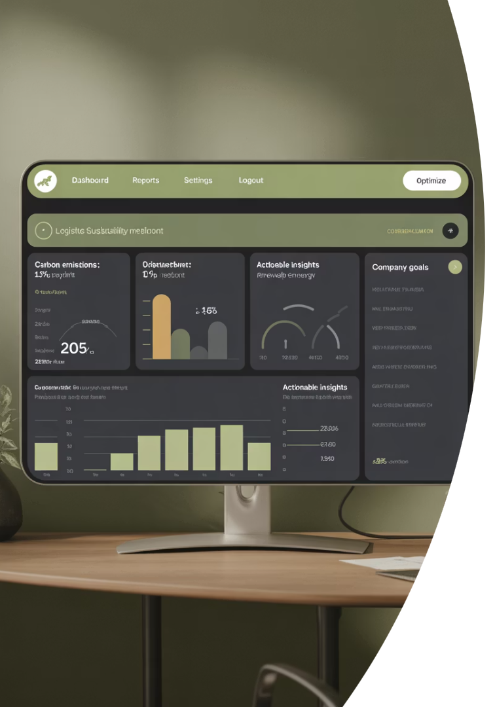
Measuring Decarbonisation Success
Measuring success requires establishing robust metrics that capture both environmental and operational performance. Developing specific KPIs focused on fuel consumption reduction, CO₂ emissions, and operational efficiency can serve as a benchmark for assessing improvements and can be tailored to meet the company's specific sustainability objectives (Liang et al., 2019).
15%
Emissions Reduction
Target for CO₂ reduction in first 2 years
30%
Fleet Transition
Percentage of fleet to be hybrid/electric by year 5
25%
Fuel Efficiency
Improvement target through route optimisation
90%
Employee Engagement
Target for staff participating in sustainability initiatives
Implementing comprehensive performance measurement systems that consider not only environmental metrics, but also economic and operational factors enhances understanding and monitoring of sustainability performance in logistics (He et al.,2017)

Slide 15
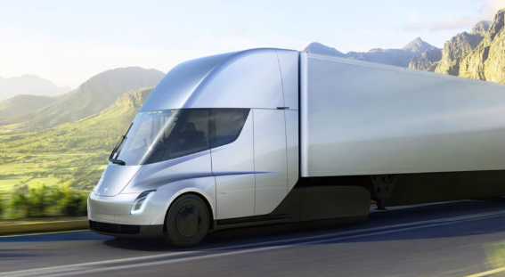
Next Steps and Recommendations
Immediate Actions (0-2 Years)
Conduct comprehensive fleet assessment (emissions , fuel efficiency) and stakeholder analysis (Internal & external opinions)
Launch detailed communication strategy outlining benefits of transition to employees, clients and partners (Liang et al., 2019)
Develop tailored training programs for eco-driving techniques and new technologies to build knowledge (Zhang, 2019)
Implement small-scale pilot projects for electric/hybrid vehicles to reinforce the benefits of wider implementation.
Medium-Term Strategies (2-5 Years)
Establish detailed roadmap that outlines clear & measurable goals for carbon reduction, resource and sustainability targets.
Collaborate with environmental consultants and industry experts to leverage best practices and solutions that have shown success in similar industries.
Create partnerships for sustainability initiatives including charging infrastructure development (Ifekanandu et al., 2025)
Cultivate continuous learning culture focused on sustainability. Encourage employee participation (Huang et al., 2018)
Long-Term Vision (5-10 Years)
Adopt sustainable procurement policies across supply chain
Develop internal accountability metrics with third-party audits. This framework helps maintain focus and mitigates complacency as best practices evolve (Björklund et al., 2016)
Invest in R&D for innovative strategies that advance the efficiency of the logistics operation (Ifekanandu et al., 2025)
Engage in community outreach and educational programs inform local stakeholders about sustainability efforts and ways they can participate.
The recommendations in this presentation underscore the need for a structured approach to both employee retention and fleet decarbonisation. By executing the strategies mention in a phased approach, addressing immediate concerns while laying a foundation for future initiatives, the logistics company can successfully navigate the complexities of transformation and achieve their sustainability and workforce stability goals.

Slide 16
References
Aggarwal, A., Jaisinghani, D., & Nobi, K. (2022). Effect of organisational justice and support on organisational commitment and employee turnover intentions: the mediating role of employee engagement. International Journal of Quality and Service Sciences, 14(4), 525-554. https://doi.org/10.1108/ijqss-08-2021-0112
Ramachandaran, S. D. (2023). Employee retention in the tourism industry of China amid post pandemic times. International Journal of Professional Business Review, 8(10), e01621.
AMAHWA, O. M. and EGESSA, D. R. (2021). Succession planning and employee retention; a literature review. Strategic Journal of Business & Amp; Change Management, 8(1).
Arasanmi, C. N. and Krishna, A. (2019). Employer branding: perceived organisational support and employee retention – the mediating role of organisational commitment. Industrial and Commercial Training, 51(3), 174-183.
Arubayi, O. D. (2022). Influence of engagement strategies on employee retention in Nigeria. European Journal of Business and Management Research, 7(5), 250-254.
Arubayi, O. D. (2022). Influence of engagement strategies on employee retention in Nigeria. European Journal of Business and Management Research, 7(5), 250-254.
Baker, S. L. (2007). Managing resistance to change. Understanding Change, 61-71.
Bano, Y., Omar, S. S., & Ismail, F. (2024). The theoretical foundation for the development of a conceptual model on the relationship between succession planning practices, employee retention and knowledge management in heis. Mediterranean Journal of Social Sciences, 15(1), 42.
He, Z., Chen, P., Liu, H., & Guo, Z. (2017). Performance measurement system and strategies for developing low-carbon logistics: a case study in China. Journal of Cleaner Production, 156, 395-405.
Castillo, O. and Álvarez, R. (2023). Electrification of last-mile delivery: a fleet management approach with a sustainability perspective. Sustainability, 15(24), 16909.
Chhabra, D., Singh, R. K., & Kumar, V. (2021). Developing it-enabled performance monitoring system for green logistics: a case study. International Journal of Productivity and Performance Management, 71(3), 775-789.
Darmayanti, D., Perizade, B., Isnurhadi, I., & Yuliani, Y. (2024). Analysis of factors influencing employee retention: a study on start-up companies in the information technology sector. Eduvest - Journal of Universal Studies, 4(5), 3838-3846.
Komariyah, I. and Ismawanti, R. (2024). Exploring the influence of digital transformation, change management, and employee engagement on organisational performance of nonprofit organisation in Indonesia. International Journal of Business, Law, and Education, 5(2), 2651-2662.
Garg, R., Kiwelekar, A. W., Netak, L. D., & Ghodake, A. (2021). I-pulse: a nlp based novel approach for employee engagement in logistics organisation. International Journal of Information Management Data Insights, 1(1), 100011.
Ghosh, P., Goel, G., Dutta, T., & Singh, R. (2019). Turnover intention among liquid knowledge workers: a study of Indian insurance professionals. Journal of Global Operations and Strategic Sourcing, 12(2), 288-309.
Hanai, A. E. and Pallangyo, W. (2020). The contribution of compensation in the employee retention of the banking institutions in Dar es salaam, Tanzania. European Journal of Business and Management Research, 5(4).
Hassan, S. N. u. and Siddiqui, D. A. (2020). Impact of effective succession planning practices on employee retention: exploring the mediating roles. International Journal of Human Resource Studies, 10(2), 21.
He, Z., Chen, P., Liu, H., & Guo, Z. (2017). Performance measurement system and strategies for developing low-carbon logistics: a case study in China. Journal of Cleaner Production, 156, 395-405.
Heuvel, M. v. d., Demerouti, E., Bakker, A. B., & Schaufeli, W. B. (2013). Adapting to change: the value of change information and meaning-making. Journal of Vocational Behaviour, 83(1), 11-21.
Huang, Z. and Fu, M. (2020). Research on green decision making of pharmaceutical logistics considering government subsidy strategy. Plos One, 15(10), e0241400.
Huang, J., Shuai, Y., Liu, Q., Zhou, H., & He, Z. (2018). Synergy degree evaluation based on synergetic for sustainable logistics enterprises. Sustainability, 10(7), 2187.
Ifekanandu, C. C., Iloka, C. B., Anukwe, G. I., Eze, J. O., Uwakwe, I. V., & Asagba, S. O. (2025). Adoption of sustainable fuels and renewable energy in logistics: examining the role of stakeholder theory in supply chain strategy. Plos One, 20(3), e0320507.
Karaman, A. S., Kılıç, M., & Uyar, A. (2020). Green logistics performance and sustainability reporting practices of the logistics sector: the moderating effect of corporate governance. Journal of Cleaner Production, 258, 120718.
Khalid, K. and Nawab, S. (2018). Employee participation and employee retention in view of compensation. Sage Open, 8(4).
Komariyah, I. and Ismawanti, R. (2024). Exploring the influence of digital transformation, change management, and employee engagement on organisational performance of nonprofit organisation in Indonesia. International Journal of Business, Law, and Education, 5(2), 2651-2662.
Lewis, A. E. and Sequeira, A. H. (2016). Effectiveness of employee retention strategies in industry. SSRN Electronic Journal.
Liang, Z., Chiu, Y., Li, X., Guo, Q., & Yue, Y. (2019). Study on the effect of environmental regulation on the green total factor productivity of logistics industry from the perspective of low carbon. Sustainability, 12(1), 175.
Liu, S., Zhang, Y., Liu, Y., Wang, L., & Wang, X. V. (2019). An ‘internet of things’ enabled dynamic optimisation method for smart vehicles and logistics tasks. Journal of Cleaner Production, 215, 806-820.
Malhotra, R. K. (2018). Employee retention strategies in leading organisations in India: a cross-sectional perspective. International Journal of Management, IT and Engineering, 08(04), 282-290.
Mehreen, A. and Ali, Z. (2022). The interplay between employee development factors and succession planning in predicting employee performance: evidence from retail banks. Industrial and Commercial Training, 54(3), 528-543.
Nagy, G. and Szentesi, S. (2024). Green logistics: transforming supply chains for a sustainable future. Advanced Logistic Systems - Theory and Practice, 18(3), 29-42.
Ojo, S. and Alli, O. M. (2024). Influence of talent management and organisational performance on employee retention among first bank employees in Osogbo, Osun state. Quest Journal of Management and Social Sciences, 6(1), 15-32.
Ramachandaran, S. D. (2023). Employee retention in the tourism industry of China amid post pandemic times. International Journal of Professional Business Review, 8(10), e01621.
Ren, X. (2019). Exploration and research on joint training and education of logistics elite apprentices by college and enterprise. DEStech Transactions on Social Science, Education and Human Science
Rombaut, E. and Guerry, M. (2020). The effectiveness of employee retention through an uplift modelling approach. International Journal of Manpower, 41(8), 1199-1220.
Setia, B. I., Yuniarsih, T., Gaffar, M. F., Suryadi, E., Affandi, A., & Rohmawati, T. (2022). Job satisfaction as a mediator in improving employee performance through talent and knowledge management. Journal of Eastern European and Central Asian Research (JEECAR), 9(5), 749-762.
Smith, I. (2005). Continuing professional development and workplace learning 13. Library Management, 26(8/9), 519-522.
Srimulyani, V. A. and Hermanto, Y. B. (2022). Employer branding and employee performance at kai: employee retention' role as mediator. Journal Studi Komunikasi (Indonesian Journal of Communications Studies), 6(3), 921-940.
Sun, W. and Yi, S. (2020). Analysing green forward–reverse logistics with nsga-ii. Sustainability, 12(15), 6082.
Tetteh, J. and Asumeng, M. (2022). Succession planning, employee retention and career development programmes in selected organisations in Ghana. African Journal of Management Research, 27(1), 151-169.
Thai, V. V., Rahman, S., & Tran, M. D. (2021). Revisiting critical factors of logistics outsourcing relationship: a multiple-case study approach. The International Journal of Logistics Management, 33(1), 165-189.
THAKUR, B. (2025). Evaluating the effectiveness of employee retention strategies. International Journal of Scientific Research in Engineering and Management, 09(04), 1-9.
Wolnowska, A., Szabrońska, A., Matuszak, Z., & Stopka, O. (2018). Student apprenticeships of course-of-study and diploma-related types as an element used for raising the professional competences of engineers educated for the needs of maritime and inland shipping industry. New Trends in Production Engineering, 1(1), 19-25.
Yew, L. K., Lynn, H., Kowang, T. O., Zhao, X., Cheng, E. H., Trang, P. T. M., … & Dennen, V. C. (2024). The influencing factors and employee retention in Dubai hotel industry. Environment and Social Psychology, 9(7).
Zainal, N. S. B., Wider, W., Lajuma, S., Khadri, M. W. A. B. A., Taib, N. M., & Joseph, A. (2022). Employee retention in the service industry in Malaysia. Frontiers in Sociology, 7.
Zhang, Y. (2019). Research on employee pressure and resistance caused by organisational change—a case study of jingyi network co., ltd.. Open Journal of Social Sciences, 07(05), 72-85.
Heuvel, M. v. d., Demerouti, E., Bakker, A. B., & Schaufeli, W. B. (2013). Adapting to change: the value of change information and meaning-making. Journal of Vocational Behaviour, 83(1), 11-21.

