Slide 1
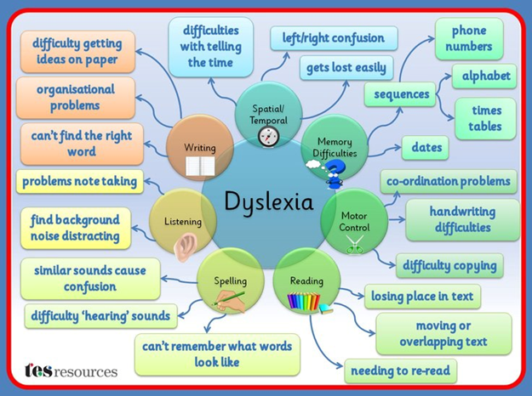
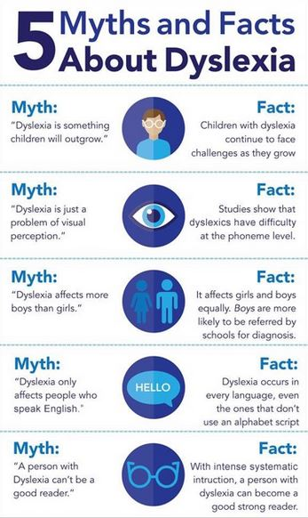
Dyslexia
Benefits
French, (et al, 2013) stated that earlier studies that have shown that introducing educational materials in a slightly more difficult-to-read font usually results in a deeper- processing. This results in improvement for information retention and recall. Before this extremely simple-to-implement and cost-effective adaptation to educational materials can be made routinely, it must be demonstrated that it benefits all students, or at the very least does not harm any particular group. French, (et al, 2013) stated that when presented with information in a disfluent font, students across the ability spectrum show a significant improvement in retention and recall, according to the authors. Importantly, students with dyslexia benefit significantly as well. NHS, (2021), claims It's a specific learning difficulty, which means it interferes with certain learning abilities, such as reading and spelling and that Intelligence, unlike learning disabilities, is unaffected.
It is estimated that up to one in every ten people in the UK suffers from dyslexia.
Dyslexia is a lifelong problem that can present difficulties on a daily basis, but help is available to improve reading and writing skills and help those with the problem to succeed in school and at work.
What is Dyslexia ??
According to The International Dyslexia Association,2022 and Snowling, 2012 Dyslexia is a type of learning disability that is caused by a neurobiological defect. It is distinguished by challenges with accurate and/or fluent word recognition, as well as poor spelling and decoding skills. However, according to Gabriel, 2018, These difficulties are usually the result of a phonological component of language deficit, which is often unexpected in relation to other cognitive qualities and the availability of quality classroom teaching. However, Toth and Siegel, 2020, claims Secondary consequences may include difficulties with reading comprehension and a lack of reading experience, which can stifle the development of vocabulary and prior knowledge and the IQ-achievement discrepancy-based definition of dyslexia involves the identification of children who are reading below their “potential”, where “potential” is determined by an IQ score.
1906417
EECEY6006
Identification & Diagnosis
Stated by Hutchinson, Whiteley, Smith, Connors (2004), It is widely accepted that dyslexia should indeed be identified early for interventions to be effective. When children speak English as an additional language (EAL), diagnosis becomes more complicated, and there is concern that these children are under-identified.
According to Cline and Frederickson (2010), children learning to read and write in their second or third language are frequently assumed to have a language problem: if they knew the target language better, it would be easier for them to learn to read. While this is often true, Cline and Frederickson (2010) argue that there is a risk that learning difficulties associated with dyslexia will be overlooked at times. Cline and Frederickson (2010) present evidence that children from linguistic minority communities are under-represented in specialist teaching provision and demonstrate how traditional methods to identifying dyslexia are likely to under-identify bilingual children with dyslexia. However, claimed by Schatschneider and Torgesen, 2004. Early detection and treatment of deficient phonologic awareness, on the other hand, is a critical step in preventing a reading problem in a child at risk of dyslexia. However, NHS (2021), has stated diagnosing dyslexia in young children can be incredibly hard for both parents and educators due to the lack of obvious signs and symptoms. Therefore, if the NHS (2021), investigate the children's abilities in reading and writing, vocabulary expansion and language development, logical thinking, memory and more. The NHS (2021), will do a report outlining their strengths and weaknesses, as well as recommendations for how to improve areas where they are struggling.
(Sourced: TES, 2015)
To conclude evidence through research has shown if society's opinions were more welcoming and positive, dyslexia would be considered positive and non different for all children. Hope for the future would be that dyslexic children are not discriminated against, and society would have patience and kindness to support these children with their future literacy..
Strategies for helping dyslexics
According to NHS, (2021) Phonics interventions can include instructing children on how to:
Recognize and distinguish between sounds in spoken words (for example, helping them recognize that even short words such as "hat" are actually made up of 3 sounds: "h", "a" and "t")
Letters are combined to form words, which are then used to construct more complex sentences over time.
Practice reading words correctly to help them read faster.
While reading, they should keep an eye on their own comprehension (for example, by encouraging them to ask questions if they notice gaps in their understanding)
However, Locke, R., ET AL., (2017) has stated Employers and educators in are charge of having to meet the requirements if stated by the person that they have dyslexia.
According to Schulte-Körne, (2010). Dyslexia does not benefit from drug treatment. Only if a dyslexic also has attention deficit hyperactivity disorder (ADHD) can drug treatment for ADHD improve learning abilities both inside and outside of the classroom.
Conclusion:
Sourced: Educational Support, 2017

Slide 2
Reference List
1906417
ECEY6006
Snowling, M.J,(2013). Early identification and interventions for dyslexia: a contemporary view. Journal of Research in Special Educational Needs, 13(1), pp.7-14.
Gabriel, R.,(2018). Preparing literacy professionals: The case of dyslexia. Journal of Literacy Research, 50(2), pp.262-270.
IDA Board of Directors. (2022). Definition of Dyslexia. Available: https://dyslexiaida.org/definition-of-dyslexia/ Last accessed 9th Jan 2022.
Toth, G. and Siegel, L.S., (2020). A critical evaluation of the IQ-achievement discrepancy-based definition of dyslexia. In Current directions in dyslexia research (pp. 45-70). Garland Science.
Knight, C. (2018). What is dyslexia? An exploration of the relationship between teachers' understandings of dyslexia and their training experiences. Dyslexia, 24(3), pp.207-219.
Tes (2015), Dyslexia Difficulties Mind Map, [Image] Dyslexia Difficulties Mind Map | Teaching Resources (tes.com) ( Accessed: 19th December 2021 )
Cline, T. and Frederickson, N., (2010). Identification and assessment of dyslexia in bi/multilingual children. International Journal of Bilingual Education and Bilingualism, 2(2), pp.81-93.
Hutchinson, J.M., Whiteley, H.E., Smith, C.D. and Connors, L., 2004. The early identification of dyslexia: Children with English as an additional language. Dyslexia, 10(3), pp.179-195.
Schatschneider, C. and Torgesen, J.K., 2004. Using our current understanding of dyslexia to support early identification and intervention. Journal of Child Neurology, 19(10), pp.759-765.
Miciak, J. and Fletcher, J.M., 2020. The critical role of instructional response for identifying dyslexia and other learning disabilities. Journal of Learning Disabilities, 53(5), pp.343-353.
National Health Service (2021) Diagnosis Dyslexia. Available at: Dyslexia - Diagnosis - NHS (www.nhs.uk) (Accessed: 11th December 2021)
Kimel, E. and Ahissar, M., 2020. Benefits from morphological regularities in dyslexia are task dependent. Journal of Experimental Psychology: Learning, Memory, and Cognition, 46(1), p.155.
French, M.M., ET AL, (2013). Changing fonts in education: How the benefits vary with ability and dyslexia. The Journal of Educational Research, 106(4), pp.301-304.
Educational Support (2017), Five Myths about Dyslexia, [Image] Articles | Tim Marsden – Educational Support – Eugene, Oregon | Developmental Assessments, Reflex Inhibition (INPP), Auditory Processing Disorder, APD, Dyslexia, Reading, Writing and Math Problems, Attention Deficit Disorder (ADD), ADHD, Anxiety, Panic Disorders and Behavioral Difficulties (educationalsupportonline.com) (Accessed: 12th December 2021)
Kay, M. (2010). Brains, Learning, Education And School Placement. Available: https://www.slideshare.net/PegKay/brains-learning-education-and-school-placement-11-2010 (Last accessed 18th December 2021).
Locke, R., ET AL., (2017). Doctors with dyslexia: strategies and support. The clinical teacher, 14(5), pp.355-359.
Schulte-Körne, G. (2010). CONTINUING MEDICAL EDUCATION. The Prevention, Diagnosis, and Treatment of Dyslexia. 1 (Treatment), 718–27.

Slide 3
Reference List
1906417
ECEY6006
Whiteley, H. and Smith, C., (2001). The use of tinted lenses to alleviate reading difficulties. Journal of Research in Reading, 24(1), pp.30-40.
Makri, S., (2003). An accessible and multi-sensory web-based approach to Dyslexia screening (Doctoral dissertation, University of Hertfordshire).
Ryder, D. and Norwich, B., (2019). UK higher education lecturers’ perspectives of dyslexia, dyslexic students and related disability provision. Journal of Research in Special Educational Needs, 19(3), pp.161-172.
Rello, L., ET AL, (2016), May. Dytective: diagnosing risk of dyslexia with a game. In PervasiveHealth (pp. 89-96).

